Slide 1
Rising Together: Temperature, Water, Health & Strength
A social justice initiative of the Green Sanctuary Committee of the Universalist Unitarian Fellowship of Boca Raton
Presented by Dr. Ana Puszkin-Chevlin
puszkinchevlin@gmail.com

Slide 2
Contents
Climate Change Basics
II. Climate Change and Health
Poor Air Quality
Heat Waves
Flooding Risks
Dealing with Mold
Toxic Algae
Mosquito Illnesses
Contaminated Water Supply

Slide 3
Climate Change Basics
What is causing Climate Change and What are the Impacts

Slide 4
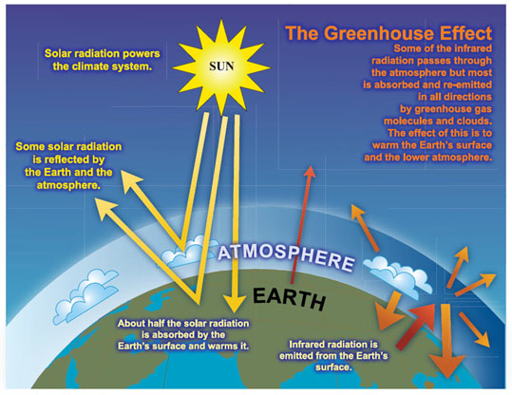
Causes of the Global Warming
Notes:
AS the sun’s energy comes to earth, some is reflected (1) off the upper layers of the atmosphere, but most is penetrates the air and is either absorbed by land and oceans or reflected if it bounces off a shiny surface like snow or ice. The rays that are absorbed (2)and then reflected back up as thermal energy heat (3 red).. In the absence of an atmosphere, the heat would dissipate and the planet would be cold. The atmosphere absorb and redirect the heat back in the lower atmosphere like a blanket.

Slide 5
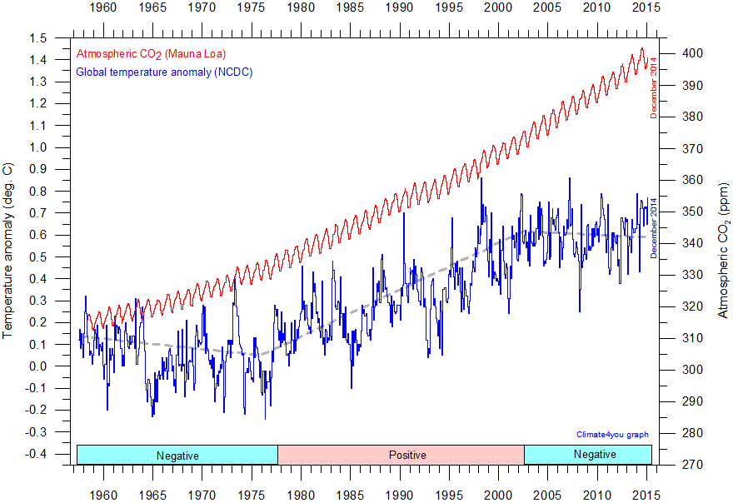
Late 20th Century Data
Notes:
As the modern age has pressed on the intensity of fossil fuel use has intensified and we have seen UNPRESIDENTED increase in CO2 in the atmosphere.
Shows the increase in co2 rising, the saw tooth pattern is the difference between winter and summer – and temperature rising.
The second should temperature land and ocean – you can se the variation year to year, but what is important is the trend.
Over the hundred years there has been a 1.4 degree increase in global temperature. That is the difference between Washington DC and Charlotte NC

Slide 6
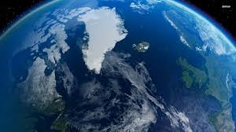
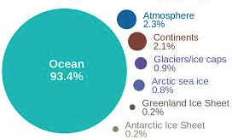
Where is Global Warming Going?
Components of global warming for the period 1993 to 2003 calculated from IPCC AR4 5.2.2.3 (Cook, 2010)
Notes:
We said that most of the sun’s electo magnetic radiation penetrates the atmosphere and gets absorobed? Where? In the ocean – Water makes up the majority of the earth and it is dark – so it absorbs most of the energy.
A small amount that hits the frozen poles bounces back – but as we lose ice and snow – this area reflects less and absorbs more.

Slide 7
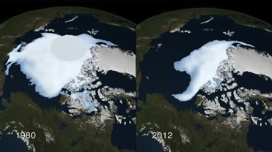
Why do Sea Levels Rise?
“Thermal Expansion” resulting from warmer oceans
Polar Cap Melt, more water
Reduced 10% per decade since satellite monitoring in 1978
Reversal from 70-90% reflection
to 80-90% heat absorption
Notes:
So when the oceans warm – you get thermal expansion.
When the Ice melts you get 1) both less reflection and more absorption, and 2) more water, which warms and is an additional feedback loop

Slide 8
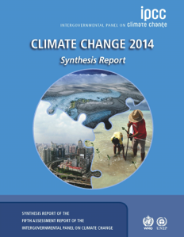
The Proof is in the Science
Notes:
This science has grown stronger - The Inter-governmental Panel for Climate Change, which began to document and plan for climate about 20 years ago has increasingly strong language in each report.

Slide 9
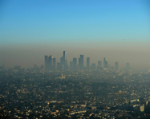
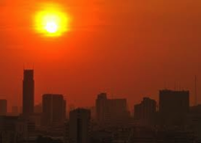
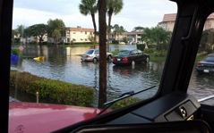
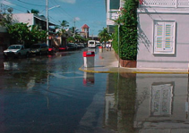
Increased Green House Gas Concentration
Rising Temperatures
Reduced Air Quality
Heat Waves
Variable Precipitation/More Extremes
Sea Level Rise
Notes:
Together, air quality, heat, variable rain and sea level rise will have Impacts on Coastal Areas, Water Resources, Agriculture and the Habitat of species. It will also impact Public Health.
This is what we are going to focus on now.

Slide 10
Climate Change and Health
Health Concerns
Adaptive Response
Poor Air Quality
Heat waves
Flooding
Mold, Algae, Mosquitos
Contaminated Water
Good Information
Pro active response
Notes:
So Now we will try to take a look at how all these changes, individually and interacting with one another, impact health of the public, and particularly certain vulnerable groups, such as people with asthma, young children and the elderly.
I will do this by gradually putting together a big flow chart that illustrates the interactions.

Slide 11
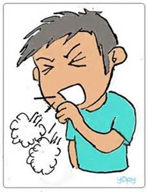
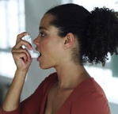
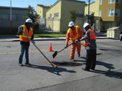
Increased Green House Gas Concentration
Rising Temperatures
Reduced Air Quality
Rising Heat Waves
Variable Precipitation/More Extremes
Sea Level Rise
Who are high risk groups?
Asthma
Emphysema
Cardiac Conditions
Eye Irritation
Throat Irritation
Skin Cancer
Notes:
AQI is reported as the highest value for the four pollutants that are tracked
OZONE, PARTICLE POLLUTION, CARBON MONOXIDE AND SULFUR DIOXIDE - NOT A COMPOSITE OF THE FOUR
Risk GROUPS ARE
Children & Elderly
People with Asthma or allergy suffers
Health and lung diseases
Allergy sufferers
People that work strenuously outdoors

Slide 12
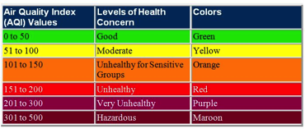
Poor Air Quality Days Precautions
Stay Indoors with air conditioning & windows closed
Avoid exertion outdoors, if you exercise do it in the morning. Avoid exercising within 400 feet of heavy traffic roadways
Avoid car traffic and set car air conditioner on re-circulate
Consider using a mask outdoors for allergens
Keep asthma and allergy medications on hand
Source http://www.airnow.gov/index.cfm?action=aqi_brochure.index
Television – The Weather Channel, USA Today, CNN
Internet – EPA http://www.airnow.gov/
Sign for Email at www.enviroflash.info
Notes:
Here are some common sense approaches to minimizing exposure.

Slide 13
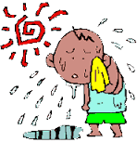
Increased Green House Gas Concentration
Rising Temperatures
Reduced Air Quality
Heat Waves
Variable Precipitation/More Extremes
Sea Level Rise
Who are high risk groups?
Health Impacts
Heat Stress
Heat Stroke
Cardiac Disease
Stroke
Increase Violence
Notes:
Temperatures are rising. How much they will rise depends on the ability of humanity to cut greenhouse gas emissions.
Between 1940-1995 the frequency of heat waves increased 20%.
By Mid century (2040- 2060) under a Moderate Scenario 3-5 degrees in most of the US -1-2 degrees in Florida
But Humidity will rise with the amount of vapor in the air – so the frequency of heat waves will increase – this is problematic because we will use more energy to cool ourselves with air conditioning and so it is harder to cut emissions, unless we move to clean energy.
Groups at risk of Health Impacts include:
Infants and children up to four years of age,
Athletes and those that work outdoors
65 years of age and older,
Overweight, diabetic or asthmatic
Infirmed or on certain medications
Residents in “urban heat islands”

Slide 14
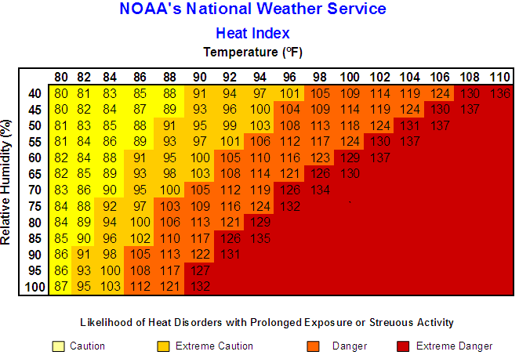
Heat Waves Precautions
Heat Index of 103° F (39.4° C) be cautious. Vulnerable populations should be cautions at 91° F (32.8°C)
Stay indoors in air conditioned places, including shopping malls, public libraries, or movie theaters.
Stay on the lower level of a non-air conditioned space.
If outdoors remain in shaded areas. Use pools or sprinklers to cool down. Wear light color breathable clothing
Drink plenty of non-alcoholic beverages
STAY INFORMED via TV, Radio
GET the OSHA (Occupational Safety & Health Administration) Heat Safety Tool on your phone
Notes:
The index you are looking for is Heat Index it is reported on the Television along with the weather of you can get it from the NOAA National Weather service. Vulnerable populations have to be careful any time it is in the “Caution” range, and all people should be careful in the “Danger” zone.
Risk categories include:

Slide 15
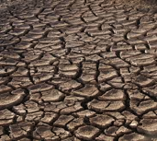
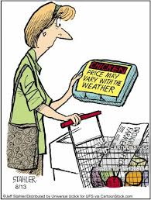
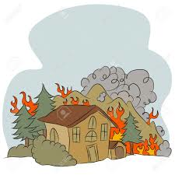
Increased Green House Gas Concentration
Rising Temperatures
Reduced Air Quality
Heat Waves
Variable Precipitation/More Extremes
Sea Level Rise
Drought
Decreased Food/
Production
Wildfire
Notes:
There is still some under certainty in precipitation models., but generally speaking some areas will get drier and some areas wetter.
Models for Florida suggest that the dry season will be drier – which could create drought situations, just at the time when Florida is in peak food production for the US.
We had such a drought in 2012 – and you can see how it impacted the state.
“…..Some studies suggest the region will be wetter, while others project 20% less rainfall…”
Source: South Florida Water Management District

Slide 16
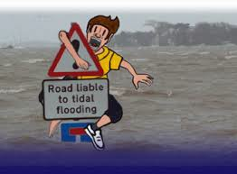
Increased Green House Gas Concentration
Rising Temperatures
Reduced Air Quality
Heat Waves
Variable Precipitation/More Extremes
Sea Level Rise
Health Impacts
Car Accidents
Drowning
Injury/Lacerations
Electrocution
Notes:
The wet seasons may be wetter, and when we do have rain, the amount of rainfall may be higher. This is a likely scenario and something we have been experiencing more frequently. Consider the month of January this year.
This will increase the number of days we will have flooding. Consider the ranges below. 7 to 9 inches in 72 hours will hamper our ability to get around.

Slide 17
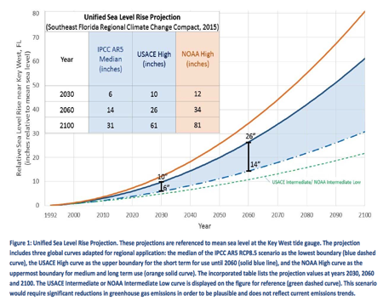
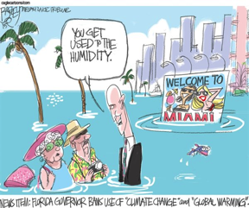
Increased Green House Gas Concentration
Rising Temperatures
Reduced Air Quality
Heat Waves
Variable Precipitation/More Extremes
Sea Level Rise
Notes:
The other large impact that everyone talks about is sea level rise. As a region we are very connected with the oceans, canals and waterways. Sea level rise will initially cause “nuisance” flooding on high tides, but this is a slow creeping flooding that will eventually flood many homes and neighborhoods. Impacting property values and tax base.
In the next 15 years we could see 6 to 10 inches, or up to 12 inches depending on the projection models. By 2060, we are looking at 14 to 26 inches.
Because of Florida’s flat topography, this amount of sea level rise will flood most of the Florida coastline areas.

Slide 18
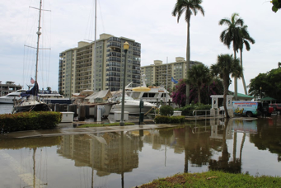
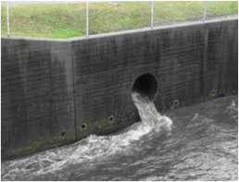
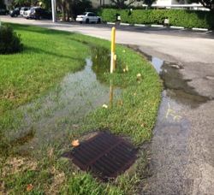
Increased Green House Gas Concentration
Rising Temperatures
Reduced Air Quality
Heat Waves
Variable Precipitation/More Extremes
Sea Level Rise
Intense Rain Storm
Lighting & Wind
Inland and Coastal Flooding
Notes:
This is what we are seeing today in 2016. On the King Tides, the high tides that occur in the fall and spring, the Intracoastal just spills out over the neighboring streets.
The flooding can be away from the coastline too – as sea level rise compromises the ability of the storm drain system to discharge. As sea waters rise and cover discharge valves water flows backward up the drain systems and floods surrounding streets.

Slide 19
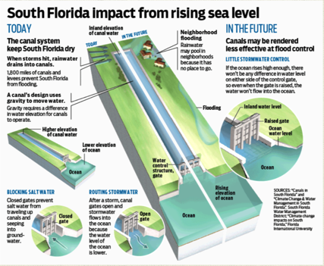
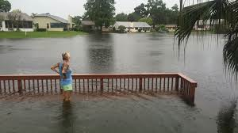
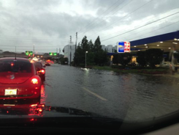
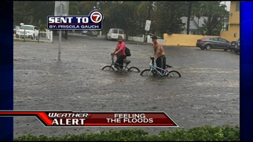
Worsening Flooding
5 to 6” of rain in 24 hours,
standing water in yards, swales and ditches. Crowns of community roads should remain dry and passable.
7 to 9” of rain in 72 hours
Swales, road, lawns and driveways flood as designed , but finished floors of home should remain dry.
15 to 23” or more in a 72 hours
Some businesses may experience finished floor flooding. Some Roads will be flooded.
Notes:
You can see the overall picture on this graphic which explains how the canal systems work. Essentially it is a gravity systems where fresh water from rain flows into the canals and builds up. When the water on the inland side of the control system is higher than the ocean (tail water), you can open the gates and the water will flow out. But when the ocean levels rise, the difference between the headwater and tail water will decrease, and it will be harder to drain the area.

Slide 20
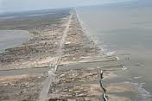
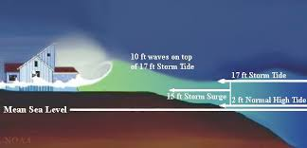
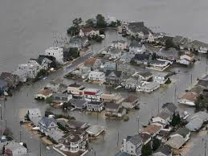
Increased Green House Gas Concentration
Rising Temperatures
Reduced Air Quality
Heat Waves
Variable Precipitation/More Extremes
Sea Level Rise
Intense Rain Storm
Lighting & Wind
Stronger Hurricanes with Higher Storm surge
Inland and Coastal Flooding
Notes:
We can also anticipate that Climate change will result in more intense coastal storms, including Hurricanes. The warmer oceans will feed the storms making them pack a harder punch. Every 1.8 degree warmer ocean temperature increases water vapor 7% so the storms may be wetter.
Then there is storm surge – the ocean wave action that is produced when increased winds pile up the water pushing them onto the beaches.
Sea level rise makes the problem worse, because the water is already higher, and then you get a high tide on top of that.

Slide 21
Flood Conditions SAFE Response
Stay Informed –Code Red APP
Have a Plan - Evacuate when told!
Sign up for County notification services
Know where your shelter is and the evacuation route
Make Plans for Pets, don’t leave them behind.
Have an Emergency Kit Prepared
252.358 Emergency-preparedness prescription medication refills.
Communicate with family members and neighbors
Prepare appropriately for sheltering in place
Make sure storm drains and gutters are clear of debris
Use Floodgates or sandbags to protect home
Stock food, water 1gal per person per day, batteries, communication
Stay Out of Flood Waters - MOVE TO HIGHER GROUND!
Difficult to gauge depth,
6 inches of moving water can sweep you off your feet.
Don’t push a stalled car!!
Conceal objects resulting entanglement or injury
Downed electric cables cause electrocution
Notes:
Have a Plan - Know your elevation, shelter location and evacuation route.
Emergency Kit include:
Medications
Valuable Documents
Document belongs for insurance claims
Shelter in place – have water, batteries, communication methods
Unplug appliances, move valuables to higher areas, raise furniture on blocks if needed
Help insure the storm water system works. Make sure the storm drain systems are clear of debris, so water does not accumulate. Make sure the canals near your home are free and clear of trees and bushes that reduce water flow. Keep retention areas clear of garbage.

Slide 22
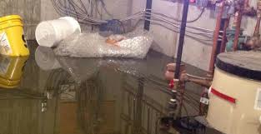
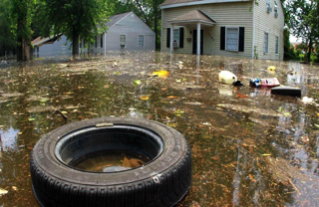
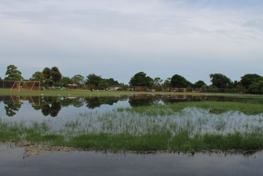
Contaminated Flood Water
Toxic Chemicals
Raw Sewage
Bacteria
Health Impacts
Respiratory Problems
Skin Irritations
Wound Infections
Headaches
Legionnaires
Notes:
Flood waters can be contaminated with Toxic Chemicals, sewage, or bacteria. Most commonly water can have gasoline or oil from flooded cars, and pesticides from lawn spraying. Oil produces will appear as a rainbow slick on the surface, and the fumes will evaporate and are harmful if breathed in.
In your house, it can have any type of detergent, or solvent that you keep in your cabinets. The mixture of solvents can be caustic, irritant.
Sewage can also back up the sewer system. If the electricity is out or a prolonged period of time, the pumping stations down the road get filled above the input pipe and the line gets backed up. There should be a release valve on the property, which would allow the sewage to flow onto the lawn instead of the house, but these should not be opened unless advised by the city.

Slide 23
Contaminated Flood Waters Preventive Measures
Be Cautious. What is in the water ? Animals ? Do not let children play or splash in puddles.
Avoid contact with flood waters. Use waterproof boots, gloves and mask.
Avoid inhaling evaporating chemicals
Disinfect cleanable surfaces with a solution of 1 ½ cups bleach to 1 gallon of water.
Throw out ALL food items that touched flood water, except can goods in good condition. Disinfect the cans before opening
Notes:
If your home is flooded – here are some practical tips about clean up.

Slide 24
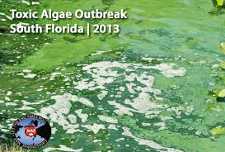
Increased Green House Gas Concentration
Rising Temperatures
Reduced Air Quality
Heat Waves
Variable Precipitation/More Extremes
Intense Rain Storm
Lighting & Wind
Increased Pollen
Algae Blooms
Notes:
Rain plus heat makes plants bloom earlier and with more pollen.
Algae blooms occur from nutrient loads that are flushed into streams and ponds.
In the future, warmer temperatures spur more blooms, droughts will change the salinity of coastal fresh water allowing marine algae to invade freshwater systems.
CO2 concentrations help algae bloom
Heavy downpours overwhelm the storm water system, causing street flooding

Slide 25
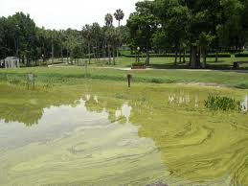
Toxic Algae Blooms
Most algae is not harmful, but “blue-green” algae or or red tide produce toxins.
You can’t see or smell the difference between good and bad algae, it must be tested in a lab.
Eating fish, drinking water or breathing it can make you sick.
Don’t swim, play or fish in water with algae. Keep pets away from it.
If You see this, Call
Florida Dept. Environmental Protection, Bureau of Labs
(850) 245-8159 or
Dept. of Health, Aquatic Toxins Program (850) 245-4250
Notes:
Algae blooms may occur anytime, typically in the warmer months, and when the waters are slow moving. Most algae is NOT toxic, just unattractive, but some does produce toxins. The water districts do not monitor all water bodies all the time for toxic algae, but rely of people reporting blooms, so that they can be tested.
Large Ocean algae blooms are followed by Department of Environmental Protection, Fish and Wildlife service and NOAA. They will post maps and notify local government, which may place restrictions on swimming and fishing. These will appear at the beach access points, and may be announced on television.
It may be obvious that you shouldn’t eat/drink or bathe in the water. But what most people don’t realize is that the toxins can get in the air, through wave action, and actually impact people nearby, by breathing them in.
Also its important to keep PETS out of the water, they may get really sick if they drink the water.

Slide 26
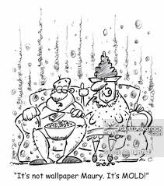
Increased Green House Gas Concentration
Rising Temperatures
Reduced Air Quality
Heat Waves
Variable Precipitation/More Extremes
Sea Level Rise
Intense Rain Storm
Lighting & Wind
Stronger Hurricanes with Higher Storm surge
Increased Pollen
Algae Blooms
Inland and Coastal Flooding
Saltwater Intrusion
Indoor/Outdoor
Mold & Fungi
Vector Borne-Disease
Contamination
of Water Supply
Health Impacts
Health Impacts
Health Impacts
Health Impacts
Respiratory Problems
Skin Irritations
Liver Problems
Wound Infections
Headaches
Legionnaires
Notes:
Mold and Fungi – mushrooms are “decomposer” and will grow on wood, gypsum, ceiling tile, fabrics, almost any porous material if it has moisture. Allow to grow it will spread throughout a building. Mold will irritate your respiratory system and immune system triggering allergic reactions.

Slide 27
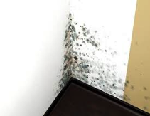
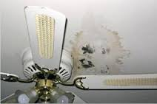
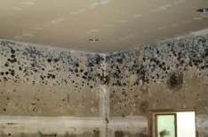
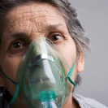
Indoor Mold
Grows in damp warm environments. It may be visible or hidden.
Spores can reactivate with moisture
Molds are allergens, some produce or release toxins
Exposure is through breathing or touching
Who is at high risk?
Notes:
Mold is a common problem in Florida, as it is a warm and humid environment favorable to mold development.
You may see mold growth, but often it is hidden from view and behind the walls. If you suspect mold, but can’t see it, you can have your house tested by a mold remediation company. Testing a home could run between $300 - $1000 .
A small amount of mold, Level I can often be addressed by the home owner, but larger amounts require a professional, with appropriate equipment. For the DYI, be careful not to spread it. Washing it with a sponge may move it around. It is often best to cut the wall patch out, and replace. Don’t do these projects around people that are sensitive.
High Risk Groups, Infants and children, asthma, allergies and respiratory illness, immune disorders

Slide 28
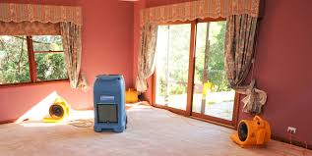
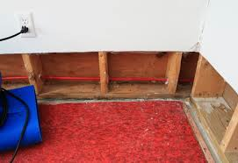
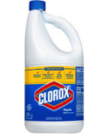
How to Prevent Mold
Eliminate dampness
Throw out things that have been wet for 2 days or more
Freeze important things to save.
Open holes in the wall baseboard to dry behind the wall
Disinfect with a solution of 1.5 cup bleach per 1 gallon of water.
Never mix bleach and ammonia. The fumes can be fatal.
Use paper towels not cloth towels to dry.

Slide 29
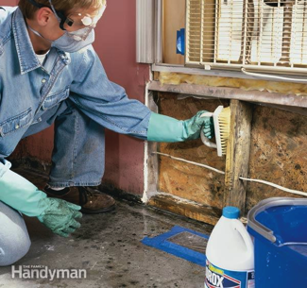
If Mold Develops
DO NOT DISTURB MOLD, IT SPREADS –ELIMINATE IT!
Areas less than 10 square feet can sometimes be cleaned by the resident, larger areas require a professional.
HVAC needs to be serviced by qualified professional.
Seal moldy items in plastic bags and store outside the home. Flood insurance covers property unless no effort was made to clean or prevent the damage.
Scrub mold with brush and a solution of 2 cups bleach /1 gallon of water.
Make sure that people with allergies, asthma and compromised immune systems are not present

Slide 30
Increased Green House Gas Concentration
Rising Temperatures
Reduced Air Quality
Heat Waves
Variable Precipitation/More Extremes
Sea Level Rise
Intense Rain Storm
Lighting & Wind
Stronger Hurricanes with Higher Storm surge
Increased Pollen
Algae Blooms
Inland and Coastal Flooding
Saltwater Intrusion
Indoor/Outdoor
Mold & Fungi
Mosquitos
Contamination
of Water Supply
Health Impacts
Health Impacts
Health Impacts
Health Impacts
Denge Fever
West Nile
Chikungunya Fever
St. Louis Encephalitis
Zika Virus
Notes:
Vector-Borne Disease is a fancy name for disease carried by host animal, commonly Mosquitos, but also rats and birds. We get an increase in these diseases because climate change will alter the natural habitat range of different species allowing different types of insects and animals to migrate into the region.

Slide 31
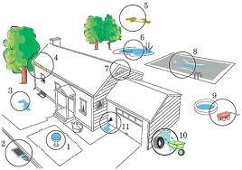
Preventing Mosquito Diseases
Drain standing water from items around your property.
Little pools
Bird feeders
Tires and wheels barrels
gutters
^{Mosquito Infestation Call}
Dept. of Environmental Resources Management Mosquito Control Division
9011 W. Lantana Road ,Lake Worth, FL 33467
^{Phone: 561-967-6480} Air Spray HOTLINE: 561-642-8775

Slide 32
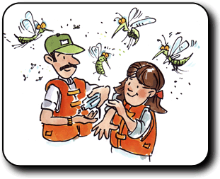
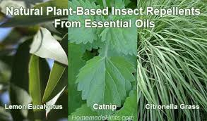
Preventing Mosquito Diseases
Prevent bites. Wear long sleeves, long pants, and socks when outdoors, especially at dawn and dusk .
Use insect repellent with DEET or oil of lemon eucalyptus. Limit DEET exposure in young children by washing it off before bedtime.

Slide 33
Increased Green House Gas Concentration
Rising Temperatures
Reduced Air Quality
Heat Waves
Variable Precipitation/More Extremes
Sea Level Rise
Intense Rain Storm
Lighting & Wind
Stronger Hurricanes with Higher Storm Surge
Increased Pollen
Algae Blooms
Inland and Coastal Flooding
Saltwater Intrusion
Indoor/Outdoor
Mold & Fungi
Vector Borne-Disease
Contamination
of Water Supply
Health Impacts
Health Impacts
Injury& Accidents
Health Impacts
Food Poisoning
Parasite Infection
Diarrhea
Vomiting
Wound Infection
Notes:
Finally, we have water contamination – and here we are talking not about the flood water by of drinking water. This can occur after a storm, when a water line breaks, or the power is out and it impacts the public water treatment plan. It can also occur when private wells get contaminated with flood waters.
Drinking contaminated water can cause all types of stomach problems, poisoning that impacts liver, and kidney, and also infections in the skin.

Slide 34
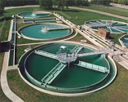
Contaminated Drinking Water
Sources of Contamination
How you Know
Electrical Failure at Plant
Sign up at
https://public.coderedweb.com/CNE/9C01FEC0EDA0
Break in Distribution System
Salt Water Intrusion from SeaLevel Rise

Slide 35
Boil Water Alert
Boil Water Advisories - “NO”
Don’t serve, use ice, prepare food, or brush teeth with tap water. Use bottled water for drinking if possible, especially for baby formula.
Don’t wash hands, or expose open wounds to tap water.
Don’t bathe babies in tap water.
Don’t wash dishes, glasses or cutlery with tap water. Use boiled water.
“Anytime there is a drop in water pressure, consider it a precautionary boil water alert.”

Slide 36
Boil Water Alert
Boil Water Advisories – “YES”
Do boil water to roiling boil for a minimum of 1 minute. Boil water even if you have filters, filters don’t kill bacteria.
If you can’t boil water, it can be disinfect with 8 drops unscented bleach per 1 gallon of water. Allow water to sit for 20 minutes.
Do flush lines for 5 minutes after boil alert has been lifted.
Change filters of water & ice systems that may have been contaminated.

Slide 37
Thank You
The ReAct Tool Kit project was funded through EPA Grant #

