Slide 1
ReAct Tool Kit
Mitigating the Health Impacts of Climate Change
A social justice initiative of the Green Sanctuary Committee of the Universalist Unitarian Fellowship of Boca Raton
Presented by Dr. Ana Puszkin-Chevlin
puszkinchevlin@gmail.com

Slide 2

Notes for community leaders to talk about climate and health
Introduction script:
Hi, I’m ____________, you neighbor from ______.
Thank you for taking time to talk to me and learn a little about how you and your family’s health could be impacted by weather, temperature and pollution related to climate change.
This outreach effort is a environmental social justice project of the Unitarian Universalist Church in Boca Raton, and they received a grant from the US Environmental Protection Agency to educate communities about the issue of health and climate change.
I’d like to talk to you for about 15 to 20 minutes, ask you answer a simple 15 question survey about what you think of climate change issues in our community, and then I will give you this information page you can take home and hang up with a summary of the key points and a _________plant/gift card. Ok? Let start.
We hear about climate change a lot in the news, but in school you may never have learned about what is happening. So first I want to explain very simply what is causing climate change and sea level rise.
Then we can see what some of the direct and indirect impacts are, and how they impact community health.
Most importantly, I want highlight things we should know to stay safe and healthy.
I’ll be focusing on these 6 things.
Poor Air Quality and Heat Waves
Flood Dangers
Contaminated Drinking Water
Mold, Algae and Mosquitos
Notes:
So Now we will try to take a look at how all these changes, individually and interacting with one another, impact health of the public, and particularly certain vulnerable groups, such as people with asthma, young children and the elderly.
I will do this by gradually putting together a big flow chart that illustrates the interactions.

Slide 3



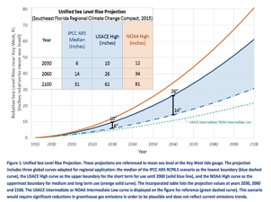
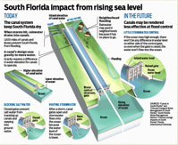
The Basics of Climate Change and Sea Level Rise
As the sun’s energy comes to earth, some is reflected (1) off the upper layers of the atmosphere, some bounces off a shiny surface, like snow or ice in the polar caps, and reflected back through the atmosphere (2), but most penetrates the air and is either absorbed by land and oceans (3) then released into the atmosphere as infra-red radiation.
As the concentration of Green House Gases (GHG) rise (specifically Co2, Methane, Nitrous Oxide and Water Vapors) they act like a Thicker Blanket (4) and capture more of the heat, causing temperatures rise.
Rising temperatures reduce the amount of ice and snow – especially in the polar caps (5). As the polar caps shrink and dark earth and ocean is reveled, more of the heat is absorbed and less is reflected upward – it’s a feedback mechanism. The rate at which it happens directly impacts the projections of climate change impacts.
The melting polar ice increases the amount of water in the oceans and atmosphere, which is one reason we are experiencing “sea-level rise.” The other is that the temperature of the oceans is warmer, and warmer water takes up more space, called “Thermal Expansion” (6).
In South Florida sea levels are expected to rise between 3 and 5.7 inches in the next 15 years, and between 11 inches and 21.7 inches by 2060. This represents a 6 to 12 inch rise between the 1992 base year and 2030, or a 14 to 34 in rise between 1992 and 2060. (7) 3-6 inches does not seem like a lot, but because our area is very flat and the ground beneath is porous, impacts in coastal areas will be significant. Some properties have direct flooding from the oceans and canals, and even those way from the coastal will experience more flooding as the current storm drainage infrastructure will struggle to handle the rain waters in the future.
The current canal drainage system was not designed to accommodate rising sea levels. In the future, it will take longer to drain storm waters, as there is less “head”, the difference between levels in the canal and the ocean (8). Discharge valves maybe under water too. Rising water tables means the ground will have less capacity to absorb the rain, and storms and tropical storms have have more rain, because of warmer oceans have greater evaporation.
All of these factors suggest that South Florida will be more prone to three types of flooding: 1) gradual sea-level rise,2) inland flooding from storm events, and 3) higher storm surge events. Flooding and its aftermath pose various type of health risks, which is the focus of the outreach effort. We have to begin preparing now, to reduce the impacts on our communities in the next decade and to make sure our region remains viable for our children.
1
3
4
2
5
6
7
8
Developed by Dr. Ana Puszkin-Chevlin

Slide 4





How Climate Change Exacerbates Health Conditions
Increased Green House Gas Concentration
Rising Temperatures
Reduced Air Quality
Heat Waves
More Extreme Rains & Drought
Sea Level Rise
Intense Rain Storm
Lighting & Wind
Stronger Hurricanes/ Stronger Storm Surge
Increased Pollen
Decreased Food/
Production Wildfire
Algae Blooms
Inland and
Coastal Flooding
Saltwater Intrusion
Indoor/Outdoor
Mold & Fungi
Vector Borne-Disease (Mosquitos)
Contamination
of Water Supply
These factors negatively impact community health.
Existing conditions may worsen, and new health concerns arise.
Websites with additional information: http://www.cdc.gov/climateandhealth/effects/
http://www.who.int/mediacentre/factsheets/fs266/en/
http://flhealthinnovation.org/
Developed by Dr. Ana Puszkin-Chevlin
Notes:
Together, air quality, heat, variable rain and sea level rise will have Impacts on Coastal Areas, Water Resources, Agriculture and the Habitat of species. It will also impact Public Health.
This is what we are going to focus on now.

Slide 5
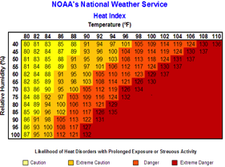
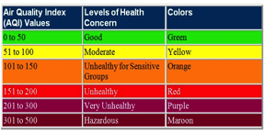
Heat Waves and Poor Air Quality
What is the Heat Index and the Air Quality Index?
The Heat Index measures the combined impact of high temperatures and humidity. (Picture 1)
The Air Quality Index (AQI) measures ozone, particle pollution, carbon monoxide and sulfur dioxide in the air. The day’s AQI is determined as the highest measure of any one of the four pollutants, but does NOT reflect a combined measure. (Picture 2)
How does climate change impact heat waves and air quality? Increased concentrations of greenhouse gases will increase land and ocean temperatures, making heat waves more frequent.
Rising temperatures are associated to a rise in ozone and nitrogen dioxide in the air. Without cooling rains, the particulate matter in urban increases. Ozone and particulates are strong respiratory irritants.
Warmer temperatures and increased rainfall will stimulate plants to bloom earlier, have longer bloom periods and produce more pollen. This impacts allergy sufferers and asthmatics.
1
2
Heat Waves
Dehydration
Heat Stress
Heat Stroke
Heart Attacks/Stoke
Violence
Poor Air Quality
Asthma
Emphysema
Cardiac Conditions
Eye Irritation
Throat Irritation
Skin Cancer
What residents need to do.
Pay attention to the air quality and the heat index, or sign up for alerts by phone or email from NOAA or OSHA.
When air quality is poor, stay in air conditioned places. Avoid exertion outdoors. If you exercise outside, do it in the morning away from heavy traffic roadways.
When in the car, set car air conditioner on re-circulate.
Keep asthma and allergy medications on hand and take them before symptom onset. Consider using a mask outdoors.
When the heat index rises above 91° vulnerable populations should stay in air conditioned places. Stay on the lower level of a non-air conditioned building.
If outdoors, remain in shaded areas and use pools or sprinklers to cool down. Wear light color breathable clothing, like cotton and linen.
Drink plenty of non-alcoholic beverages. Be vigilant of health impacts and seek medical attention, if necessary.
Developed by Dr. Ana Puszkin-Chevlin
Notes:
Here are some common sense approaches to minimizing exposure.

Slide 6
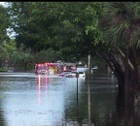

Storms & Floods Safety
What is the relationship climate change and storms? Climate change is predicted to increase the incidents of intense rain storms, as well as the severity of droughts. Warmer oceans temperatures will fuel stronger tropical storm systems. Sea-level rise will impact drainage capacity of our infrastructure, increasing incidents of flooding and the time it takes to subside.
Health Impacts
Car Accidents
Drowning Deaths
Injury/Lacerations
Electrocution
What residents need to do. Know your risk. Do you live or work in a flood zone, near a waterway or retention pond?
Stay informed by sign up for CodeRed,(Picture 1) an emergency notification service, or getting the PBC DART App which provides information on disaster preparedness.
Evacuate or Shelter in Place? Have a Plan!
  Know the evacuation route and which shelters are open.
  Pre-register for special needs shelter or transportation assistance. The information is on the card.
  Communicate with family members and neighbors about your plan for action. Have one contact person (out of the area), communicate with others who may be concerned about you.
  Have an Emergency Kit Prepared. Include copies of identification papers, insurance policies, medications, and irreplaceable keepsakes. During a declared emergency, prescription medication can be refilled early.
  Evacuate when told! Don’t leave pets behind or tied-up. County-run pet shelters are available on a reservation basis.
Sheltering in place if appropriate.
  Prevent Damage – Clear storm drains and gutters of debris. Use floodgates or sandbags to protect property. Unplug electrical devices, raise furniture and appliances on blocks.
  Plan to stay put for 72 hours. Stock food and 1gallon of water per person per day for 4-5 day supply. Charge communication devices have batteries and flashlights.
During a flood event, move IMMEDIATELY to higher ground!
It is NEVER safe to walk into flood waters. It is difficult to gauge depth and 6 inches of moving water can sweep you off your feet. Concealed objects and uneven surfaces can cause injury or entanglement resulting in drowning. Downed electric cables cause electrocution.
“Turn Around, Don’t Drown”. DO NOT drive into flood waters. Don’t push a stalled car! Just 12 inches of rushing water can carry away a small car and 2 feet will carry away most cars.
Warning Levels
1
Flash Flood Warning: Take Action! Flash flood is imminent or occurring. Move immediately to high ground.
Flood Warning: Take Action! Hazardous weather event is imminent or happening.
Flood Watch: Be Prepared: Conditions are favorable for flooding. Flooding is possible.
Flood Advisory: Be Aware: weather event is forecast become a nuisance
How Much Flooding?
5 to 6” of rain in 24 hours,
standing water in yards, swales and ditches. Crowns of community roads should remain dry and passable.
7 to 9” of rain in 72 hours
Swales, road, lawns and driveways flood as designed , but finished floors of home should remain dry.
15 to 23” or more in a 72 hours
Some businesses may experience finished floor flooding. Some Roads will be flooded.
Key websites
http://emergency.cdc.gov/disasters/floods/
https://www.ready.gov/floods
Developed by Dr. Ana Puszkin-Chevlin
Notes:
The Information on Storms and Hurricanes come from the National Weather Service and will appear as a map. A Flood Advisory tells you to “Be Aware” , Flood Watch is that flooding likely of it may be a nuisance, but not imminent danger. Still use COMMON SENSE – some areas are more prone to flooding than others.
Flood Warning means TAKE ACTION
Flash Floods are sudden Floods which are potentially dangerous. They could occur far from the area where its raining, as the surge of water travels through the watershed system/Tom

Slide 7


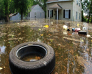

Contaminated Flood Water
Why be concerned about standing flood water?
  Flooding can occur as a result of heavy rain, a storm surge, a broken water main, or sea-level rise, which periodically causes water to seep up through storm drains or spill over sea walls. Water that has not drained away or evaporated after a day or two is standing water. To be safe, one should consider it contaminated. Contaminates can be 1) Toxic chemicals like oils or gas from cars, pesticides or fertilizer from lawns or garages, or industrial chemicals from surrounding businesses. Substances like Benzene, Xylenes and Toleune are toxic. 2) Raw sewage that leeches from nearby septic systems or back flow from sewer lift-stations. 3) Bacteria from floating garbage, dead animals or fish, and items in storm drains.
  How does climate change impact flooding?
  With warmer land and water temperatures, South Florida can expect to more frequent intense rain events, resulting in inland flooding, and wetter, stronger tropical storms with greater storm surge, and increasing coastal flooding risk.
  Sea-level rise will gradually increase the frequency of ‘sunny-day’ flooding of coastal areas, and cause higher storm surges during coastal storms. It will decrease the effectiveness of current storm water infrastructure to handle run-off. Together, these impacts mean more frequent and potentially more severe floods .
1
2
3
4
Health Impacts
Wheezing/Coughing
Nose/Throat Irritation
Skin Irritations
Wound Infections
Headaches
Legionnaires
Ibrio vulnificus
Leptospirosis
Who is at high risk?
All residents in flood-prone areas, but specifically young children, pregnant women, the elderly, and people with compromised immune systems. Diabetics with foot wounds.
What residents need to know. Avoid contact with floodwater, water in retention ponds or even shallow puddles along roads and property. Standing flood water may appear clean but be contaminated. ((Picture 4)
Do not let children play in puddles, or water retention areas.
Murky flood water conceal sunken objects and be deceptively deep.
Use water proof boots, gloves and a mask when cleaning or walking through it.
Avoid inhaling chemicals that may evaporate from flood waters. Call a remediation company for cleaning if chemicals are a concern .
Disinfect all hard cleanable surfaces with a solution of 1 ½ cups of bleach to 1 gallon of water, and throw out any items that can not be properly disinfected and dried.
If air condition or heating systems are impacted by flood, have them professionally serviced.
Throw out ALL food that was in contact with flood water, less canned items in good condition. Disinfect the cans before opening
Key Website
http://www.cdc.gov/healthywater/emergency/extreme-weather/floods-standingwater.html
Developed by Dr. Ana Puszkin-Chevlin
Notes:
Flood waters can be contaminated with Toxic Chemicals, sewage, or bacteria. Most commonly water can have gasoline or oil from flooded cars, and pesticides from lawn spraying. Oil produces will appear as a rainbow slick on the surface, and the fumes will evaporate and are harmful if breathed in.
In your house, it can have any type of detergent, or solvent that you keep in your cabinets. The mixture of solvents can be caustic, irritant.
Sewage can also back up the sewer system. If the electricity is out or a prolonged period of time, the pumping stations down the road get filled above the input pipe and the line gets backed up. There should be a release valve on the property, which would allow the sewage to flow onto the lawn instead of the house, but these should not be opened unless advised by the city.

Slide 8
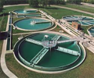

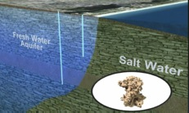

Contaminated Water Supply: Boil Water Alert
How does water get contaminated?
Maintaining water quality and purity is critical to public health, as microbial or chemical contaminates can lead to serious disease or poising.
Contamination can occur if chemicals or bacteria leech into the water supply, if the treatment systems are compromised to due electrical outage, or if there is a decrease in pressure in the water mains, especially due to a rupture. (Pictures 1 & 2)
Homes on well systems can also get contaminated if the well cap is not tight, or sewage or chemicals leech into the aquifer. Wells less that 50”deep are particularly susceptible.
How does climate change impact water supply?
During a drought periods, low water supply may concentrate contaminates in aquifers and wells.
During heavy rains, flooding may leech contaminants into water aquifers or well fields. Flooding may also damage well infrastructure or pipes. Overtime, sea level rise will cause saltwater to get into the fresh water aquifers, forcing wells to be moved inland.(picture 3)
What do residents need to know?
Anytime water pressure drops, there may be a breech in the pipe; assume you are under a precautionary boil alert and notify authorities.
Before a hurricane, stock bottled water, or set aside in containers a 3 to 5 day supply. Assume 1 gallon per person per day in a household. Keep in mind that bottled water typically has a 6 month expiration date.
Sign up for alerts through CodeRed, to receive telephone notifications of emergency conditions automatically. City or county authorities will let you know of a boil water advisory by tagging your door or putting up street notices. If more than 300 homes are impacted, the media will be advised.
If you suspect contamination, notify both the public utility or the Department of Health.
1
2
3
Health Impacts
Food Poisoning
Parasite Infection
Diarrhea
Vomiting
Wound Infection
Boil Water Advisories
Don’t serve, use ice, prepare food, or brush teeth with tap water. Use bottled water for drinking if possible, especially for baby formula.
Don’t wash hands, or expose open wounds to tap water.
Don’t bathe babies in tap water.
Don’t wash dishes, glasses or cutlery with tap water. Use boiled water.
Do boil water to roiling boil for a minimum of 1 minute. Boil water even if you have filters, filters don’t kill bacteria.
If you can’t boil water, it can be disinfect with 8 drops unscented bleach per 1 gallon of water. Allow water to sit for 20 minutes.
Do flush lines for 5 minutes after boil alert has been lifted.
Change filters of water & ice systems that may have been contaminated.
^{Key website}
http://www.cdc.gov/healthywater/emergency/dwa-comm-toolbox/tools-templates-main.html
https://safewater.zendesk.com/hc/en-us/categories/201454937-Fact-Sheets
Developed by Dr. Ana Puszkin-Chevlin

Slide 9

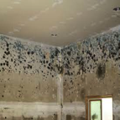
Preventing Indoor Mold
What is Mold? Molds, mushrooms, mildews, and yeasts are ‘decomposers’ that digest materials in which they live. There are about 100,000 kinds of mold, fewer than 500 are harmful to humans. Molds are allergens and some produce toxins or release volatile organic compounds in materials.
Active mold growth is usually green, black, orange, or purple and inactive mold is dry, powdery and may be white.
Molds spread by making spores, which are small, lightweight and travel through the air, on pets, and people. The spores are very resilient, and can dormant for a long time before activating when exposed to moisture. This makes mold difficult to get rid of.
Why is climate change impact mold? Strong storms and flood events that may result in leaks and water damage in homes and businesses. There may also be increased humidity and warmer temperatures which create ideal conditions for mold growth.
What residents need to know.
Health Impacts
Asthma trigger
Sinus and chest congestion
Headaches
Eyes and Throat Irritation
Skin Irritations
Liver Problems
Wound Infections
Who is at high risk?
People with asthma, allergies, respiratory illness. Infants and children and people with immune disorders or undergoing chemotherapy.
Preventing Mold
Maintain roofs and windows in good repair and make sure gutters work properly.
If a flood or leak occurs, open doors and windows, use fans or dehumidifiers. If necessary, open holes in the wall baseboard to allow drainage and drying.
Disinfect surfaces with a solution of 1 cup bleach per 1 gallon of water. Wear rubber boots, rubber gloves, and goggles when working with bleach.
Never mix bleach and ammonia, the fumes from the mixture can be fatal.
Wipe surfaces dry with paper towels, not cloth towels.
Throw out porous, non-cleanable items that have been wet for longer than 48 hours and cannot be thoroughly cleaned and dried.
Objects you can save should be dried or frozen as soon as possible. Freezing inactivates mold.
Addressing Mold
Areas less than 10 square feet can sometimes be remediated by the resident, but larger areas require a professional .
Heating and air conditioning systems need to be inspected and disinfected by a professional.
Avoid disturbing mold by washing or dusting, it spreads. Water will active inactive mold.
Eliminate mold by scrub it with brush and a solution of ½ cup bleach to 1 quart of water. Or, cut moldy section out of the wall board.
Seal moldy items in plastic bags and remove them immediately from the house.
Flood insurance covers these items unless no effort was made to clean or prevent damage.
Key websites:
//http://www.cdc.gov/mold/faqs.htm
http://www.floridahealth.gov/Environmental-Health/mold/index.html
Or www.cdc.gov/mmwr/preview/mmwrhtml/rr5508a1.htm
Developed by Dr. Ana Puszkin-Chevlin
Notes:
Mold is a common problem in Florida, as it is a warm and humid environment favorable to mold development.
You may see mold growth, but often it is hidden from view and behind the walls. If you suspect mold, but can’t see it, you can have your house tested by a mold remediation company. Testing a home could run between $300 - $1000 .
A small amount of mold, Level I can often be addressed by the home owner, but larger amounts require a professional, with appropriate equipment. For the DYI, be careful not to spread it. Washing it with a sponge may move it around. It is often best to cut the wall patch out, and replace. Don’t do these projects around people that are sensitive.

Slide 10
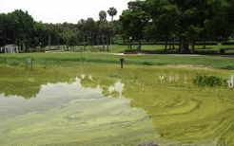

Report Algae Blooms
What is a Toxic Algae Bloom? Algae are simple plant-like organisms that grow in marine, estuarine, fresh water lakes, rivers, canal systems and even pools. Water with an oversupply of nutrients, such as fertilizer, which are warm and slow moving encourage an overgrowth of algae, called an algal bloom. (Picture 1) Algae can be as a green, red or yellowish brown scum that floats on the surface of the water.
Most algae is not harmful, but some “blue-green” algae, and algae that produce “red tide” make harmful toxins (picture 2). Algae scum will stop sunlight from reaching plant life below, killing it and the marine life that depends on it. The dead material on the bottom feed more algae and bacteria growth.
How is climate change related to algae blooms?
Heavy rain falls flush fertilizers from lawns and fields into the retention ponds and canals. This, along with warmer water temperatures create favorable conditions for algae blooms. Conversely, during droughts, lower water levels allow ponds and canals to get warmer and move less, creating favorable conditions for algae.
1
2
Health Impacts
Sore throat, coughing
Difficulty breathing, wheezing
Skin rashes
Headaches.
Vomiting/diarrhea
Tingling in fingers and toes
Liver and kidney failure
What residents need to know. It’s not possible to distinguish between toxic and non-toxic algae by looking at or smelling the water. Report algae blooms to local or state authorities so the water can be tested.
Don’t swim or wade in water with algae and keep children and pets away from algae waters.
Do not fish or eat shell fish from contaminated areas. Toxic algae can cause neurological liver and kidney problems in eaten.
The algae toxins can be aerosolized by waves and wind and inhaled by people living around the ponds and streams. It will aggravate respiratory illnesses like asthma.
The bacterial concentration in algal water can poses a risk to humans and animals.
Who is at high risk?
Children and pets that come it contact water and ingest it accidentally.
Fisherman and people that catch or eat contaminated fish from toxic algae water.
People with asthma or respiratory illness that inhale toxins that get into the air.
  Report Algae Blooms to
  Department of Environmental Protection Bureau of Labs, Biology Section in Tallahassee (850)245-8159 http://www.dep.state.fl.us/labs/ or the Department of Health Aquatic Toxins Program (850) 245-4250 phtoxicology@FLHealth.gov
Key websites
http://www.epa.gov/nutrientpollution/harmful-algal-blooms
http://www.cdc.gov/healthcommunication/toolstemplates/entertainmented/tips/algalblooms.
Developed by Dr. Ana Puszkin-Chevlin
Notes:
Algae blooms may occur anytime, typically in the warmer months, and when the waters are slow moving. Most algae is NOT toxic, just unattractive, but some does produce toxins. The water districts do not monitor all water bodies all the time for toxic algae, but rely of people reporting blooms, so that they can be tested.
Large Ocean algae blooms are followed by Department of Environmental Protection, Fish and Wildlife service and NOAA. They will post maps and notify local government, which may place restrictions on swimming and fishing. These will appear at the beach access points, and may be announced on television.
It may be obvious that you shouldn’t eat/drink or bathe in the water. But what most people don’t realize is that the toxins can get in the air, through wave action, and actually impact people nearby, by breathing them in.
Also its important to keep PETS out of the water, they may get really sick if they drink the water.

Slide 11
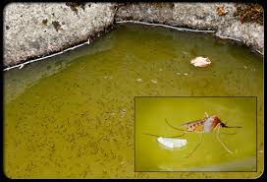
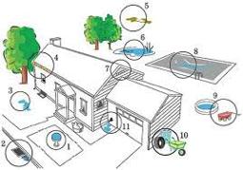
Mosquito (Vector Borne )Diseases
What is a Vector-borne Disease? A vector borne disease is an illness from a virus or bacteria that you get from contact with another living organism, usually a mosquito, tick, bird or rodent. Not every insect carries a disease, but you can not distinguish which ones may carry illnesses.
How does climate change impact vector born disease? Warmer temperatures and rain patterns will change where certain disease-carrying species will live. Things found in the tropics will become more common in Florida. Without cold winter temperatures to kill off the insect populations or their eggs, they will increase in number, paving the way for higher rates of illness.
What do residents need to do? In South Florida we are particularly concerned about controlling mosquito populations that carry several disease (listed to the right). County government monitor and spray areas that are mosquito breeding grounds, but they public cooperation to eliminate standing water on private property. Standing water is where mosquitos breed.(Picture 1)
Drain standing water from buckets, flower pots, drums, plastic pools, clogged gutter or low areas around your property.(picture 2)
Prevent bites by installing and fixing broken screens, wearing long sleeves, long pants, and socks when outdoors and insect repellent with DEET or oil of lemon eucalyptus.
Be wary1 hour before and after dawn and dusk, when mosquitoes are more active.
Contact the Dept. of Environmental Resources Management, Mosquito Control Division about mosquito infestations.
1
2
Health Impacts
Dengue Fever
St. Louise Encephalitis
Eastern Equine Encephalitis
West Nile
Chikungunya Fever
Zika Virus
Who is at high risk?
Everyone is at risk of being bitten by mosquitos and becoming ill, but children, older adults and people that are immune compromised may be at risk of getting more seriously ill than others. Zika Virus poses a greater risk to pregnant women and the unborn fetus as it is thought to cause microcephaly in babies.
If someone develops symptoms, seek medical attention Immediately!
^{Report to:}
Dept. of Environmental Resources Management Mosquito Control Division
9011 W. Lantana Road, Lake Worth, FL 33467
^{Phone: 561-967-6480} Air Spray HOTLINE: 561-642-8775
Key website
http://www.floridahealth.gov/diseases-and-conditions/mosquito-borne-diseases/
Developed by Dr. Ana Puszkin-Chevlin
Notes:
Not everyone will get symptoms, but some people will get very ill. The symptoms may appear long after the bug bite, so anyone with symptoms should see a physician, and tell them if you have mosquito bites.
The most serious of these are Encephalitis – which causes brain swelling and often death.
Zika Virsus is the newest vector borne disease to emerge. Florida is one of the few states in the US with a climate that is conducive to the mosquito that carries this. There are no vaccines at the moment, so public health officials are assessing the risk and the approach to containment.

Slide 12
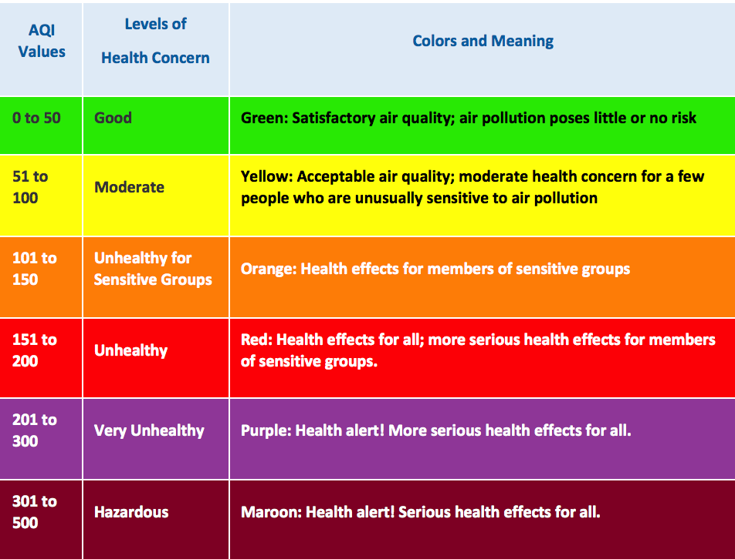
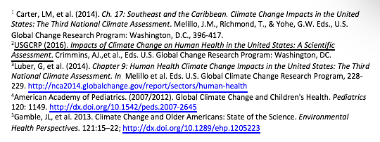
Asthma
How does climate change impact asthma? Climate change is creating warmer temperatures and more frequent heat waves, which, in turn, lead to increases in heat stress, respiratory illnesses, and heat-related deaths. Individuals with asthma are at risk of worsened symptoms and asthma attacks.¹
Climate Change Increases Air Pollution
Rising temperatures increase the concentration of ground-level ozone, which pollutes the air. When ozone remains in the upper atmosphere (the stratosphere), it shields us from ultraviolet radiation. However, at ground level, ozone creates smog, which can cause breathing problems by damaging lung tissue, reducing lung function, and inflaming airways.¹
Climate Change Increases Allergens in Air
Climate change increases the concentration of airborne allergens, as rising temperatures increase pollen levels. In addition, flowering starts earlier, resulting in a longer ragweed pollen season, and more time for exposure to airborne allergens.²
What can you do to stay healthy?
Monitor the Air Quality Index Daily to Keep Healthy
The U.S. Environmental Protection Agency’s (EPA) Air Quality Index (AQI) measures the level of pollution. The purpose of the AQI is to let you know when the air quality may be hazardous to your health. When the AQI is in the unhealthy range, stay indoors in air-conditioning as much as possible; when you go outside, avoid exertion and heavily trafficked roadways and consider wearing a mask. Check local AQI daily at https://www.airnow.gov/.
Monitor the Heat Index (HI) Daily to Keep Healthy
The National Weather Service’s Heat Index (HI) measures the “real feel” temperature, which combines heat and humidity. Young children, pregnant women, people who work outdoors, and older adults are vulnerable to heat exhaustion and heat stroke and should stay indoors in air-conditioning when HI rises above 91. Drink plenty of water and stay in the shade if you do go outside. Check the HI daily at http://www.nws.noaa.gov/om/heat/index.shtml or Google Air Now AQI.
Air Quality Index (AQI) and Your Health
Source: US Environmental Protection Agency. (2016). Air Quality Index: Air Now. Available at: https://airnow.gov/index.cfm?action=aqibasics.aqi.
Health Impacts
Breathing problems
Reduced lung function
Inflamed airways
Damaged lung tissue
Who is most vulnerable?
The American Lung Association (ALA) notes that all those with asthma and other lung diseases are particularly at risk from exposure to heat, air pollution, airborne allergens, and extreme weather events. In addition, the following populations are especially vulnerable to public health threats from climate change:
Low-income households and some communities of color, due to exposure to higher levels of pollution in their neighborhood, and inadequate access to medical care;³
Children and pregnant women, due to their immature lungs and immune system and their increased exposure to pollution due to breathing more air per pound than adults and spending more time outdoors;⁴
Older adults, due to medical conditions and depressed immune functioning associated with aging.⁵
Developed by Debra Weiss-Randall, EdD, CHES
Notes:
Not everyone will get symptoms, but some people will get very ill. The symptoms may appear long after the bug bite, so anyone with symptoms should see a physician, and tell them if you have mosquito bites.
The most serious of these are Encephalitis – which causes brain swelling and often death.
Zika Virsus is the newest vector borne disease to emerge. Florida is one of the few states in the US with a climate that is conducive to the mosquito that carries this. There are no vaccines at the moment, so public health officials are assessing the risk and the approach to containment.

