Slide 1



EPA Grant #EQ-00D35415-0
Powerpoint by Janice T. Booher, MS & Dr. Debra Weiss-Randall
Notes:
Rising Together was an environmental justice project funded by the United States Environmental Protection Agency (EPA) through the umbrella organization of the Unitarian Universalist Fellowship of Boca Raton (UUFBR). This pilot study targeted two vulnerable communities. In Delray Beach, the community partner was Toussaint L’Ouverture High School for Arts and Social Justice. This slide set presents the data for Delray Beach, collected in the target community of SE Delray Beach in spring 2016.

Slide 2
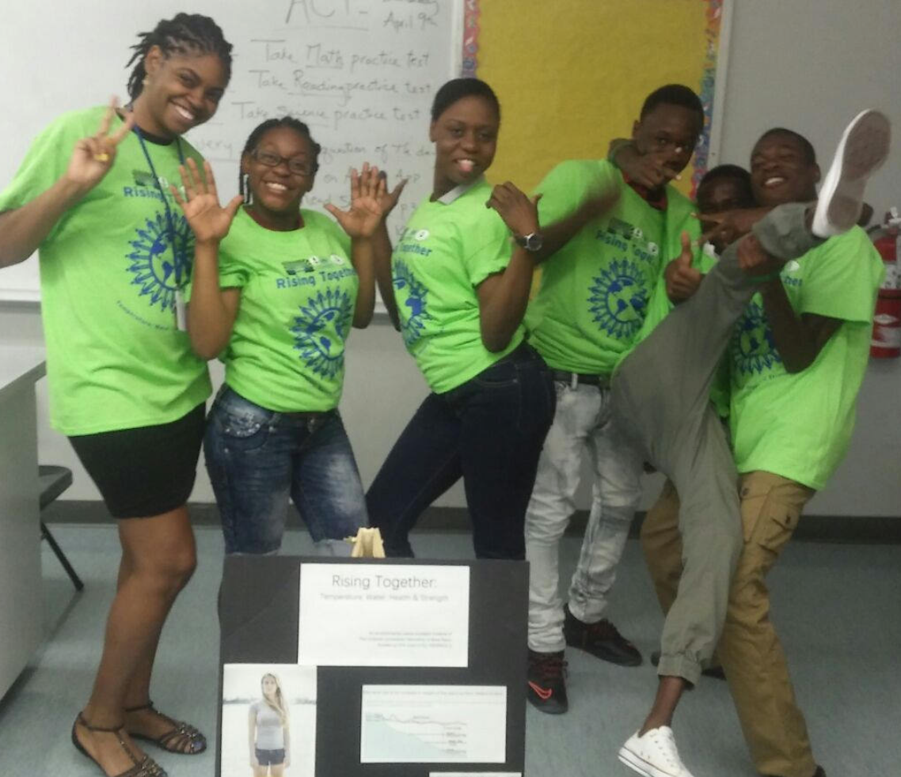
Building
Climate
Resilience
By the Numbers
Notes:
Climate Resilience is the ability of a community to work together to adapt successfully to climate change. This project identified 3 key actions this community can address to increase its climate resilience (see slide 28). Pictured are Dr. Ashley Ridley and her students from Toussaint L’Ouverture High School.

Slide 3
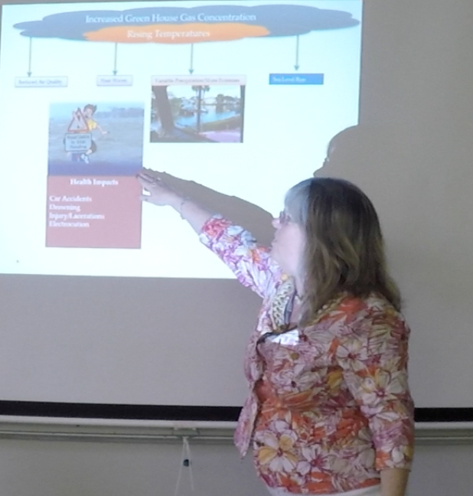
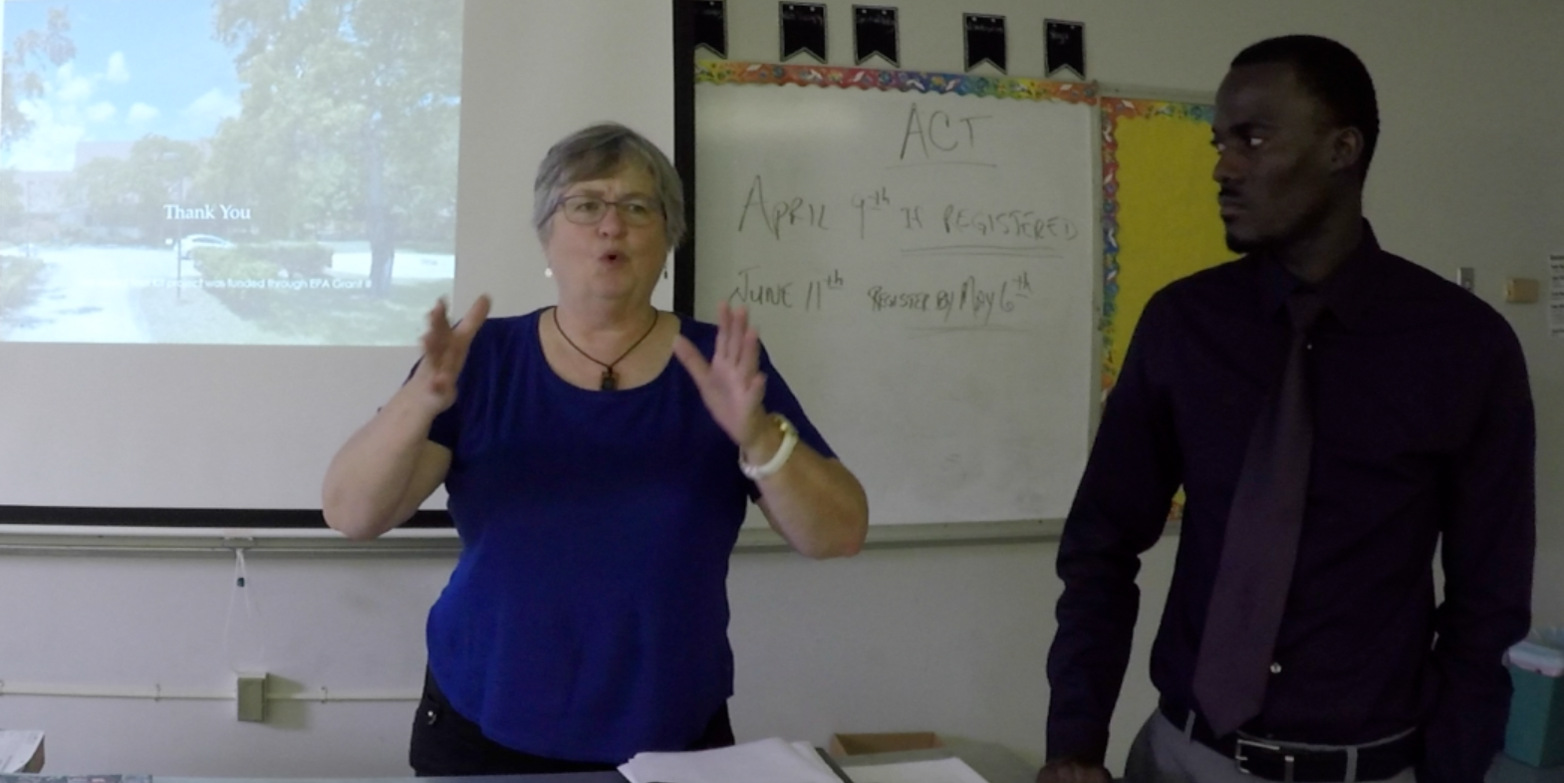
Two Training Sessions
Notes:
The outreach teams received two training sessions: Oral History training from Dr. Sandra Norman, Professor of History at Florida Atlantic University, and training on the Health impacts of Climate Change, from Dr. Ana Puszkin-Chevlin, Project Manager Phase I.

Slide 4
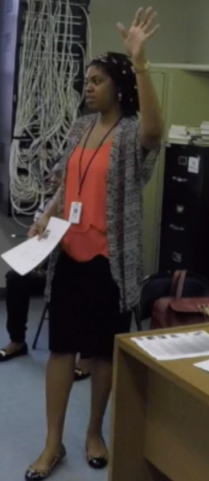
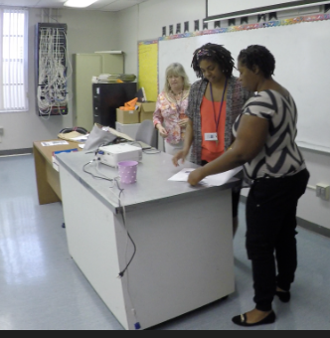
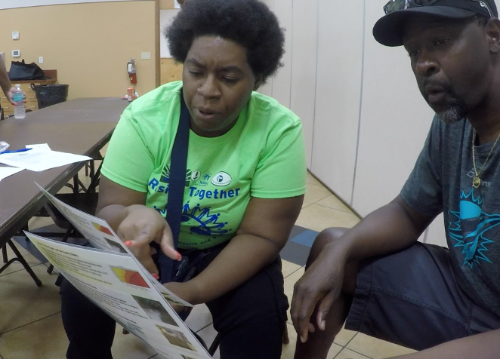
Two Outreach Leaders
Notes:
From Left to right: (Left Photo) Outreach Leader Dr. Ashley Ridley calls her class to order prior to the training sessions. (Center Photo) Project Manager Phase I Dr. Ana Puszkin-Chevlin and Outreach Leader Lyanna Ridley consult before the training sessions begin. (Right photo) Outreach Leader Lyanna Ridley explains the educational handout on health and climate change to a resident of South Delray Beach at a community event.

Slide 5
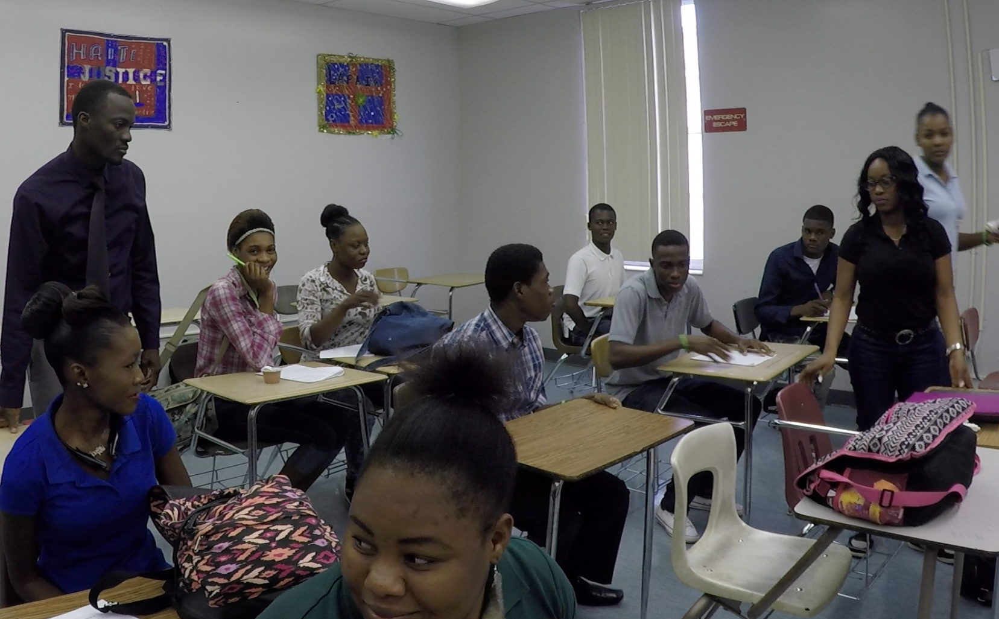
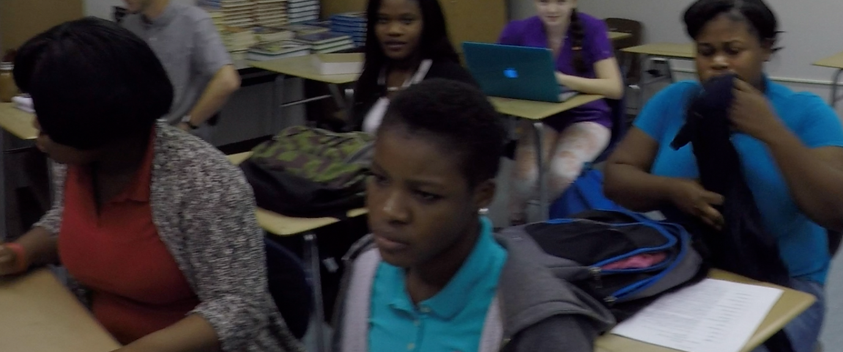
Twenty Trained Climate Communicators
Dr. Ashley Ridley, Teacher
Lyanna Ridley, Teacher
Mr. Demosthene, Creole Translator
17 Students
Notes:
Twenty climate communicators were trained at TLHS. Mr. Demosthene and students are shown here prior to the training sessions.

Slide 6
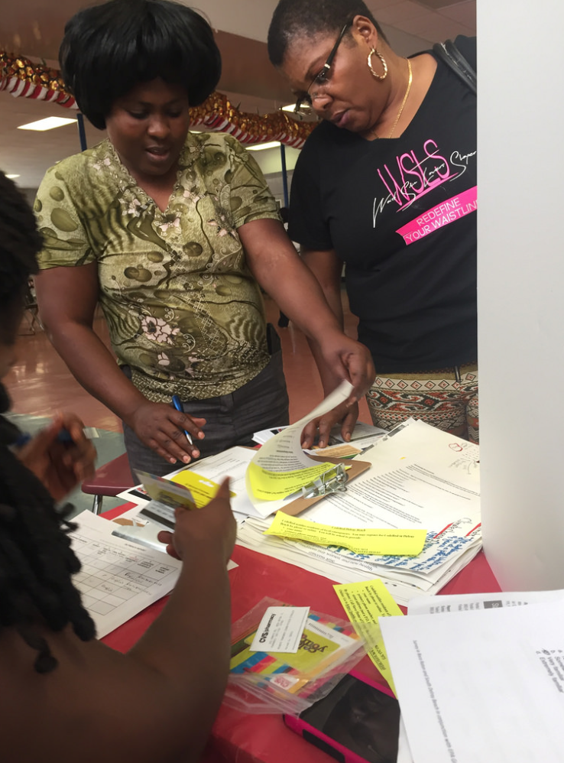
TLHS Teams Surveyed Residents at the School Health Fair…

Slide 7
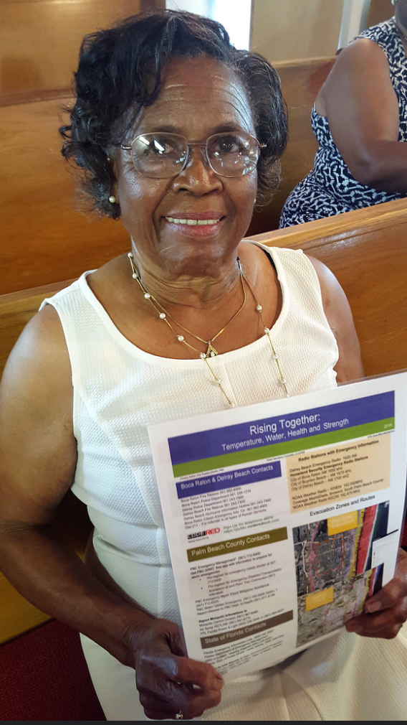
at St. Matthews Episcopal Church

Slide 8
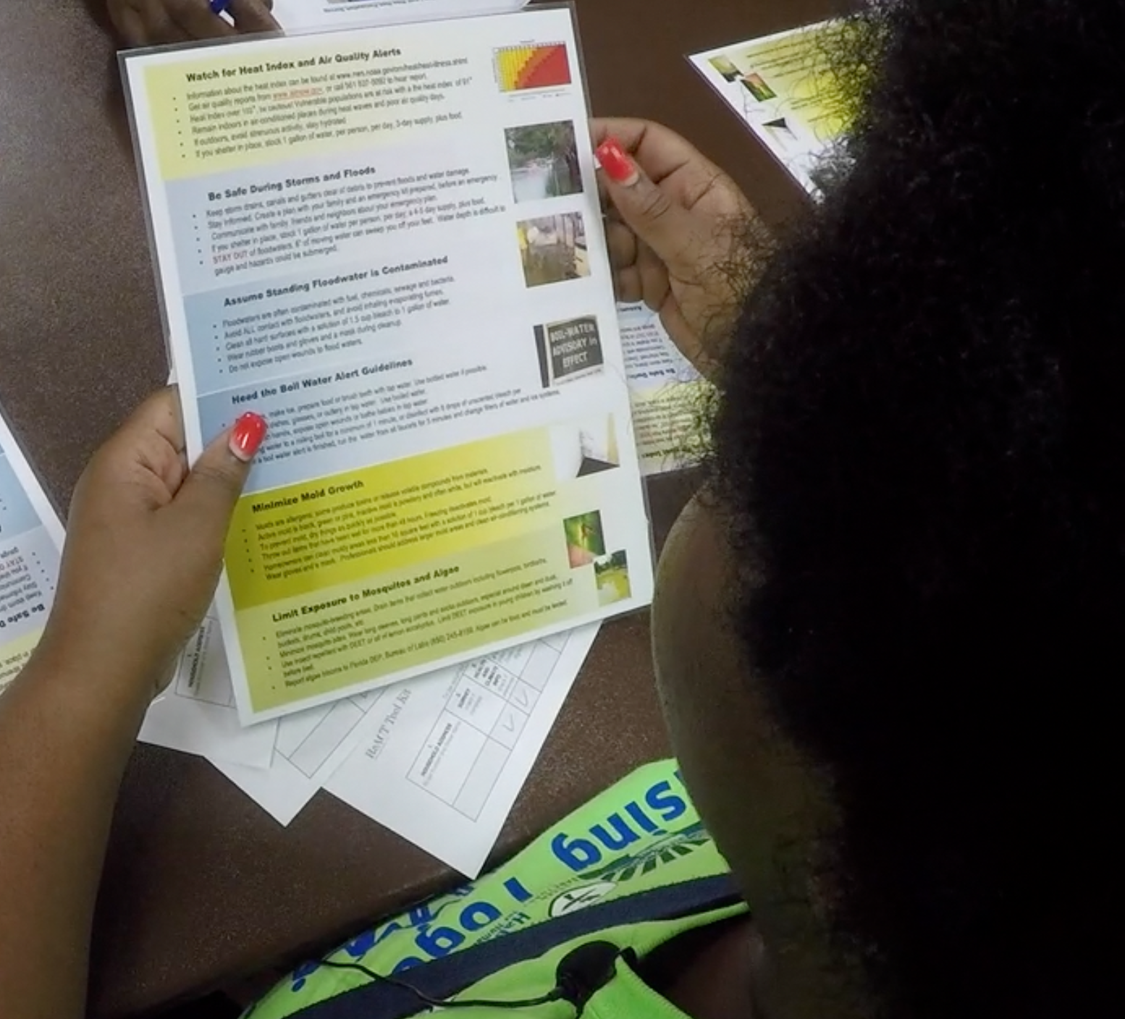
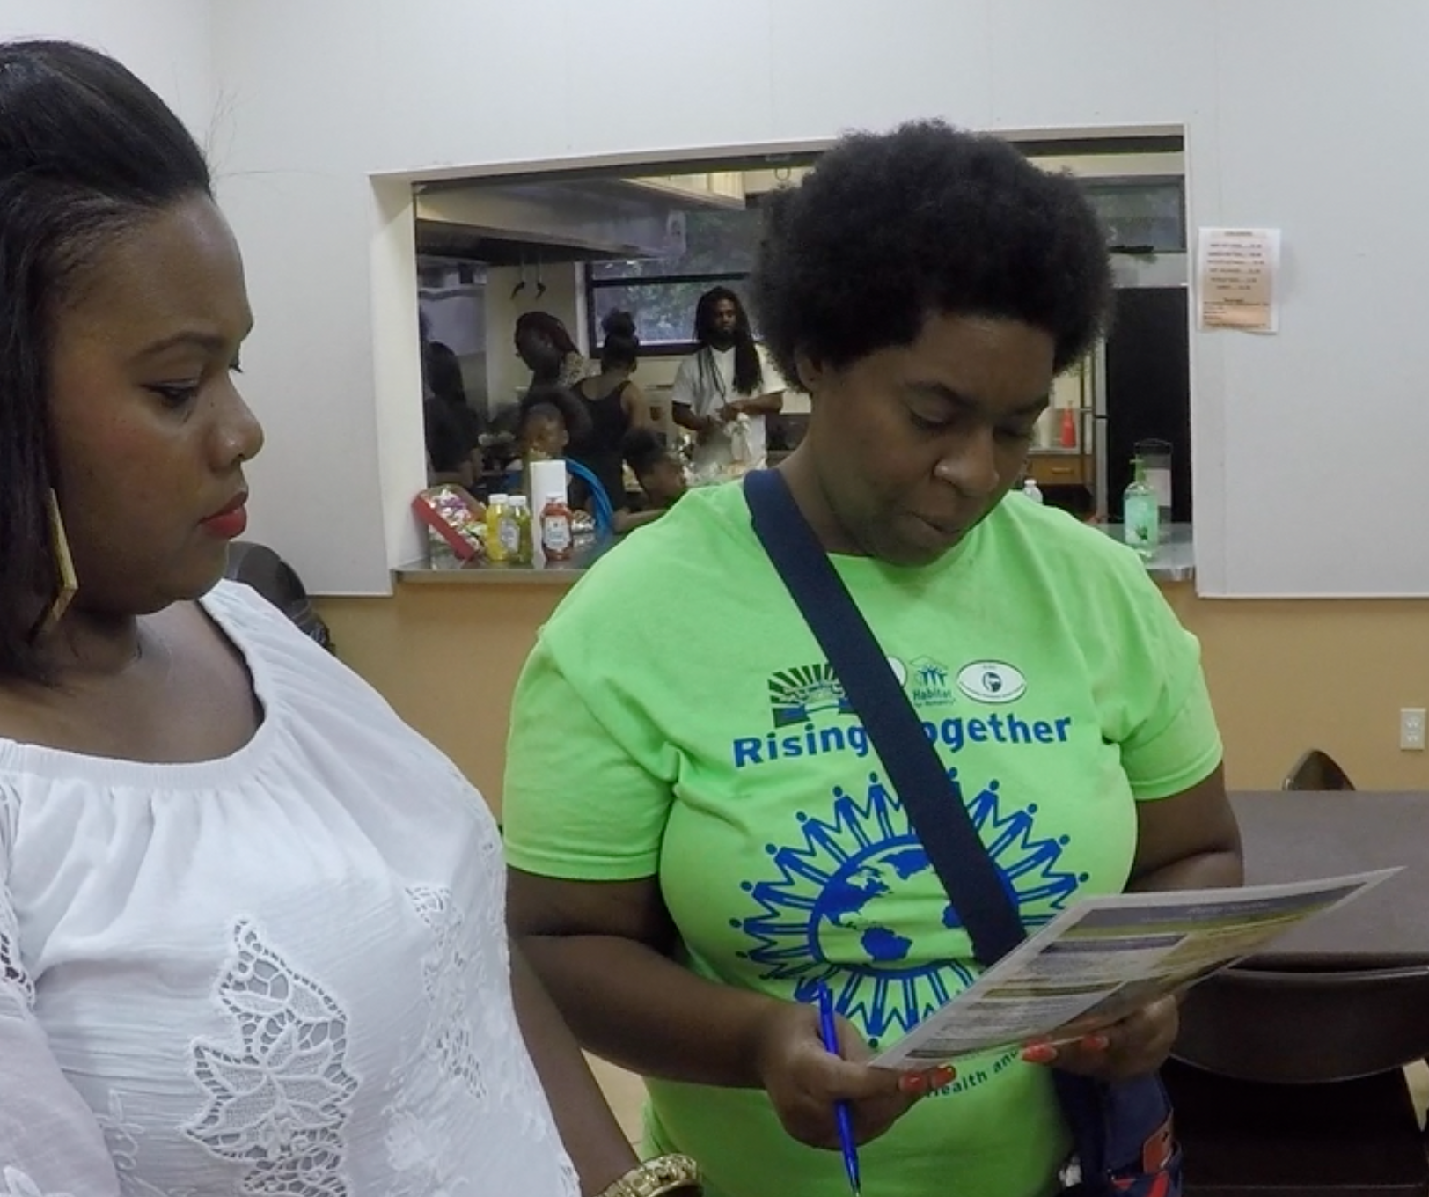
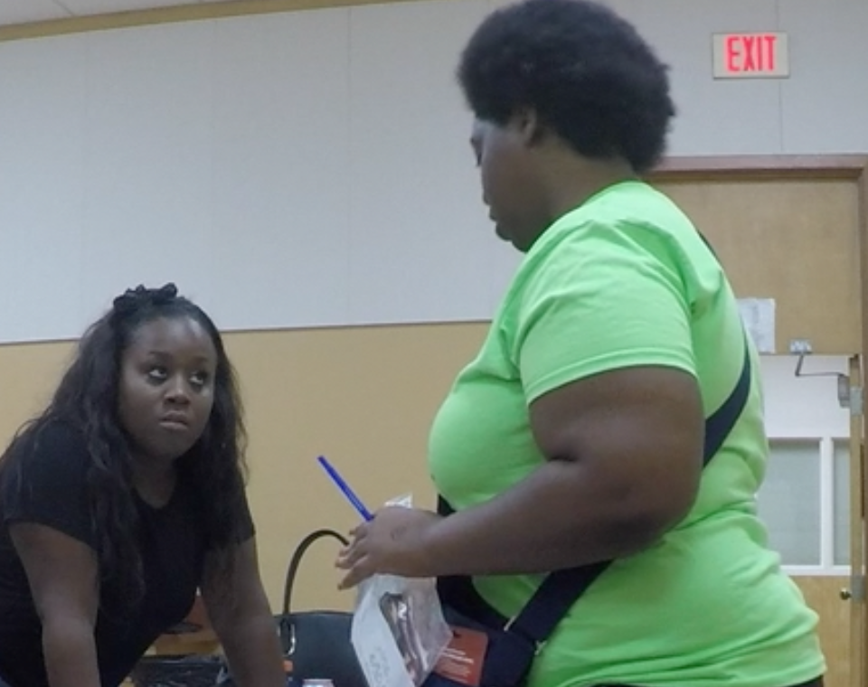
and at Pompey Park Community
Center Dance Off

Slide 9
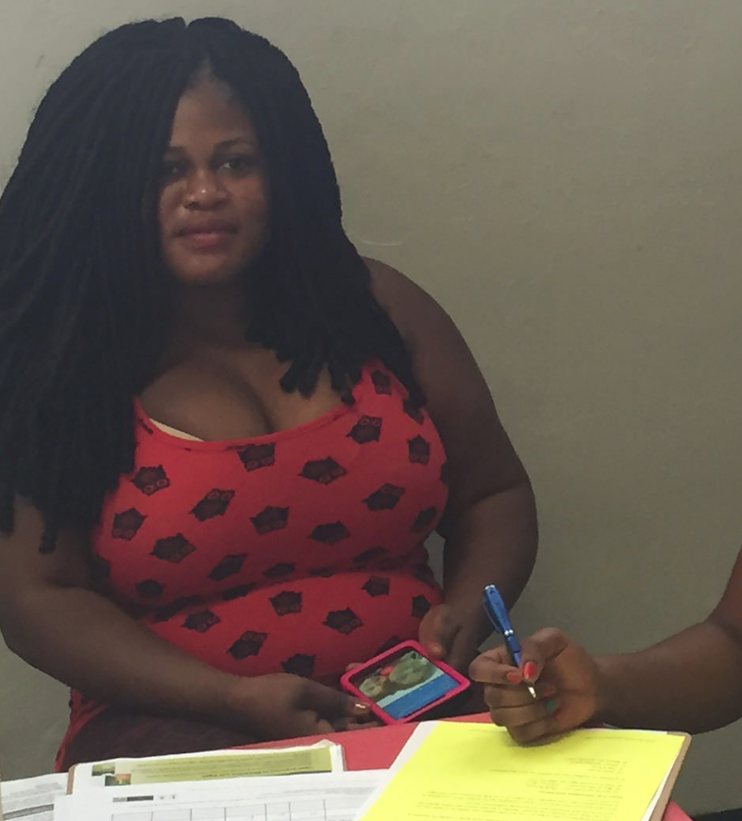
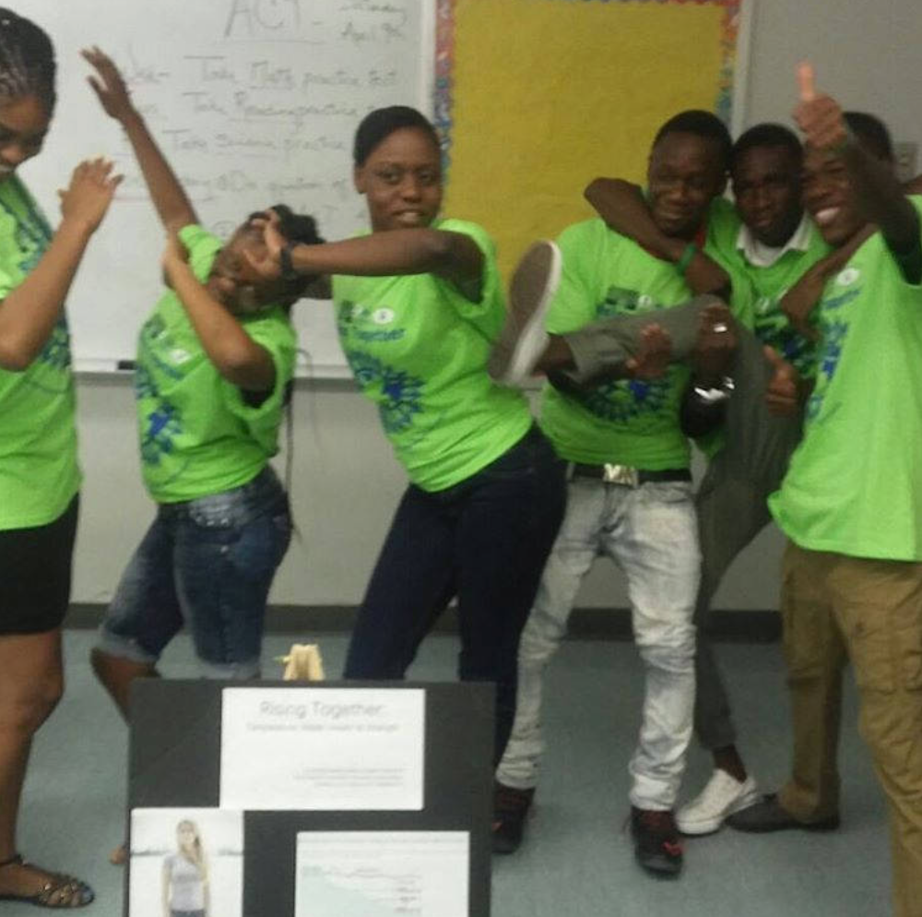
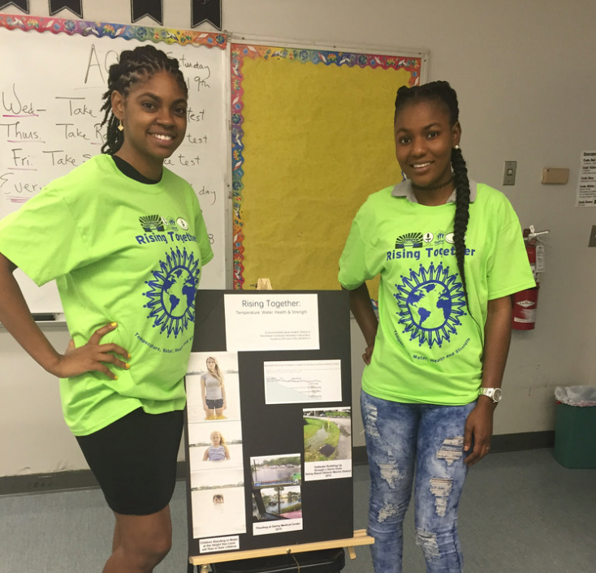
Seven Climate Outreach Team Members
Wildlaure Beneche
Suze Jean Charles
Corlie Jean Pierre
Woldens Mercy
Donelson Septimus
Yamise Thermidor
Luckson Valmir
Notes:
Seven climate outreach communicators from TLHS surveyed residents.

Slide 10
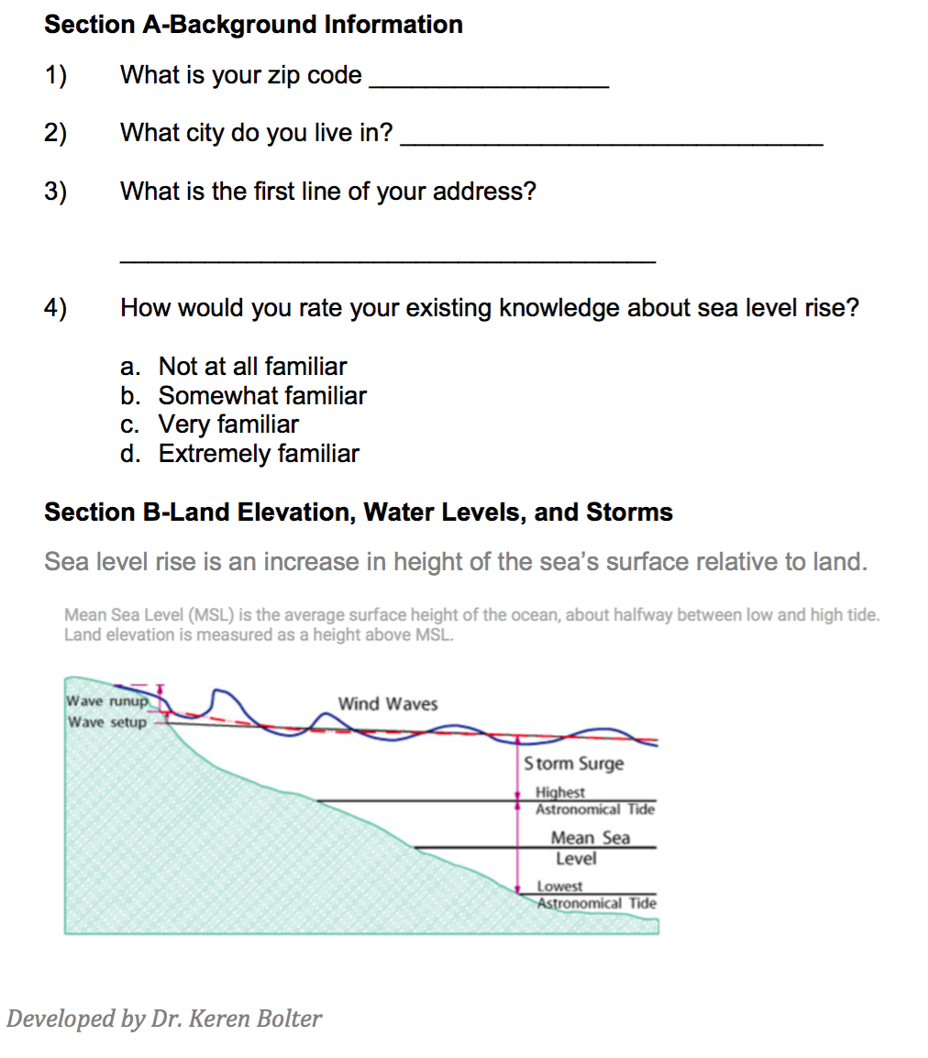
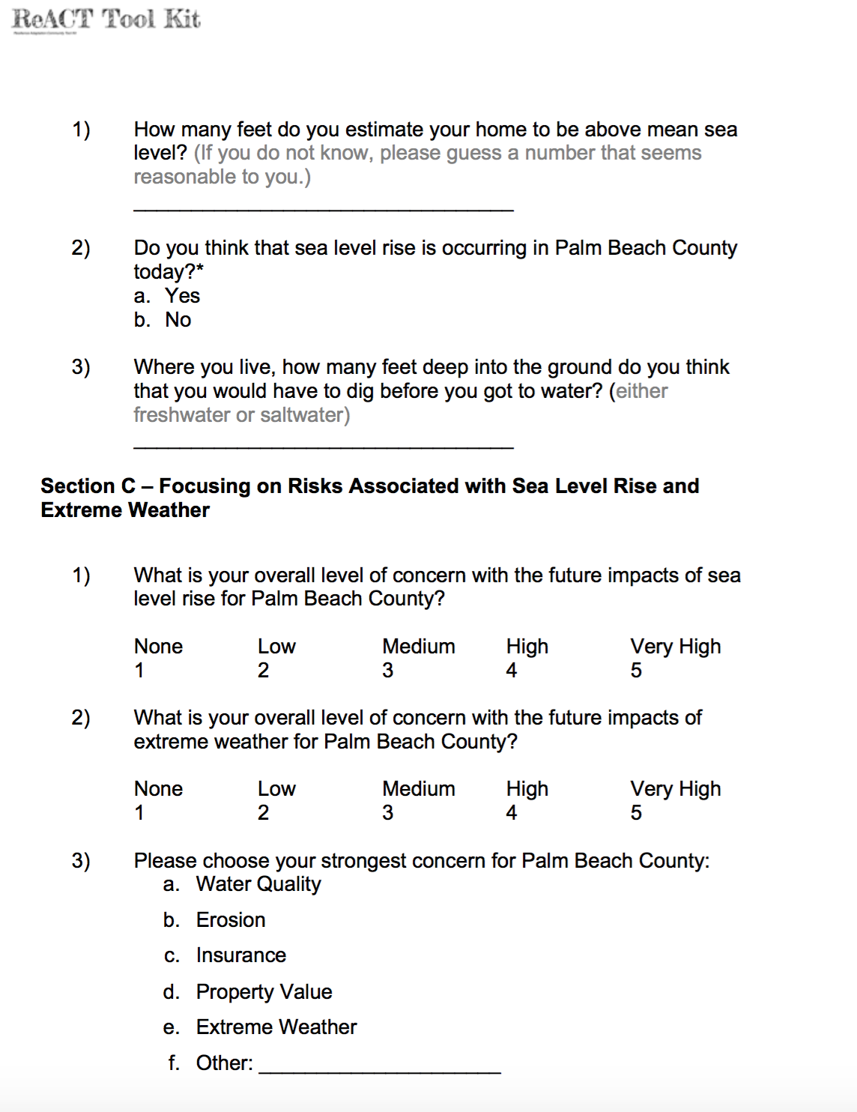
91 Residents in 77 Households Surveyed
Notes:
A total of 91 residents in 77 households completed surveys.

Slide 11
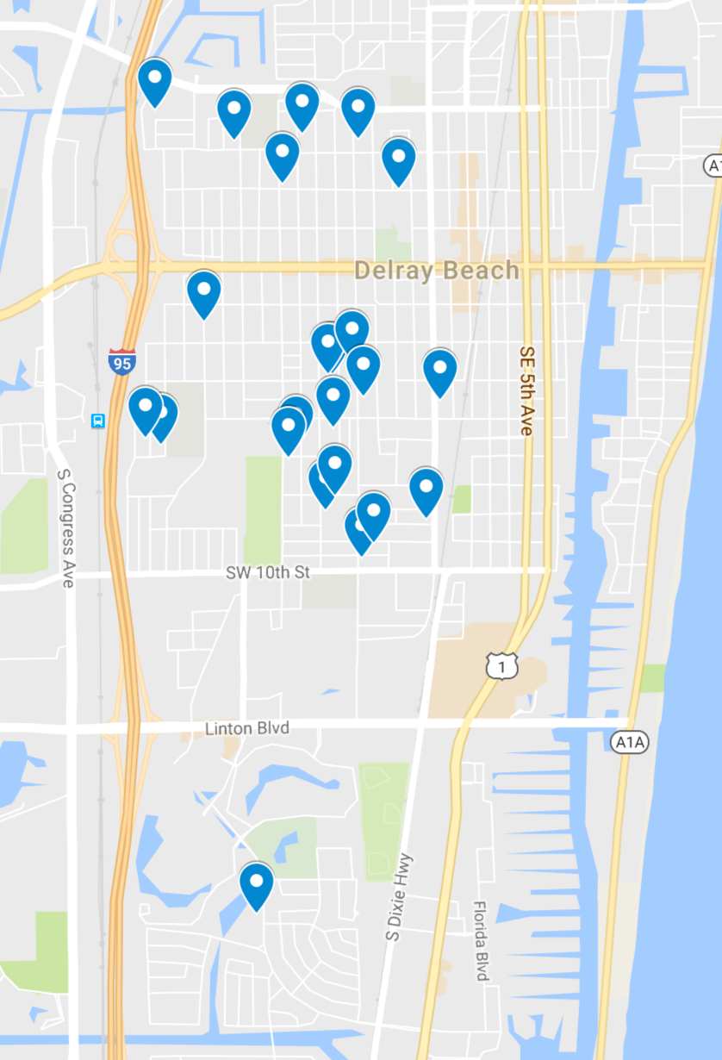
23 Reports of Flooding
Notes:
This map gives the location of households reporting flooding.

Slide 12
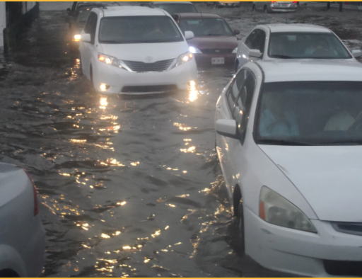
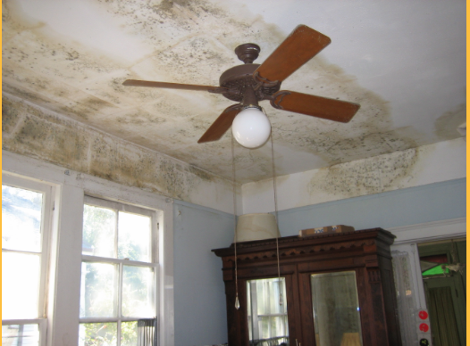
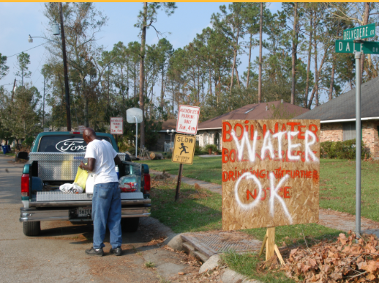
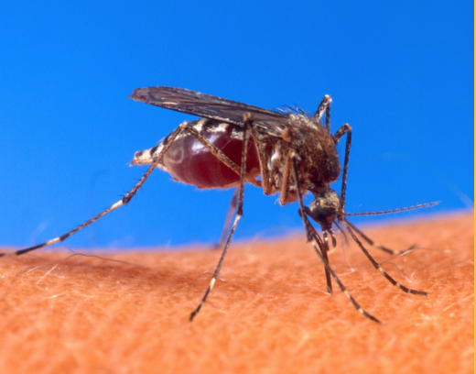


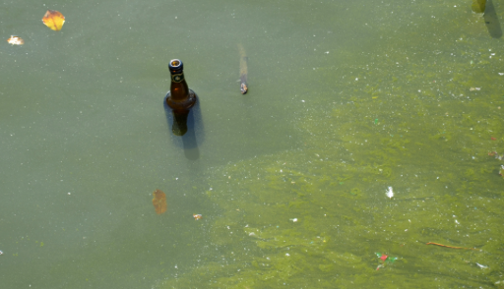
91 Residents in 77 Households Educated
Mold
Water Contamination
Vector Borne Disease
Storm Preparedness
Heat Waves and
Poor Air Quality
Standing Water
Algae Blooms
Notes:
Ninety-one residents were educated about the public health effects of climate change. Education included: storm preparedness, mold, water contamination, vector borne diseases, heat waves and poor air quality, standing water and algae blooms.

Slide 13
Notes:
Of the residents surveyed in South Delray Beach, slightly more than three-quarters of the households spoke English, 8.8% spoke Creole, and 10.1% were bilingual or trilingual, speaking English as well as Creole and/or French.

Slide 14
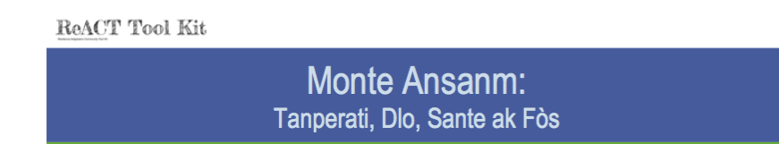
Two Outreach Languages
English
Creole
Notes:
Educational materials used in South Delray Beach were in two languages – English and Creole. Educational materials also are available in Spanish. Trilingual educational materials are available at www.Reacttoolkit.net.

Slide 15

26 People Signed up for Code Red
Source: CodeRed Emergency Notification System, City of Delray Beach.
Available at: http://mydelraybeach.com/i_want_to/learn_about/codered_emergency_notification.php
Notes:
After respondents completed the survey, they completed an educational handout on sea level rise and were then encouraged to sign up for CodeRed, the emergency response warning system for Delray Beach; a total of 26 respondents signed up for CodeRed.

Slide 16
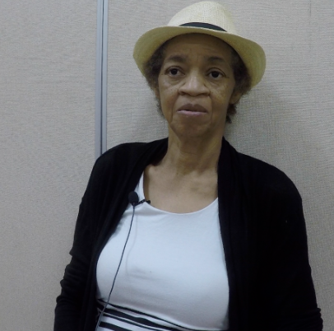
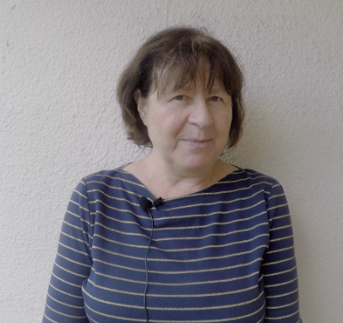
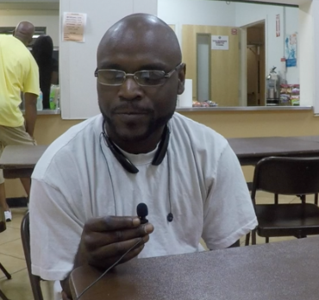
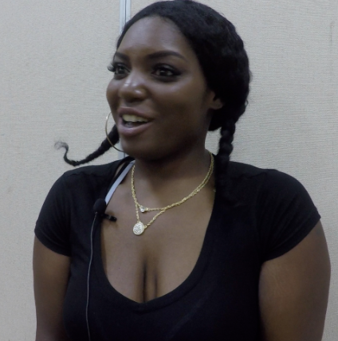
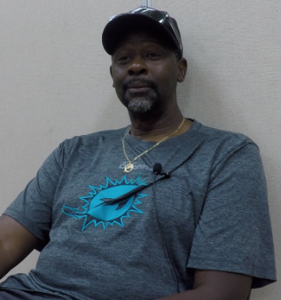
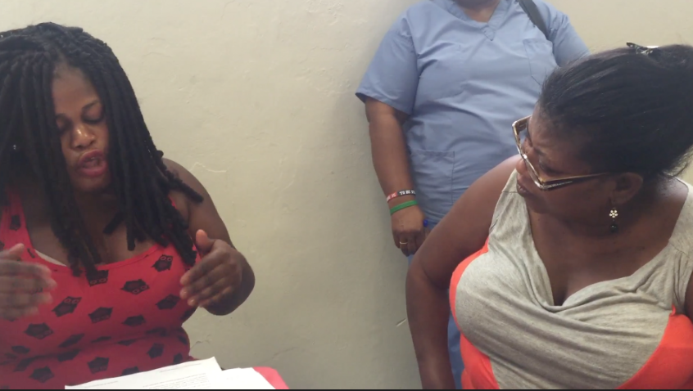
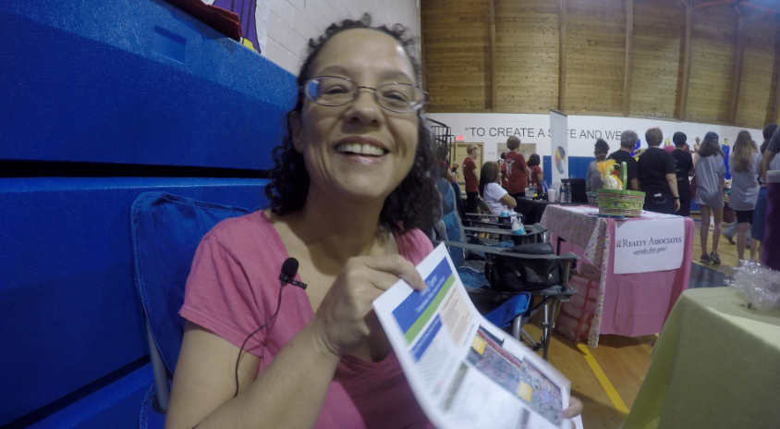
19 Oral Histories
Notes:
To augment the survey data and yield more qualitative data on respondents’ experience with sea level rise, 19 respondents were interviewed. Their oral histories detail their experiences with mold, asthma, flooding, severe storms and evacuation.

Slide 17
What We Learned
Familiarity with Sea Level Rise
Perceptions of Sea Level Rise Risk
Top Concerns about Sea Level Rise
Percentages of Households that Have Experienced Mold, Asthma and Water Contamination
Notes:
The survey data documented respondents’ self-reported familiarity with sea level rise, their perceived risk from sea level rise, their top concerns about sea level rise, and their history of mold, asthma, and water contamination.

Slide 18
Red-Not at all familiar Yellow-Somewhat familiar Green-Very familiar White-Extremely Familiar
Notes:
A total of 35.6% of respondents reported that they were not at all familiar with sea level rise, and another 36.8% reported that they were somewhat familiar with it. Only 21.1% reported being very familiar with sea level rise, and 6.6% reported being extremely familiar with sea level rise. It is clear that more health education on sea level rise is needed!

Slide 19
Notes:
When asked what their top concerns were regarding sea level rise, 27.3% of respondents named water quality as a top concern, with extreme weather a close second at 26.0%. Property value was third, with 19.5% naming it as a top concern, and insurance was fourth, at 18.2%. Erosion was a top concern for 9.1% of respondents.

Slide 20
Notes:
The percentage of households that reported having a member who had asthma was 28.6%, more than 2 1/2 times the County prevalence rate of 10.4% (Florida CHARTS, 2013). The percentage of households reporting having had mold was 22.1%, and the percentage reporting water contamination was 11.7%.

Slide 21
Asthma and Climate Change
Climate change poses a health threat to those with asthma by increasing air pollution and airborne allergens.
Notes:
Carter, LM, et al. (2014). Ch. 17: Southeast and the Caribbean. Climate Change Impacts in the United States: The Third National Climate Assessment. Melillo, J.M., Richmond, T., & Yohe, G.W. Eds., U.S. Global Change Research Program: Washington, D.C., 396-417.

Slide 22
Mold and Climate Change
Climate change increases the frequency and severity of flooding, resulting in dampness in and around the home.
Dampness may lead to mold, which is an allergen that worsens asthma and allergy symptoms.
It is important to keep homes dry to prevent the growth of mold.
For more advice about how to deal with mold, visit website: https://www.epa.gov/mold/ten-things-you-should-know-about-mold
Notes:
Source: US Environmental Protection Agency. (2016). 10 Things You Should Know about Mold. Available at: https://www.epa.gov/mold/ten-things-you-should-know-about-mold

Slide 23
Airborne Allergens and Climate Change
Climate change increases the concentration of airborne allergens, as rising temperatures increase pollen levels.
Flowering starts earlier, resulting in a longer ragweed pollen season, and more time for exposure to airborne allergens.
Notes:
USGCRP. (2016). Impacts of Climate Change on Human Health in the United States: A Scientific Assessment. Crimmins, AJ.,et al., Eds. U.S. Global Change Research Program: Washington, DC.

Slide 24
Air Pollution and Climate Change
Rising temperatures increase the concentration of ground-level ozone, which pollutes the air.
When ozone remains in the upper atmosphere, it shields us from ultraviolet radiation.
However, at ground level, ozone creates smog, which can cause breathing problems by damaging lung tissue, reducing lung function, and inflaming airways.
Notes:
Carter, LM, et al. (2014). Ch. 17: Southeast and the Caribbean. Climate Change Impacts in the United States: The Third National Climate Assessment. Melillo, J.M., Richmond, T., & Yohe, G.W. Eds., U.S. Global Change Research Program: Washington, D.C., 396-417.

Slide 25
Delray Beach Rising Together and ReACT Tool Kit
Janice T. Booher, MS
Project Director
UUFBR Green Sanctuary Committee
Robert Duchemin
UUFBR Treasurer
Training Session Technical Support
UUFBR Green Sanctuary Committee
Jeffrey L. Booher
UUFBR Project Account Manager
Dr. William Bode
UUFBR Green Sanctuary Committee
Training Session Technical Support
Seyril Siegel
UUFBR Spanish Translation
Green Sanctuary Committee
Griselle Martinez
UUFBR Spanish Translation
Dr. Diane Allerdyce
TLHS Liaison
Dr. Ashley Ridley
TLHS Outreach Leader
Lyanna Ridley
TLHS Outreach Leader
Dieunet Demosthene
Creole Translation
Outreach Team
Corlie Jean Pierre
Donelson Septimus
Woldens Mercy
Wildlaure Beneche
Donelson Septimus
Suze Jean-Charles
Yamise Thermidor
Luckson Valmir
Dr. Ana Puszkin-Chevlin
Project Manager, Phase I
Dr. Debra Weiss-Randall
Project Manager, Phase II
Dr. John Hardman
Spanish Translation
Debora Kerr, MA
Grant Application Consultation and ReACT Toolkit Proof-Reader
Academic Oversight:
Dr. Keren Bolter, Florida Atlantic University
Sea Level Rise Risk Perception Survey Oversight
Dr. Sandra Norman, Florida Atlantic University
Oral Histories Oversight
Special Thanks to
St. Matthews Episcopal Church
Pompey Park Community Center

Slide 26
EPA Grant #EQ-00D35415-0
Powerpoint by Janice T. Booher, MS & Dr. Debra Weiss-Randall
Notes:
Rising Together was an environmental justice project funded by the United States Environmental Protection Agency (EPA) through the umbrella organization of the Unitarian Universalist Fellowship of Boca Raton (UUFBR). This pilot study targeted two vulnerable communities. In Delray Beach, the community partner was Toussaint L’Ouverture High School for Arts and Social Justice. This slide set presents the data for Delray Beach, collected in the target community of SE Delray Beach in spring 2016.

