Slide 1




EPA Grant #EQ-00D35415-0
Powerpoint by JaniceT. Booher, MS & Dr. Debra Weiss-Randall
Notes:
The Pilot Project of Rising Together was an environmental justice project funded by the United States Environmental Protection Agency (EPA) through the umbrella organization of the Unitarian Universalist Fellowship of Boca Raton (UUFBR). This pilot study targeted two vulnerable communities. In Boca Raton, the community partners were DISC (Developing Interracial Social Change) and Habitat for Humanity. This slide set presents some of the data for Boca Raton, collected in the target community of Pearl City/Dixie Manor/Lincoln Court in spring 2016.

Slide 2
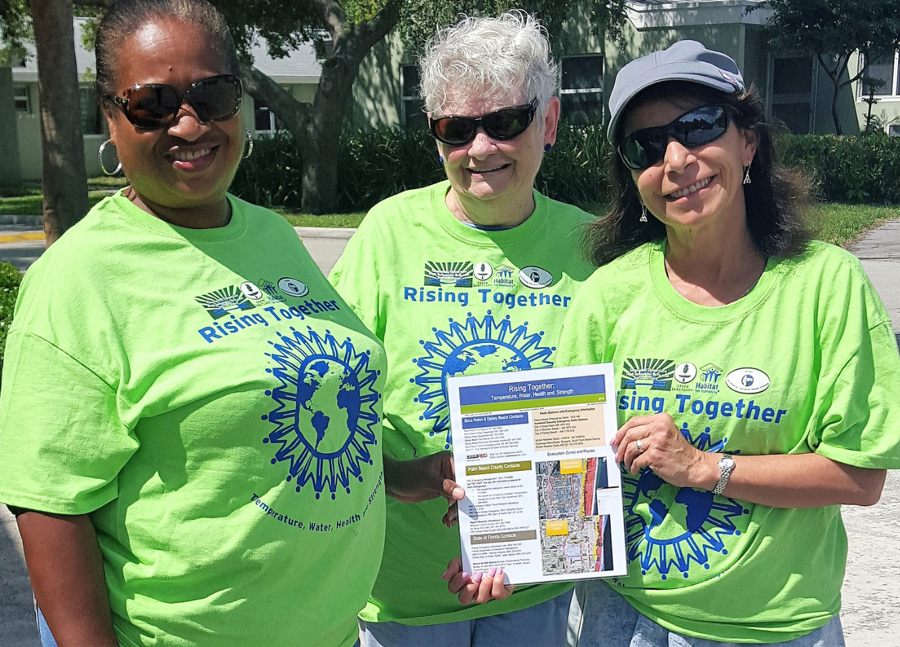
Building
Climate
Resilience
By the Numbers
Notes:
Climate Resilience is the ability of a community to work together to adapt successfully to climate change. This project identified 4 key actions this community can address to increase its climate resilience (see slide 25) . Pictured here are DISC Outreach Leader LeJeune Goddard, DISC Board Liaison Marjorie O’Sullivan, and Project Manager Phase II Dr. Debra Weiss-Randall.

Slide 3
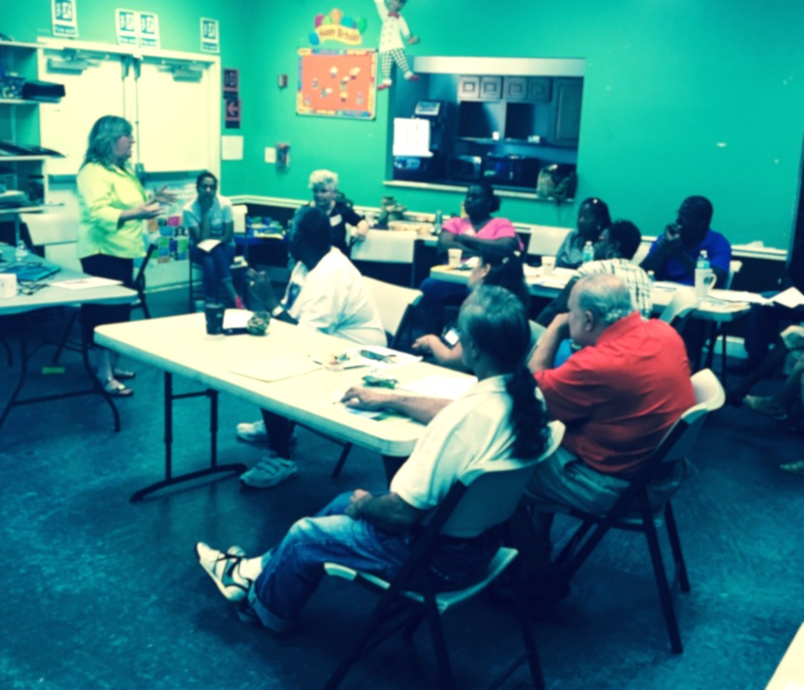
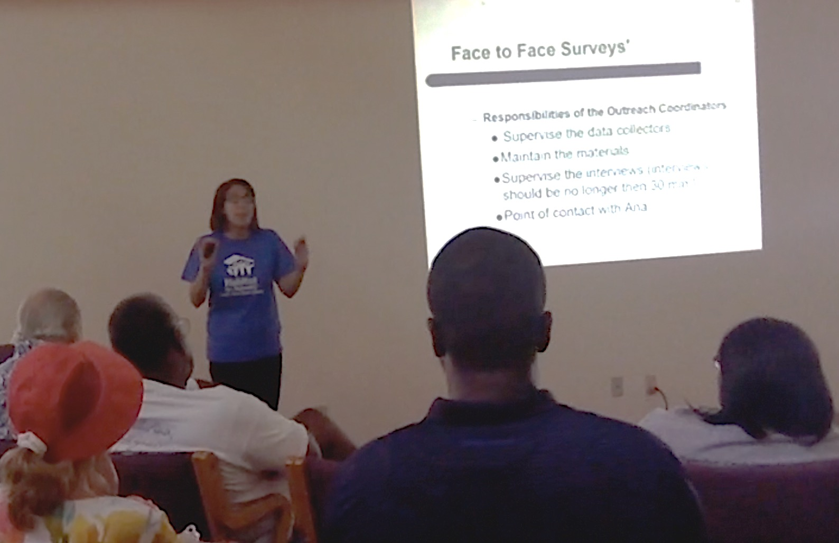
Two Training Sessions
Notes:
The outreach teams received a training session on the health effects of climate change from Project Manager Phase I, Dr. Ana Puszkin-Chevlin. They also received training on how to survey their neighbors from Habitat for Humanity Community Organizer Ana Neira, and Oral History training from Dr. Sandra Norman, Professor of History at Florida Atlantic University,

Slide 4
Eleven Trained Climate Communicators
Mike Allen
John E. Brown
David Collesano
Anita Gonzales
Katie Mae Goddard
LeJeune Goddard
Marlow Harris
Marie Hester
Fenilde Jean Baptiste
Allison Jenkins
Marjorie O’Sullivan
Notes:
Eleven climate communicators finished the two trainings and were organized into two teams, one headed by LeJeune Goddard & and the other by Marie Hester.

Slide 5
Three Bi-Lingual Climate Communicators
Anita Gonzales
Spanish Translation
Fenilde Jean Baptiste
Creole Translation
David Collesano
Creole Translation
Notes:
Educational materials on sea level rise and the health impacts of climate change were created in English, Spanish, and Creole, to serve the trilingual needs of the community. Three residents volunteered to translate during outreach, so their Spanish-speaking and Creole-speaking neighbors could participate in the survey.

Slide 6
Three Experienced Community Leaders
Experience Conducting a Public Health Campaign
Experience Documenting Neighborhood Concerns
Marjorie O’Sullivan
DISC Board Liaison
LeJeune Goddard, MSW
DISC Outreach Leader
Marie Hester
DISC Outreach Leader
Notes:
The Community Leaders were mature, experienced DISC members.

Slide 7
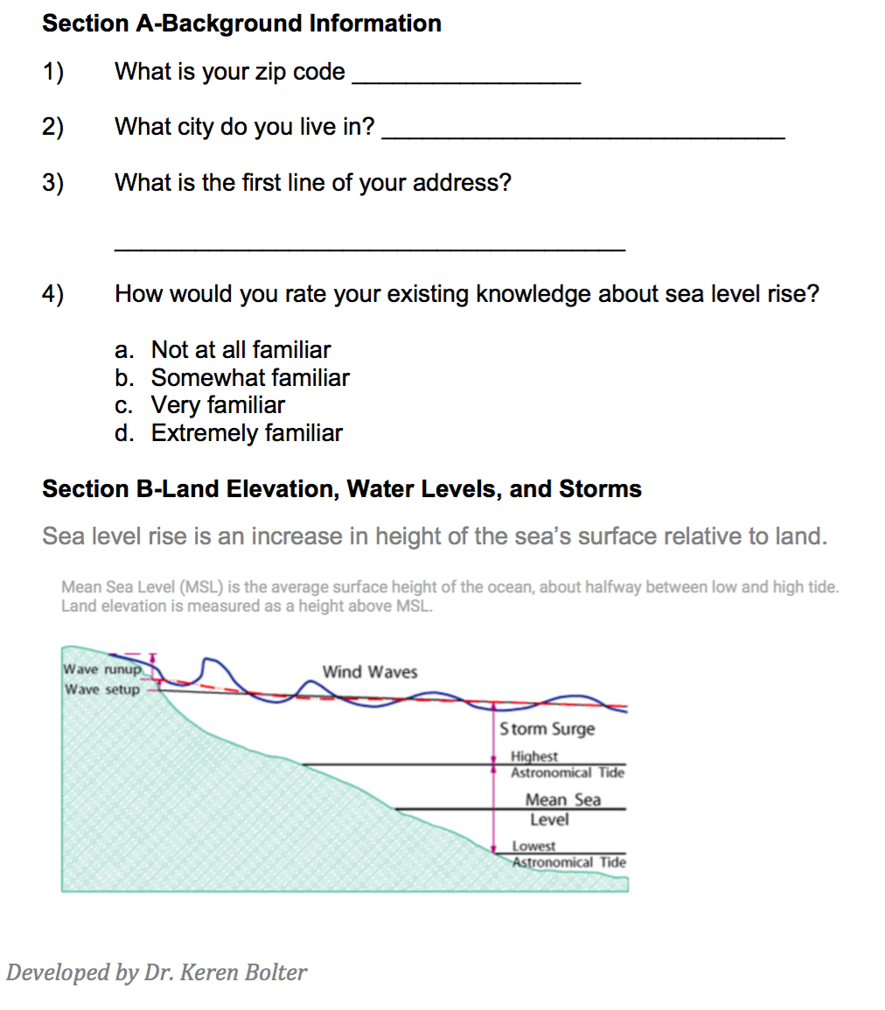
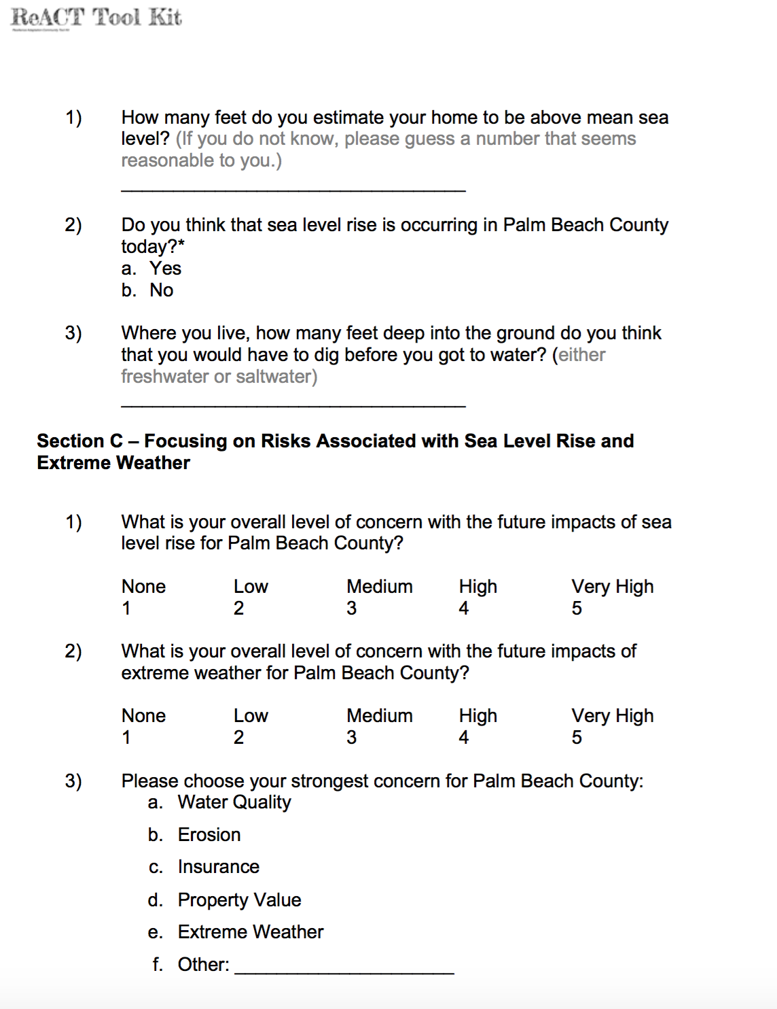
91 Households Surveyed
Notes:
A total of 91 households completed the survey, which asked respondents about their familiarity with sea level rise and its impact on their community, as well as their top concerns about sea level rise. Respondents were also asked whether they had experienced mold or water contamination, and whether any member of the household had had asthma.

Slide 8
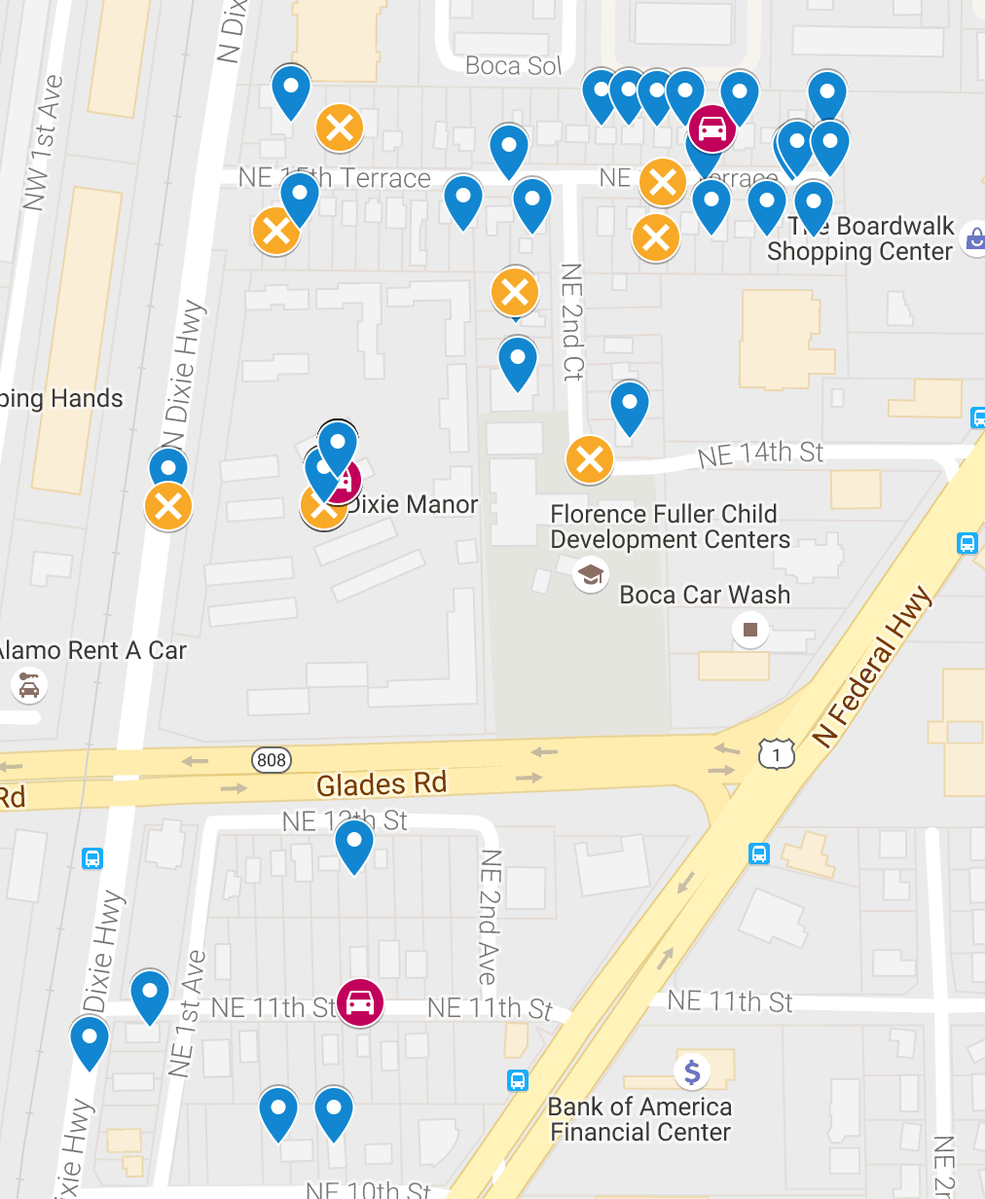
59 Reports of Flooding
12 Reports of Blocked
Storm Drains
4 Reports of Flooded Cars
Notes:
This map gives the location of households reporting flooding, blocked storm drains, and flooded cars.

Slide 9
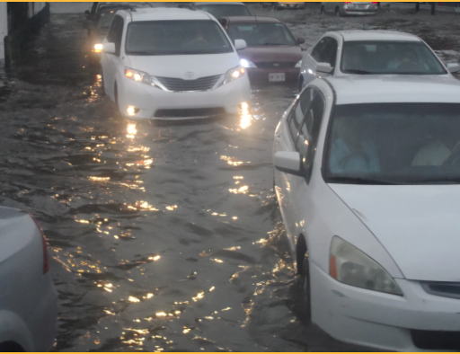
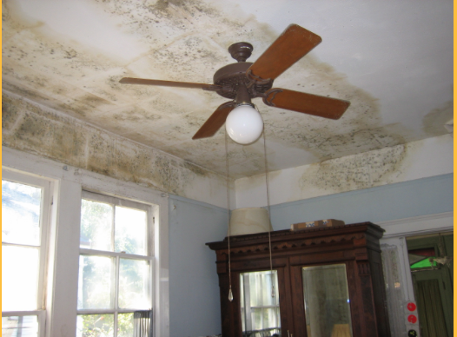
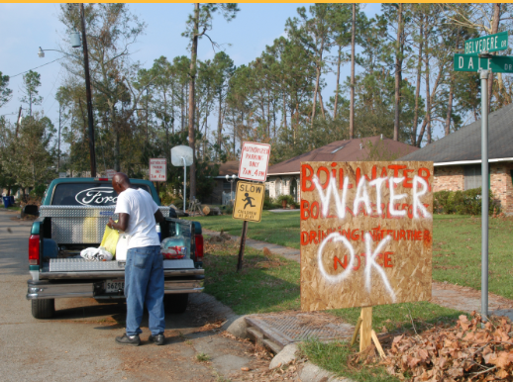
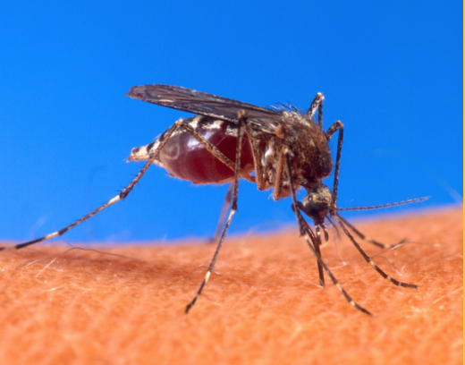


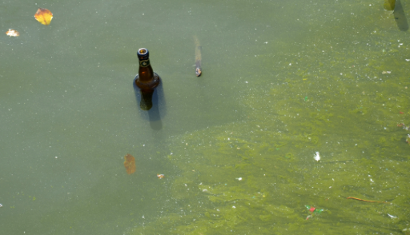
102 Residents Educated
Mold
Water Contamination
Vector Borne Disease
Storm Preparedness
Heat Waves and
Poor Air Quality
Standing Water
Algae Blooms
Notes:
In total, 102 Residents were educated about the public health effects of climate change. Education included: storm preparedness, mold, water contamination, vector borne diseases, heat waves and poor air quality, standing water and algae blooms. Educational materials are available in English, Creole, and Spanish on home page of www.Reacttoolkit.net.

Slide 10
Three Outreach Languages
Notes:
About three-fifths of the residents surveyed spoke English in the household; of the remainder, 9.2% spoke Creole and 10.2% spoke Spanish or Spanish/English.

Slide 11
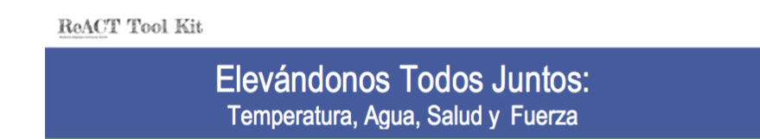
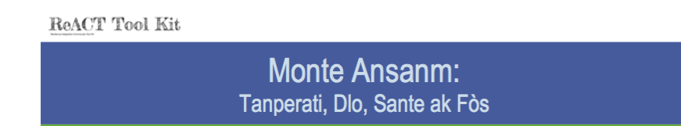
Notes:
The educational materials created for Rising Together are available in three languages – Spanish, English, and Creole – at www.Reacttoolkit.net.

Slide 12

82 People Signed up for Code Red
Source: Code Red. Community Notification Enrollment. City of Boca Raton. Available at: https://public.coderedweb.com/cne/en-US/8F5346C20DBB
Notes:
After the survey was administered and the respondent was given an educational handout on sea level rise, the respondent was asked if he/she wanted to sign up for CodeRed, the emergency response warning system for Boca Raton; a total of 82 respondents signed up for CodeRed.

Slide 13
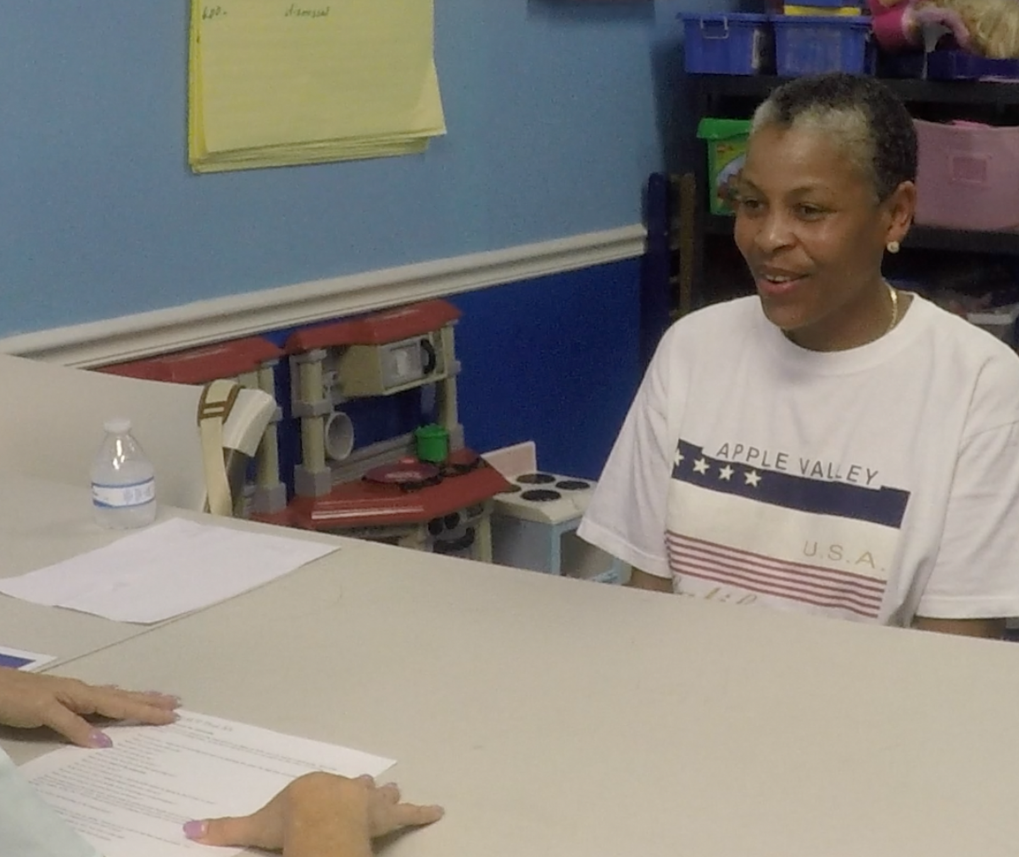
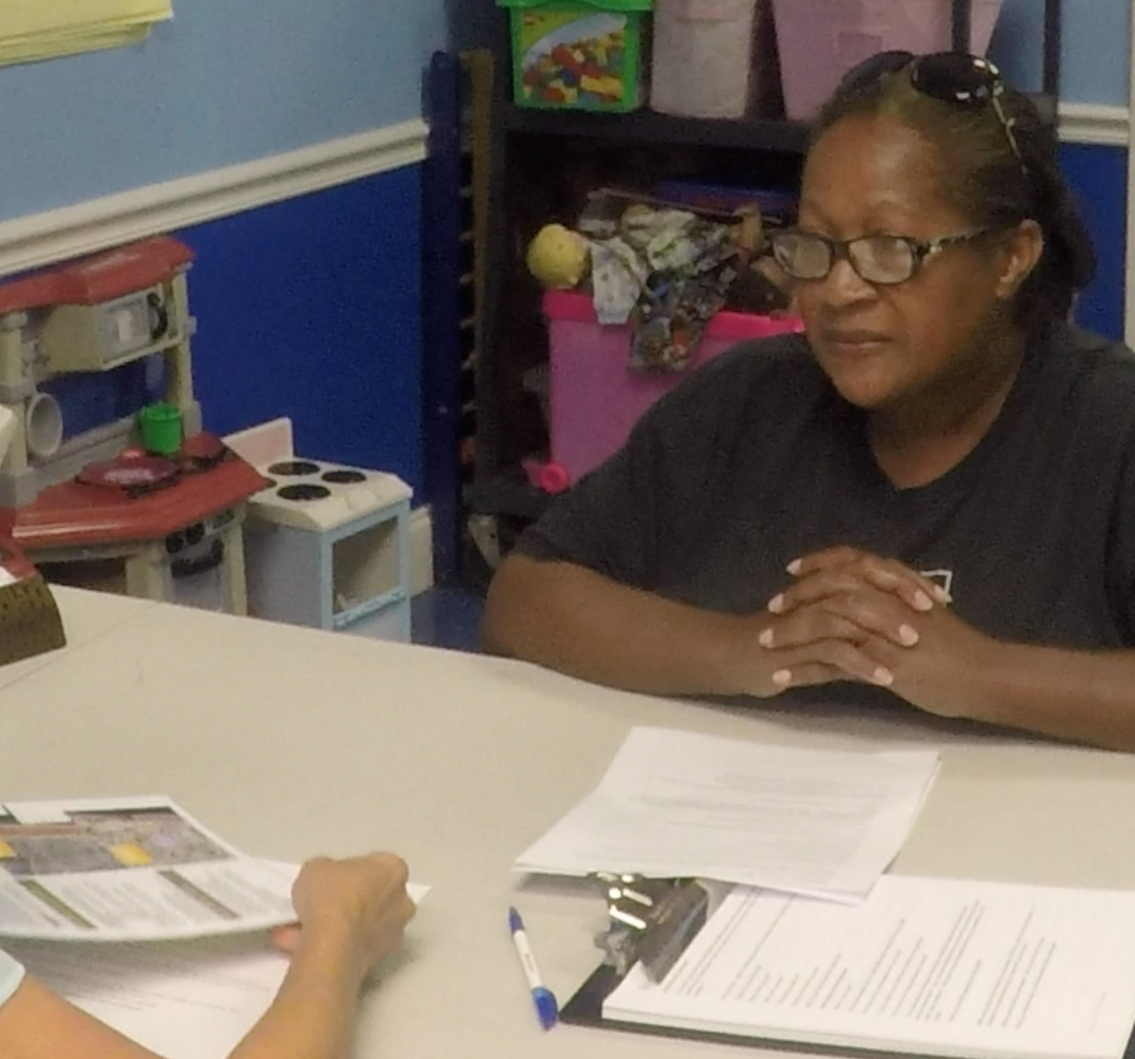
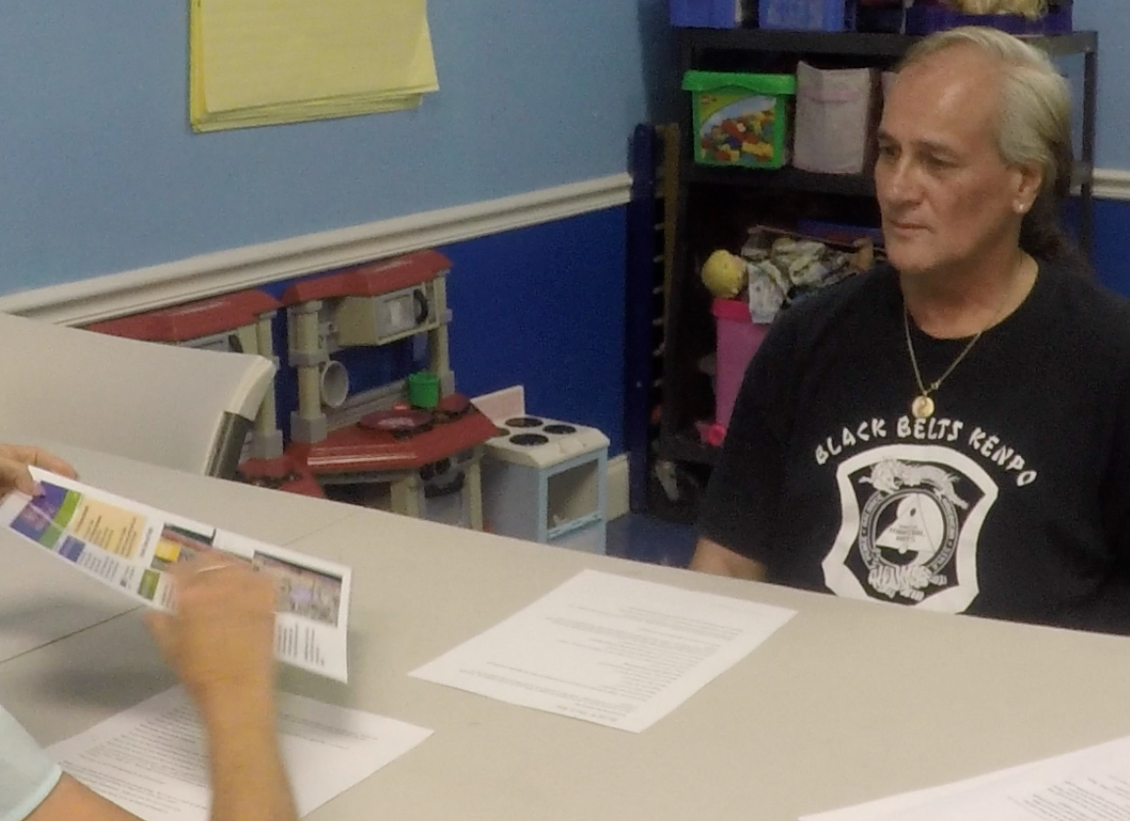
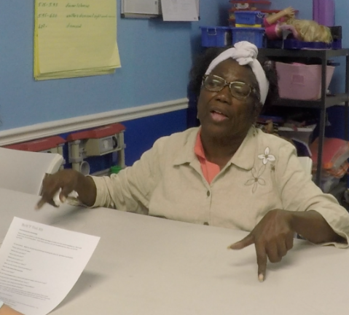
Twelve Oral Histories
Notes:
To augment the survey data and yield more qualitative data on respondents’ experience with sea level rise, 12 respondents were interviewed. Their oral histories detail their experiences with mold, asthma, flooding, severe storms and evacuation. They also recounted anecdotal details about growing up in the traditionally African American community of Pearl City, which was segregated until the 1960s.

Slide 14
What We Learned
Familiarity with Sea Level Rise
Perceptions of Sea Level Rise Risk
Primary Concerns about Sea Level Rise
Percentages of Households that Have Experienced Mold, Asthma and Water Contamination
Notes:
The survey data documented respondents’ self-reported familiarity with sea level rise, their perceived risk from sea level rise, their primary concerns about sea level rise, and their history of mold, asthma, and water contamination.

Slide 15
Red-Not at all familiar Yellow-Somewhat familiar Green-Very familiar White-Extremely Familiar
Notes:
More than one-third of respondents reported that they were not at all familiar with sea level rise, and almost half reported that they were somewhat familiar with it. Only 13.2% reported being very familiar with sea level rise, and a scant 3.3% reported being extremely familiar with sea level rise. It is clear that more health education on sea level rise is needed!

Slide 16
Notes:
When asked what their top concerns were regarding sea level rise, 30.8% of respondents named water quality as their number one concern, with extreme weather second at 27.5%. Property value was third, with 25.3% naming it as a top concern, and insurance was fourth, at 22.0%. About one-fifth named erosion as a top concern. They referred to erosion of their buildings and streets.

Slide 17
Notes:
The dark orange bars in the graph represent the public housing (Dixie Manor) and show significantly higher percentages of mold, asthma, and water contamination than do the non-public housing units, shown in brown. The gold bars represent all neighborhoods combined. The percentages of households that reported a member of the household that had asthma were well above the County asthma prevalence rate of 10.4% (Florida Charts, 2013). In the public housing units, the rate of asthma was more than three times the County rate.

Slide 18
Asthma and Climate Change
Climate change poses a health threat to those with asthma by increasing air pollution and airborne allergens.
Notes:
Carter, LM, et al. (2014). Ch. 17: Southeast and the Caribbean. Climate Change Impacts in the United States: The Third National Climate Assessment. Melillo, J.M., Richmond, T., & Yohe, G.W. Eds., U.S. Global Change Research Program: Washington, D.C., 396-417.

Slide 19
Mold and Climate Change
Climate change increases the frequency and severity of flooding, resulting in dampness in and around the home.
Dampness may lead to mold, which is an allergen that worsens asthma and allergy symptoms.
It is important to keep homes dry to prevent the growth of mold.
For more advice about how to deal with mold, visit website: https://www.epa.gov/mold/ten-things-you-should-know-about-mold
Notes:
Source: US Environmental Protection Agency. (2016). 10 Things You Should Know about Mold. Available at: https://www.epa.gov/mold/ten-things-you-should-know-about-mold

Slide 20
Airborne Allergens and Climate Change
Climate change increases the concentration of airborne allergens, as rising temperatures increase pollen levels.
Flowering starts earlier, resulting in a longer ragweed pollen season, and more time for exposure to airborne allergens.
Notes:
USGCRP. (2016). Impacts of Climate Change on Human Health in the United States: A Scientific Assessment. Crimmins, AJ.,et al., Eds. U.S. Global Change Research Program: Washington, DC.

Slide 21
Air Pollution and Climate Change
Rising temperatures increase the concentration of ground-level ozone, which pollutes the air.
When ozone remains in the upper atmosphere, it shields us from ultraviolet radiation.
However, at ground level, ozone creates smog, which can cause breathing problems by damaging lung tissue, reducing lung function, and inflaming airways.
Notes:
Carter, LM, et al. (2014). Ch. 17: Southeast and the Caribbean. Climate Change Impacts in the United States: The Third National Climate Assessment. Melillo, J.M., Richmond, T., & Yohe, G.W. Eds., U.S. Global Change Research Program: Washington, D.C., 396-417.

Slide 22
Air Quality Index (AQI) and Climate Change
The U.S. Environmental Protection Agency’s (EPA) Air Quality Index (AQI) measures the level of air pollution.
The AQI lets you know when the air quality may be hazardous to your health.
When the AQI is in the unhealthy range, you should stay indoors in air-conditioning as much as possible; when you go outside, avoid exertion and heavily trafficked roadways and consider wearing a mask. Check local AQI daily at https://www.airnow.gov/ or Google Air Now AQI.
Notes:
US Environmental Protection Agency. (2016). Air Quality Index: Air Now. Available at: https://airnow.gov/index.cfm?action=aqibasics.aqi

Slide 23
AQI Values | Health Status | Colors and Meaning
0 to 50 | Good | Green: Satisfactory air quality; air pollution poses little or no risk
51 to 100 | Moderate | Yellow: Acceptable air quality; moderate health concern for a few people who are unusually sensitive to air pollution
101 to 150 | Unhealthy for Sensitive Groups | Orange: Health effects for members of sensitive groups
151 to 200 | Unhealthy | Red: Health effects for all; more serious health effects for members of sensitive groups.
201 to 300 | Very Unhealthy | Purple: Health alert! More serious health effects for all.
301 to 500 | Hazardous | Maroon: Health alert! Serious health effects for all.
Source: US Environmental Protection Agency. (2016). Air Quality Index: Air Now. Available at: https://airnow.gov/index.cfm?action=aqibasics.aqi.
Notes:
The AQI is a useful tool for all Americans. It is indispensable for vulnerable populations such as those with asthma and other respiratory diseases, pregnant women, children, older adults, and some communities of color. It is also an important guide for outdoor workers, who may want to don a mask when the numbers get into the unhealthy range.

Slide 24
4 Key Actions to
Increase Climate Resilience
Tree Trimming Schedule with Debris Removal
Regular Storm Drain Clearing
Address Flooding in the Dixie Manor Parking Lot
Further Study of Dixie Manor Mold, Asthma and Water Contamination
Notes:
Data analysis revealed four key actions that would increase climate resilience in the neighborhoods surveyed.

Slide 25
Boca Raton Rising Together and ReACT Tool Kit
Janice T. Booher, MS
Project Director
UUFBR Green Sanctuary Committee
Robert Duchemin
UUFBR Treasurer
Training Session Technical Support
UUFBR Green Sanctuary Committee
Jeffrey L. Booher
UUFBR Project Account Manager
Dr. William Bode
UUFBR Green Sanctuary Committee
Training Session Technical Support
Seyril Siegel
UUFBR Spanish Translation
Green Sanctuary Committee
Griselle Martinez
UUFBR Spanish Translation
Dr. Ana Puszkin-Chevlin
Project Manager, Phase I
Dr. Debra Weiss-Randall
Project Manager, Phase II
Dr. John Hardman
Spanish Translation
Anna Neira
Habitat for Humanity: Neighborhood Outreach Training
Debora Kerr, MA
Grant Application Consultation and ReACT Toolkit Proof-Reader
Academic Oversight:
Dr. Keren Bolter, Florida Atlantic University
Sea Level Rise Risk Perception Survey
Dr. Sandra Norman, Florida Atlantic University
Oral Histories
Marjorie O’Sullivan
DISC Board Liaison
LeJeune Goddard
DISC Outreach Leader
Marie Hester
DISC Outreach Leader
David Collesano
DISC Creole Translation
Anita Gonzales
Spanish Translation
Fenilde Jean Baptiste
Creole Translation
Trained Climate Communicators
Mike Allen
John E. Brown
David Collesano
Anita Gonzales
Marlow Harris
Katie Mae Goddard
Fenilde Jean Baptiste
Allison Jenkins
Notes:
Rising Together was a pilot study that created an online toolkit as well as print materials to enable other communities to replicate the work done in Boca Raton. The aim is to empower vulnerable communities to receive education and help their neighbors to stay safe and healthy as they adapt to sea level rise. At the culminating public event on September 15, 2016, officials from the Boca Raton city government dialogued with DISC members about their concerns. Prior to the public event, Marjorie O’Sullivan and Dr. Debra Weiss-Randall presented a summary of findings to Boca Raton Mayor Haynie and the City Council.

Slide 26
References
Carter, LM, et al. (2014). Ch. 17: Southeast and the Caribbean. Climate Change Impacts in the United States: The Third National Climate Assessment. Melillo, J.M., Richmond, T., & Yohe, G.W. Eds., U.S. Global Change Research Program: Washington, D.C., 396-417.
CodeRed. Community Notification Enrollment. City of Boca Raton. Available at: https://public.coderedweb.com/cne/en-US/8F5346C20DBB
Florida CHARTS. (2013). Adults who have ever been told they have asthma. Palm Beach County. Available at: http://www.floridacharts.com/charts/Brfss/DataViewer.aspx?bid=0115
Rising Together Toolkit. Available at: www.Reacttoolkit.net
US Environmental Protection Agency. (2016). Air Quality Index: Air Now. Available at: https://airnow.gov/index.cfm?action=aqibasics.aqi.
US Environmental Protection Agency. (2016). 10 Things You Should Know About Mold. Available at: https://www.epa.gov/mold/ten-things-you-should-know-about-mold
USGCRP. (2016). Impacts of Climate Change on Human Health in the United States: A Scientific Assessment. Crimmins, AJ.,et al., Eds. U.S. Global Change Research Program: Washington, DC.

Slide 27
EPA Grant #EQ-00D35415-0

