Slide 1





-This project was funded in part by the Unitarian Universalist Fund for Social Responsibility.
-This project was funded in part by the UUFBR Endowment Fund.
-Development of the ReACT Tool Kit and the Pilot Project was funded by EPA Environmental Justice Grant
#EQ-00D35415-0 awarded to the Green Sanctuary Committee of the UU Fellowship of Boca Raton.

Slide 2
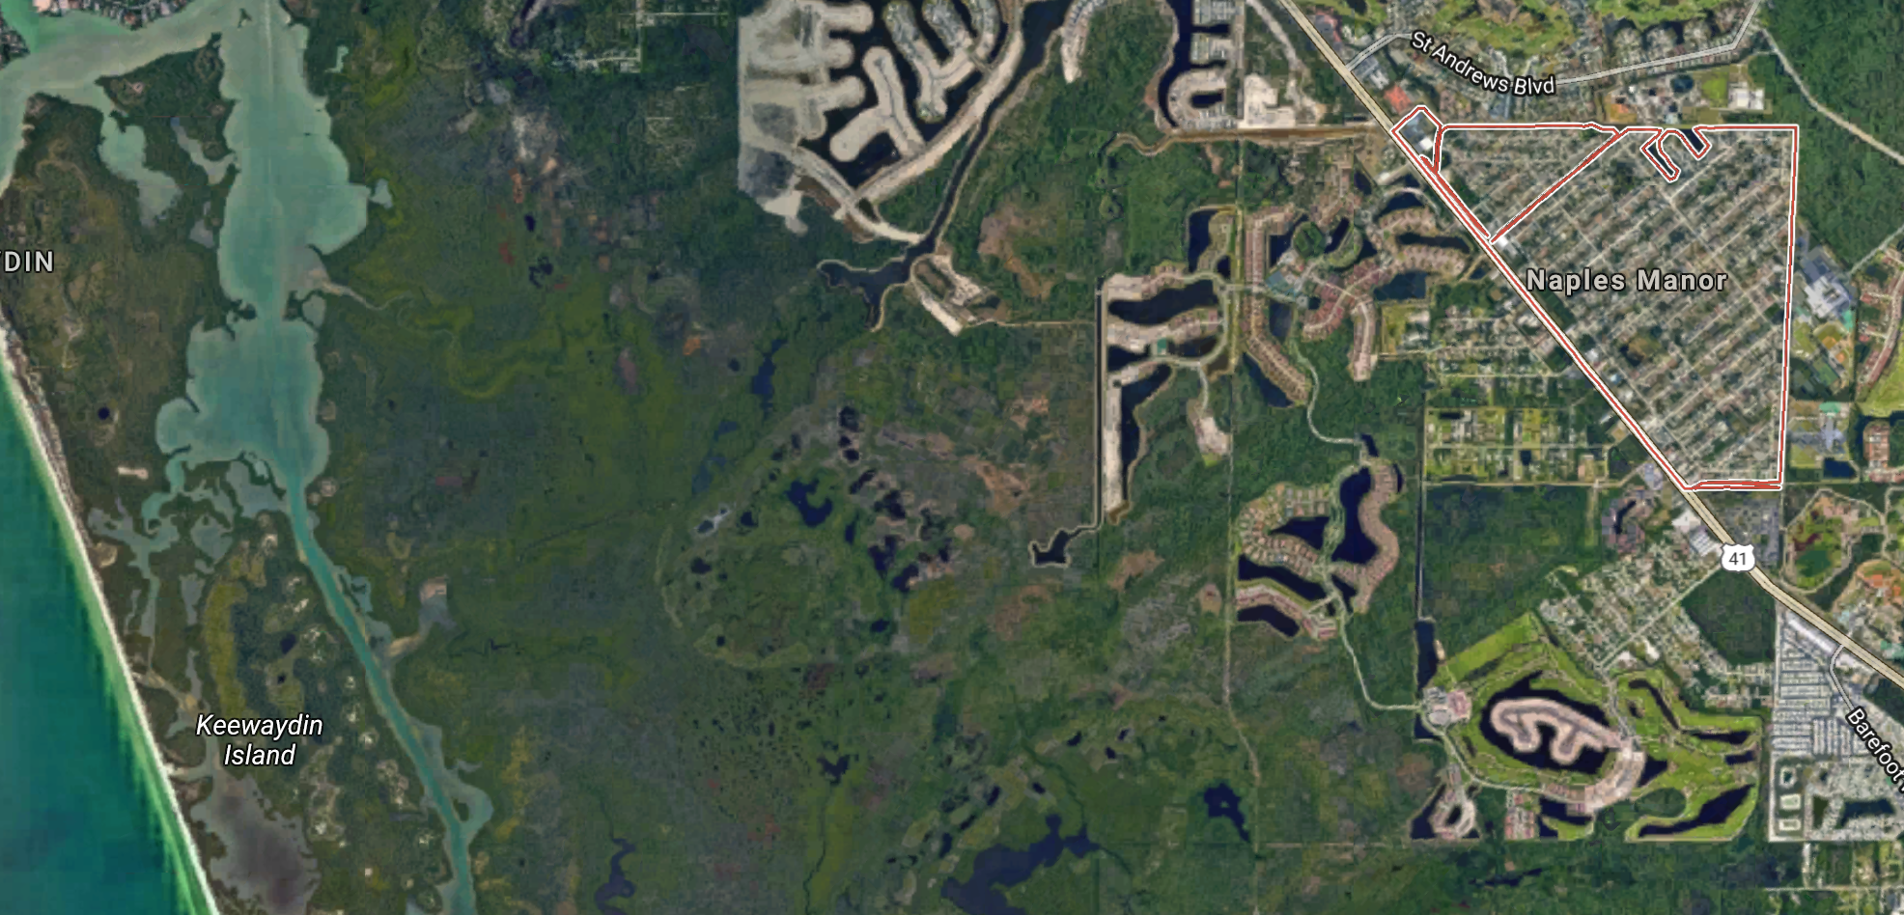
Building climate resilience
Notes:
Climate Resilience is the ability of a community to respond to climate change, so it can continue to function well as the climate changes. This project identified 4 key areas this community can address to increase its climate resilience.

Slide 3
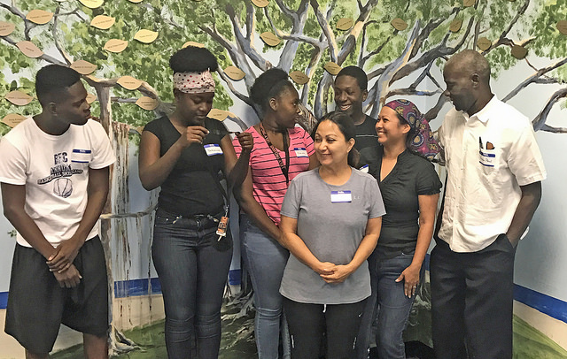
One Training Session

Slide 4
Nine Trained Climate Communicators
Bertha Castro Diana Thelvsnord Cornelius Baptiste
Joshua Victor Christelle Garcon Kesley Dolce
Angela Cisneros Renisha Pavilus Bergeline Augustine

Slide 5
Two Experienced Community Leaders
Experience Conducting a Public Health Campaign
Experience Documenting Neighborhood Concerns
Pastor Jean R. Paul, Minister of the Naples New Haitian Church of the Nazarene
--------
Angela Cisneros, Community Organizer

Slide 6
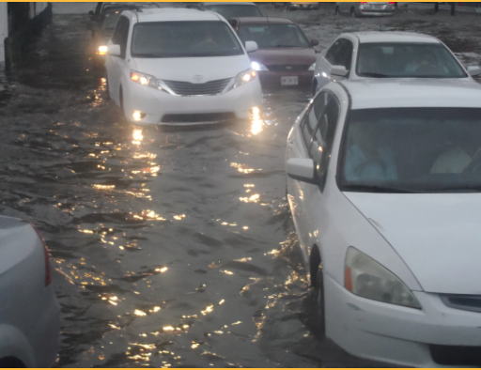
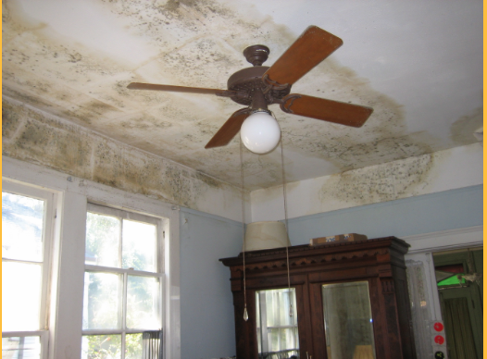
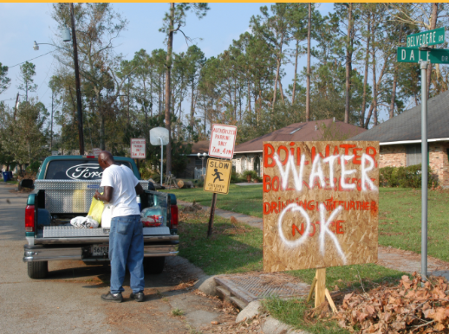
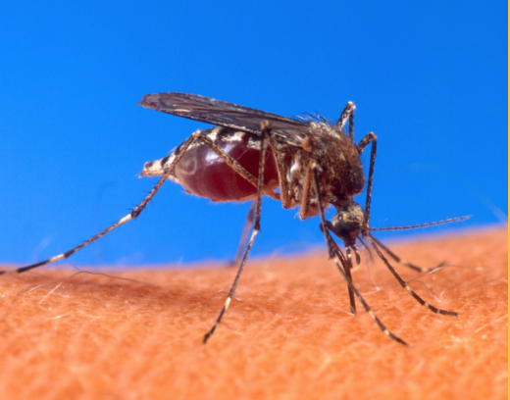


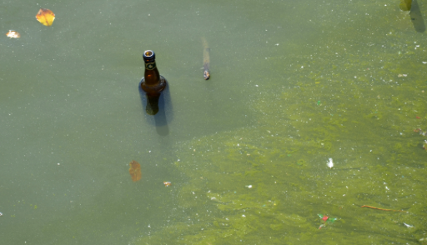
100 Residents Educated in 93 Households
Mold
Water Contamination
Vector Borne Disease
Storm Preparedness
Heat Waves and
Poor Air Quality
Standing Water
Algae Blooms
Notes:
102 Residents were educated about the public health effects of climate change. Education included: storm preparedness, mold, water contamination, vector borne diseases, heat waves and poor air quality, standing water and algae blooms.

Slide 7
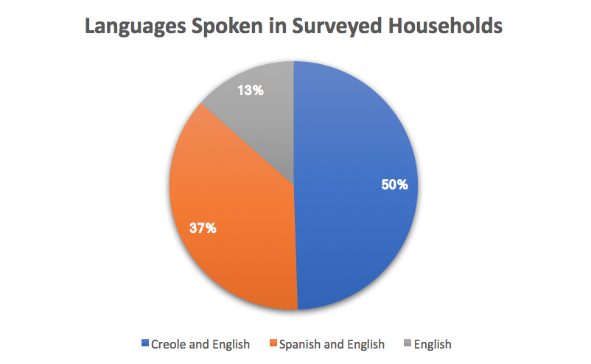
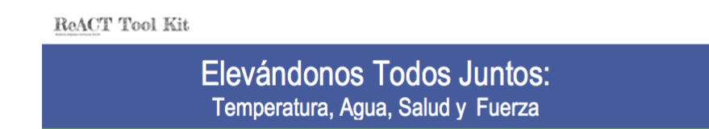
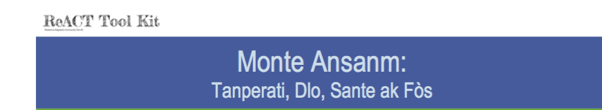
Three Outreach Languages

Slide 8
Nine Bi-Lingual Climate Communicators
2 Spanish-English Translators
Bertha Castro
Angela Cisneros
7 Creole-English Translators
Bergeline Augustin
Cornelius Baptiste
Kesly Dolce
Christelle Garcon
Renisha Pavilus
Diana (Sandjuya) Thelvsnord Joshua Victor

Slide 9
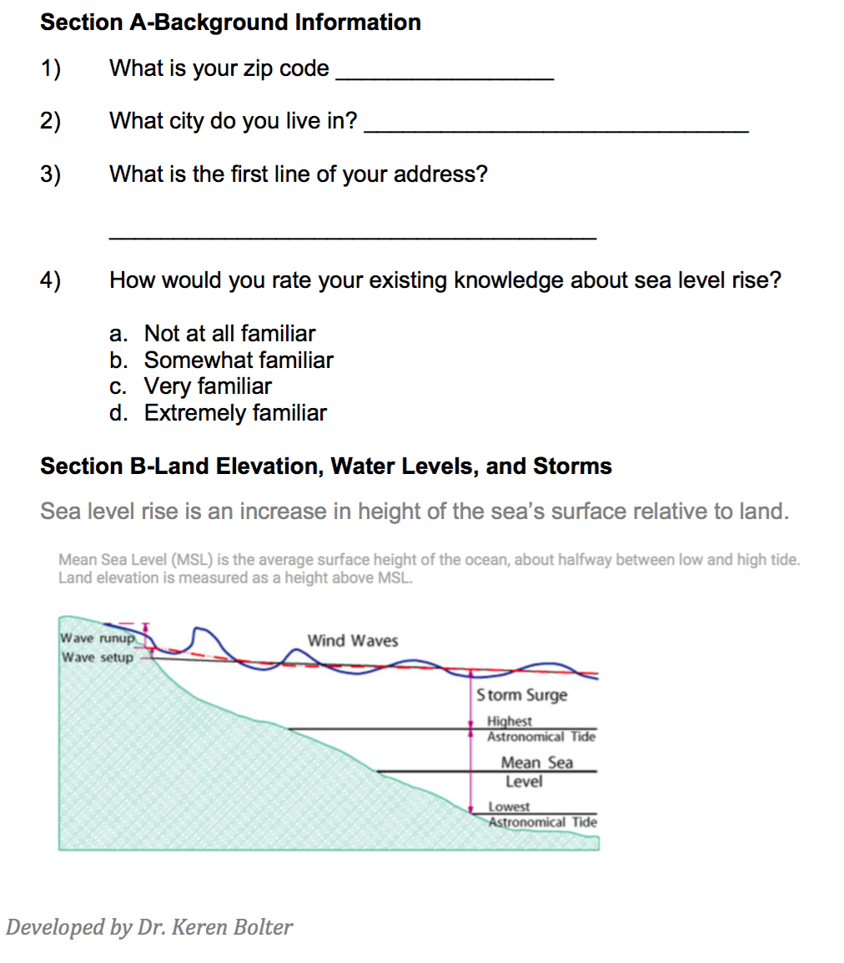
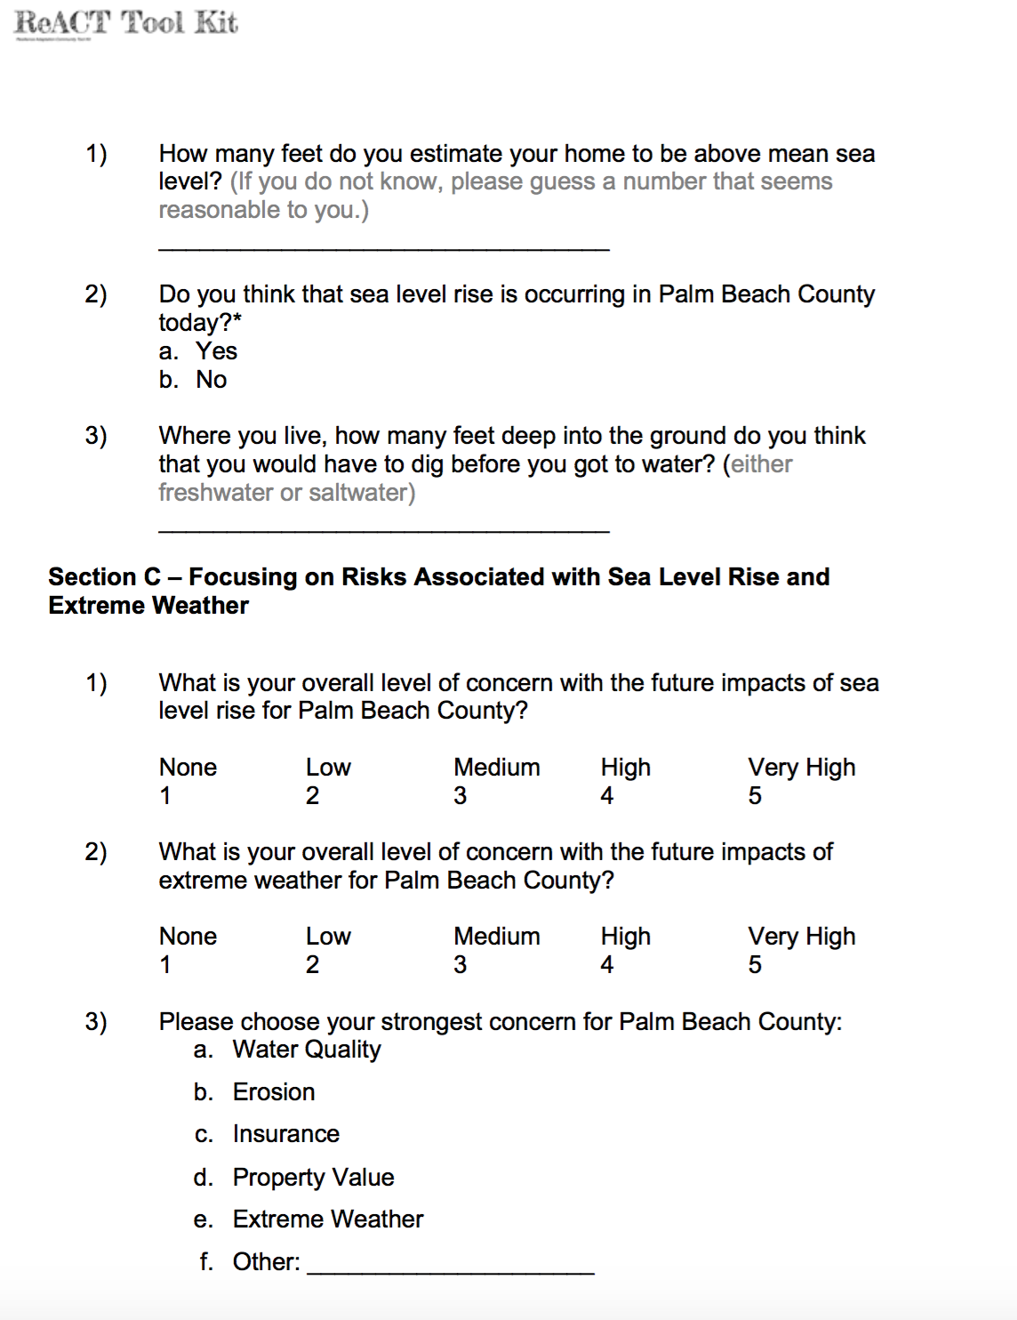
93 Households Surveyed

Slide 10
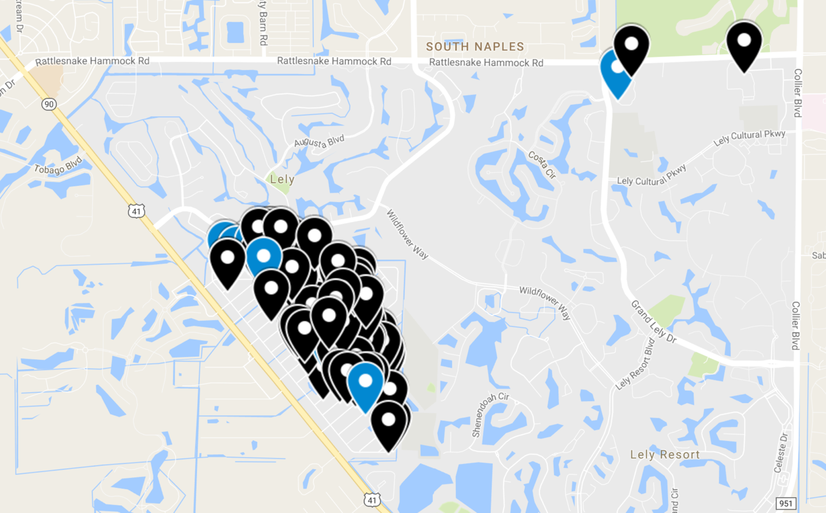
Interactive Mapping of Households

Slide 11
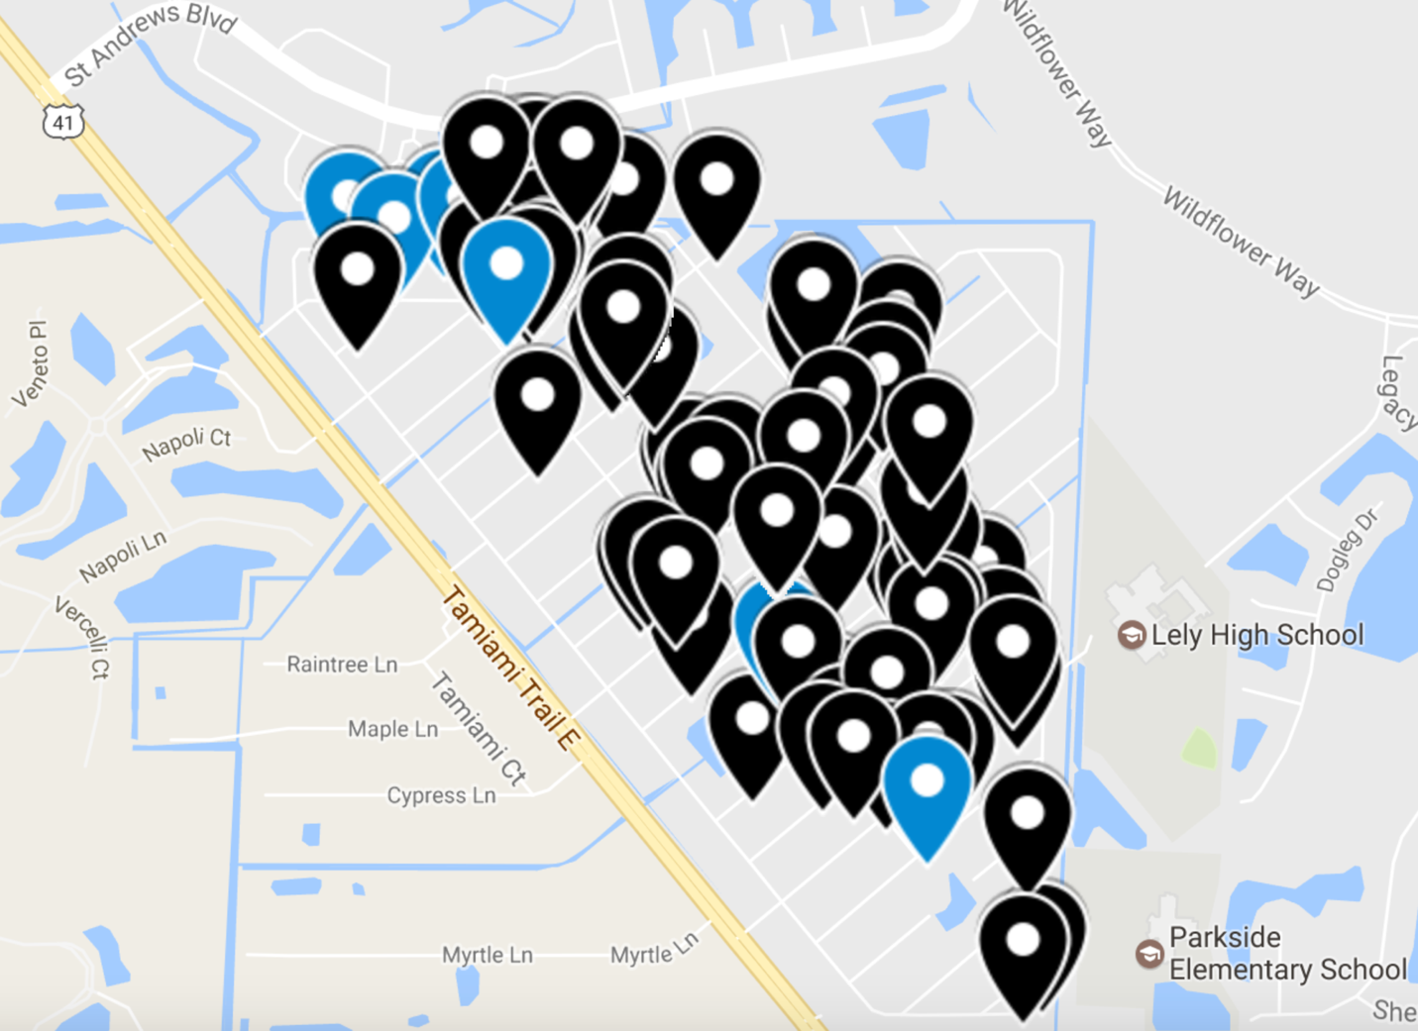
90 Households in Naples Manor

Slide 12
What We Learned
Familiarity with Sea Level Rise Risk
Primary Concerns
Incidence of Mold, Asthma and Water Contamination

Slide 13
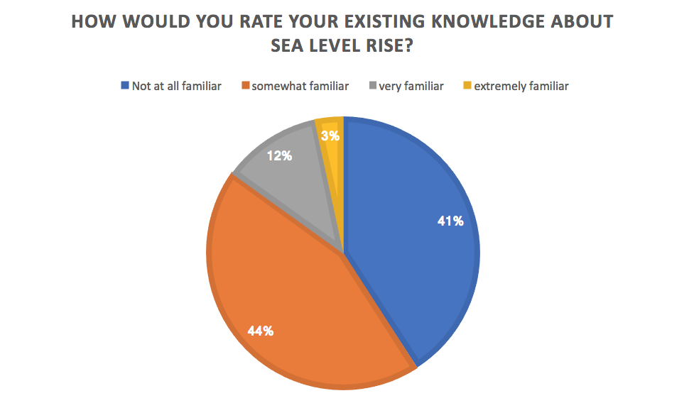
Blue-Not at all familiar Orange-Somewhat familiar Grey-Very familiar Yellow-Extremely Familiar

Slide 14
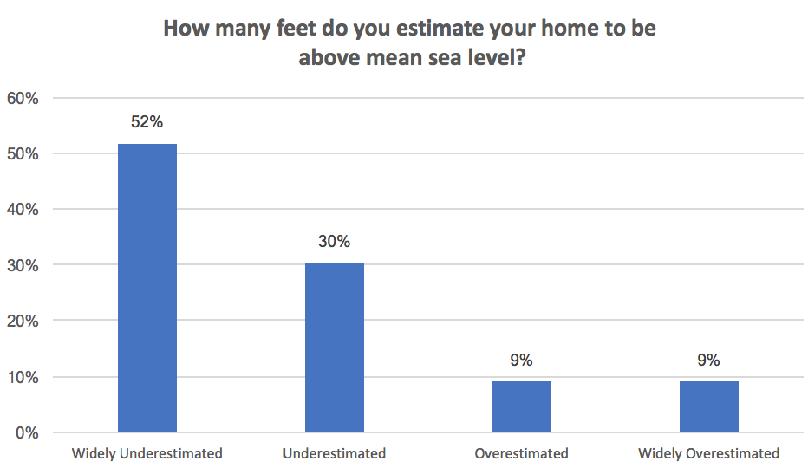
The range of reported estimates of elevation was from 10 ft below sea level to 1,000 ft above sea level.
Actual Elevations in Naples Manor are
from 7.55 ft to 18.43 ft.
Naples Manor is in an AE Flood Zone.

Slide 15
Zone AE are areas that have a 1% probability of flooding every year (also known as the "100-year floodplain"), and where predicted flood water elevations above mean sea level have been established. Properties in Zone AE are considered to be at high risk of flooding under the National Flood Insurance Program (NFIP). Flood insurance is required for all properties in Zone AE that have federally-backed mortgages. Construction in these areas must meet local floodplain zoning ordinance requirements, including evidence that priniciple structures are above the Base Flood Elevation (BFE) as shown on the adopted FIRM maps.

Slide 16
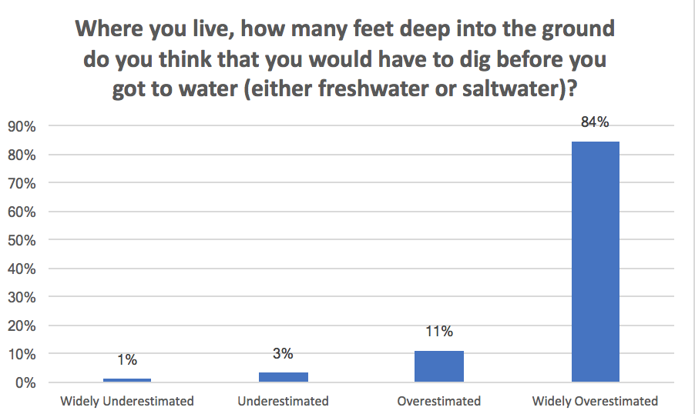
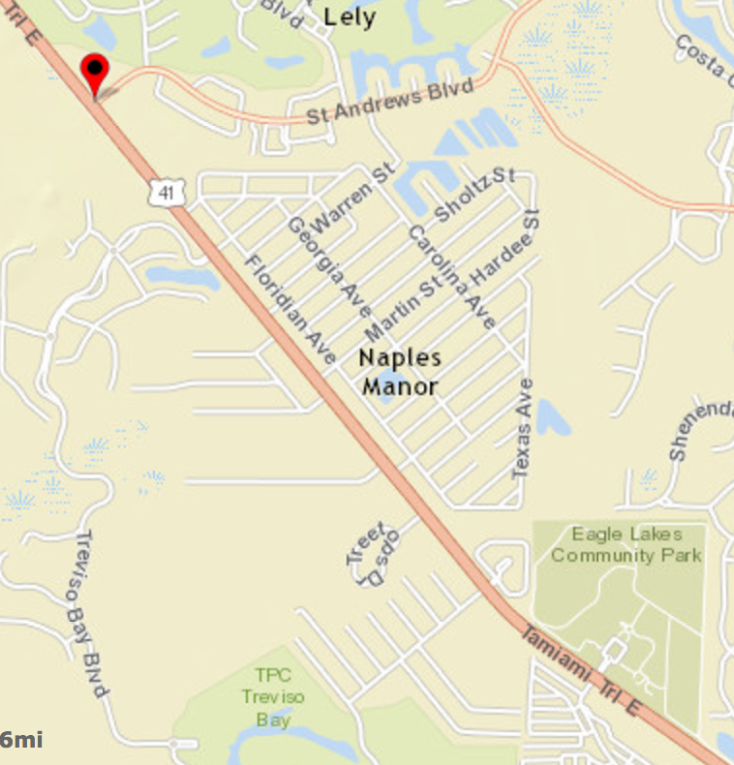
Residents estimated from 1 to 500 ft.
The depth to water level at the well at St. Andrews Blvd. and Tamiami Trail was 3.26 ft. on February 22, 2017.

Slide 17
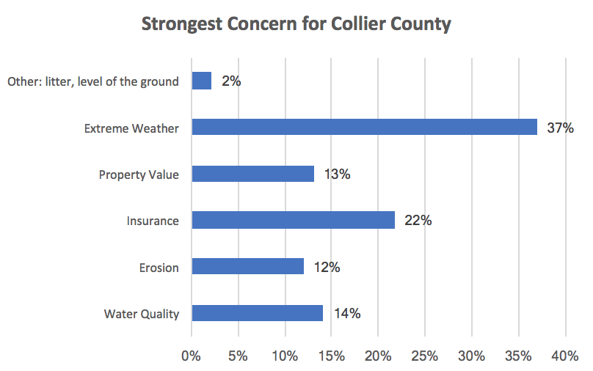

Slide 18

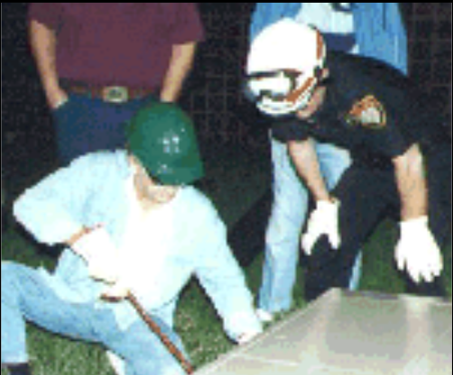
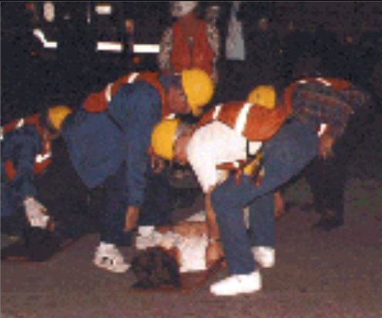

Slide 19
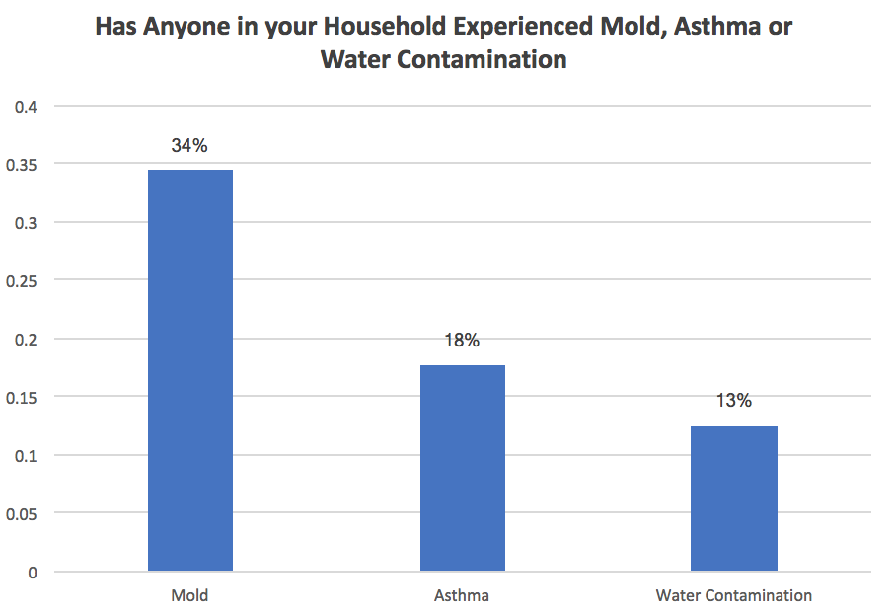
Florida CHARTS reports the Collier County adult asthma prevalence in 2013 was 3.2%. This means that the prevalence of asthma among residents responding to the survey (18%) is 5 times the 2013 county prevalence.

Slide 20
Asthma and Climate Change
Climate change poses a health threat to those with asthma by increasing air pollution and airborne allergens.

Slide 21
Air Quality Index (AQI) and Climate Change
The U.S. Environmental Protection Agency’s (EPA) Air Quality Index (AQI) measures the level of air pollution.
The AQI lets you know when the air quality may be hazardous to your health.
When the AQI is in the unhealthy range, you should stay indoors in air-conditioning as much as possible; when you go outside, avoid exertion and heavily trafficked roadways and consider wearing a mask. Check local AQI daily at https://www.airnow.gov/ or Google Air Now AQI.

Slide 22
AQI Values | Health Status | Colors and Meaning
0 to 50 | Good | Green: Satisfactory air quality; air pollution poses little or no risk
51 to 100 | Moderate | Yellow: Acceptable air quality; moderate health concern for a few people who are unusually sensitive to air pollution
101 to 150 | Unhealthy for Sensitive Groups | Orange: Health effects for members of sensitive groups
151 to 200 | Unhealthy | Red: Health effects for all; more serious health effects for members of sensitive groups.
201 to 300 | Very Unhealthy | Purple: Health alert! More serious health effects for all.
301 to 500 | Hazardous | Maroon: Health alert! Serious health effects for all.
Source: US Environmental Protection Agency. (2016). Air Quality Index: Air Now. Available at: https://airnow.gov/index.cfm?action=aqibasics.aqi.

Slide 23
16 Reports of Flooding
0 Reports of Blocked
Storm Drains
0 Reports of Flooded
Cars

Slide 24
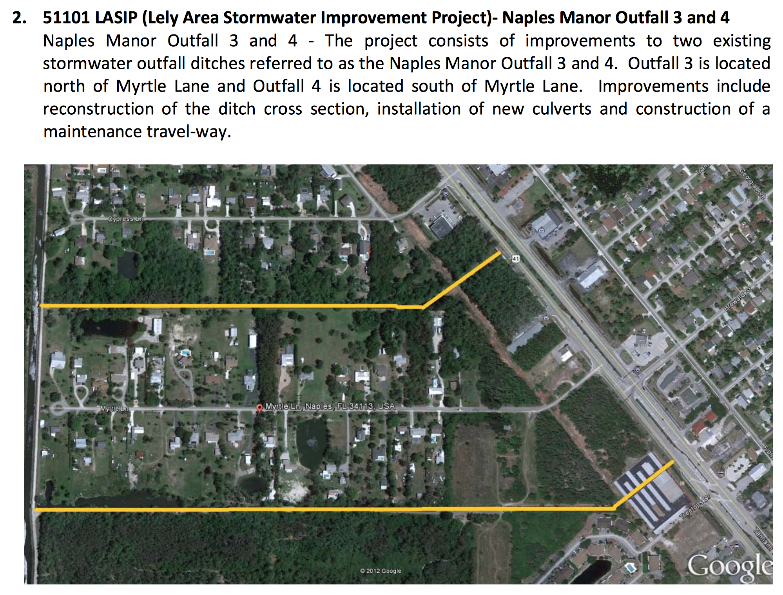

Slide 25
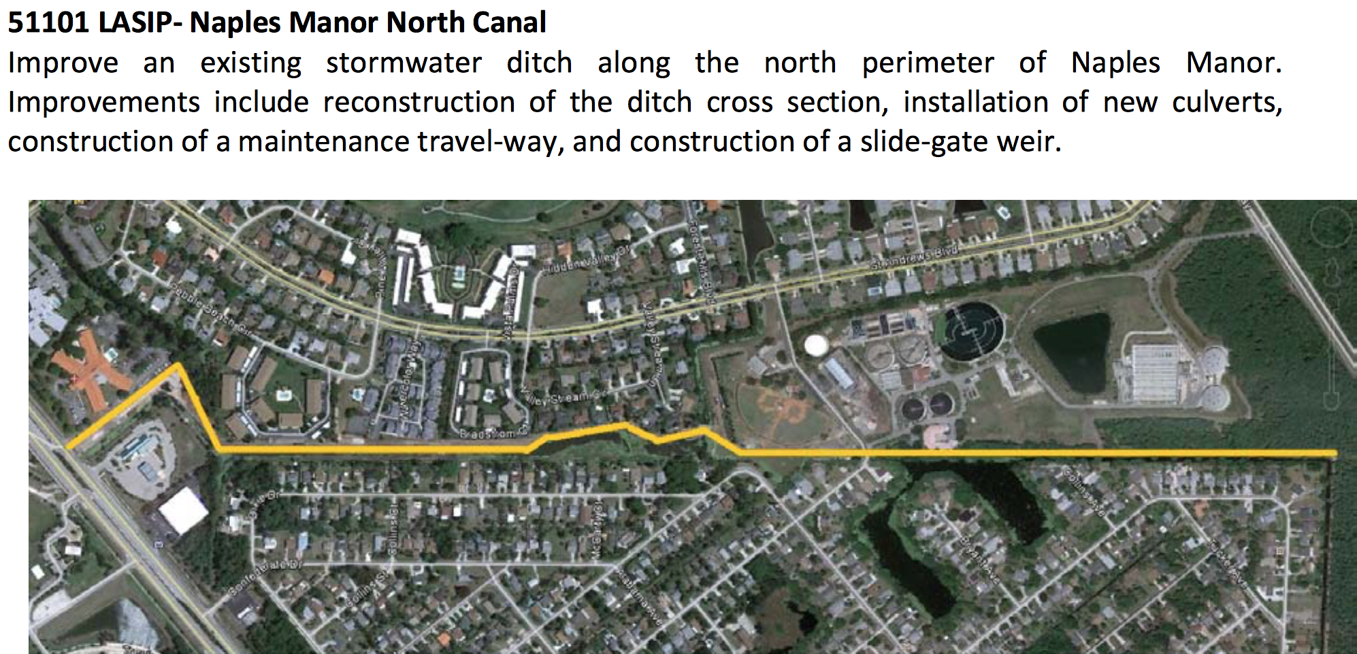

Slide 26
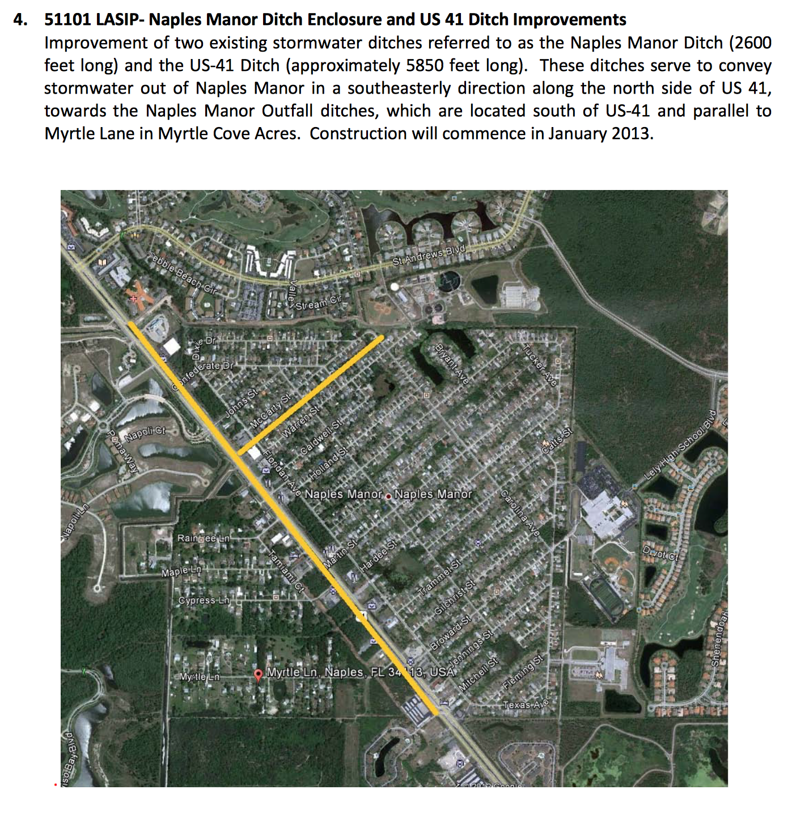

Slide 27
4 Key Actions to
Increase Climate Resilience
-Keep Storm Drains Clear of Debris
-Make Sure Your Flood Insurance is Current
-Have an Emergency Plan
-Tell Your Neighbors What You Have Learned

Slide 28
-This project was funded in part by the Unitarian Universalist Fund for Social Responsibility.
-This project was funded in part by the UUFBR Endowment Fund.
-Development of the ReACT Tool Kit and the Pilot Project was funded by EPA Environmental Justice Grant
#EQ-00D35415-0 awarded to the Green Sanctuary Committee of the UU Fellowship of Boca Raton.

Slide 29
Contributors to Rising Together: Naples Project Success
Unitarian Universalist Congregation of Greater Naples Leaders
Barbara Glasgow
Phyllis Andrews
Paul Van Valkenberg
Special Thanks to
Rev. Lisa Lefkow, Executive Director of Development & Administration
Habitat for Humanity of Collier County
Naples Manor Community Leaders
Pastor Jean R. Paul, Minister of the Naples New Haitian Church of the Nazarene
Angela Cisneros, Community Organizer
Outreach Team Members
Bergeline Augustine Cornelius Baptiste
Bertha Castro Angela Cisneros
Kesley Dolce Christelle Garcon
Renisha Pavilus Diana Thelvsnord
Joshua Victor
Government officials
Donna Fiala, Collier County Commissioner, District One
County Growth Management Department
Howard Critchfield, Floodplain Coordinator
Caroline Cilek, Land Development Code Manager
Kamila M. Diddle, Senior Environmental Specialist

