Slide 1


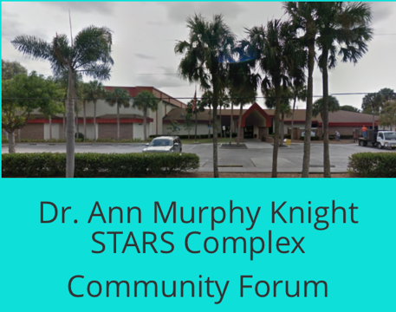

-This project was funded in part by the Unitarian Universalist Fund for Social Responsibility.
-This project was funded in part by the UUFBR Endowment Fund.
-Development of the ReACT Tool Kit and the Pilot Project was funded by EPA Environmental Justice Grant
#EQ-00D35415-0 awarded to the Green Sanctuary Committee of the UU Fellowship of Boca Raton.
Notes:
Rising Together: Temperature, Water, Health and Strength is a project of UU Justice Florida that partners UU congregations with existing leadership in vulnerable communities to build climate resilience. In Ft. Myers, All Faiths Unitarian Congregation of Ft. Myers partnered with Dr. Ann Murphy Knight STARS Complex Community Forum.

Slide 2
Building
Climate
Resilience
By the Numbers
Notes:
Climate Resilience is the ability of a community to respond to and recover from the impacts of climate change, so it can continue to function well as the climate changes.

Slide 3
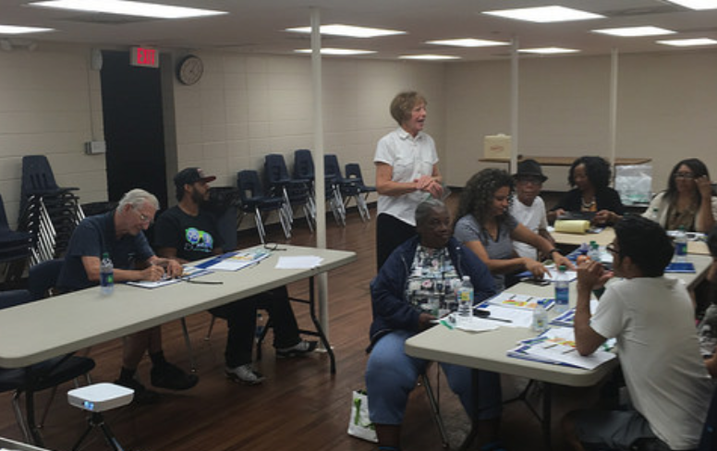
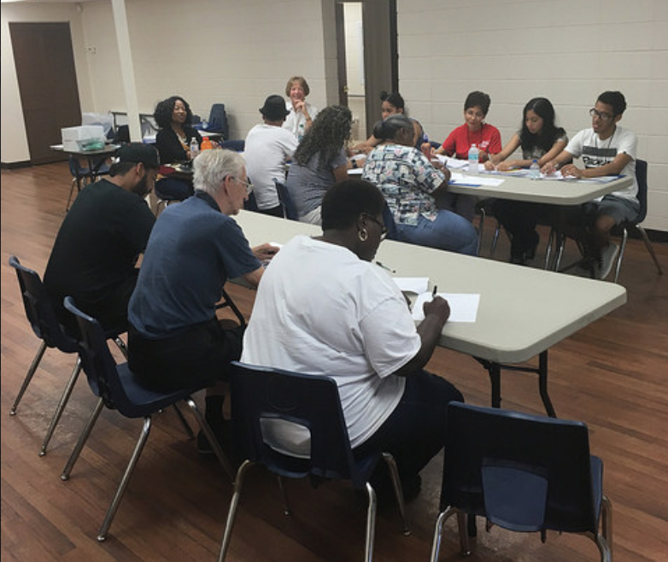
1 Training Session
10 Trained Climate & Health Communicators
Notes:
On April 1st, a training session for the Outreach Team was held at the Black History Society on Henderson Ave.

Slide 4
6 Members on the Outreach Team +
5 Active Supporters
Alexis Vidal 10 Surveys
Marsha Curry 48 Surveys
Yvonne Hill 10 Surveys &
58 Data Entries
Sophia Hidalgo 10 Surveys
Tania Matos 10 Surveys &
48 Data Entries
Barbara Key Ramos 20 Surveys
Special Thanks to Team Members who became ill or had family illness during the surveying process, but supported the teams' efforts:
Nicholas Resto
Mrs. Nicholas Resto
Luis Resto
Bob E. Stockwell
Carl Baxter
Notes:
6 members of the Outreach Team conducted the survey by neighborhood canvass. Yvonne Hill and Tanya Matos not only conducted surveys, but also entered the survey data into the online Google form so it could be analyzed, and a report could be generated. (Members of the Outreach Team will now receive certificates recognizing their contribution to their community’s climate resilience.

Slide 5
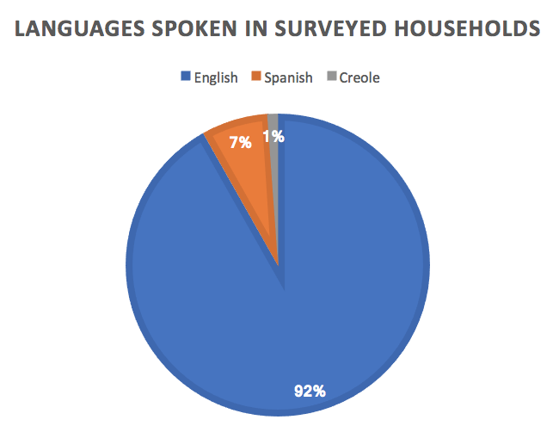
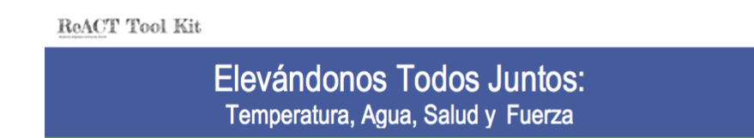
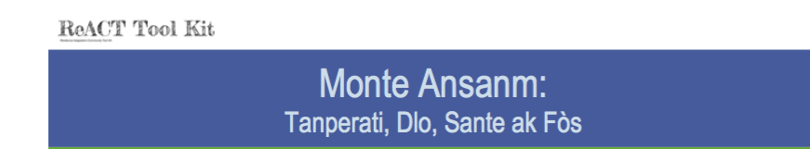
3 Outreach Languages
6 Bi-Lingual Outreach Team Members
Notes:
Most households were surveyed in English. 7 were surveyed in Spanish, and 1 was surveyed in Creole. All six of the Outreach Team Members were bilingual (Spanish and English).

Slide 6
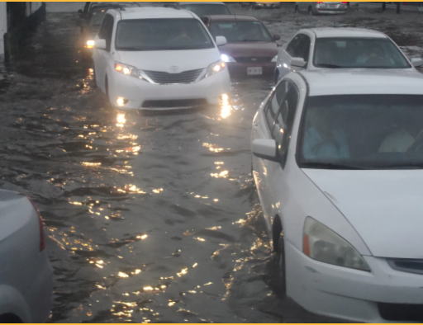
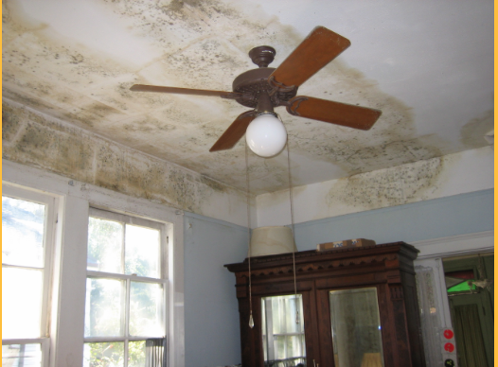
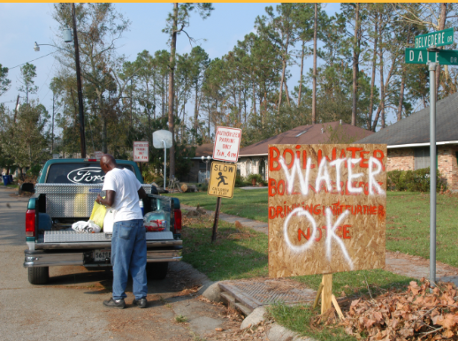
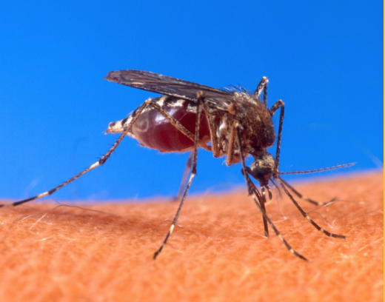


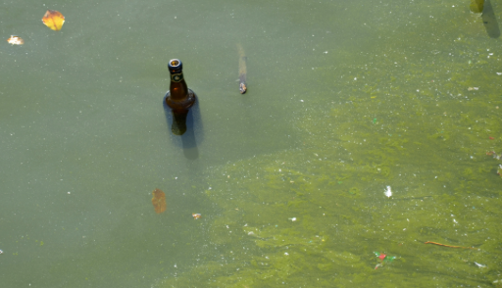
101 Residents Educated
Mold
Water Contamination
Vector Borne Disease
Storm Preparedness
Heat Waves and
Poor Air Quality
Standing Water
Algae Blooms
Notes:
101 residents in 98 households were educated about the public health effects of climate change. Education included: storm preparedness, mold, water contamination, vector borne diseases, heat waves and poor air quality, standing water and algae blooms.

Slide 7
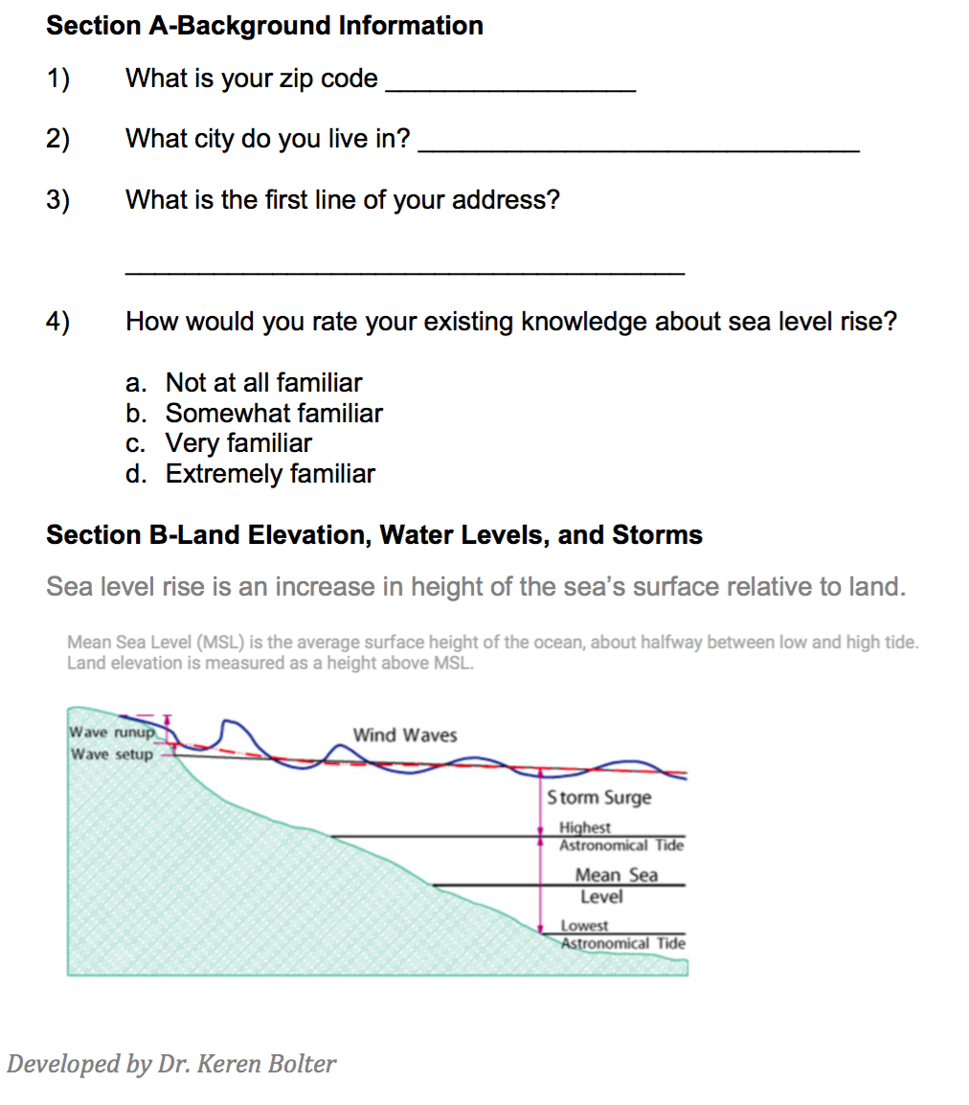
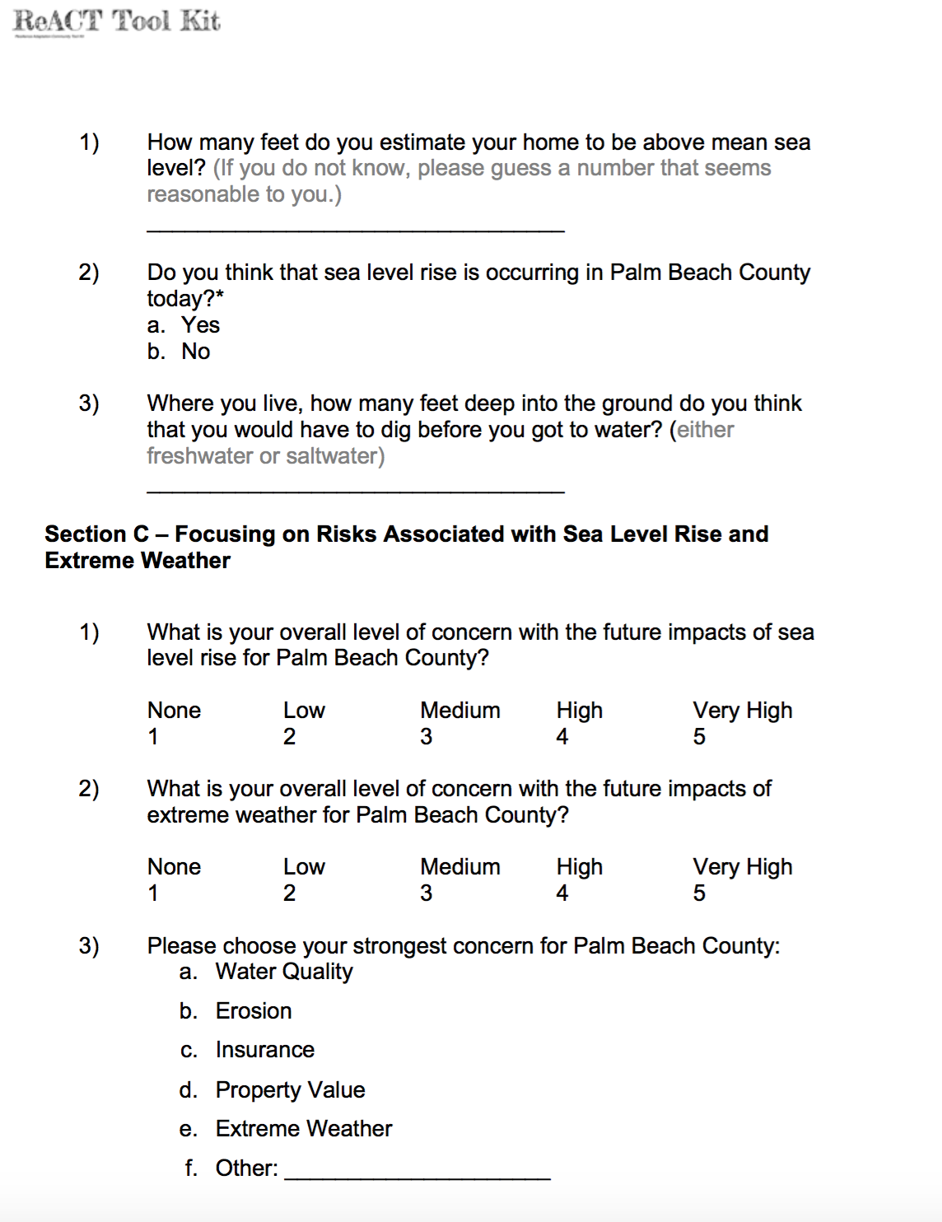
98 Households Surveyed
Notes:
Information from 98 household surveys was analyzed, and a final report was created.

Slide 8
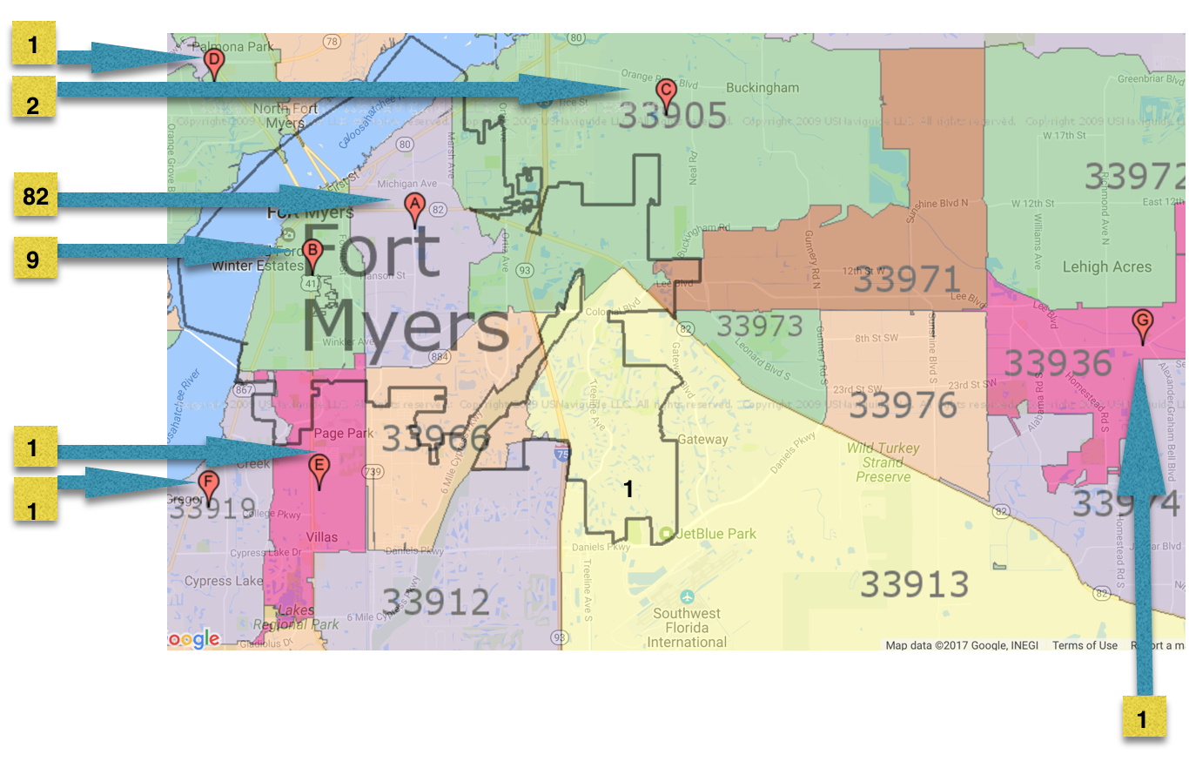
98 Households in Ft. Myers
Zip Code | Number of Respondents in the Zip Code
33916 | 83
33901 | 9
33905 | 2
33903 | 1
33907 | 1
33919 | 1
33936 | 1
Notes:
The zip codes in which most of the respondents resided are indicated in the map.
Most of the respondents (83) resided in 33916. 9 respondents resided in 33401. 2 respondents resided in zip code 33905. One repondent resided in each of zip codes 33903, 33907, 33919 and 33936.

Slide 9
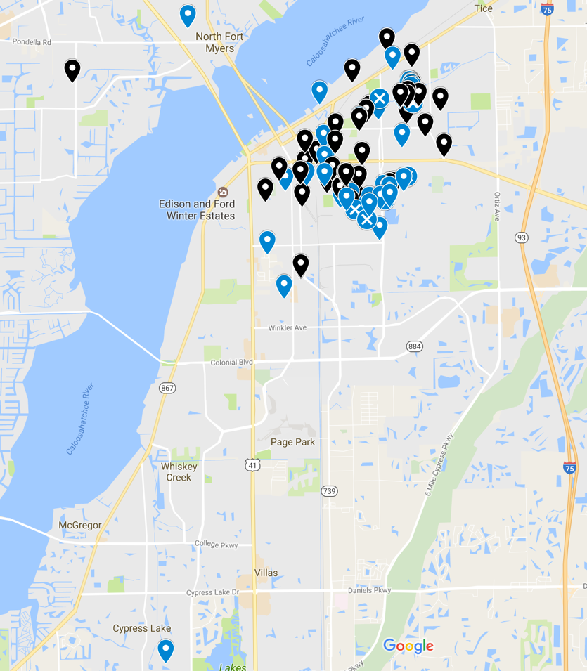
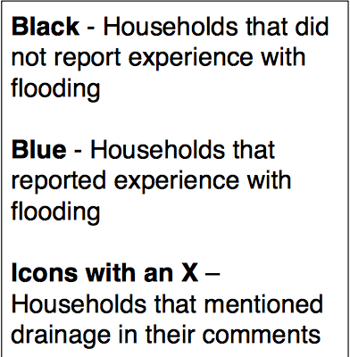
Interactive Mapping of Households
Notes:
All surveyed households were mapped in an interactive Google map. To get the password to interact with the map, researchers can contact Jan Booher JJLBOOHER@comcast.net

Slide 10

51 People Signed up for Code Red
Notes:
Google CodeRed as one word with no spaces.

Slide 11
What We Learned
Health Trends
Primary Concerns
Storms and Extreme Weather
Experience with Flooding
Familiarity with Sea Level Rise

Slide 12
Health
Mold, Asthma, water contamination, Respiratory Illness, Heat,
, water quality

Slide 13
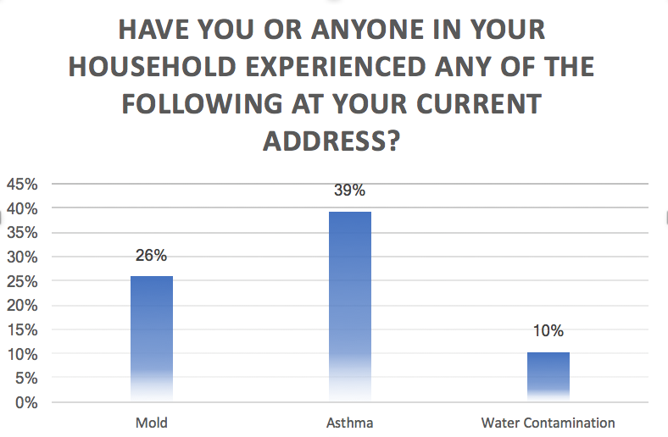
Prevalence of asthma among residents surveyed was 3.5 times the 2013 adult asthma prevalence in Lee County. Mold, which 26% of housholds reported, is an asthma trigger.
Notes:
Slightly more than a quarter (26%) of residents surveyed reported experiencing mold at their current address. Asthma was reported by 39% of responding households, and 10% of households reported experience with water contamination. Florida CHARTS reports the Lee County adult asthma prevalence in 2013 was 11.1%. This means that the prevalence of asthma among residents responding to the survey (39%) is 3.5 times the 2013 county prevalence. It is therefore important that 26% of households surveyed also experienced mold, because mold is a common asthma trigger. Asthma "FLHealthCHARTS BRFSS Indicators Dataview Page." Florida Department of Health, Division of Public Health Statistics & Performance Management., n.d. Web. 30 Mar. 2017 http://www.flhealthcharts.com/charts/Brfss/DataViewer.aspx?bid=0020
"Common Asthma Triggers." Centers for Disease Control and Prevention. Centers for Disease Control and Prevention, 20 Aug. 2012. Web. 16 Feb. 2017. https://www.cdc.gov/asthma/triggers.html

Slide 14
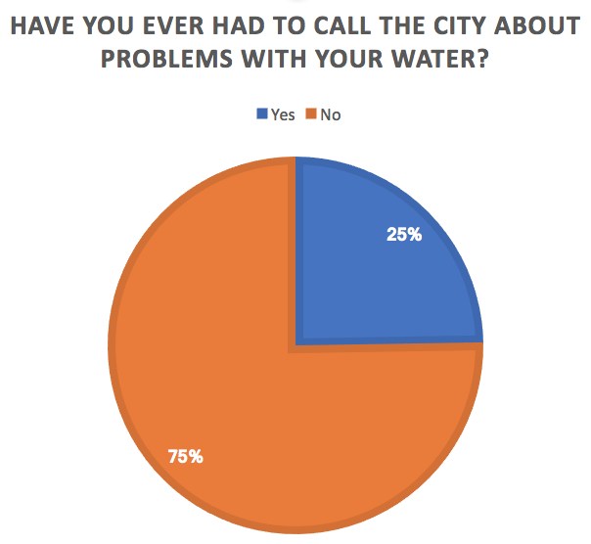
Notes:
25% of respondents have had to call the city about problems with their water.

Slide 15
Comments on Water Quality
Hoople St. | The water is brown from time to time.
Hunter Terrace | The color and flavor is variable and it has a lot of Clorox and acidity.
Patrick Ave. | The waterlines need replacing. The water is rusty.
Notes:
Three respondents reported problems with the quality of their water.

Slide 16
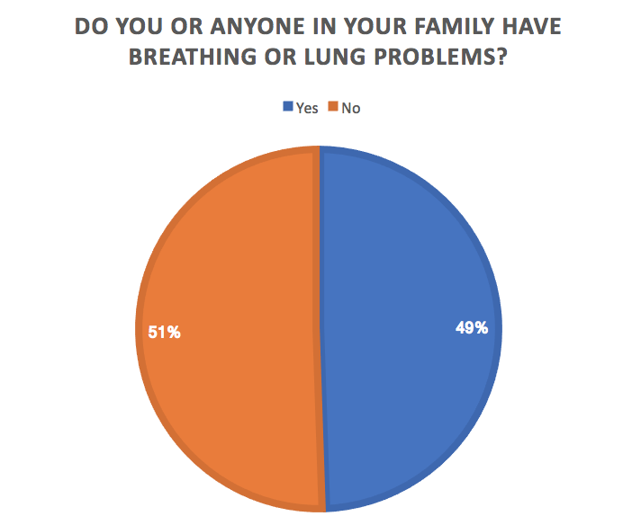
Notes:
Almost half of respondents (49%) reported that someone in their household has breathing or lung problems. Since 39% of households reported that a household member had asthma, that means an additional 10% have respiratory problems other than asthma.

Slide 17
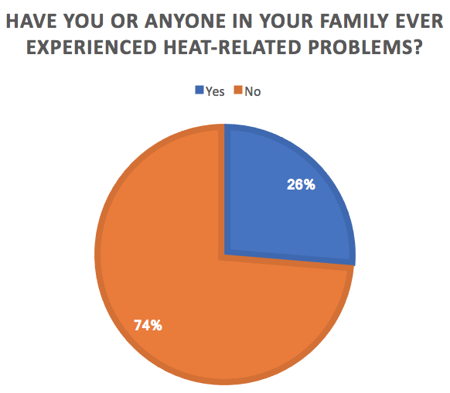
Notes:
26% of respondents have experienced heat-related problems.

Slide 18
Extreme Weather
Level of concern, evacuation, flooding

Slide 19
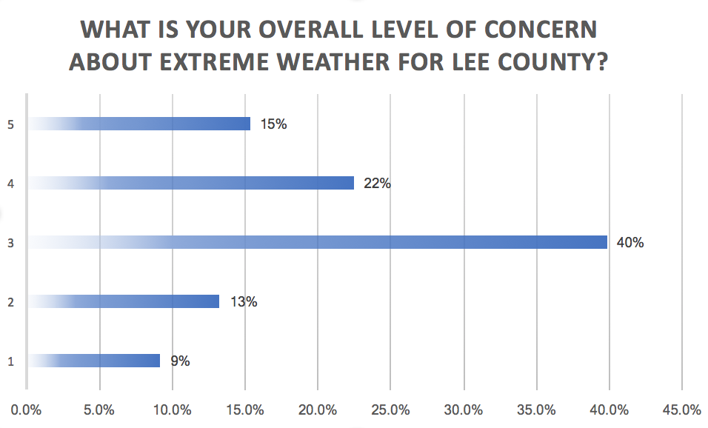
Residents chose from the following responses:
5-Very High
4-High
3-Medium
2-Low
1-None
Notes:
Respondents were asked to rate their overall level of concern with extreme weather for Lee County. They chose from the following responses: 1-None, 2-Low, 3-Medium, 4-High and 5-Very High. The medium level of concern with extreme weather was the category with the most respondents (40%), followed by a high level of concern (22%), and a very high level of concern (15%). Only 9% of respondents reported no concern with extreme weather in Lee County, although 13% reported a low level of concern

Slide 20
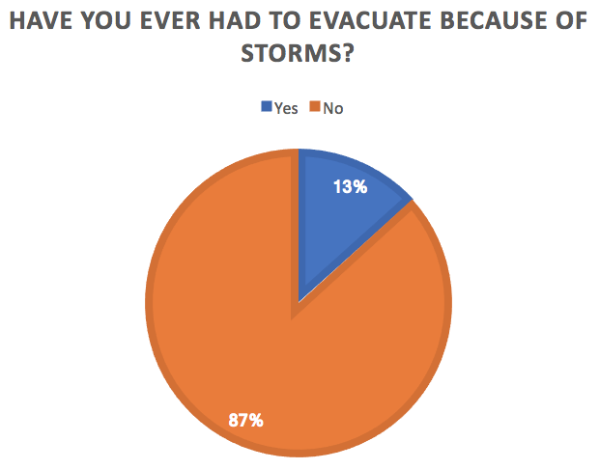
Notes:
13% of residents have had to evacuate due to storms.

Slide 21
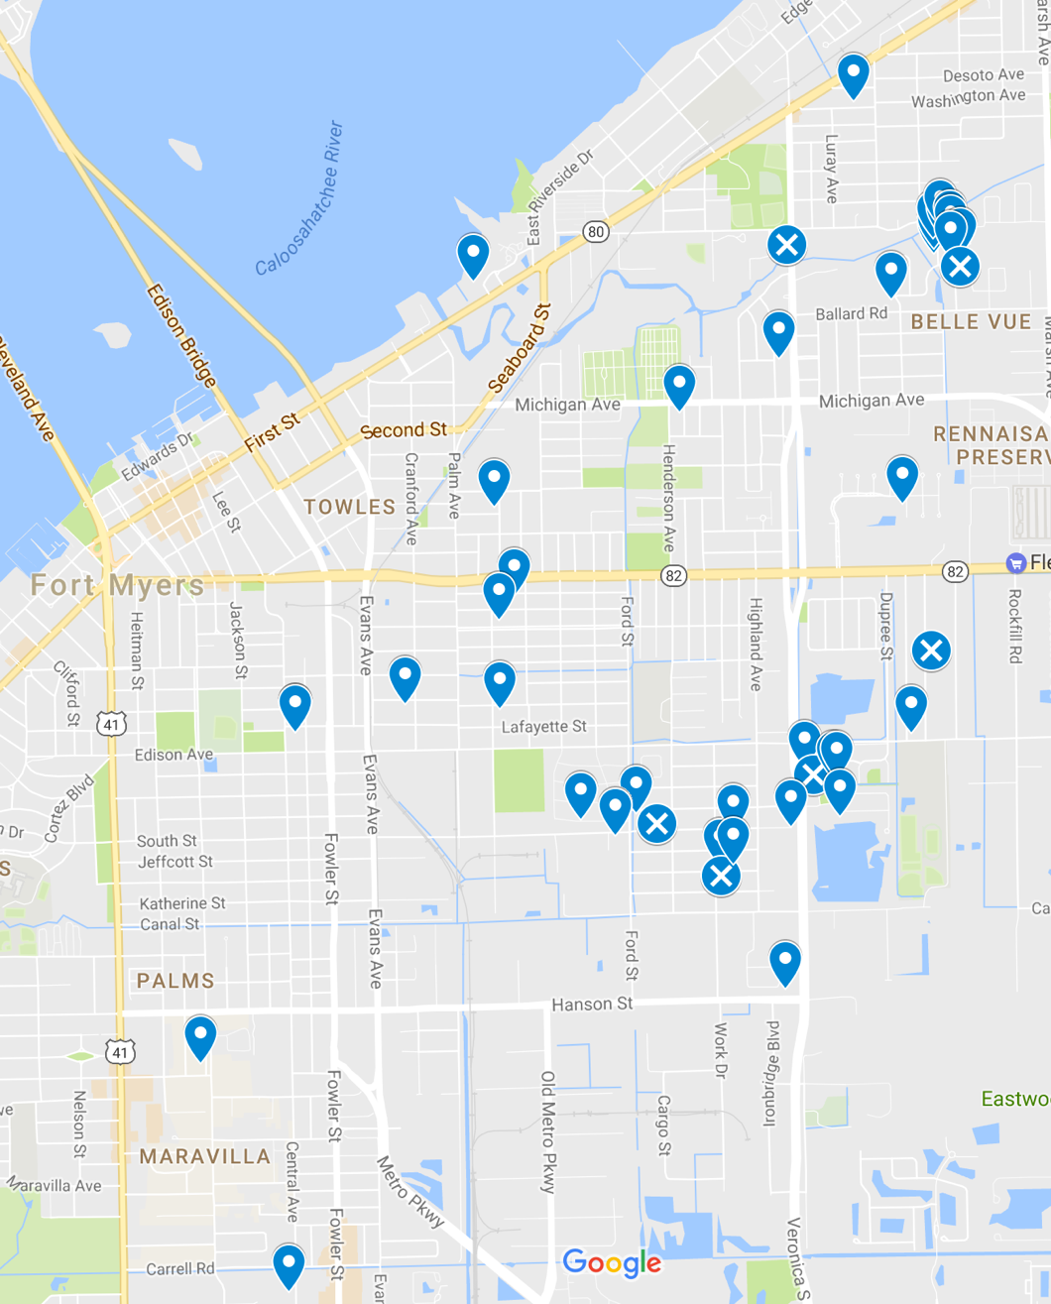
Mapped Reports of Flooding and Drainage Issues
Legend
Blue - Households that reported experience with flooding
Icons with an X – households that mention drainage in their comments
48.5% Experienced
Flooding
Reports of drainage Issues:
Barden St.
Clermont St.
Demery Circle
Patrick Ave.
South St.
Stella St.
Notes:
48.5% of respondents indicated that they had experience with flooding in their current home, and 6 households reported drainage issues. These were located on Barden St., Clermont St., Demery Circle, Patrick Ave., South St. and Stella St.

Slide 22
Sea Level Rise
Knowledge and Perception

Slide 23
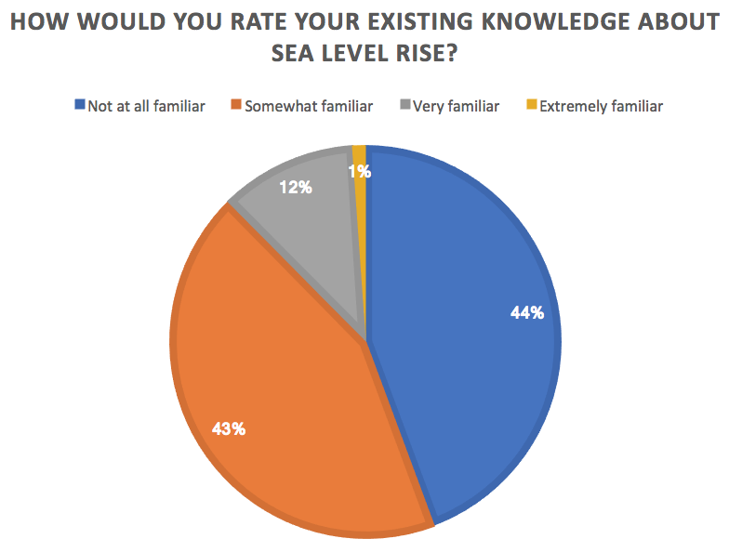
Notes:
44% of respondents reported that they were not at all familiar with sea level rise. And 43% reported that they were somewhat familiar with sea level rise. Only 1% of respondents reported that they were extremely familiar with sea level rise, and 12% reported that they were very familiar with it, indicating a need for further outreach and education.

Slide 24
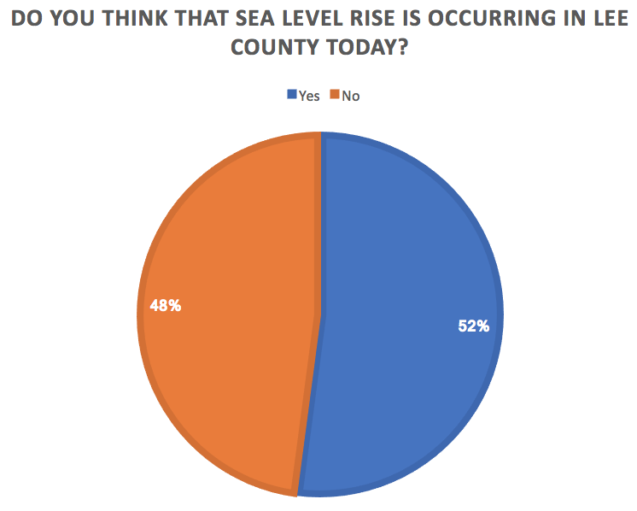
Notes:
Slightly over half of survey respondents think that sea level rise is occurring in Lee County.

Slide 25
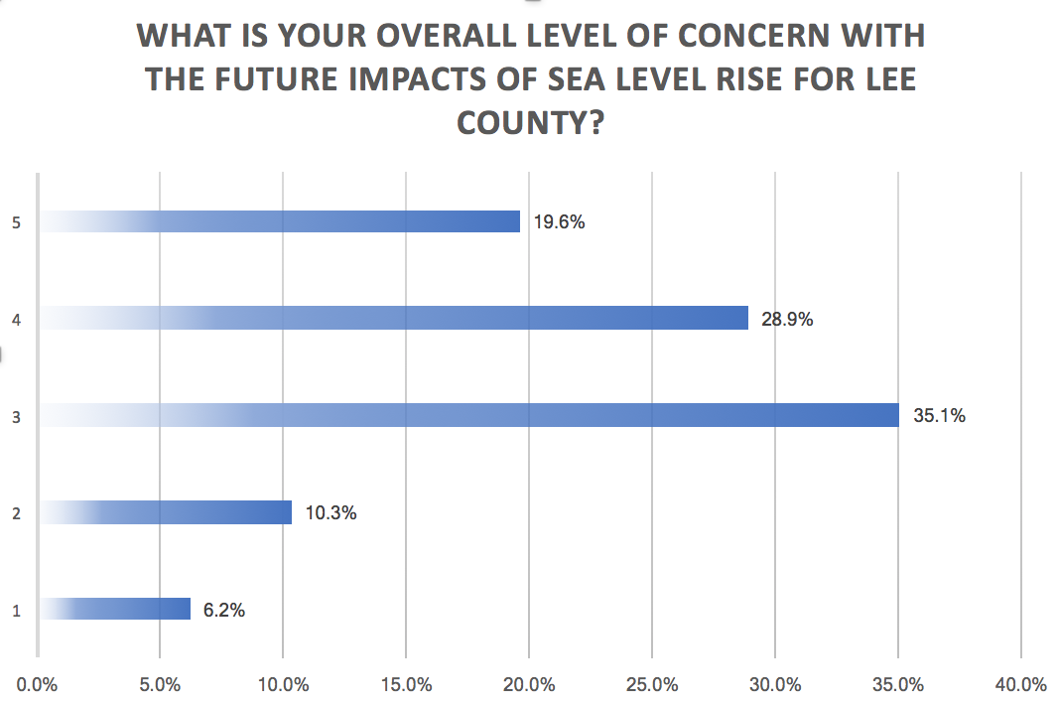
Residents chose from the following responses:
5-Very High
4-High
3-Medium
2-Low
1-None
Notes:
Most respondents surveyed had a medium level of concern with future impacts of sea level rise (35.1%), followed by 28.9% who had a high level of concern, and 19.6% had a very high level of concern. Only 10.3% of respondents had a low level of concern, and 6.2% had no concern regarding the future impacts of sea level rise on Lee County.

Slide 26
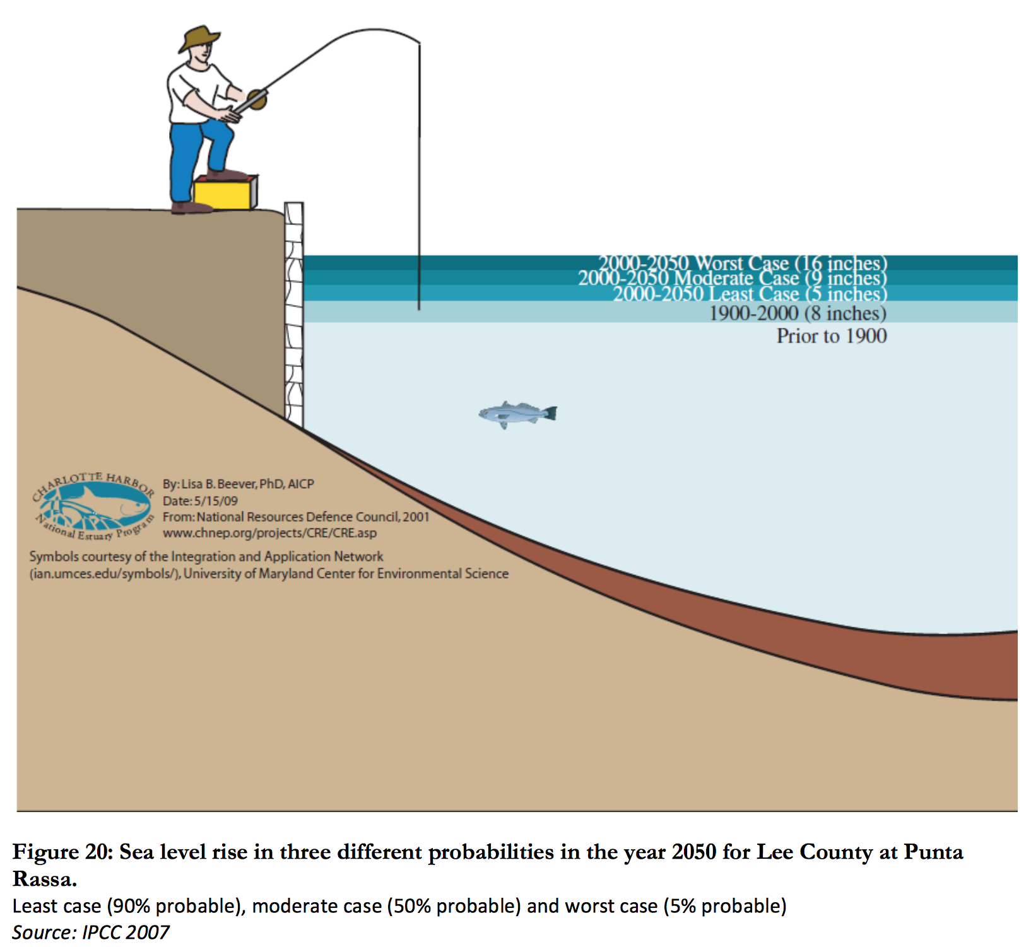
Projection for Lee County at
Punta Rassa
2000-2050
________
Worst case – 16 in.
Moderate case - 9 in.
Least case - 5 in.
Notes:
The Lee County Climate Change Vulnerability Assessment (2010) gives 3 sea level rise scenarios. The worst case is 16 inches from 2000-2050, the moderate case is 9 inches from 2000-2050, and the least case scenario is 5 inches from 2000-2050. Note that sea level only rose 8 inches in the 100 years between 1900 and 2000, showing the accelerating trend due to human activity.

Slide 27
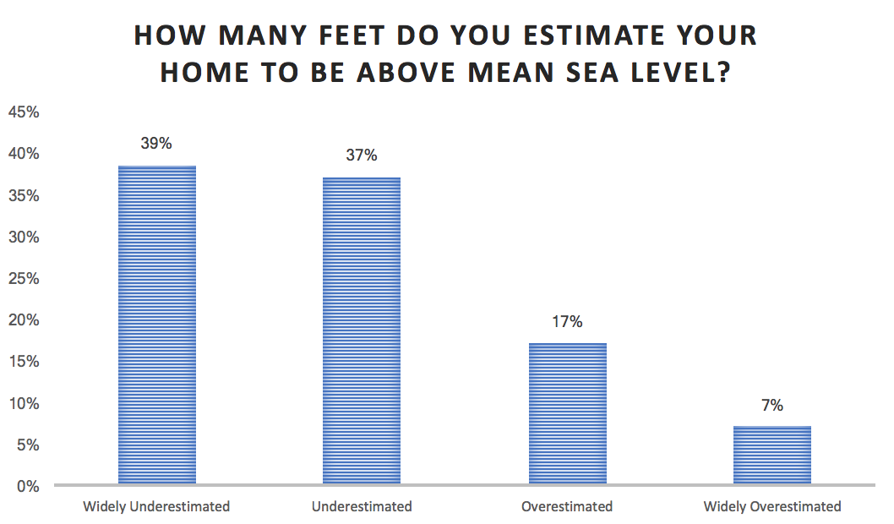
Residents’
Estimated Elevations
1 ft - 250 ft
_______
Actual Elevations
5.66 ft - 18.11 ft
Notes:
Most residents widely underestimated their elevation (39%) or underestimated it (37%). Only 7% of respondents widely overestimated their elevation, and 17% overestimated it. This means that most people who took the survey overestimated their risk from sea level rise based on elevation alone. The range of reported estimates of elevation was from 1 ft to 250 ft above sea level. Education about sea level rise should therefore include basic information about local topography so residents can understand the implications of sea level rise projections.

Slide 28
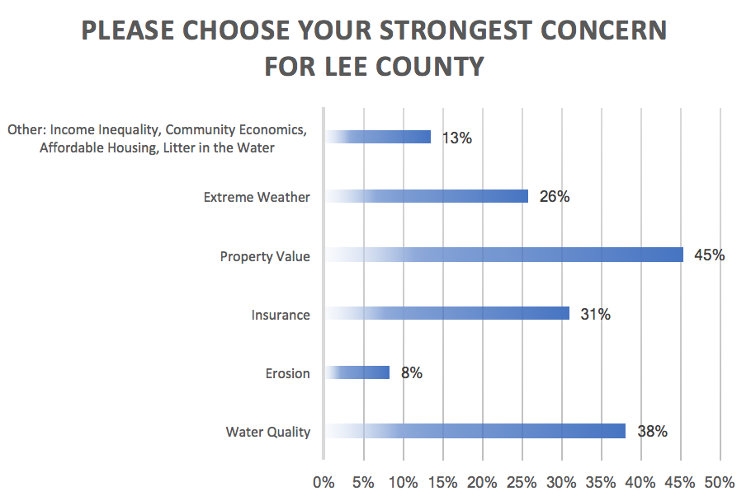
Notes:
Respondents could select more than one concern. Property value was identified by 45% of respondents as their strongest concern for Lee County, followed by Water Quality (38%), Insurance (31%), Extreme Weather (26%), Other (13%), and Erosion (8%) Other concerns included Income Inequality, Community Economics, Affordable Housing, and Litter in the Water.

Slide 29
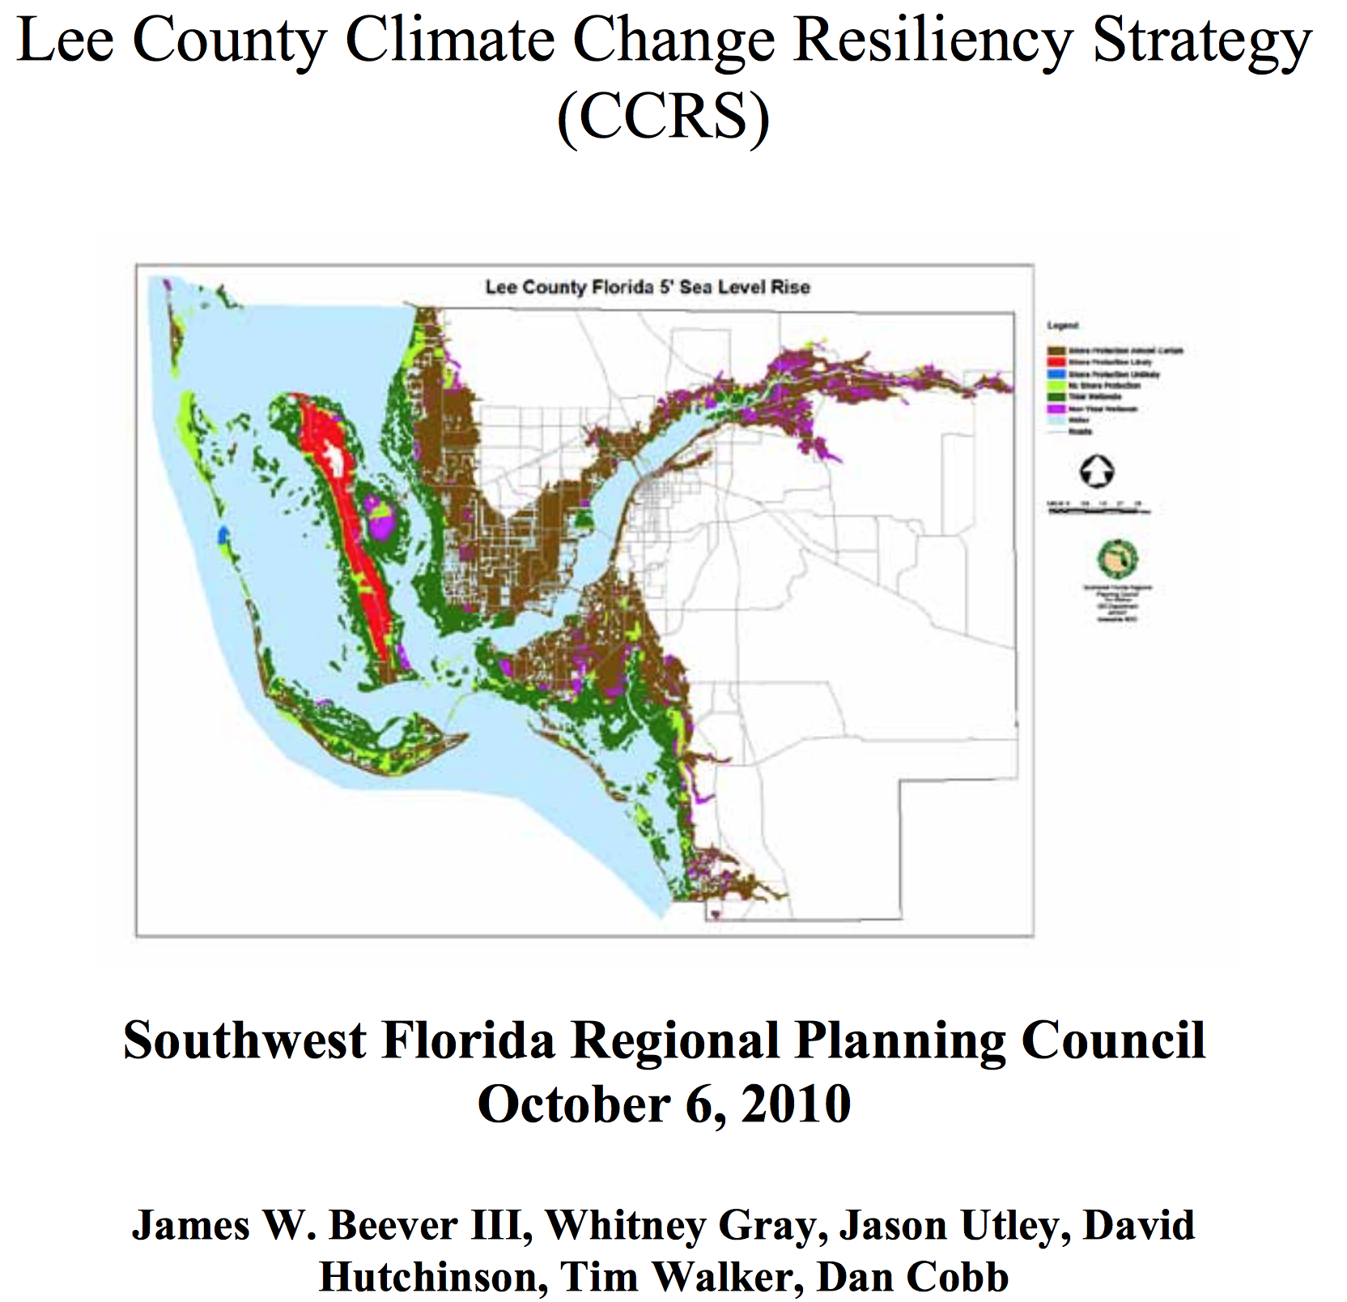
Lee County has a Climate Change Resiliency Strategy
Notes:
Lee County has done a vulnerability analysis, and has created a climate change resiliency strategy.

Slide 30
Rising Together: Ft. Myers 2017 addressed these Recommendations in the
Lee County Climate Resiliency Strategy
Disseminate information specific to vulnerable populations (e.g., outdoor workers and residents in urban heat islands or people with chronic illness regarding heat, immigrants with literacy/language needs).
Disseminate information to address specific risks associated with climate change (e.g. to prevent heat illness in communities and in workplaces, vector borne, or food-borne disease, etc.).
Educational materials should be available in multiple languages to reach wider audiences.
Empower and engage communities for action to mitigate and adapt to climate change.
Engage vulnerable communities and at-risk populations.
Notes:
The 5 recommendations here, that are included in the Lee County Climate Resiliency Strategy were addressed by this Rising Together project.

Slide 31
Key Actions to
Increase Climate Resilience
Encourage CodeRed Registration
Keep Storm Drains Clear of Debris and Report Drainage problems
Make Sure Your Flood Insurance is Current
Have an Emergency Plan
Share Health and Climate Facts w Others

Slide 32
Rising Together: Ft Myers 2017
Contributors to Success
All Faiths Unitarian Congregation
Climate Leader Joan Marshall
Project Director Dr. Lewis Robinson
Special Thanks to Basis Learning Skills
For use of office space and telephones.
Mr. Roy Kennix
Ms. Frankie Jennings
Dr. Ann Murphy Knight STARS Complex
Community Forum
Community Committee Chair Crystal Johnson
Goodwill of SW Florida Barbara Key Ramos
Community Kids of SW Florida Nicolas Resto
Outreach Team
Alex Sophia Mantos
Marsha Curry Tanya Mantos
Yvonne Hill Barbara Key Ramos
Outreach Team Supporters
Nicholas Resto Bob E. Stockwell
Mrs. Nicholas Resto Carl Baxter
Luis Resto
Government Officials
City Manager, City of Fort Myers Saeed Kazemi, P.E.
Councilwoman, Ward 1
Teresa Watkins Brown
Councilman, Ward 2
Johnny W. Streets, Jr.
City Attorney, City of Fort Myers
Grant Williams Alley
Environmental Manager
FL Dept. of Health, Lee County Geordie Smith, PhD.

Slide 33
-This project was funded in part by the Unitarian Universalist Fund for Social Responsibility.
-This project was funded in part by the UUFBR Endowment Fund.
-Development of the ReACT Tool Kit and the Pilot Project was funded by EPA Environmental Justice Grant
#EQ-00D35415-0 awarded to the Green Sanctuary Committee of the UU Fellowship of Boca Raton.
Notes:
Rising Together: Temperature, Water, Health and Strength is a project of UU Justice Florida that partners UU congregations with existing leadership in vulnerable communities to build climate resilience. In Ft. Myers, All Faiths Unitarian Congregation of Ft. Myers partnered with Dr. Ann Murphy Knight STARS Complex Community Forum.

