Slide 1
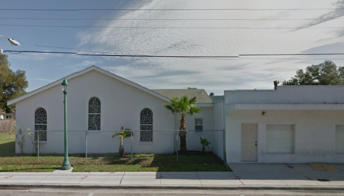
Community Bible Church
1959 Dr. Martin Luther King Way
Sarasota, FL 34234
-This project was funded in part by the Unitarian Universalist Fund for Social Responsibility.
-This project was funded in part by the UUFBR Endowment Fund.
-Development of the ReACT Tool Kit and the Pilot Project was funded by EPA Environmental Justice Grant
#EQ-00D35415-0 awarded to the Green Sanctuary Committee of the UU Fellowship of Boca Raton.

Slide 2
Building Climate Resilience
By the Numbers
Notes:
Climate Resilience is the ability of a community to respond to climate change, so it can continue to function well as the climate changes.

Slide 3
One Training Session

Slide 4
13 Trained Climate & Health Communicators

Slide 5
Five Members on the Outreach Team
Pastor Jo Thomas
Phillip Felder
Vivianna Martin
Barbara Sallee
Peg Tams

Slide 6
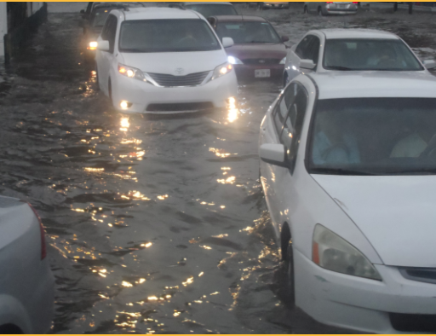
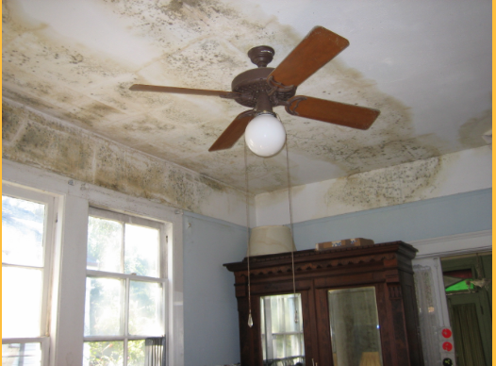
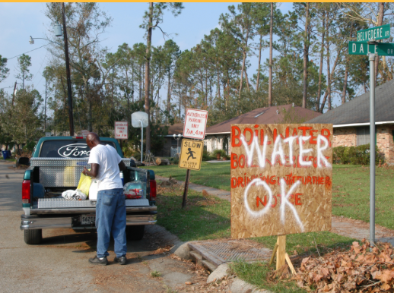
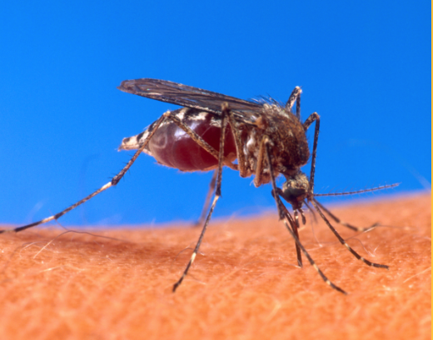
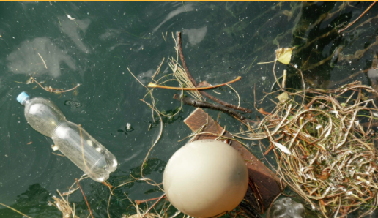
96 Households Educated
Mold
Water Contamination
Vector Borne Disease
Storm Preparedness
Heat Waves and
Poor Air Quality
Standing Water
Algae Blooms
Notes:
96 Residents were educated about the public health effects of climate change. Education included: storm preparedness, mold, water contamination, vector borne diseases, heat waves and poor air quality, standing water and algae blooms.

Slide 7
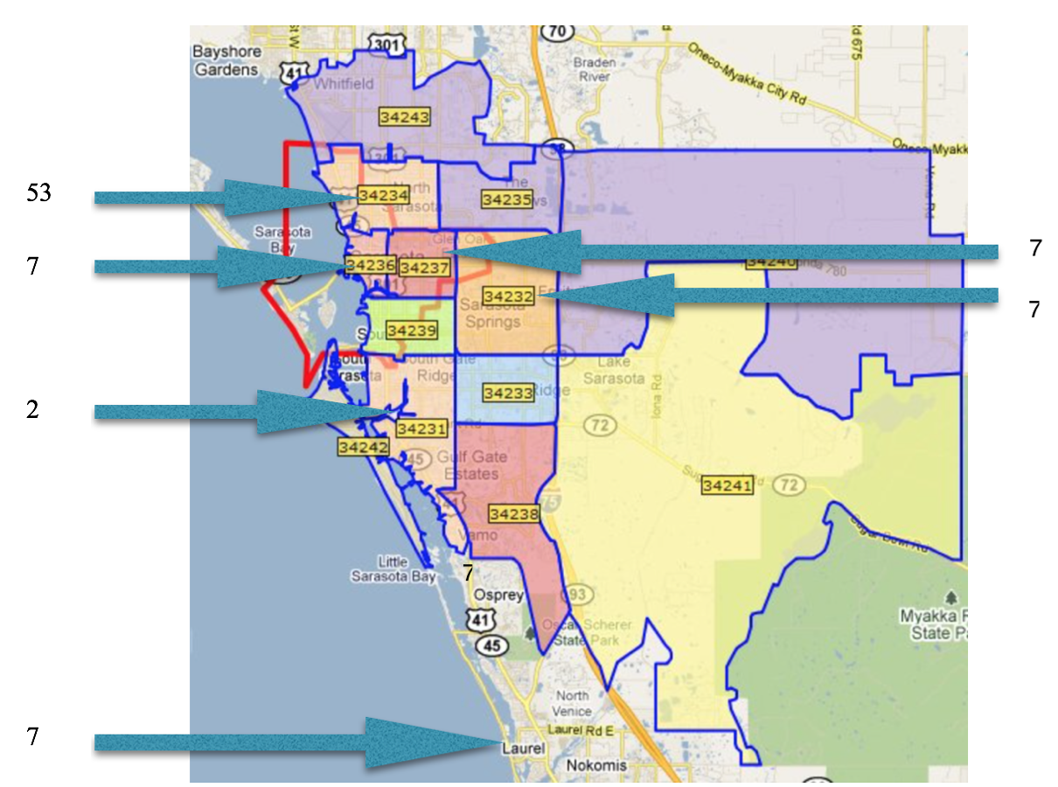
89 Sarasota Residents
in
10 Zip Codes
7 Manatee County Residents in
5 Zip Codes
Notes:
Outreach from Community Bible Church in Newtown reached households in 14 zip codes in Manatee and Sarasota Counties. Of the 96 households responding to the survey, 89 were in Sarasota County, and 7 were in Manatee County. There is overlap in the 34243 zip code, which has both Sarasota and Manatee County addresses.

Slide 8
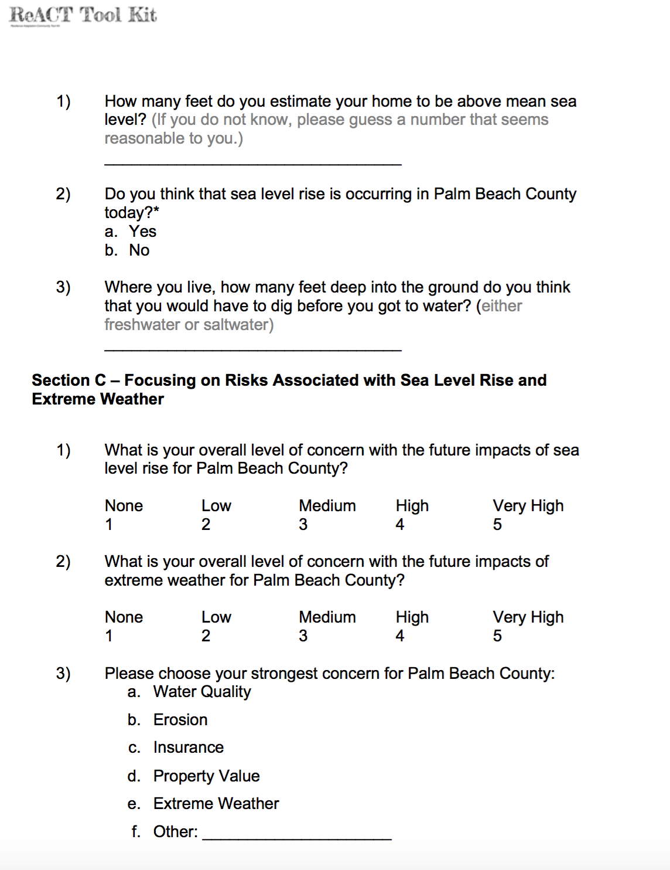
96 Households Surveyed

Slide 9
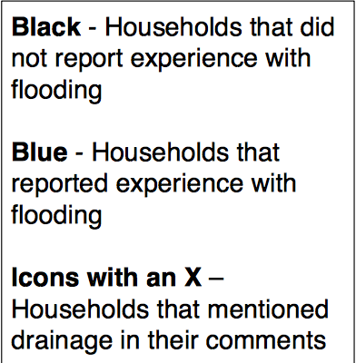
Interactive Mapping of Households
Notes:
To obtain a link to the Google Map with all flooding comments from surveys, together with addresses, contact Janice T. Booher at JJLBooher@comcast.net. Comments regarding flooding are available by clicking the icons when the password is entered.

Slide 10
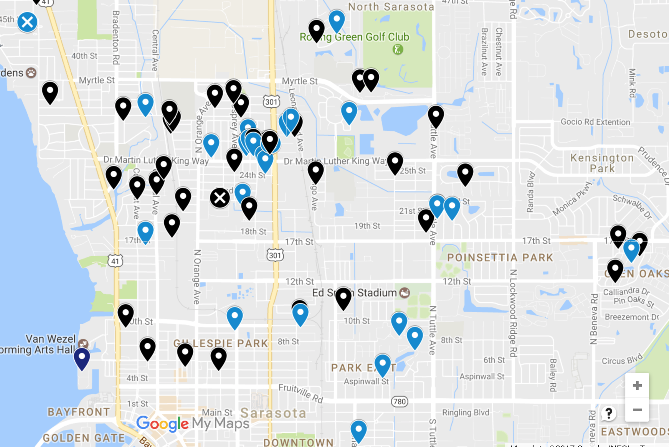

Slide 11
46% of Households
Reported Experience with Flooding and Made Specific Comments
Notes:
In response to the question, “What flood related impacts have you experienced in your neighborhood?” 46% of respondents indicated that they had experience with flooding. All households surveyed are mapped below. To obtain a link to the Google Map with all flooding comments from surveys, together with addresses, contact Janice T. Booher at JJLBooher@comcast.net. Comments regarding flooding are available by clicking the icons when the password is entered.

Slide 12
41 People Signed up for Code Red

Slide 13
What We Learned
Familiarity with Sea Level Rise
Primary Concerns
Incidence of Mold, Asthma and Water Contamination
Experience with Flooding

Slide 14
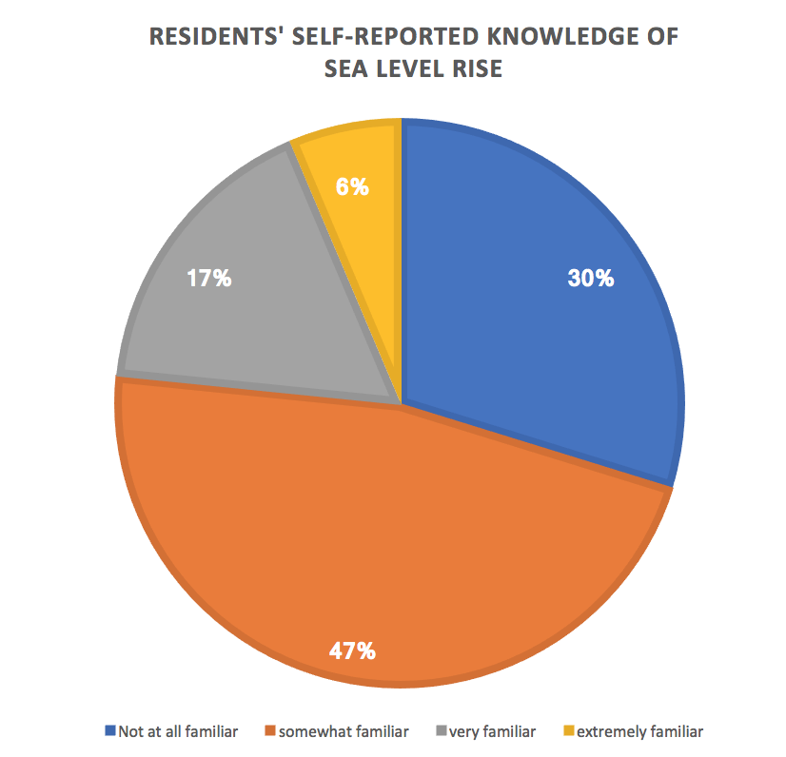
Notes:
Almost half of the respondents (47%) reported that they were somewhat familiar with sea level rise, and an additional 6% reported that they were extremely familiar with sea level rise. 17% reported that they were very familiar with sea level rise. However, 30% of residents reported that they were not at all familiar with sea level rise, indicating a need for further outreach and education.

Slide 15
Most Respondents Underestimated their Elevation
Estimated Elevations
-10 ft. – 1,000 ft.
__________________
Actual Elevations
6.8 ft. – 33.59 ft.
__________________
Elevation at Community Bible Church is 28.99 ft.
Source: Eyes on the Rise <http://citizeneyes.org/app/>

Slide 16
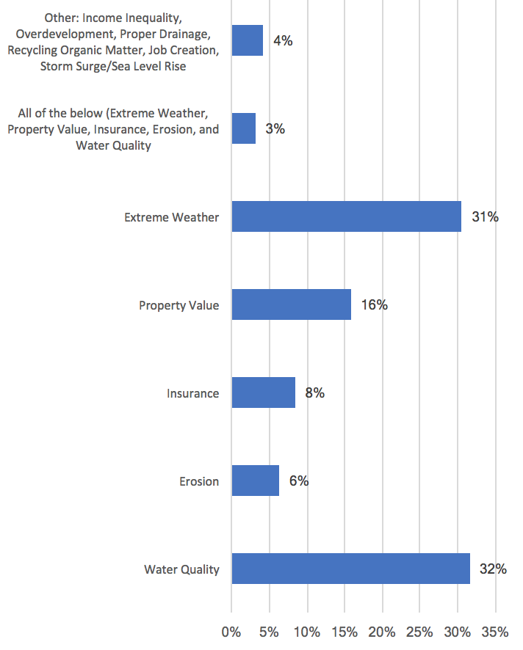
Residents’ Strongest Concerns for Lee
County
Notes:
Three percent of residents surveyed stated that extreme weather, property value, insurance, erosion and water quality were all of concern. Residents’ individually identified strongest concerns were water quality (32%) and extreme weather (31%), followed by property value (16%), insurance (8%) and erosion (6%). A variety of concerns were entered in the “other” category by 4% of respondents, as indicated in the figure above.

Slide 17
Residents’ Water Quality Concerns
Leon Ave. | Water pollution is already bad in the neighborhood. Rain makes it worse.
Mango Ave. | Our water supplies sometimes force us to buy water.
N. Tamiami Trail | The water quality I am thinking of is the Gulf. Last summer there was a "bacteria" closure at Lido because of that heavy rain -- I forgot what month. Tampa/St. Petersburg had a similar incident during a storm last summer.
20th St. | In flood situation, the people in my neighborhood have water impacts. They all just drink out of the tap.
29th St. | I know some areas with well water, and people can't drink it.
Notes:
Most respondents’ Water Quality comments dealt with concerns for the future. These 5 comments referred to current concerns.

Slide 18
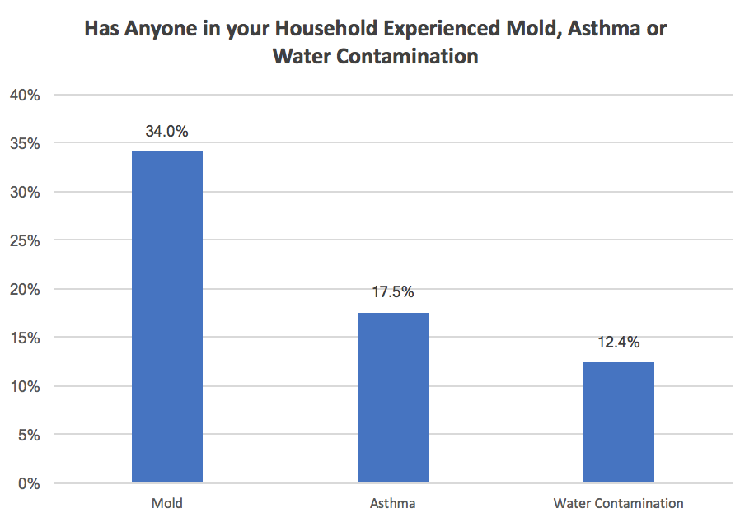
Notes:
Slightly more than a third (34%) of residents surveyed reported experiencing mold at their current address. Asthma was experienced by 18% of responding households, and 13% of households reported experience with water contamination. Florida CHARTS reports the Sarasota County adult asthma prevalence in 2013 was 5.3%. This means that the prevalence of asthma among residents responding to the survey (18%) is more than three times the 2013 county prevalence. It is therefore important that 34% of residents sampled also experienced mold, because mold is a common asthma trigger.
"FLHealthCHARTS BRFSS Indicators Dataview Page." Florida Department of Health, Division of Public Health Statistics & Performance Management., n.d. Web. 30 Mar. 2017
"Common Asthma Triggers." Centers for Disease Control and Prevention. Centers for Disease Control and Prevention, 20 Aug. 2012. Web. 16 Feb. 2017. https://www.cdc.gov/asthma/triggers.html
"Common Asthma Triggers." Centers for Disease Control and Prevention. Centers for Disease Control and Prevention, 20 Aug. 2012. Web. 16 Feb. 2017. https://www.cdc.gov/asthma/triggers.html

Slide 19
Air Pollution and Climate Change
Increased temperature
raises the concentration of ground-level ozone
pollutes the air
Ground level ozone creates smog
Can cause breathing problems
Can damage lung tissue, reduce lung function, and inflame airways

Slide 20
AQI Values | Health Status | Colors and Meaning
0 to 50 | Good | Green: Satisfactory air quality; air pollution poses little or no risk
51 to 100 | Moderate | Yellow: Acceptable air quality; moderate health concern for a few people who are unusually sensitive to air pollution
101 to 150 | Unhealthy for Sensitive Groups | Orange: Health effects for members of sensitive groups
151 to 200 | Unhealthy | Red: Health effects for all; more serious health effects for members of sensitive groups.
201 to 300 | Very Unhealthy | Purple: Health alert! More serious health effects for all.
301 to 500 | Hazardous | Maroon: Health alert! Serious health effects for all.
Source: US Environmental Protection Agency. (2016). Air Quality Index: Air Now. Available at: https://airnow.gov/index.cfm?action=aqibasics.aqi.
Notes:
The U.S. Environmental Protection Agency’s (EPA) Air Quality Index (AQI) measures the level of air pollution.
The AQI lets you know when the air quality may be hazardous to your health.
When the AQI is in the unhealthy range, you should stay indoors in air-conditioning as much as possible; when you go outside, avoid exertion and heavily trafficked roadways and consider wearing a mask. Check local AQI daily at https://www.airnow.gov/ or Google Air Now AQI.

Slide 21
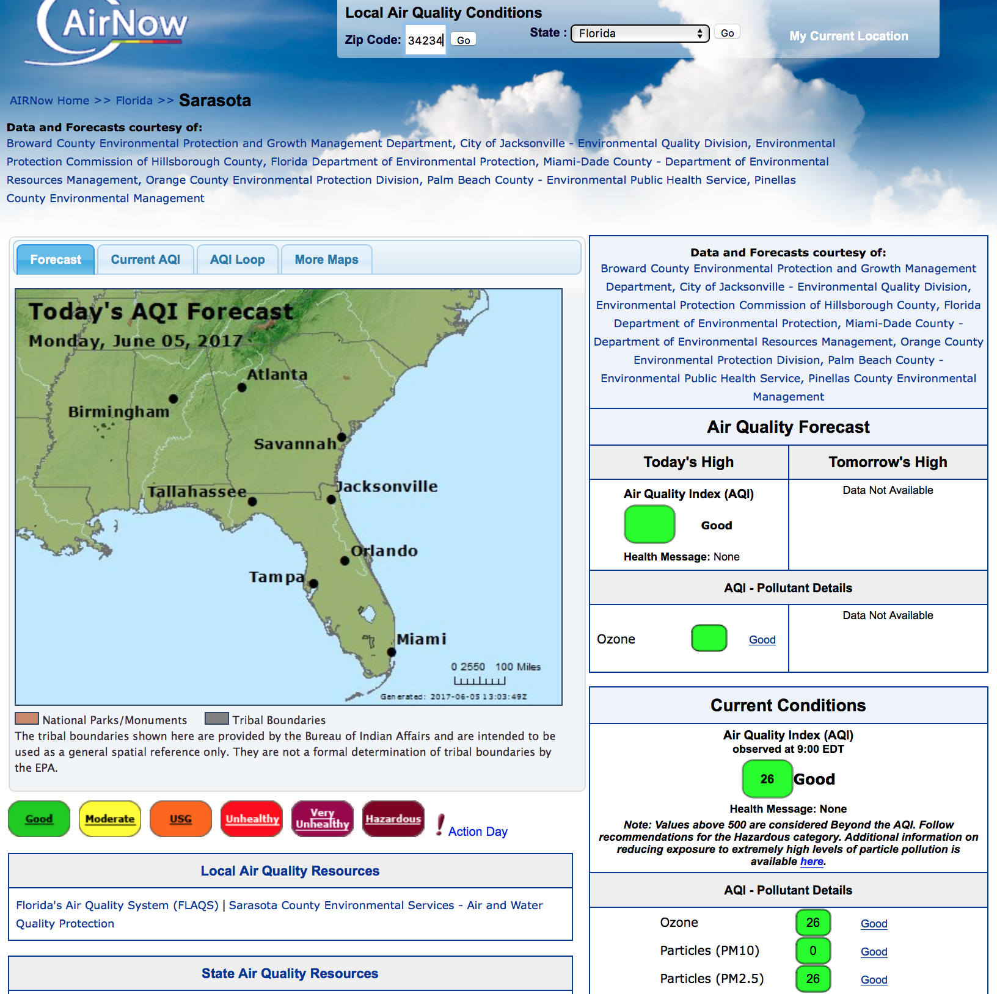
AirNow.gov
June 5, 2017
Notes:
On June 5, 2017 here was the air quality report on AirNow.gov. The zip code 33234 was entered in Florida, and the air quality for the day was reported as “Good.” Ozone was also reported as “Good.” The Air Quality Index for the day was 26, Particles (PM10) were reported at 0 and smaller Particles (PM 2.5) were reported at 26. Particles (PM 10) are particles in the air that have a diameter of 10 micrometers or less. Particles less than or equal to 10 micrometers in diameter are so small that they can get into the lungs, potentially causing serious health problems. Particles (PM 2.5) are particles in the air that are 2.5 micrometers in diameter or smaller. Fine particulate matter (PM_{2.5}) is an air pollutant that is a concern for people's health when levels in air are high. PM_{2.5} are tiny particles in the air that reduce visibility and cause the air to appear hazy when levels are elevated.

Slide 22
Key Actions to Increase Climate Resilience
-Encourage CodeRed Registration
-Keep Storm Drains Clear of Debris
-Make Sure Your Flood Insurance is Current
-Have an Emergency Plan
-Share Health and Climate Tips

Slide 23
Rising Together: Sarasota 2017 Contributors to Success
Unitarian Universalist
Church of Sarasota
Climate Leader - Diane Cirksena
Graphic Design - Ann Urick
President – Ward Pallota
Community Bible Church Outreach Team
Pastor Jo Thomas
Vivianna Martin
Phillip Felder
Barbara Sallee
Peg Tams
Government Officials
Sarasota Sustainability Manager
Stevie Freeman-Montes, PMP
Sarasota County Stormwater Engineer
Ben Quartermine, P.E.
Community Support
Newtown Women’s Group Helen James
Former Sarasota Mayor Richard Martin

Slide 24
Community Bible Church
1959 Dr. Martin Luther King Way
Sarasota, FL 34234
-This project was funded in part by the Unitarian Universalist Fund for Social Responsibility.
-This project was funded in part by the UUFBR Endowment Fund.
-Development of the ReACT Tool Kit and the Pilot Project was funded by EPA Environmental Justice Grant
#EQ-00D35415-0 awarded to the Green Sanctuary Committee of the UU Fellowship of Boca Raton.

