Slide 1
-This project was funded in part by the Unitarian Universalist Fund for Social Responsibility.
-This project was funded in part by the UUFBR Endowment Fund.
-Development of the ReACT Tool Kit and the Pilot Project was funded by EPA Environmental Justice Grant
#EQ-00D35415-0 awarded to the Green Sanctuary Committee of the UU Fellowship of Boca Raton.

Slide 2
Building Climate Resilience
By the Numbers
Notes:
Climate Resilience is the ability of a community to respond to climate change, so it can continue to function well as the climate changes. This project identified 4 key areas this community can address to increase its climate resilience.

Slide 3
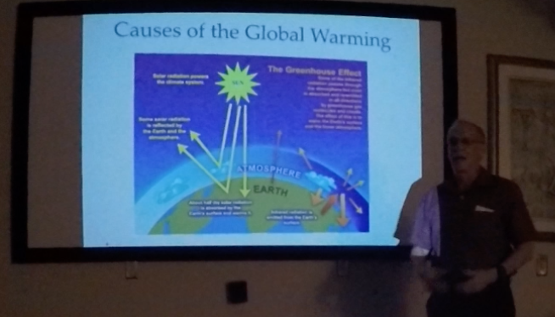
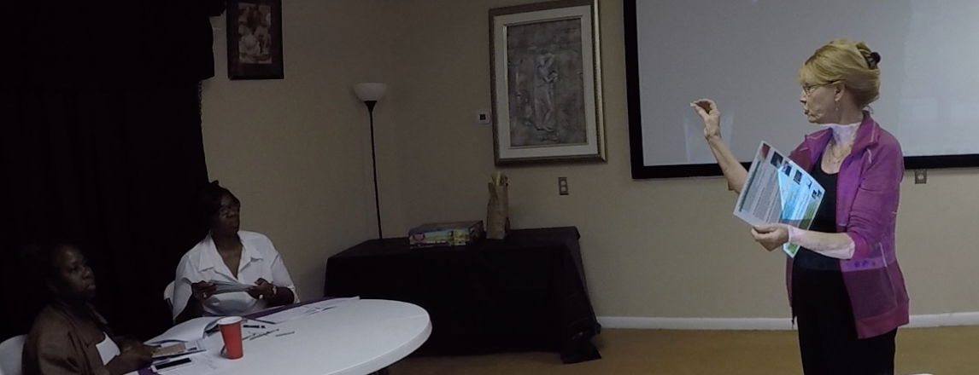
One Training Session

Slide 4
11 Trained Climate & Health Communicators
Georgie Dixon Tangenika Williams Samella Burnett Cynthia Simmons
Deborah Mcglothum
Linda Tomlinson
Angela Williams
Teresa Shannon Katrina Scott
Nettie Jennings
Ghia Phillips

Slide 5
Six Members on the Outreach Team
Georgie Dixon 20 Surveys
Tangenika Williams 20 Surveys
Samella Burnett 20 Surveys
Cynthia Simmons 20 Surveys
Teresa Shannon 10 Surveys
Katrina Scott 10 Surveys

Slide 6
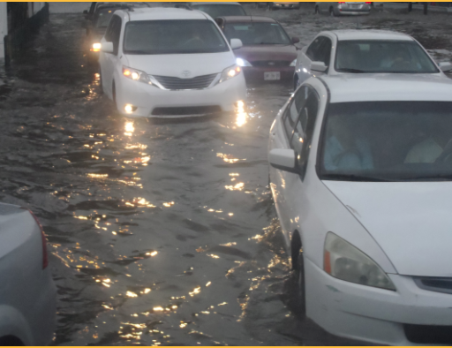
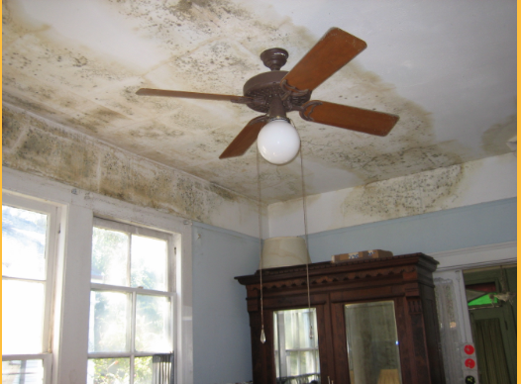
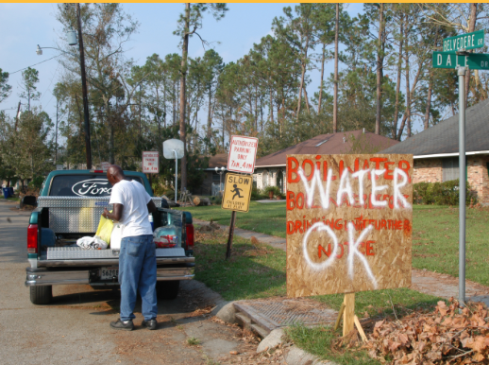
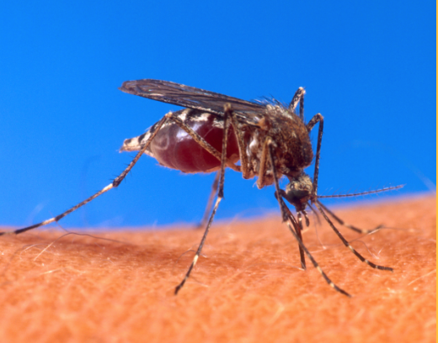
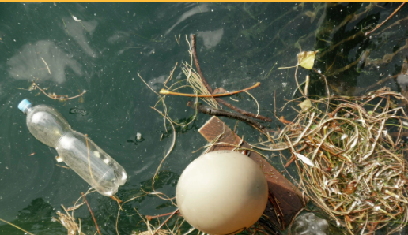
100 Residents Educated
Mold
Water Contamination
Vector Borne Disease
Storm Preparedness
Heat Waves and
Poor Air Quality
Standing Water
Algae Blooms
Notes:
102 Residents were educated about the public health effects of climate change. Education included: storm preparedness, mold, water contamination, vector borne diseases, heat waves and poor air quality, standing water and algae blooms.

Slide 7
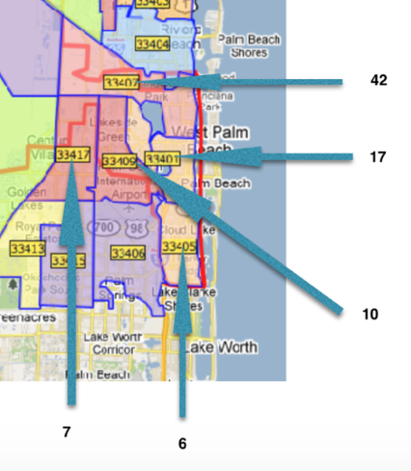
96 Households in West Palm Beach
Notes:
The zip codes in which most of the respondents resided are indicated in the map.
42 respondents resided in 33407. 17 respondents resided in 33401. 10 respondents resided in 33409.
7 respondents were in 33417, and 6 respondents were in 33405. Zip codes with one or two respondents are not included in this graphic.

Slide 8
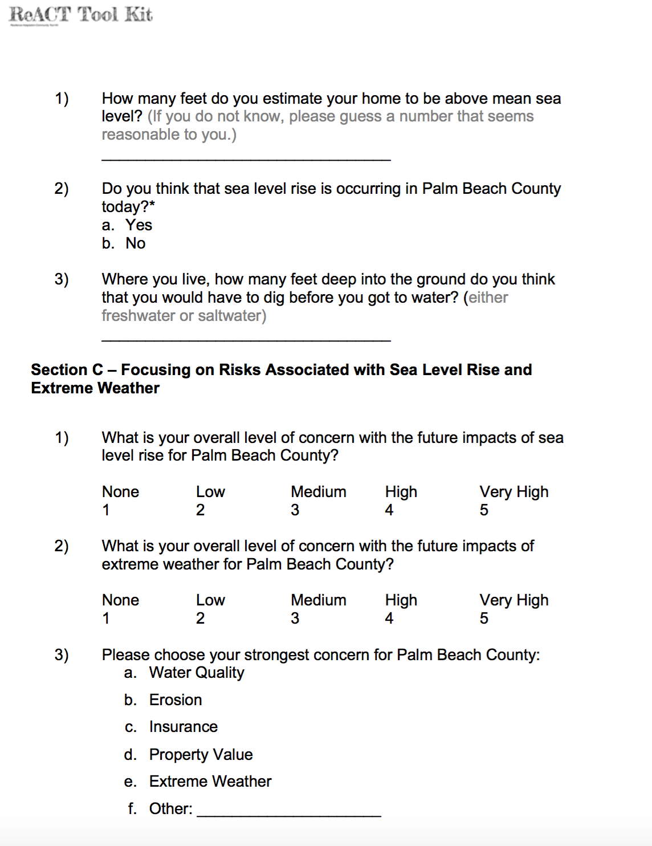
100 Households Surveyed

Slide 9
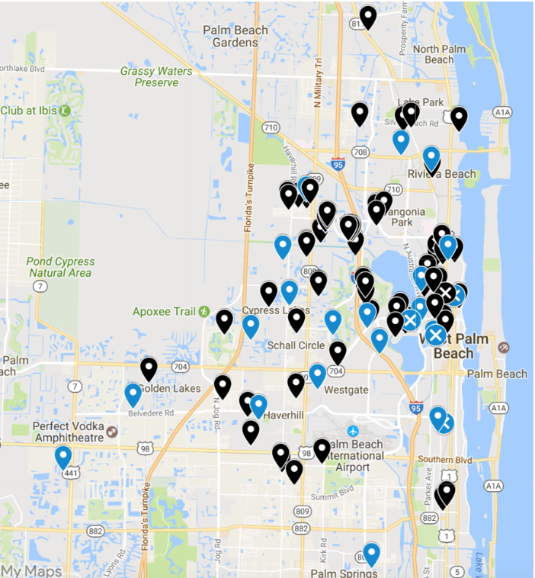
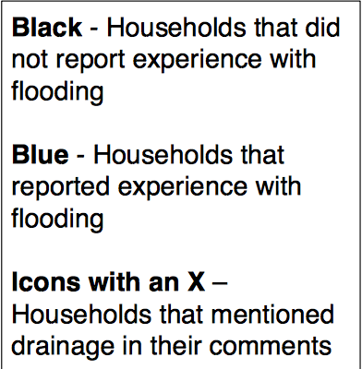
Interactive Mapping of Households
Notes:
This is a still shot of an interactive Google map that documents survey responses related to flooding. 24% of residents reported experience with flooding in West Palm Beach and environs, with 5 respondents east of I-95 specifically citing drainage issues.

Slide 10
0 People Signed up for Code Red But You Can Sign Up NOW
Notes:
Google CodeRed as one word with no spaces.

Slide 11
Notes:
Click on Resident Enrollment.

Slide 12
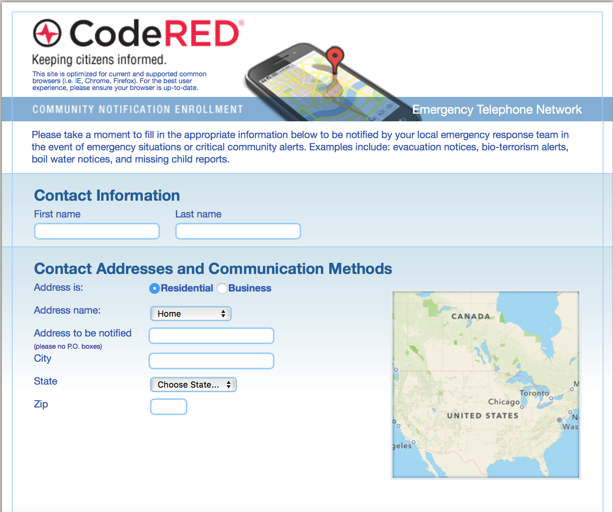
Notes:
Enter your information and select the Communications methods you want used to contact you.

Slide 13
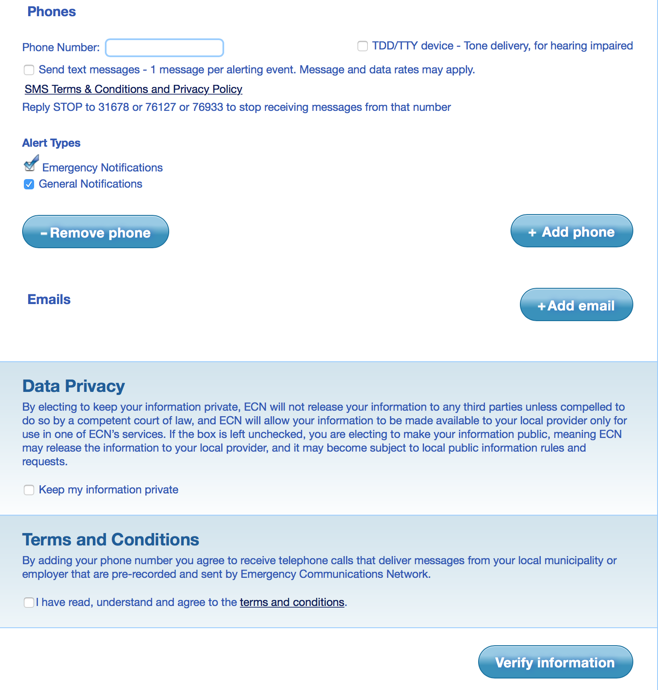

Slide 14
What We Learned
Familiarity with Sea Level Rise
Primary Concerns
Incidence of Mold, Asthma and Water Contamination
Experience with Flooding

Slide 15
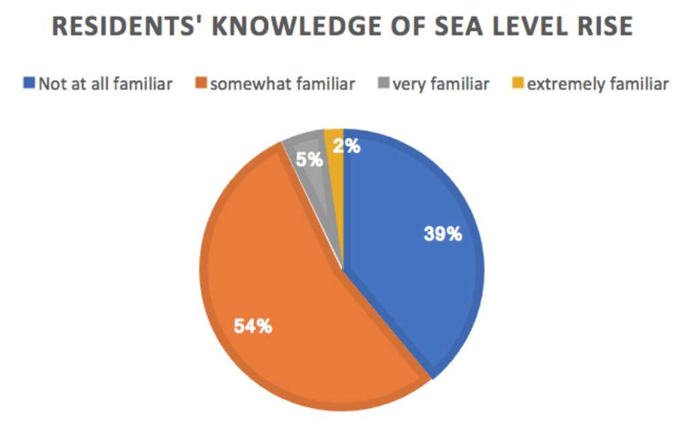
Notes:
Although 83% of respondents were concerned about sea level rise, fully 39% said they were not at all familiar with it. More than half of residents surveyed reported that they were somewhat familiar with sea level rise, and an additional 2% reported that they were extremely familiar. 5% reported that they were very familiar with sea level rise. However, 39% of residents reported that they were not at all familiar with sea level rise, so there is a need for further outreach and education.

Slide 16
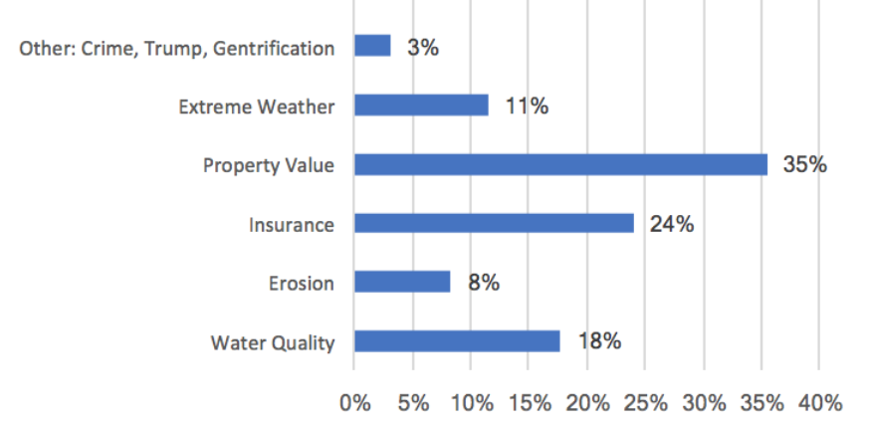
Residents Strongest Concern for Palm Beach County
Notes:
Residents’ strongest concern for Palm Beach County was property value (35%), followed by insurance (24%) and water quality (18%). Extreme weather was identified as the strongest concern by 11% of respondents, and Erosion was identified by 8%. Crime, Trump and Gentrification were listed as “Other” as residents’ strongest concerns for Palm Beach County.

Slide 17
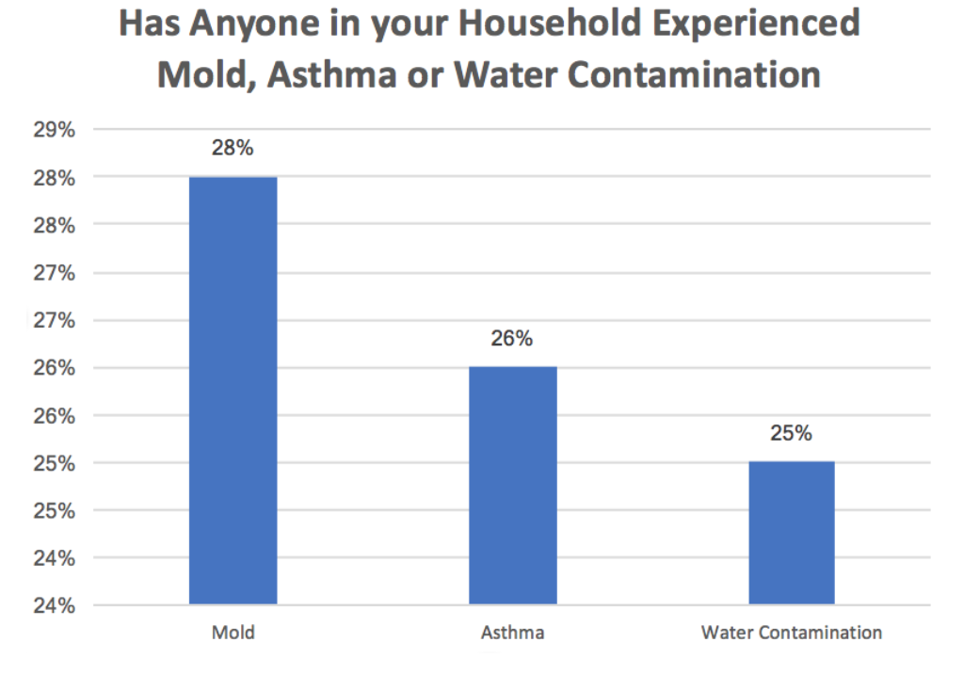
Notes:
Asthma was experienced by 26% of respondents, which is approximately two and a half times the county lifetime asthma prevalence. Slightly more than a quarter (28%) of residents surveyed in West Palm Beach reported experiencing mold at their current address. Water contamination was experienced by 25% of responding households. Florida CHARTS 2015 reports the Palm Beach County lifetime asthma prevalence is 10.4%

Slide 18
Air Pollution and Climate Change
Increased temperature
raises the concentration of ground-level ozone
pollutes the air
Ground level ozone creates smog
Can cause breathing problems
Can damage lung tissue, reduce lung function, and inflame airways

Slide 19
AQI Values | Health Status | Colors and Meaning
0 to 50 | Good | Green: Satisfactory air quality; air pollution poses little or no risk
51 to 100 | Moderate | Yellow: Acceptable air quality; moderate health concern for a few people who are unusually sensitive to air pollution
101 to 150 | Unhealthy for Sensitive Groups | Orange: Health effects for members of sensitive groups
151 to 200 | Unhealthy | Red: Health effects for all; more serious health effects for members of sensitive groups.
201 to 300 | Very Unhealthy | Purple: Health alert! More serious health effects for all.
301 to 500 | Hazardous | Maroon: Health alert! Serious health effects for all.
Source: US Environmental Protection Agency. (2016). Air Quality Index: Air Now. Available at: https://airnow.gov/index.cfm?action=aqibasics.aqi.
Notes:
The U.S. Environmental Protection Agency’s (EPA) Air Quality Index (AQI) measures the level of air pollution.
The AQI lets you know when the air quality may be hazardous to your health.
When the AQI is in the unhealthy range, you should stay indoors in air-conditioning as much as possible; when you go outside, avoid exertion and heavily trafficked roadways and consider wearing a mask. Check local AQI daily at https://www.airnow.gov/ or Google Air Now AQI.

Slide 20
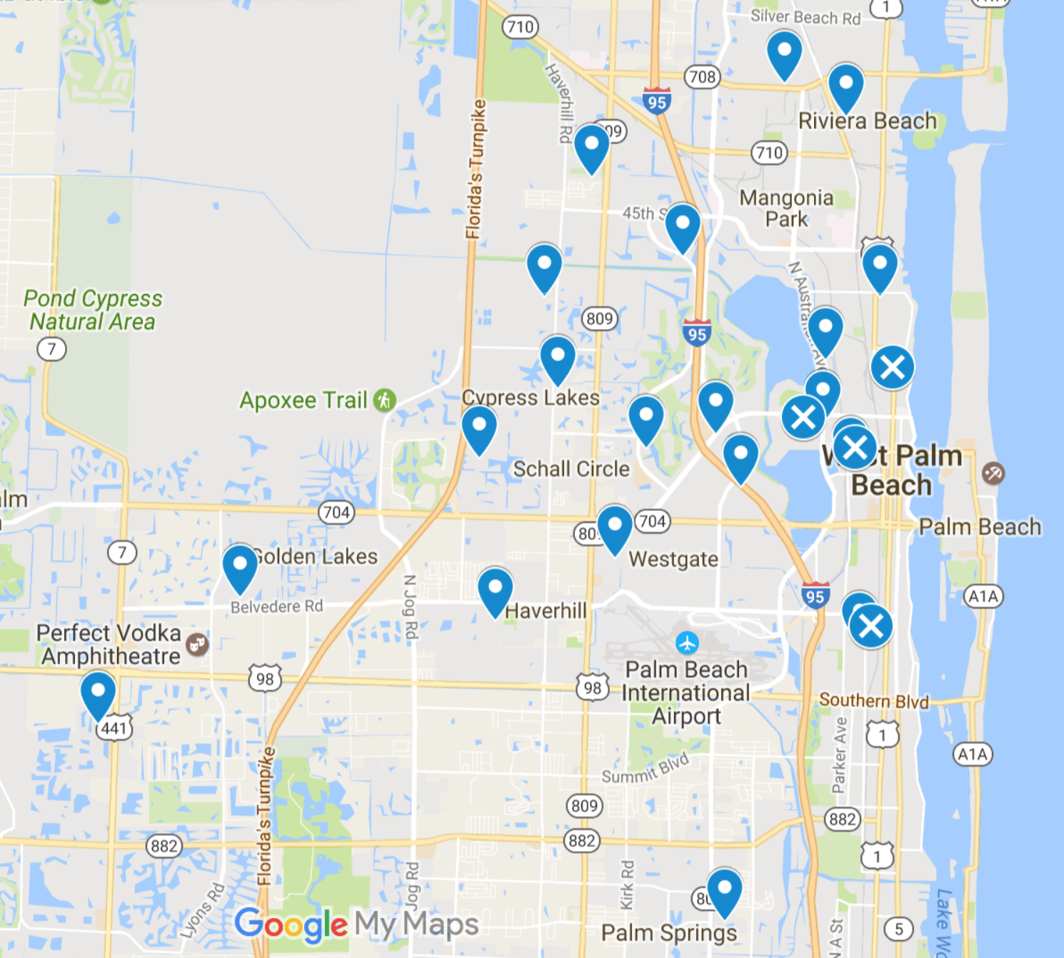
24 Reports of Flooding 5 Mention Poor Drainage 0 Reports of Flooded Cars
Notes:
Canterbury Dr. S: High tide flooding - poor draining system.
Snead Cir: Draining problems in low land areas.
21st St: High tide flooding, with or without severe rain, due to low land and poor drainage system.
6th St: Drainage.
Palm Beach Lakes Blvd: It rains and floods and the drainage is backed up.

Slide 21
Key Actions to Increase Climate Resilience
-Encourage Code Red Registration
-Keep Storm Drains Clear of Debris (822-2222)
-Make Sure Your Flood Insurance is Current
-Have an Emergency Plan
-Share Health and Climate Tips

Slide 22
-This project was funded in part by the Unitarian Universalist Fund for Social Responsibility.
-This project was funded in part by the UUFBR Endowment Fund.
-Development of the ReACT Tool Kit and the Pilot Project was funded by EPA Environmental Justice Grant
#EQ-00D35415-0 awarded to the Green Sanctuary Committee of the UU Fellowship of Boca Raton.

Slide 23
Rising Together: West Palm Beach Contributors to Success
1st UU Congregation of the Palm Beaches
Climate Leader Ramsay Laing
Social Action Chair Judy Bonner
Climate Action Coalition of South Florida
With thanks to Jerry Lind, Co-Founder of the Climate Action Coalition of South Florida, for his climate change presentation at the training session for the Outreach Team.
Mothers Against Murderers Association
President Angela Williams
Outreach Team
Georgie Dixon Cynthia Simmons
Tangenika Williams Teresa Shannon
Samella Burnett Katrina Scott
Government Officials
West Palm Beach Mayor’s Office of Sustainability Ralph T. Wall, Jr. MCP, CFM
Resilience and Climate Change Manager West Palm Beach Development Services Department
Penni Redford Management Analyst
Soil and Water Conservation District, Group 3 Board Member
Pat Edmonson

