Slide 1
Collaboratory Hernando
This project was funded in part by the Unitarian Universalist Fund for Social Responsibility.
This project was funded in part by the UUFBR Endowment Fund.
-Development of the ReACT Tool Kit and the Pilot Project was funded by EPA Environmental Justice Grant #EQ-00D35415-0 awarded to the Green Sanctuary Committee of the UU Fellowship of Boca Raton.
Notes:
Rising Together: Temperature, Water, Health and Strength is a project of UU Justice Florida that partners congregations with existing leadership in vulnerable communities to build climate resilience. In Hernando County, UU Church in the Pines partnered with Greater Love Outreach Ministries.

Slide 2
Building Climate Resilience
By the Numbers
Notes:
Climate Resilience is the ability of a community to respond to and recover from the impacts of climate change, so it can continue to function well as the climate changes.

Slide 3
1 Training Session 10 Trained Climate & Health Communicators
Pastor Yvonne Woods
Tawanna Baumgardner
TuKierre Bostic
Nikiya Brown
Adrian Castillo
Fahaeem Taalin Din
Wanda Graham
Octavia Peterson
Rashawn Smith
Nicki Washington
Jakaria Williams
Notes:
Pastor Yvonne Woods conducted a training session to train an Outreach Team.

Slide 4
6 Members of the Outreach Team + 4 Supporters
Special Thanks to these additional Team Members : Jakaria Williams Octavia Peterson Fahaeem Taalin Din
Adrian Castillo
Nicki Washington
Pastor Yvonne Woods 44 Surveys
Tawanna Baumgardner 10 Surveys
Wanda Graham 10 Surveys
Rashawn Smith 10 Surveys TuKierre Bostic 10 Surveys
Nikiya Brown 10 Surveys
Notes:
6 members of the Outreach Team conducted the survey by neighborhood canvass. Yvonne Hill and Tanya Matos not only conducted surveys, but also entered the survey data into the online Google form so it could be analyzed, and a report could be generated. (Members of the Outreach Team will now receive certificates recognizing their contribution to their community’s climate resilience.

Slide 5
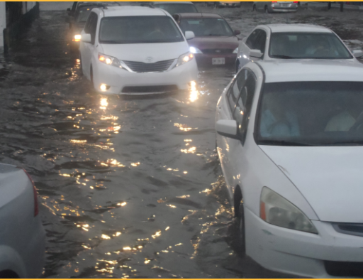
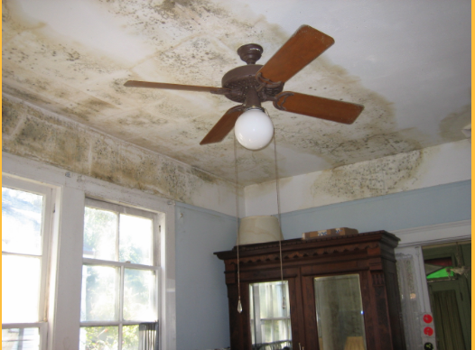
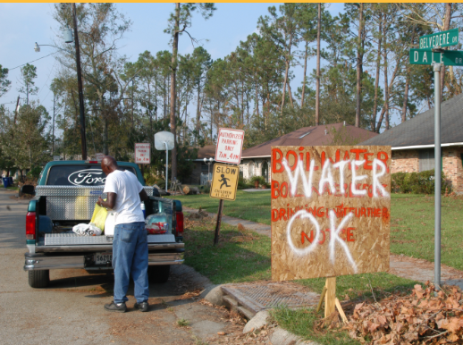
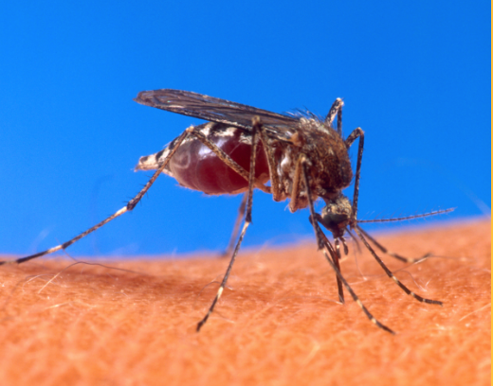
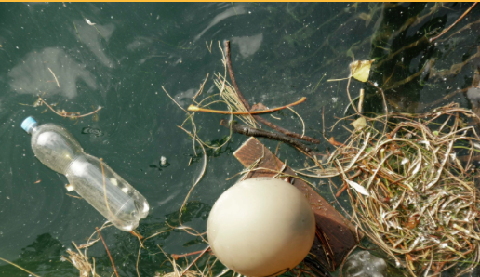
94 Households Educated
Mold
Water Contamination
Vector Borne Disease
Storm Preparedness
Heat Waves and
Poor Air Quality
Standing Water
Algae Blooms
Notes:
94 households were educated about the public health effects of climate change. Education included: storm preparedness, mold, water contamination, vector borne diseases, heat waves and poor air quality, standing water and algae blooms.

Slide 6
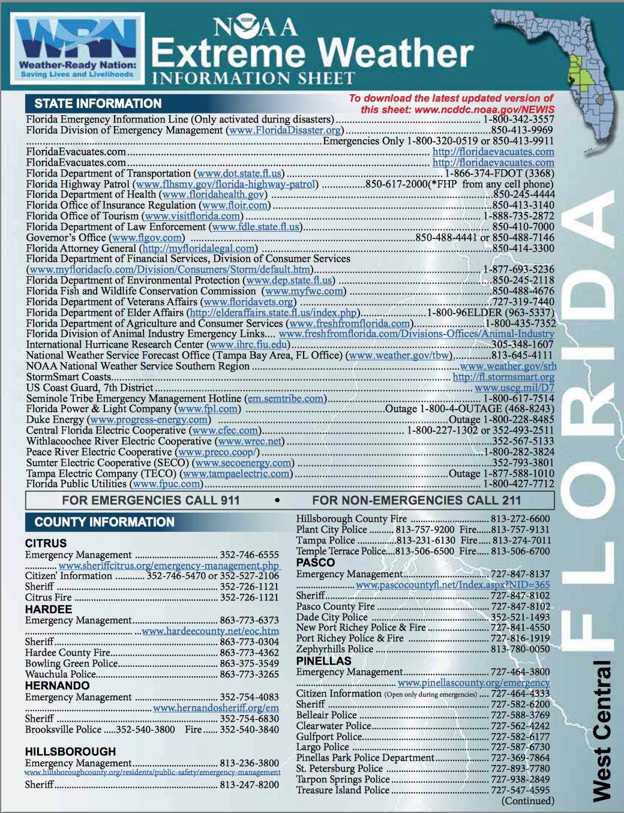
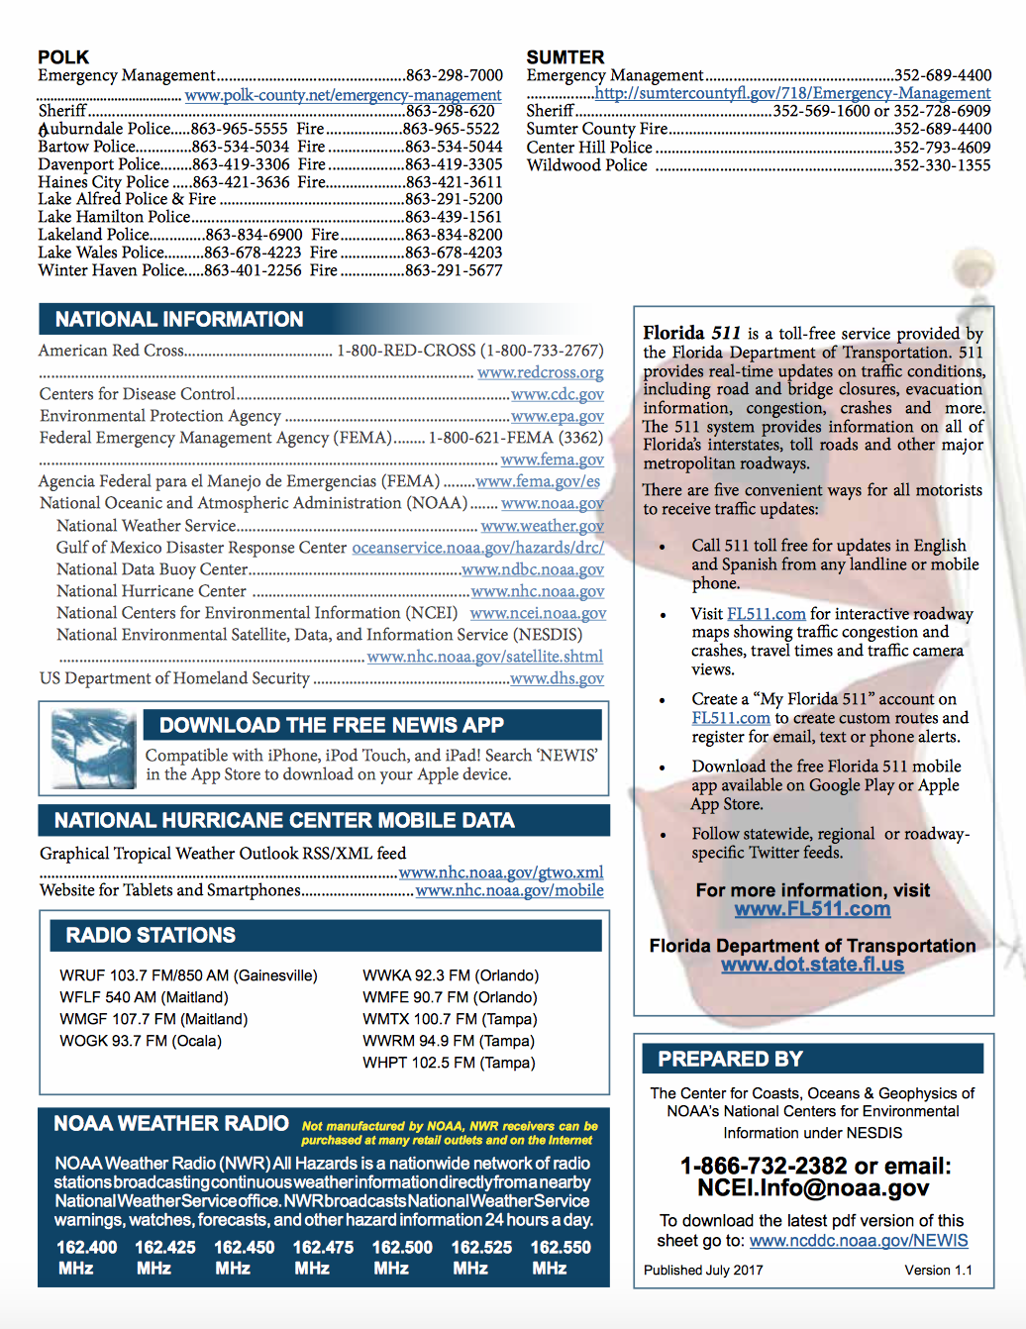
3 Outreach Fact Sheets
Notes:
The Outreach Team learned how to speak to their neighbors using 3 Outreach Fact Sheets that were vetted by the Hernando County Emergency Management Department

Slide 7
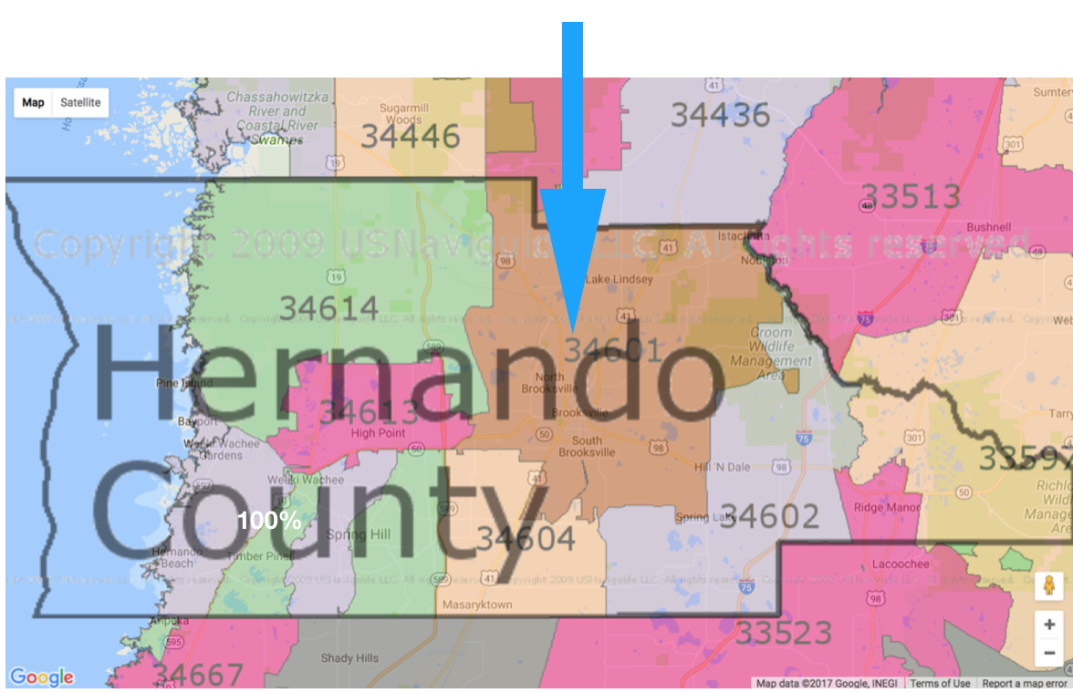
94 Households in Hernando County
All households were in Brooksville in zip code 34601.
Notes:
The Outreach Team educated people in 94 households in Brooksville in zip code 34601, and gave them the public health fact sheets.

Slide 8
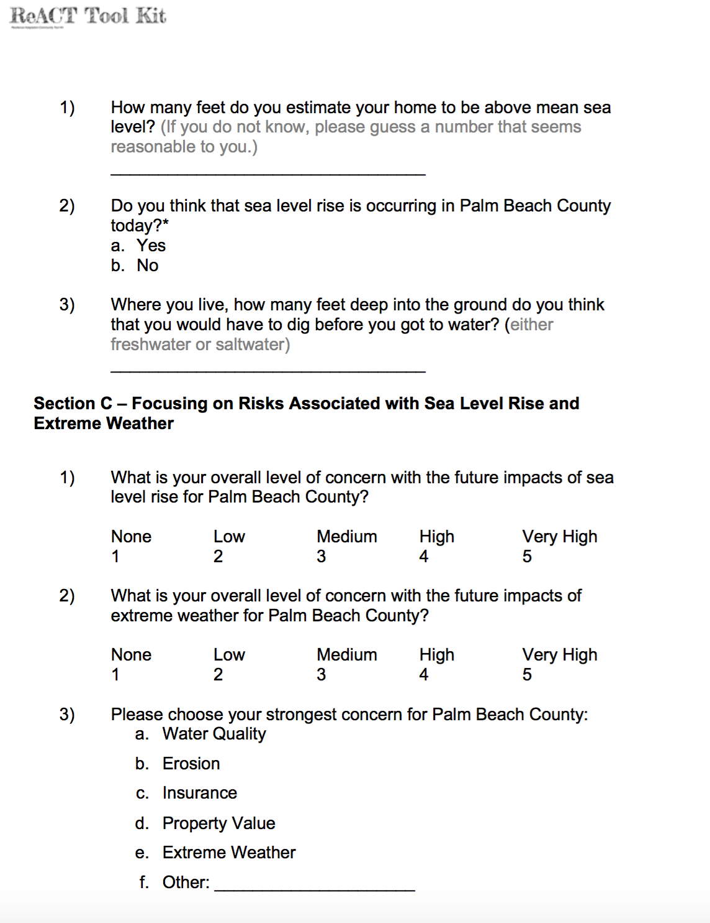
89 Household Surveys Analyzed
Notes:
Information from 89 household surveys with complete addresses was analyzed, and a final report was created.

Slide 9
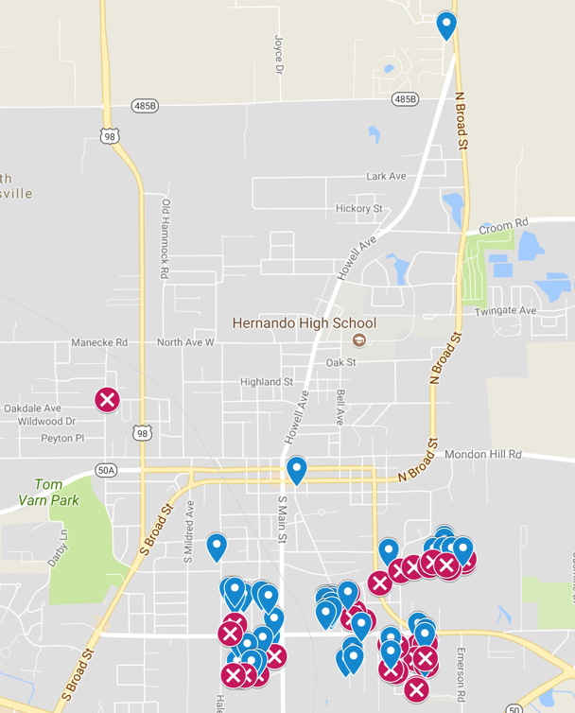
Interactive Mapping of 89 Surveyed Households
Notes:
All 89 surveyed households were mapped in an interactive Google map. To get the password to interact with the map, researchers can contact Jan Booher JJLBOOHER@comcast.net
Red icons with an X represent households that mentioned drainage problems in their comments.

Slide 10
Signing up for CodeRed
Notes:
Households are encouraged to be registered for Code Red. Google CodeRed as one word with no spaces to sign up to receive notifications about hurricanes and extreme weather.

Slide 11
What We Learned
Strong Concerns
Evacuation and Safety
Health
Extreme Weather and Flooding
Familiarity with Sea Level Rise

Slide 12
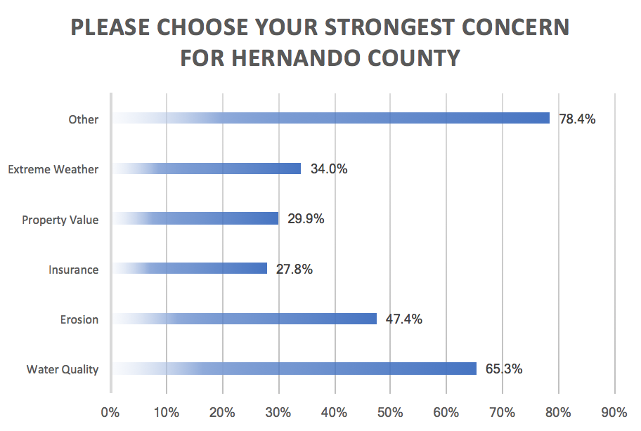
82% of the “Other Comments” were about:
Flooding,
Drainage, or
Mosquitos
Notes:
Respondents could select more than one concern in response to the question. 78.4% of respondents chose “Other” as their strongest concern for Hernando County. Flooding, drainage or mosquitos appearing in 82.0% of the “Other” comments. Water Quality (65.3%), Erosion (47.4%), Extreme Weather (34.0%), Property Value (29.9%) and Insurance (27.8%) were the remaining concerns, listed in decreasing order.

Slide 13
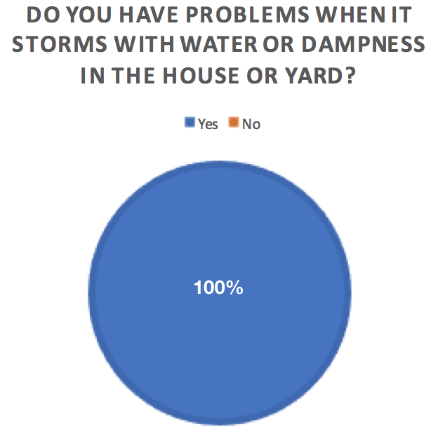
Notes:
100% of survey respondents said they have problems with water or dampness in their house or yard.

Slide 14
Evacuation and Safety
Flooding causing evacuation risks
Wildlife

Slide 15
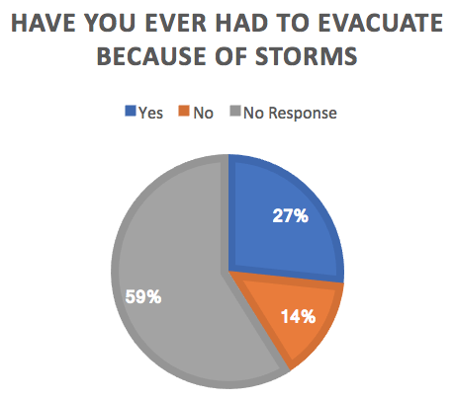
26.7% of Households Have Had to Evacuate
Wood Drive: flooding blocks the road out of the neighborhood
Hale Avenue: the road washes out and floods often
School Street: can not get out due to floodwaters
Notes:
27% of households have had to evacuate due to storms in the past. And residents on Wood Drive, Hale Avenue and School Street reported flooding that can make evacuation difficult.

Slide 16
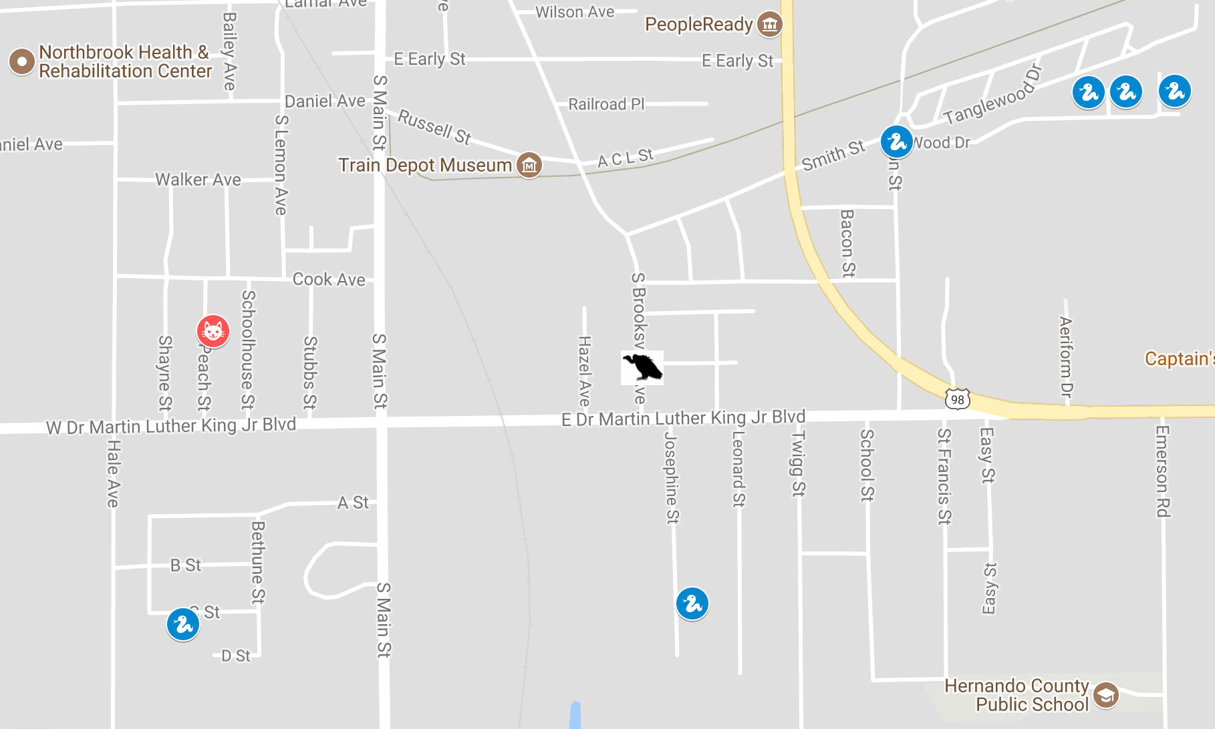
SNAKES
Wood Drive
C Street
Mae View Circle
Kings Circle
Josephine Street- water moccasins
STRAY CATS
Peach Street
BUZZARDS
S. Brooksville Ave.
Notes:
Residents on Wood Drive, C Street, Mae View Circle, Kings Circle reported snakes. A resident on Josephine Street reported the presence of water moccasins.
Stray cats were reported on Peach Street, and Buzzards were reported on S. Brooksville Ave.

Slide 17
Health
Mold, Asthma, water contamination, Respiratory Illness, Heat,
water quality

Slide 18
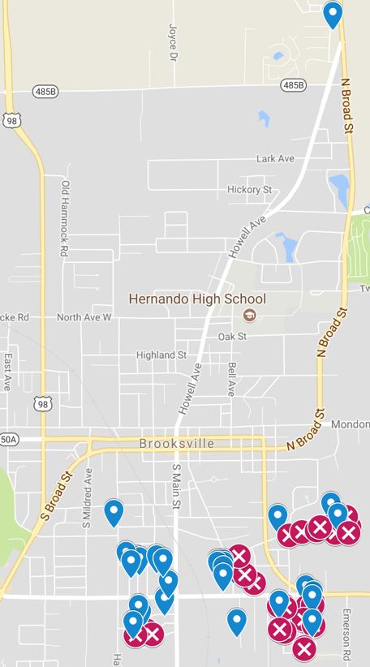
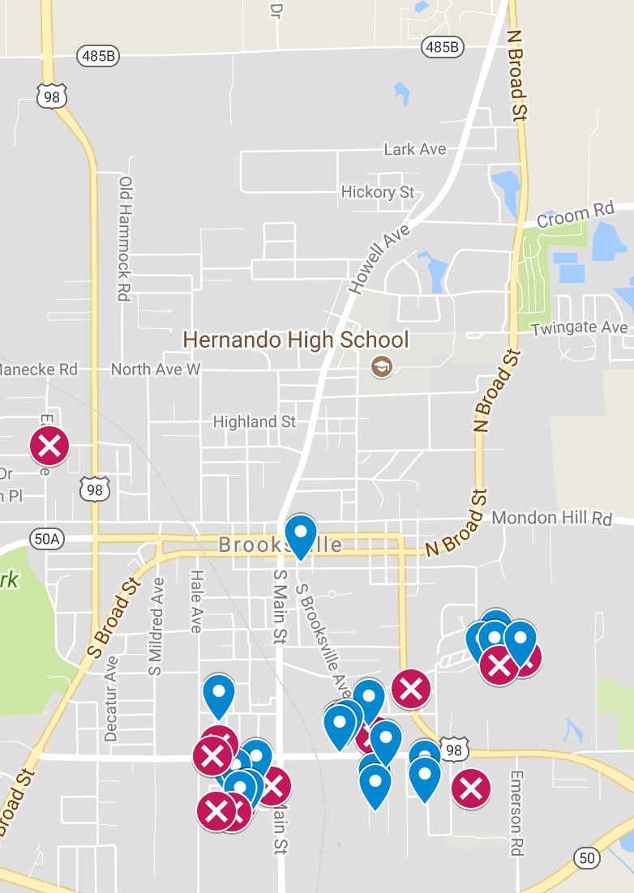
Mapping of 57 Households Voluntarily Reporting Mosquitos
Households Reporting
Mosquitos
Households
Not Reporting
Mosquitos
Legend
Blue - Households surveyed, but did not mention drainage issues
Red Icons with an X – households that mention both mosquitos and drainage in their comments
Notes:
All surveyed households were mapped in an interactive Google map. To get the password to interact with the map, researchers can contact Jan Booher JJLBOOHER@comcast.net
57 residents reported mosquitos and 28 of those voluntarily mentioned drainage. Mosquitos can carry diseases such as Zika virus and Dengue Fever.

Slide 19
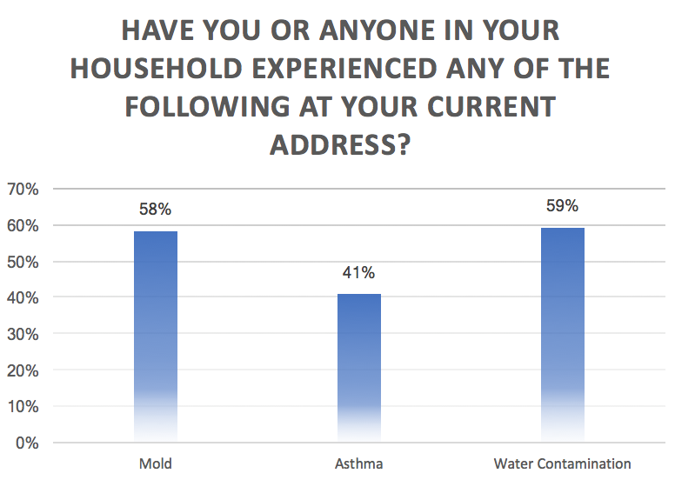
More than half of residents reported experiencing water contamination (59%) and mold (58%).
Prevalence of asthma among residents surveyed was 3.4 times the 2013 adult asthma prevalence in Hernando County.
Notes:
Slightly more than a half (58.2%) of residents surveyed reported experiencing mold at their current address. Asthma was reported by 40.8% of responding households, and 59.2% of households reported experience with water contamination. Florida CHARTS reports the Hernando County adult asthma prevalence in 2013 was 12.1%. This means that the prevalence of asthma among residents responding to the survey (40.8%) is 3.4 times the 2013 Hernando County prevalence. It is therefore important that 58.2% of households surveyed also experienced mold, because mold is a common asthma trigger.
“Adults Who Currently Have Asthma.” FLHealthCHARTS BRFSS Indicators Dataview Page, Florida Department of Health, Division of Public Health Statistics & Performance Management., www.flhealthcharts.com/charts/Brfss/DataViewer.aspx?bid=20.
"Common Asthma Triggers." Centers for Disease Control and Prevention. Centers for Disease Control and Prevention, 20 Aug. 2012. Web. 16 Feb. 2017. https://www.cdc.gov/asthma/triggers.html

Slide 20
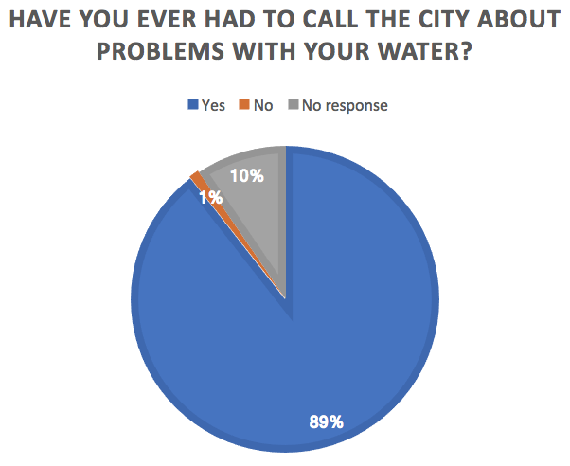
Notes:
89% of respondents have had to call the city about problems with their water.

Slide 21
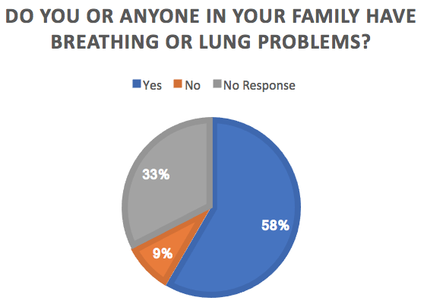
Notes:
Over half of respondents (58%) reported that someone in their household has breathing or lung problems. Since 40.8% of households reported that a household member had asthma, that means an additional 17.2% have respiratory problems other than asthma. Climate change causes deteriorating air quality, and those with existing respiratory illnesses are at risk.

Slide 22
Extreme Weather
Level of concern, flooding & drainage issues

Slide 23
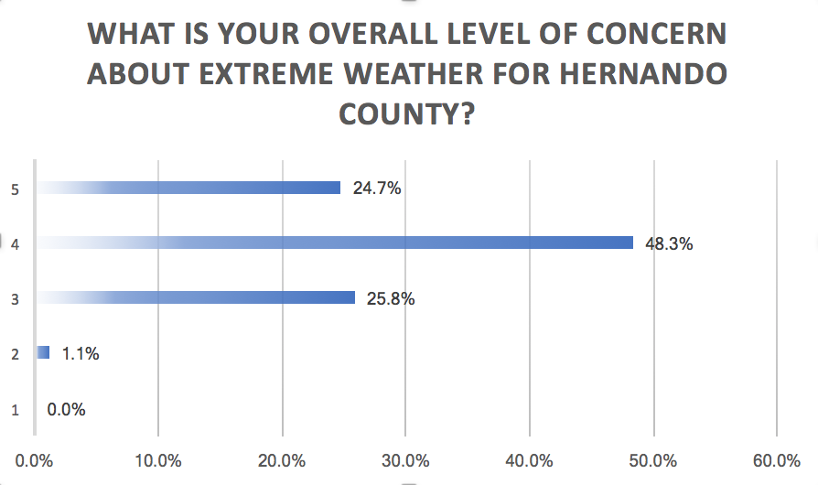
Residents chose from the following responses:
5-Very High
4-High
3-Medium
2-Low
1-None
Notes:
Almost half of survey respondents (48.3%) reported a high level of concern with extreme weather, followed by a medium level of concern (25.8%), and a very high level of concern (24.7%). No respondents indicated a lack of concern with extreme weather in Hernando County, and only 1.1% reported a low level of concern.

Slide 24
100% Have Experienced Impacts of Flooding
46% Reported
Drainage
Issues
Bethune Street
Clermont Street
Duke Street
Easy Street
Kings Circle
Mae View Circle
School Street
Wood Drive
Icons with an X – households that mention drainage in their comments
Notes:
46% of respondents mentioned that they had drainage problems in their comments. These homes were on Bethune St., Clermont Street, Duke Street, Easy Street, Kings Circle, Mae View Circle, School Street, and Wood Drive.

Slide 25
Sea Level Rise
Knowledge and Perception

Slide 26
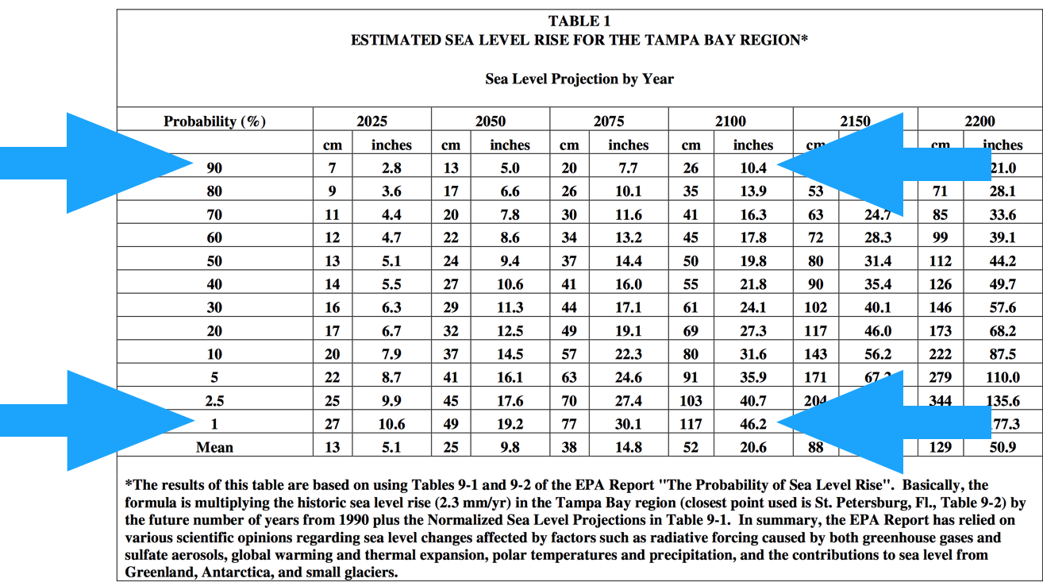
What humans do to reduce contributors to global warming will ultimately determine how much sea levels will rise over the long term.
Short term sea level rise is already “baked in.”
Tampa Bay can expect 5 inches of sea level rise in the next 33 years.
Notes:
What humans do to reduce greenhouse gases, sulfate aerosols and other contributors to global warming will determine how much sea level rise we will ultimately experience. The authoritative Tampa Bay estimate for sea level rise shows a range of 10.4inches to 46.2 inches by 2100.
SOURCE: “Sea Level Rise in the Tampa Bay Region.” Greenhouse Effect and Sea Level Rise, 14 Aug. 2006, www.tbrpc.org/mapping/pdfs/sea_level_rise/Tampa%20Bay%20-%20Sea%20Level%20Rise%20Project%20Draft%20Report%20without%20maps.pdf.

Slide 27
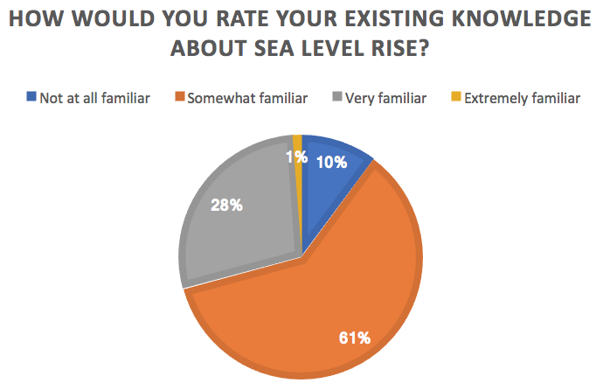
Notes:
Fully 60.7% of respondents reported that they were somewhat familiar with sea level rise. And 28.1% reported that they were very familiar with sea level rise. Only 1.1% of respondents reported that they were extremely familiar with sea level rise, and 10.1% reported that they were very familiar with it, indicating a need for further outreach and education.

Slide 28
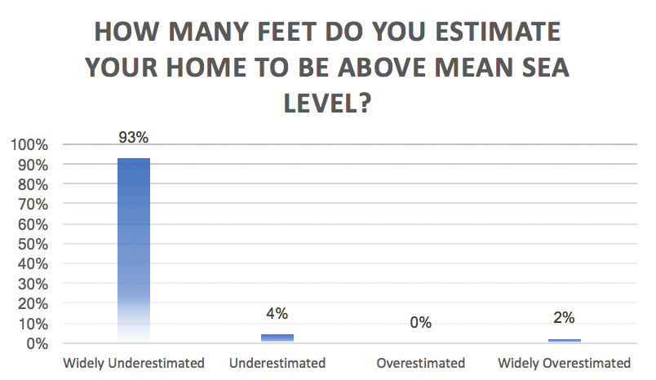
Residents’
Estimated Elevations
2 ft - 600 ft
_______
Actual Elevations
94.84 ft - 188.33 ft
Notes:
Most residents widely underestimated their elevation (93.3%) or underestimated it (4.5%). Zero respondents overestimated their elevation, and 2.2% overestimated it. This means that most people who took the survey overestimated their risk from sea level rise based on elevation alone. The range of reported estimates of elevation was from 2 ft to 600 ft above sea level, and the actual range of elevations was 94.84 ft to 188.33 ft. Education about sea level rise should therefore include basic information about local topography so residents can understand the implications of sea level rise projections.

Slide 29
Key Actions to Increase Climate Resilience
Report drainage and flooding issues
Request Mosquito Control
Make Sure Your Flood Insurance is Current
Have an Emergency Plan
Notes:
Residents need to advocate for stormwater management plan review and mosquito control in their neighborhoods. The report created by this survey will help to communicate the extent of the problem to elected officials and staff. Individual actions that people can take are to make sure their flood insurance is current and to have an emergency plan.

Slide 30
Rising Together: Hernando County 2017 Contributors to Success
UU Church in the Pines
Climate Leaders Ellen Paul
Irene Keim
Collaboratory Hernando
Facilitator Chaplain Robert Keim
Greater Love Outreach Ministries
Community and Clerical Leadership
Rev. Yvonne Woods
Outreach Team
Government Officials
Hernando County
Emergency Management
Pastor Yvonne Woods
Tawanna Baumgardner
Wanda Graham
Rashawn Smith
TuKierre Bostic
Nikiya Brown
Outreach Team Supporters
Jakaria Williams Octavia Peterson Fahaeem Taalin Din
Adrian Castillo
Nicki Washington

Slide 31
Collaboratory Hernando
This project was funded in part by the Unitarian Universalist Fund for Social Responsibility.
This project was funded in part by the UUFBR Endowment Fund.
-Development of the ReACT Tool Kit and the Pilot Project was funded by EPA Environmental Justice Grant #EQ-00D35415-0 awarded to the Green Sanctuary Committee of the UU Fellowship of Boca Raton.
Notes:
Rising Together: Temperature, Water, Health and Strength is a project of UU Justice Florida that partners congregations with existing leadership in vulnerable communities to build climate resilience. In Hernando County, UU Church in the Pines partnered with Greater Love Outreach Ministries.

