Slide 1
King Tide Flood Monitoring in Shorecrest
Depth, salinity and presence or absence of coliform bacteria were measured at some locations in Shorecrest in September and October.

Slide 2
October 7th King Tide Depth ____ Plan Your Commute
Notes:
We need more people to do sampling and crowd sourced data uploading because only a fraction of the flooded area is being monitored.

Slide 3
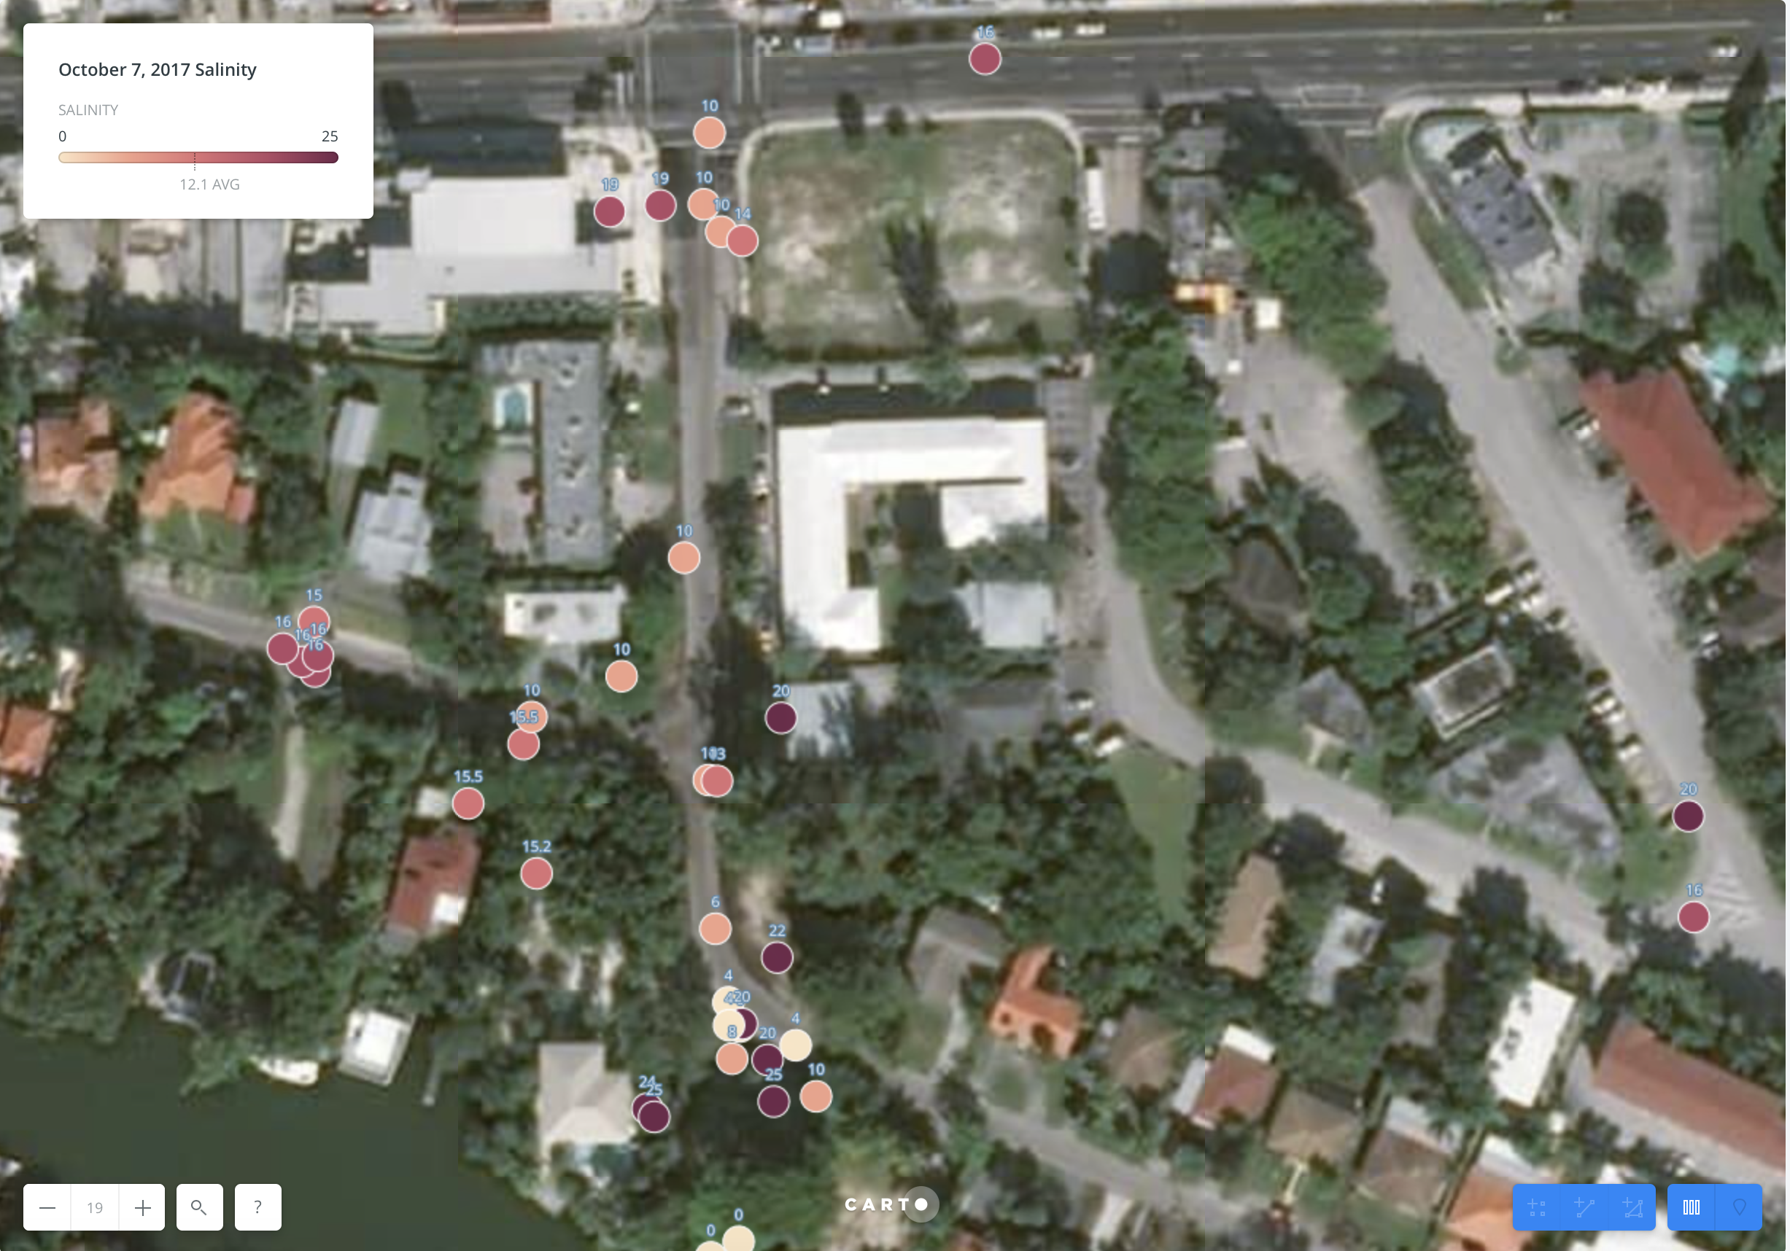
October
7th
King Tide
Salinity
___
Reroute to Protect Your Car

Slide 4
Coliform Sampling
Coliform is a rod-shaped bacteria which is always present in the digestive tract of warm-blooded animals, including humans. Coliforms are found in human and animal waste, and are also found in water, plants and soil.

Slide 5
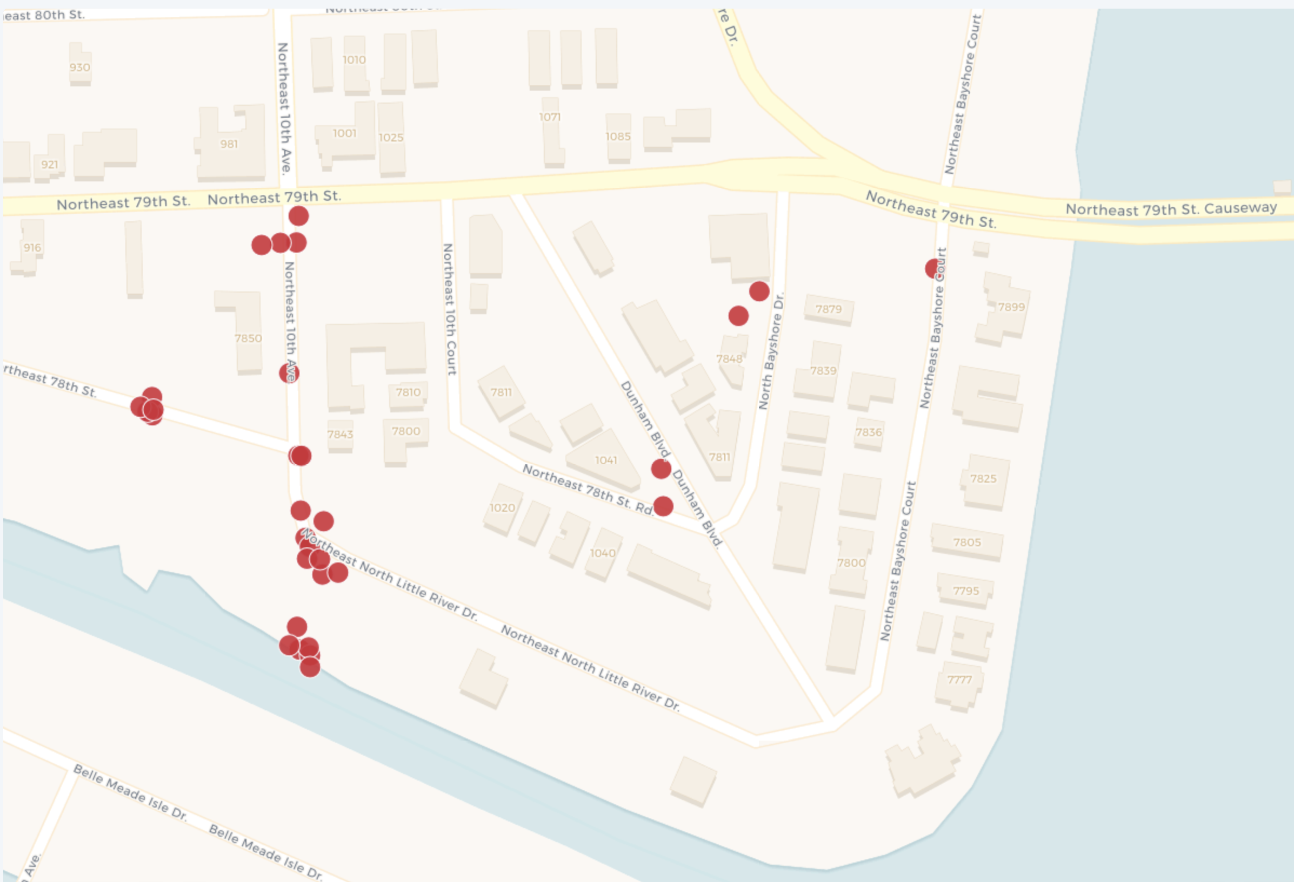
Where
Water
Was
Sampled for Coliform

Slide 6
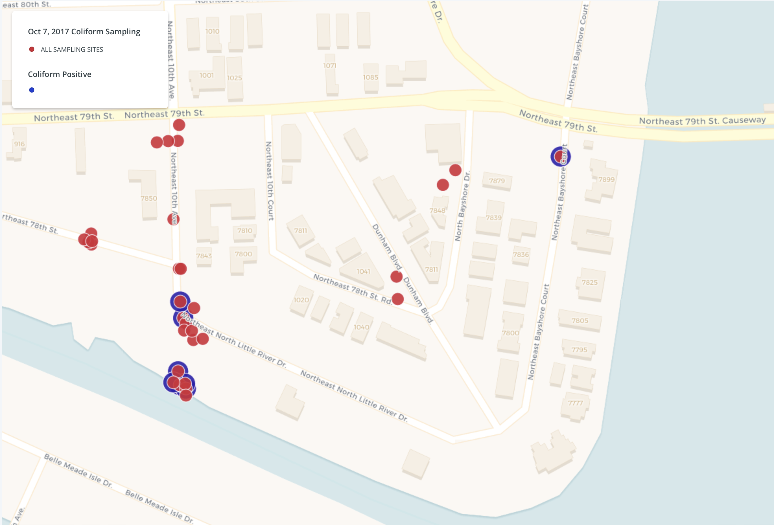
Positive
Coliform
Samples

Slide 7
The Parking Challenge in Shorecrest

Slide 8
City of Miami
Shorecrest residents can request a Parking Permit at the Upper East Side NET Office.

Slide 9
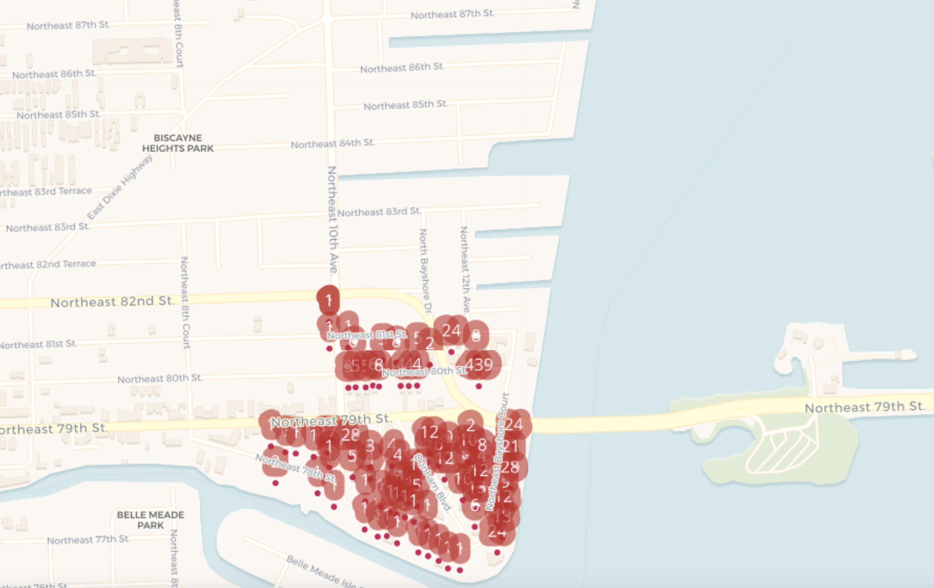
The 137 parcels on the list are clustered
in the southeast corner of Shorecrest

Slide 10
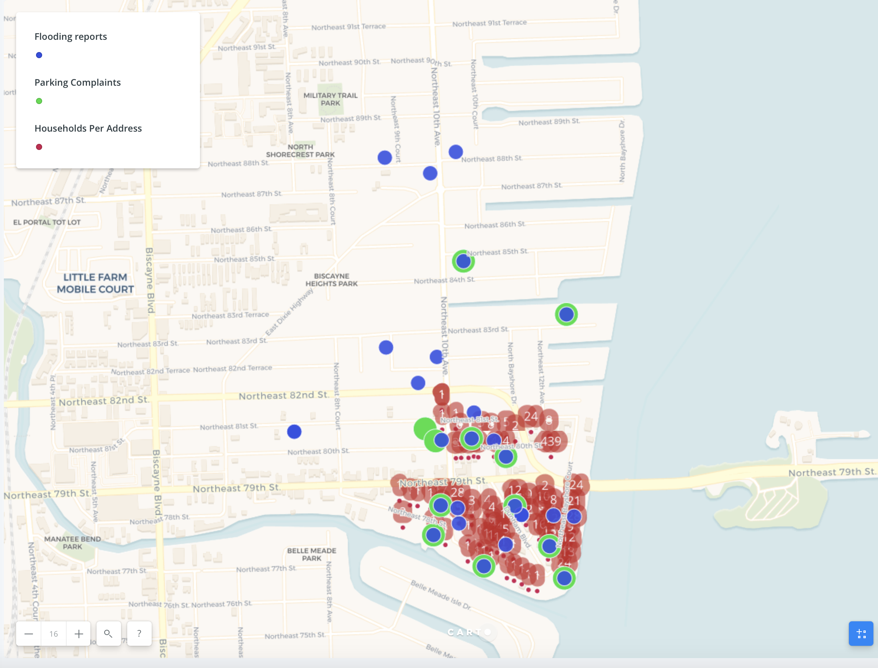
31
Parcel Addresses
_____
14
Parking Complaints
_____
50
Household Flooding Reports
_______
Flooding and Parking Reports extended north and west of the area receiving permits.

Slide 11
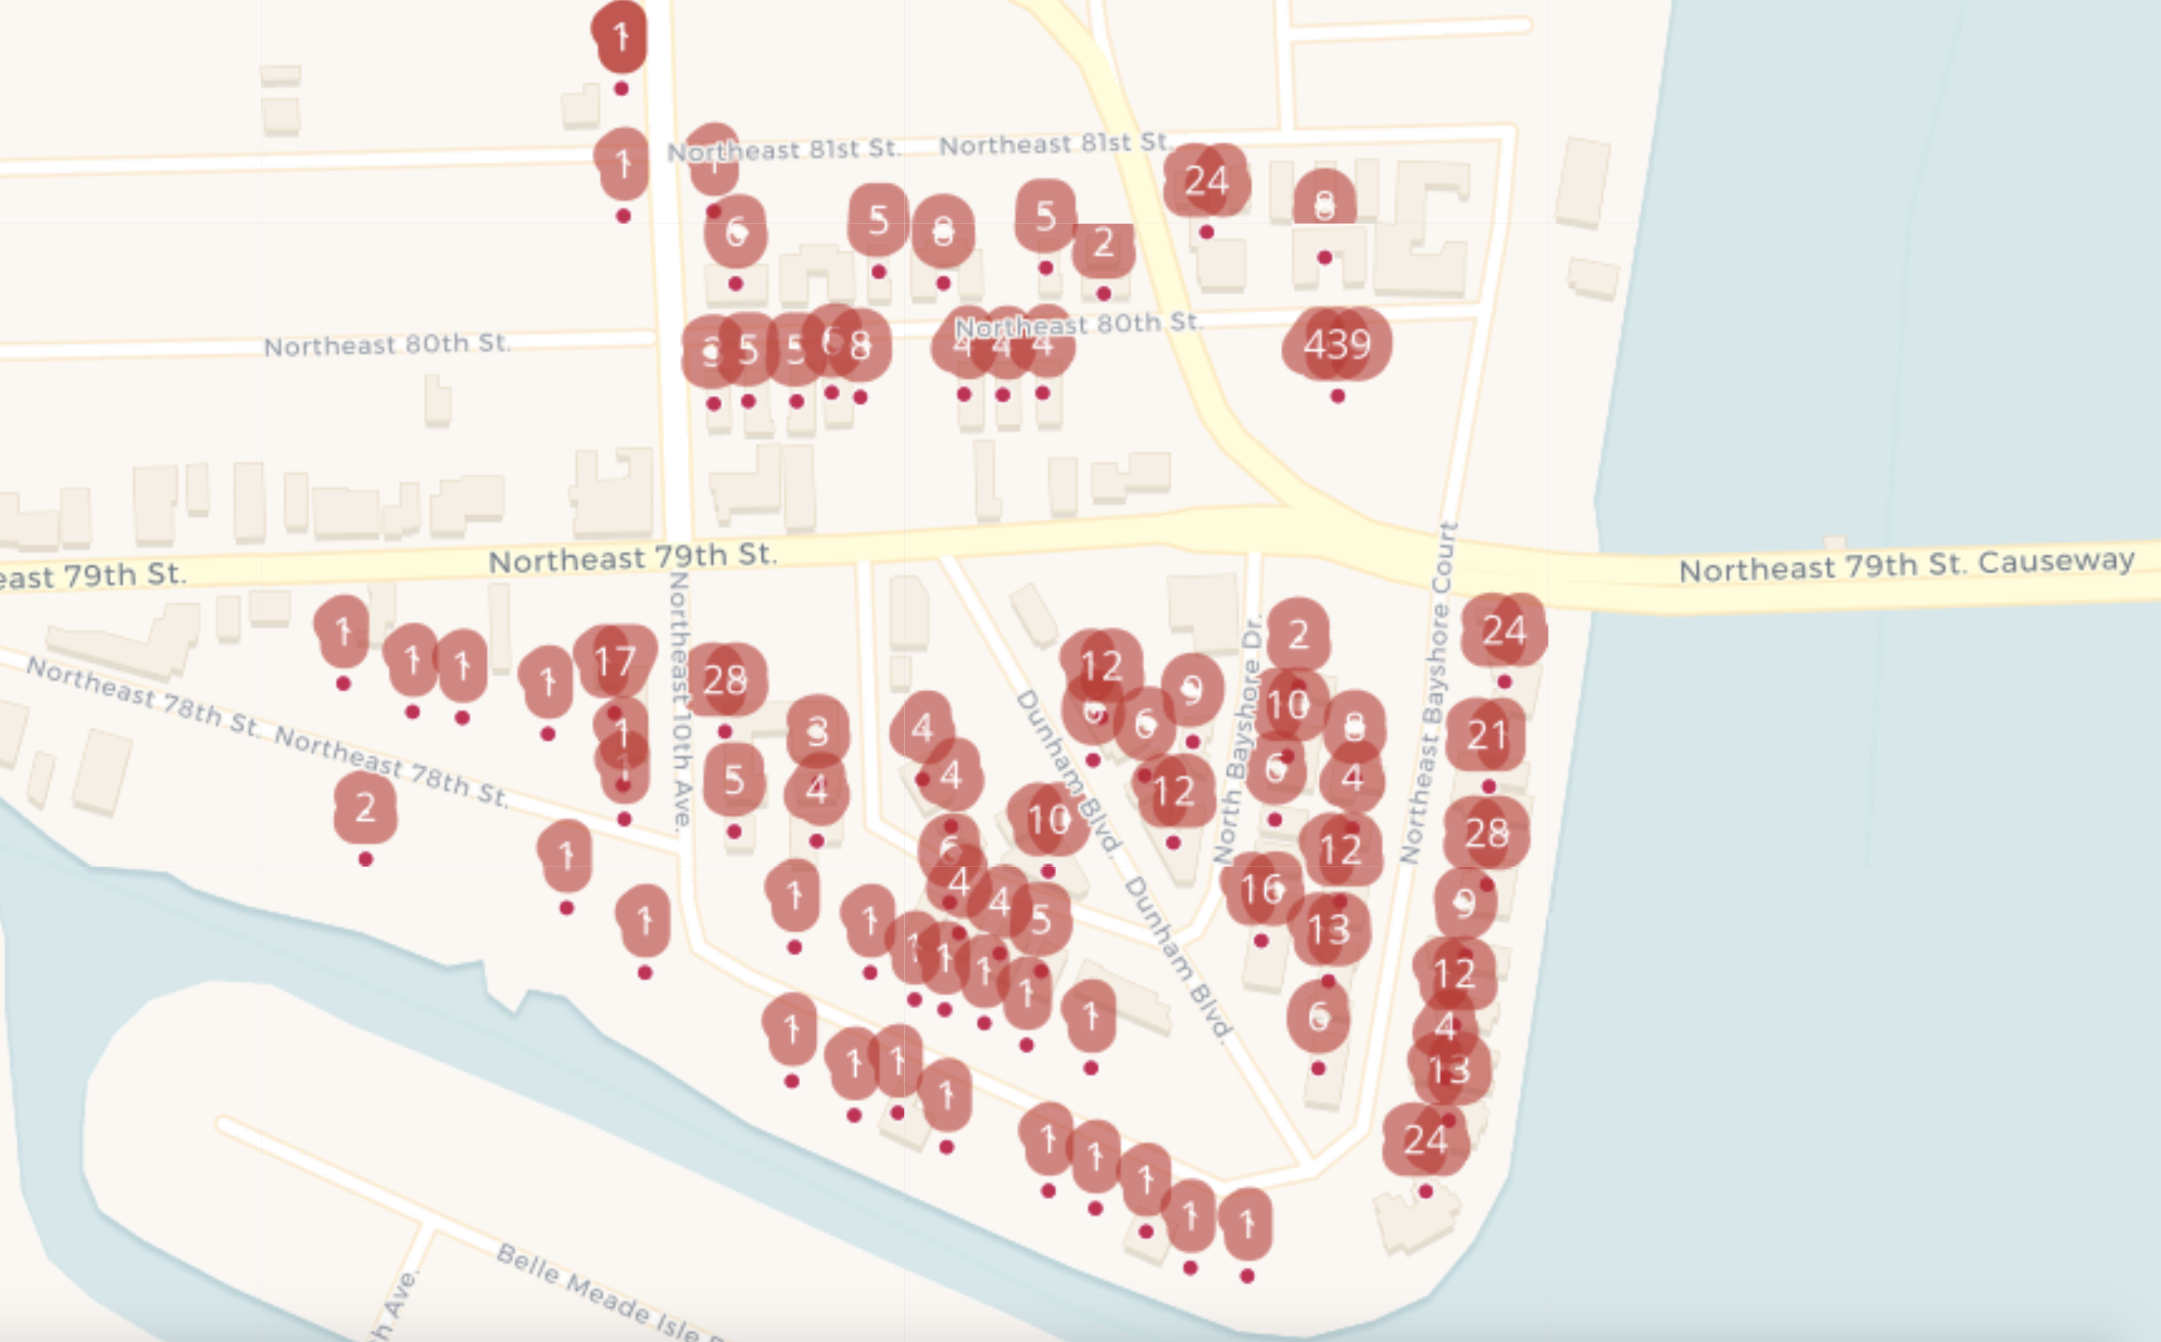
Included Parcels:
33
Single Family Homes
450
Condo Units or Apts
1 Fire Station
1 Elementary School
2 Businesses
28 Vacant Lots
The 439 units in Seacrest Club Apts. Are excluded due to elevated parking.

Slide 12
Symptoms Reported
34 Survey Respondents reported experiencing symptoms the day of flooding or within 3 or 4 days after flood events in Shorecrest.
No causal relationship can be determined from this data, but it can give an indication of future potential areas of inquiry.

Slide 13
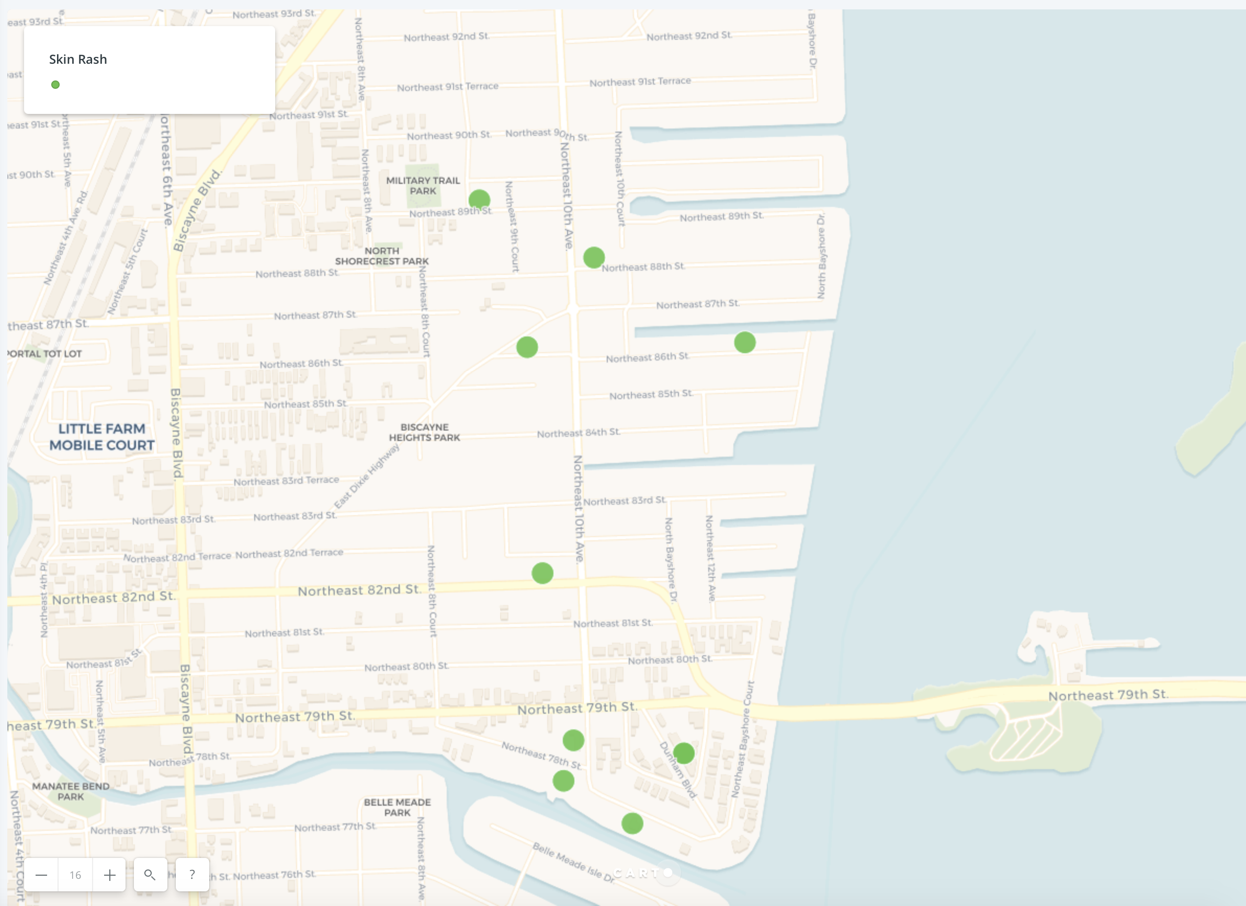
Skin
Rash
Reported
from
Little River
Up to
NE 89 St.

Slide 14
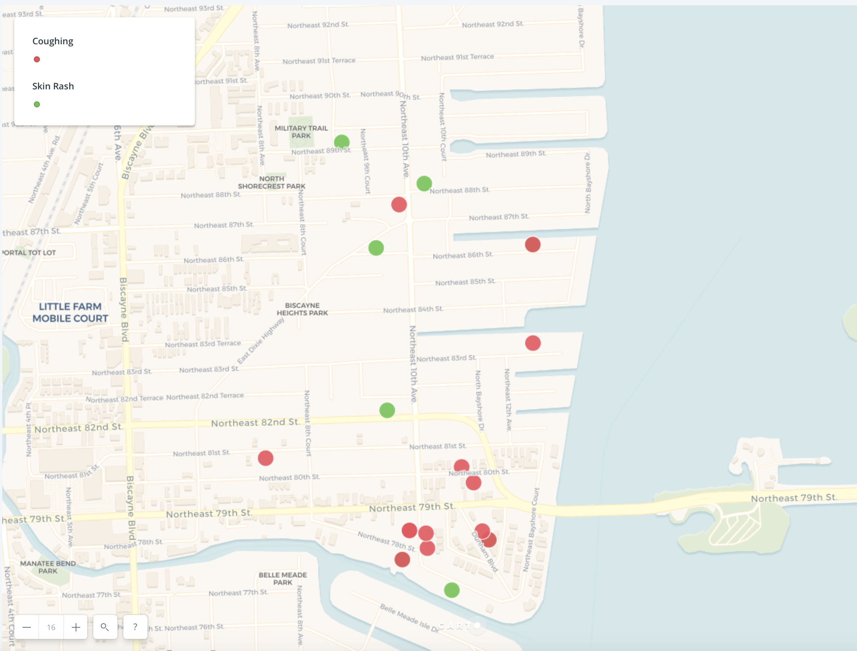
Coughing
Reported
From
Little River
Up to
NE 88 St.

Slide 15
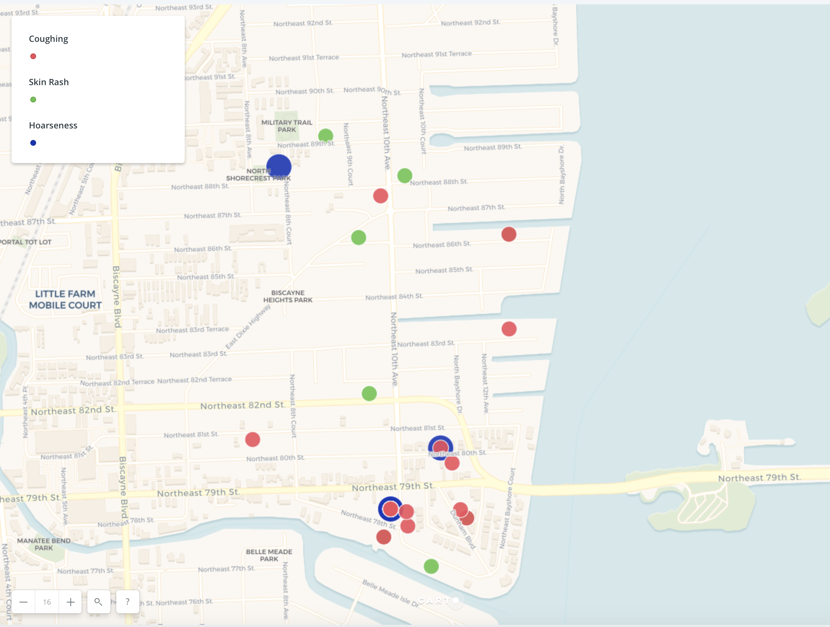
Hoarseness
Reported
From
Little River
Up to
89th St.

Slide 16
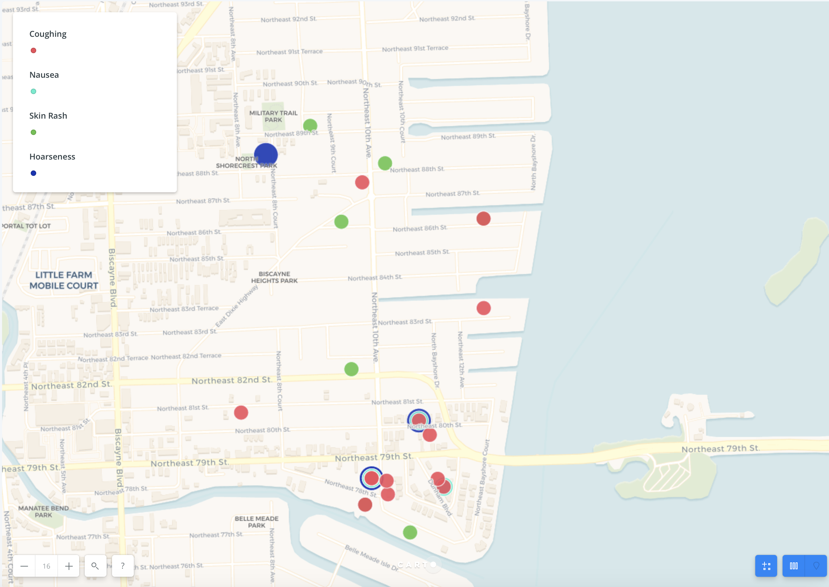
Nausea
And
Hoarseness
Appear
in
Households
Reporting
Multiple
Symptoms

Slide 17
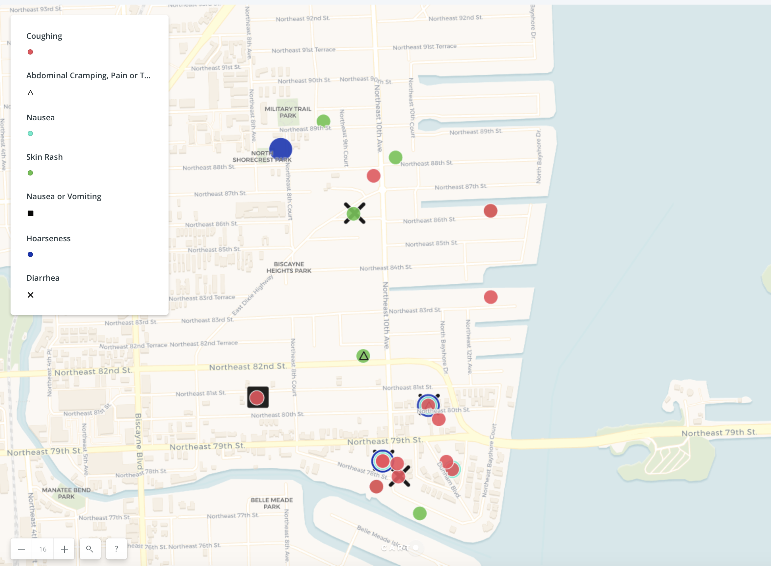
Vomiting,
Abdominal
Cramping,
And
Diarrhea
Also
Occurred
in
Multi-Symptom
Households

Slide 18
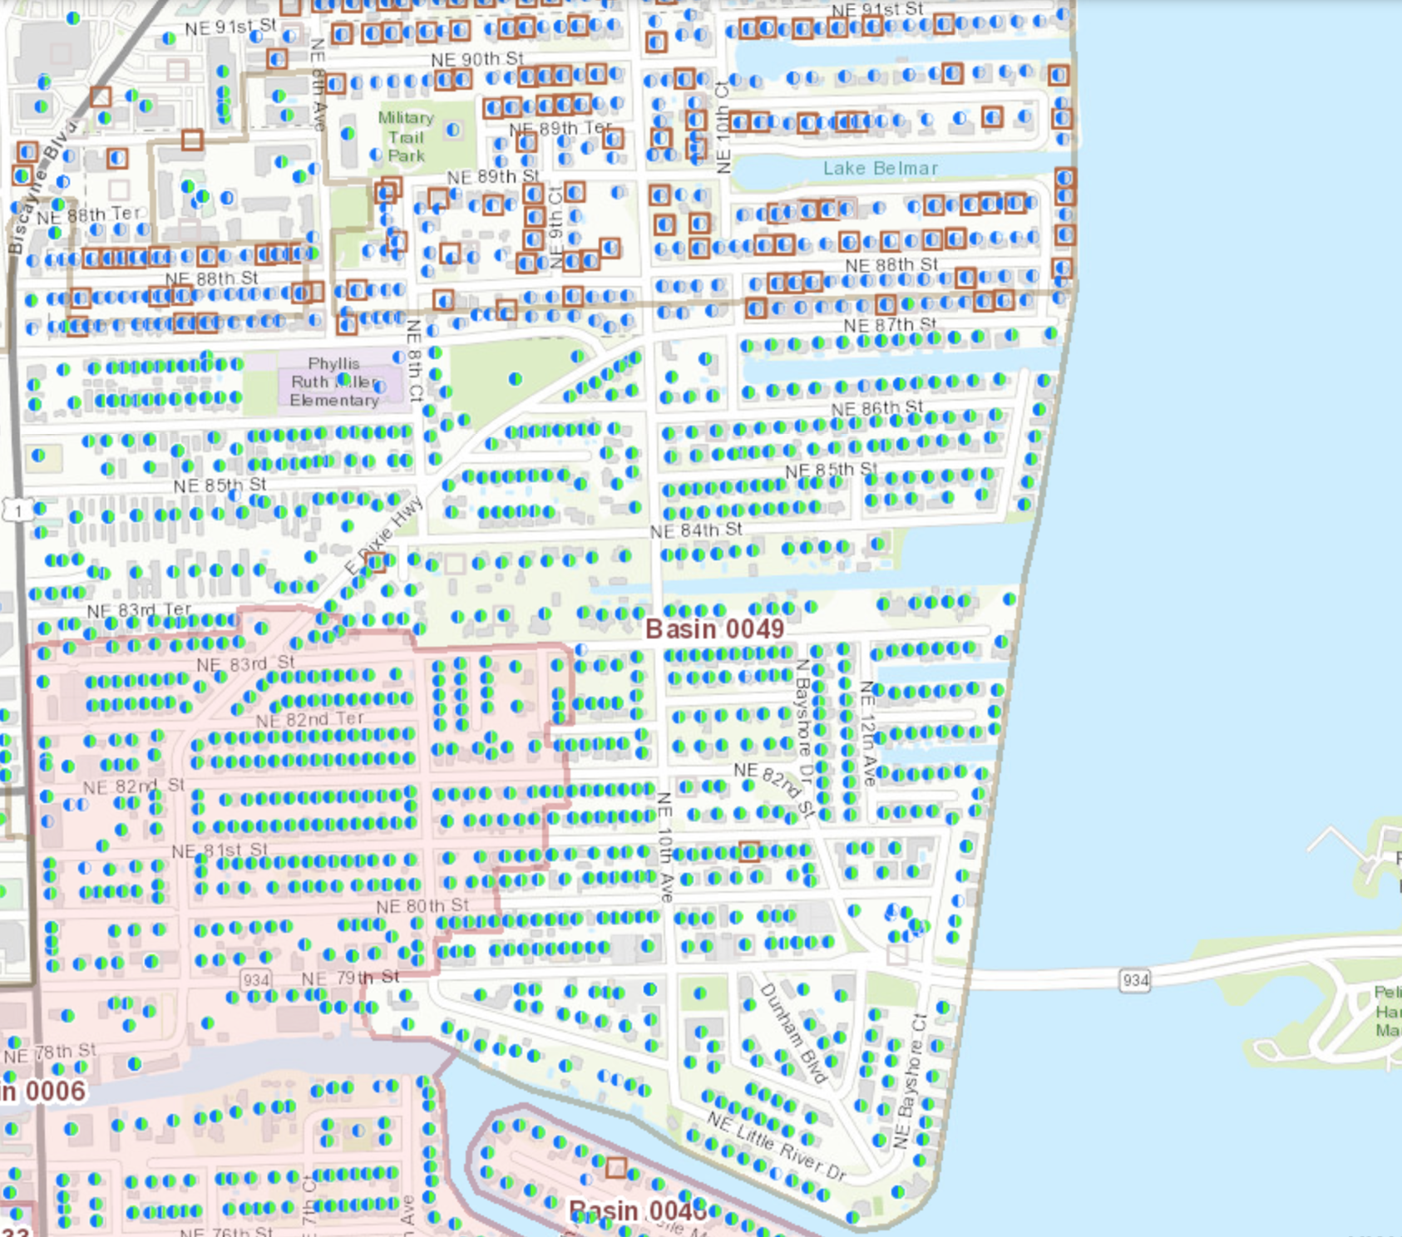
North of NE 87 St there are many septic tanks.

Slide 19
Contributors to Rising Together: Shorecrest + Community Health Mapping 2017 Project Success
National Library of Medicine/NIH
John Scott
Kurt Menke
UU Justice Florida
Jan Booher
New Florida Majority
Nancy Metayer
David McDougal
Andrea Mercado
FIU Sea Level Rise Solutions Center
Dr. Tiffany Troxler, Director
Dr. Susan Jacobson, Dept. of Communication + Journalism
SEYM Quakers
Dr. Beverly Ward
John Heimberg
Shorecrest Community Leaders
Outreach Team Members
LaTosha Robinson
Carlton Dale
Bereatha Howard
City of Miami Office of Resilience and Sustainability
Jane Gilbert, Chief Resilience Officer
Alissa Farina, Special Projects Manager
Ajani Stewart, Environmental Program Manager
Miami Dade County
Katherine Hagemann
Sustainability Initiatives Coordinator
Daisy Torres
President Shorecrest HOA
Eric Bason
Rising Together Organizer
Project Director Janice T. Booher, MS
Director, UU Justice Florida Climate Resilience Ministry

Slide 20
4 Key Actions to Increase Climate Resilience
Sign up with the NET Office to Receive Emails about City Resources for Flooding
Sign Up for Miami Dade Emergency Alerts
Register for the EEAP if you need Evacuation Assistance
Get Engaged in the Adaptation Dialogue!

Slide 21
Rising Together: Shorecrest, Miami + Community Health Mapping Initiative 2017
This project was made possible by our funders:
National Library of Medicine/NIH
UU Fund for Social Responsibility
UUFBR Endowment Fund
And generous in-kind support from:
FIU Sea Level Solutions Center
New Florida Majority
SEYM Quakers
Development of the ReACT Tool Kit and the Pilot Project was funded by EPA Environmental Justice Grant
#EQ-00D35415-0 awarded to the Green Sanctuary Committee of the
UU Fellowship of Boca Raton.
Quakers
Notes:
Rising Together: Shorecrest, Miami + Community Health Mapping Initiative 2017 is the 8th Rising Together project in a coastal community in Florida. It is at its core a faith initiative to build support for communities that are adapting to climate change. This initiative had two components: first: education of residents about the impacts of climate change in their community coupled with a survey of resident concerns and experiences, and second: Technical support for the community to be able to collect data and tell the story of the community’s experience visually in maps.

