Slide 1
Practicing Resilience
Translating academic understanding
to address specific community needs
in SE Florida
June 8, 2018
Janice T. Booher, MS
FAU Climate Resilience Seminar
Notes:
1. Public health risks can be addressed as health and safety concerns, but disaster resilience is more robust.
2. Residents need to know basic health and safety information to take individual action, but to be effective at building community resilience both policy context and community building are needed.
3. The state of environmental health in low income communities is degraded, and must be understood, even if not addressed directly, as must the overlapping challenges of scarce resources.

Slide 2
Translation
Academia→ Planning Community->
Municipal Staff->Elected
Officials->Community Groups->
Residents (English, Spanish, Creole)

Slide 3
If you don’t involve all the right people, you make a camel...
Notes:
This example shows that well-meaning efforts to address climate change and build resilience by design, based on poorly translated academic guidance, can cause problems.

Slide 4
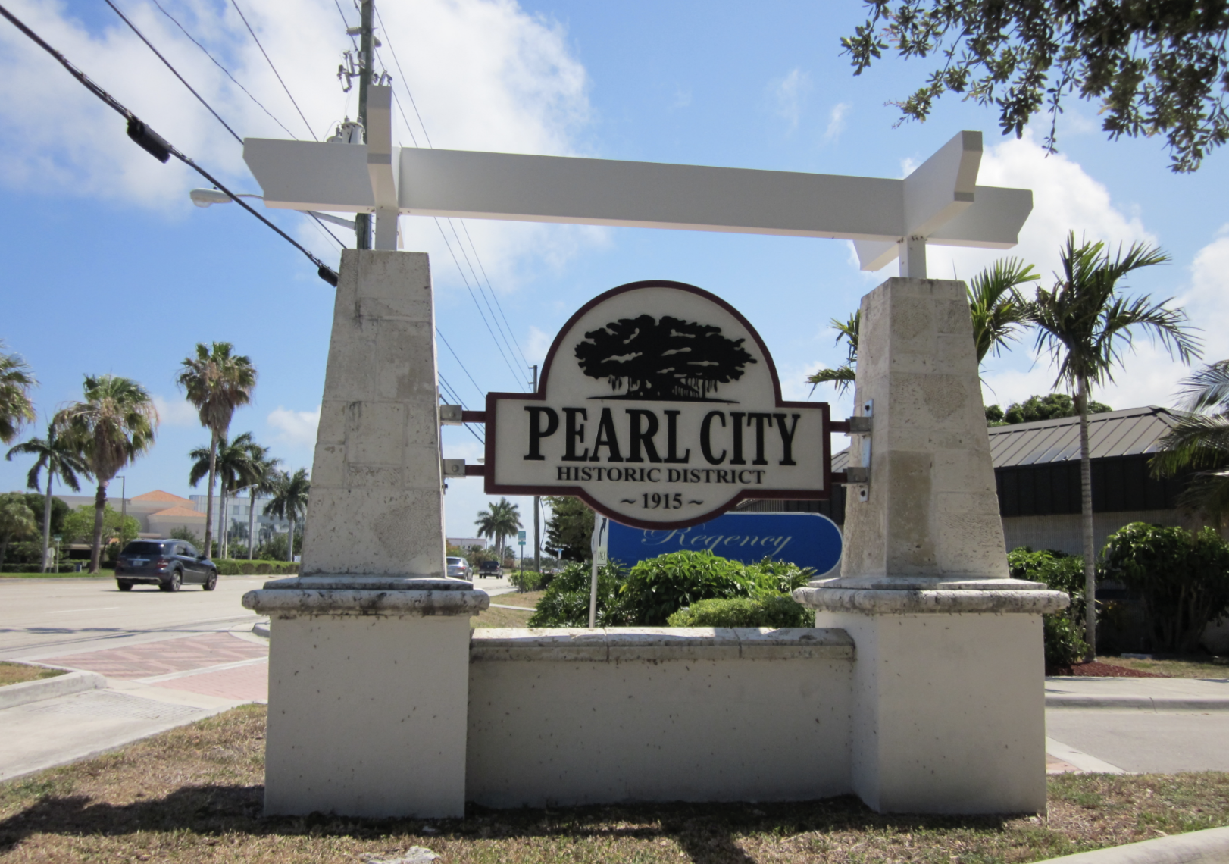
We don’t have any climate change problems here...What’s that?

Slide 5
Notes:
Residents were trained to survey their neighbors.

Slide 8
Residents Say
The trees need to be trimmed regularly because we can’t walk on the sidewalk without trees hitting us on the head.
The debris from the trees falls in the street during storms and blocks the storm drains.
Our cars and homes flood.
We didn’t ask for trees. “Nobody asked me if I wanted a tree there.”

Slide 9
City Says
Office of Sustainability: The trees sequester carbon. If we trim them, the branches will release greenhouse gases in the landfill.
Public Utilities: No one has ever reported a problem with flooding from that community.

Slide 10
Incomplete Translation of Academic Findings
The primary costs associated with planting and maintaining trees or other vegetation include purchasing materials, initial planting, and ongoing maintenance activities such as pruning, pest and disease control, and irrigation.

Slide 11
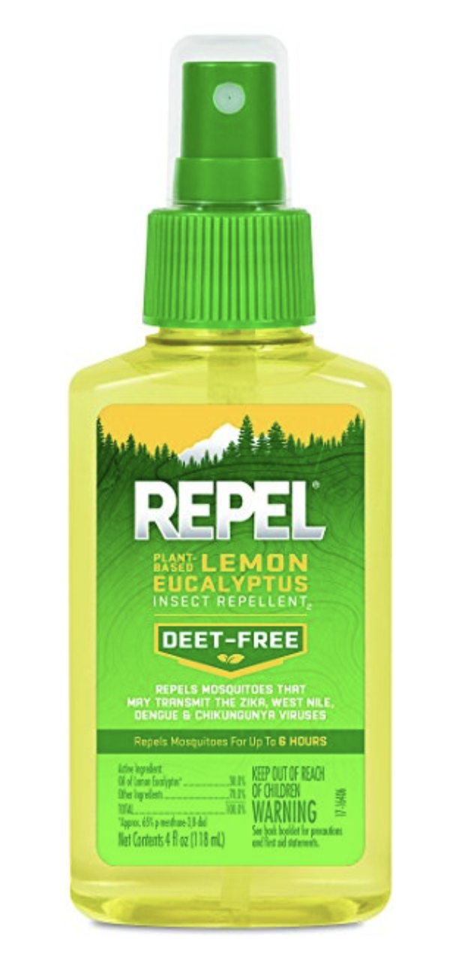
Residents value actionable health & safety information
About
$5
at
Walmart

Slide 12
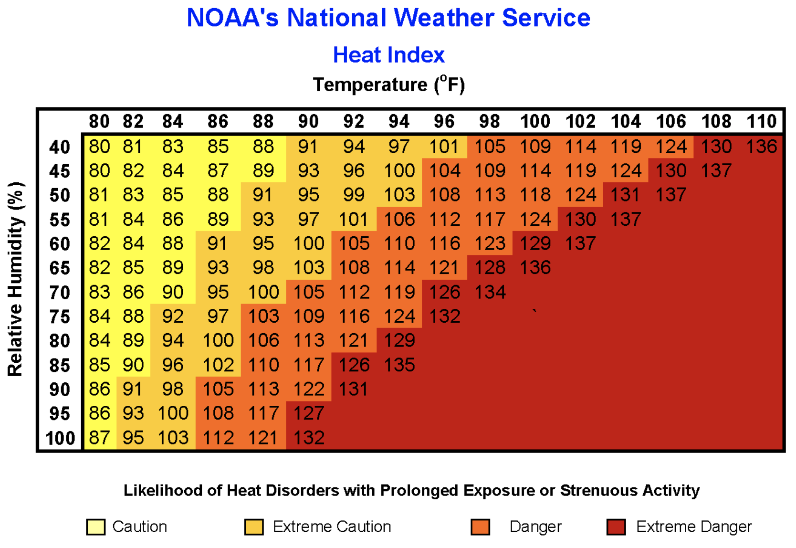
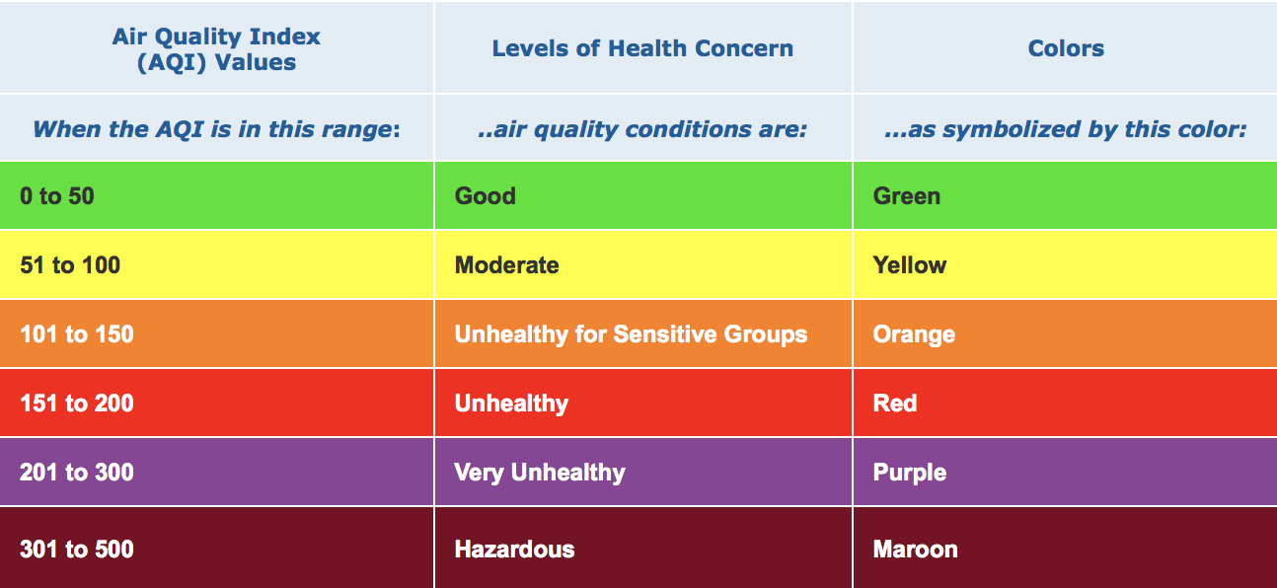
Heat waves & Poor Air Quality
Notes:
Increased concentrations of greenhouse gases increase temperatures, making heat waves more frequent. Increased temperatures correlate with elevated ozone and nitrogen oxide concentrations in the air. Without cooling rains, particulate matter accumulates in the air in urban areas. Ozone and particulates are strong respiratory irritants. When there are heavy warm rains, plants bloom earlier, have longer bloom periods, and produce more pollen. This impacts allergy sufferers and asthmatics.

Slide 13
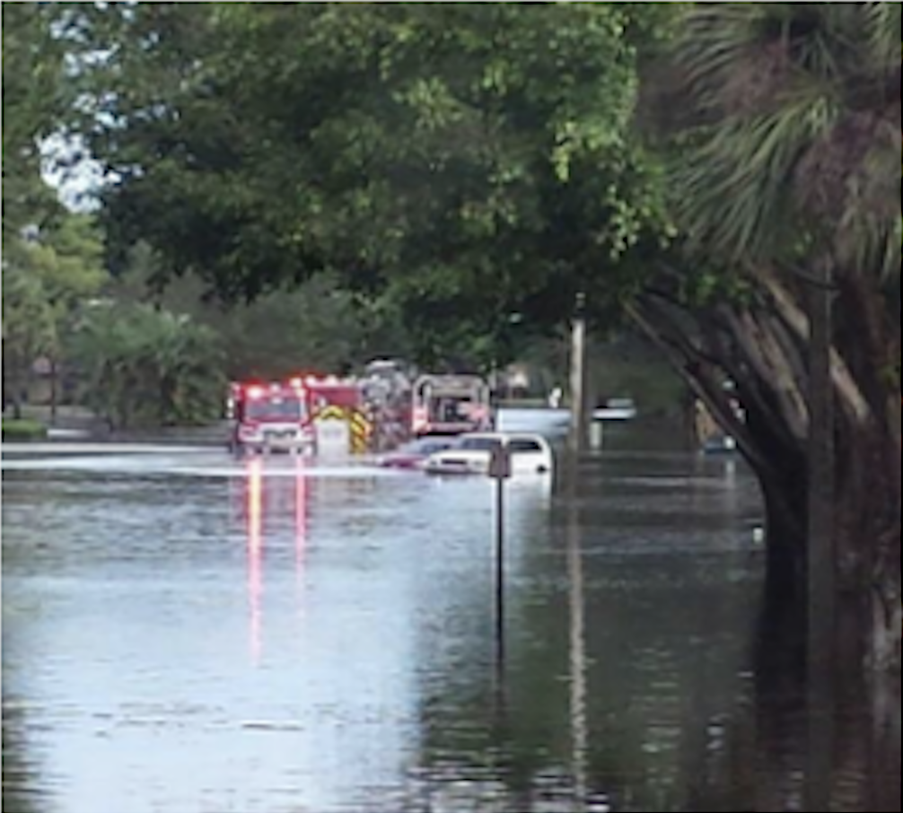
Storms with Flooding
Notes:
Extreme precipitation events are increasing. Warmer ocean temperatures are fueling more intense storms. Sea Level Rise is impacting our drainage systems, increasing frequency of flooding and the time it takes water to subside. Much of the population resides near areas with man made canals, natural waterways, or stormwater storage areas.

Slide 14
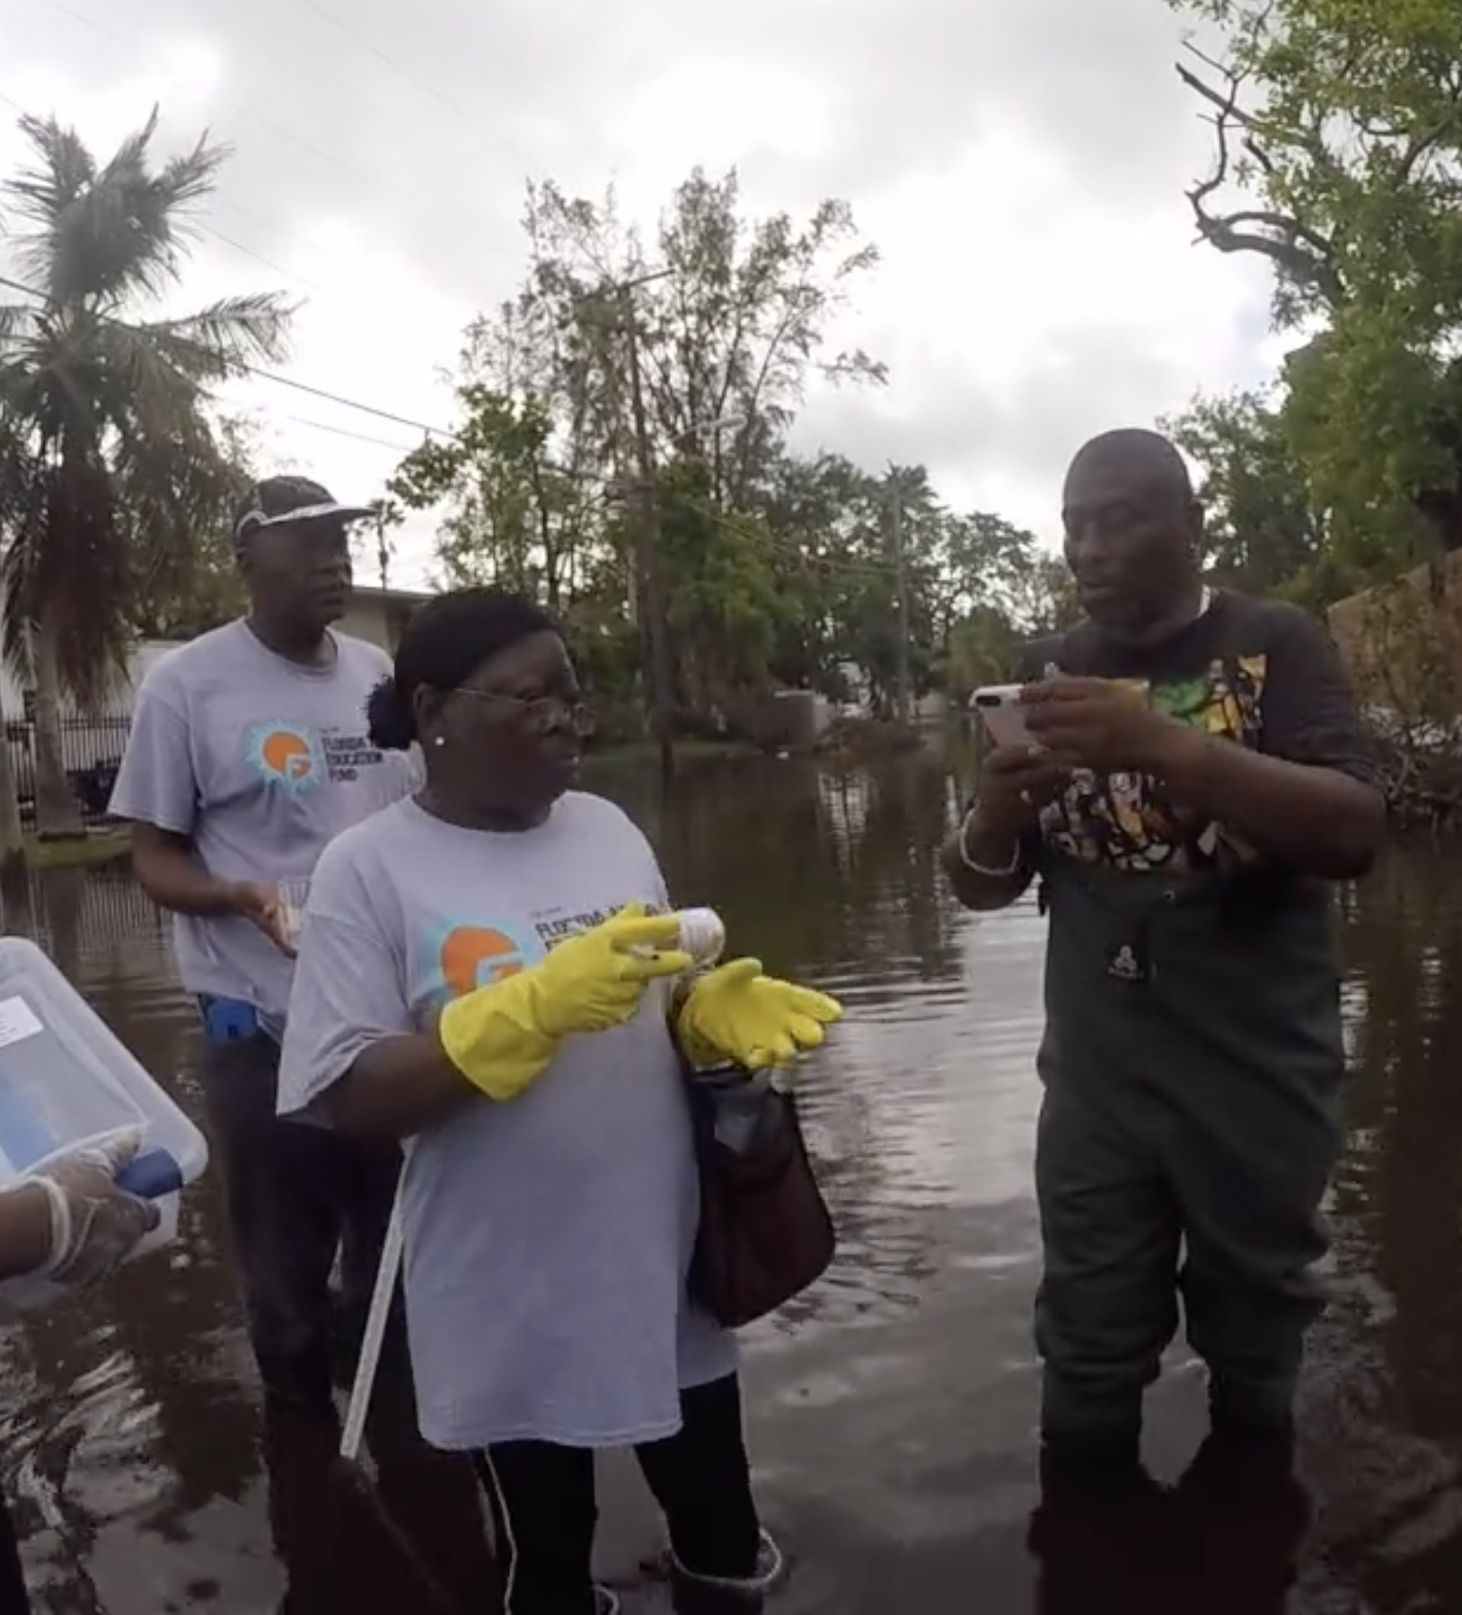
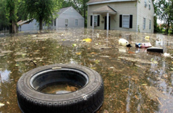
Contaminated Flood & Standing Water
Notes:
Water that has not drained or evaporated off after a day or two is standing water. Some Causes: Heavy rain, Tidal flooding exacerbated by Sea Level Rise, Broken water mains

Slide 15
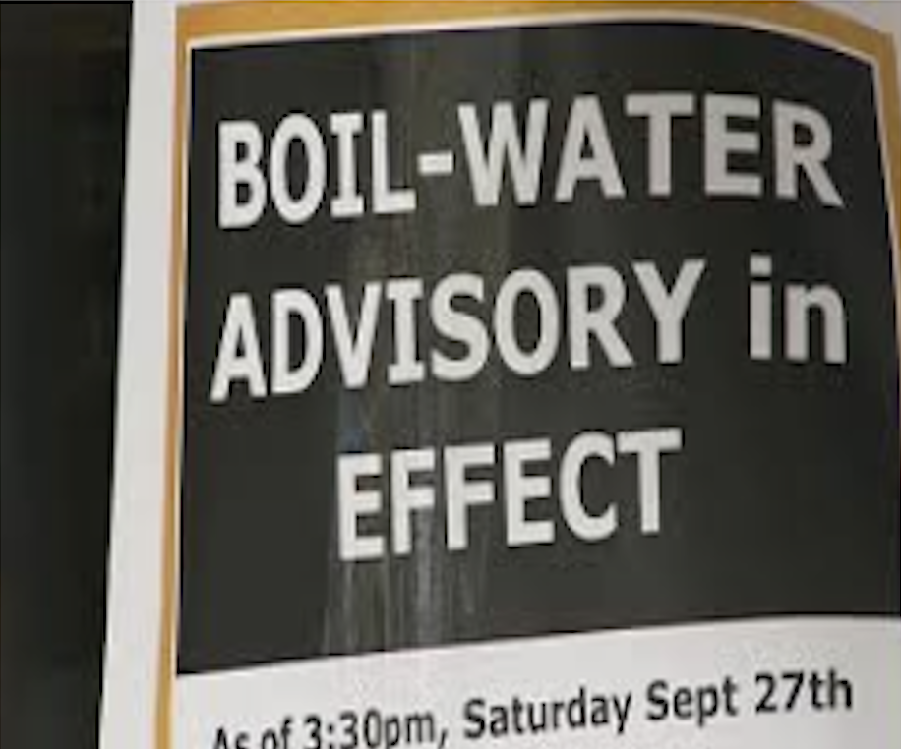
Contaminated Drinking Water
Notes:
Some Causes: Chemicals or bacteria leaching into the water, Power outage that compromises treatment systems, A rupture in the water main causing a decrease in pressure, Home wells not tightly capped can have contaminants leach into them, Flooding of septic fields, Saltwater intrusion

Slide 16
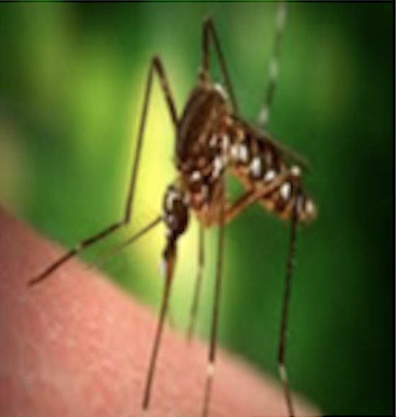
Vector Borne Diseases
Notes:
Illnesses caused by viruses or bacteria carried by another organism, such as mosquitos, ticks, birds or rodents are frequent. Warmer temperatures and altered rain patterns change where disease-carrying species live. Lack of cold winter temperatures to kill off insect populations or their eggs increases insect populations.

Slide 17
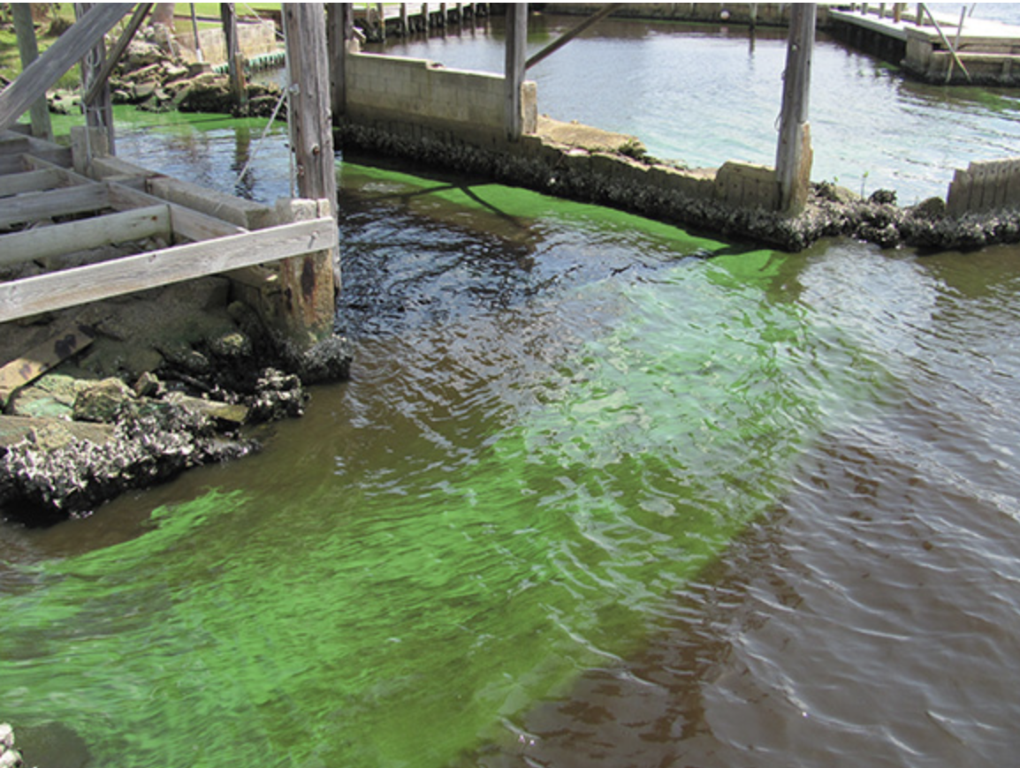
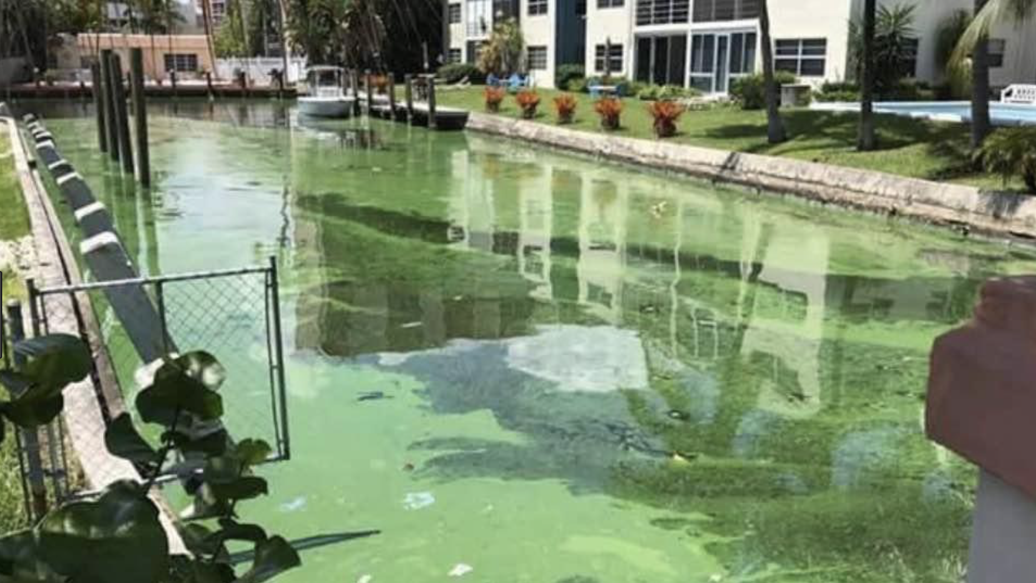
Algae
Notes:
Heavy rainfalls flush fertilizers from lawns and fields, providing nutrients for algae, Warmer water creates favorable conditions for algal growth, Droughts cause pond and canal water levels to lower. This makes the water warmer, and reduces the motion of the water.

Slide 18
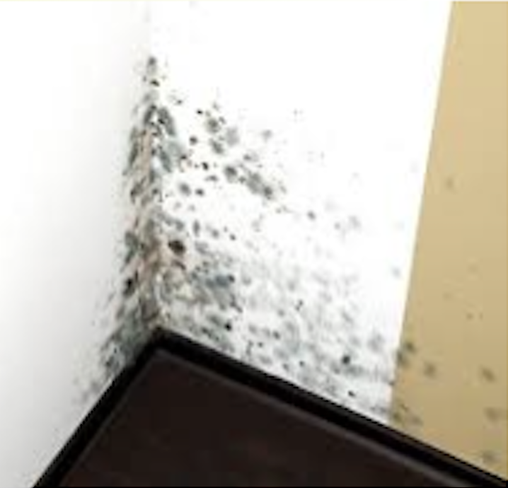
Mold
Notes:
Strong storms and flood events may result in leaks and water damage to homes and businesses. Increased humidity and moisture create ideal conditions for mold growth.

Slide 19
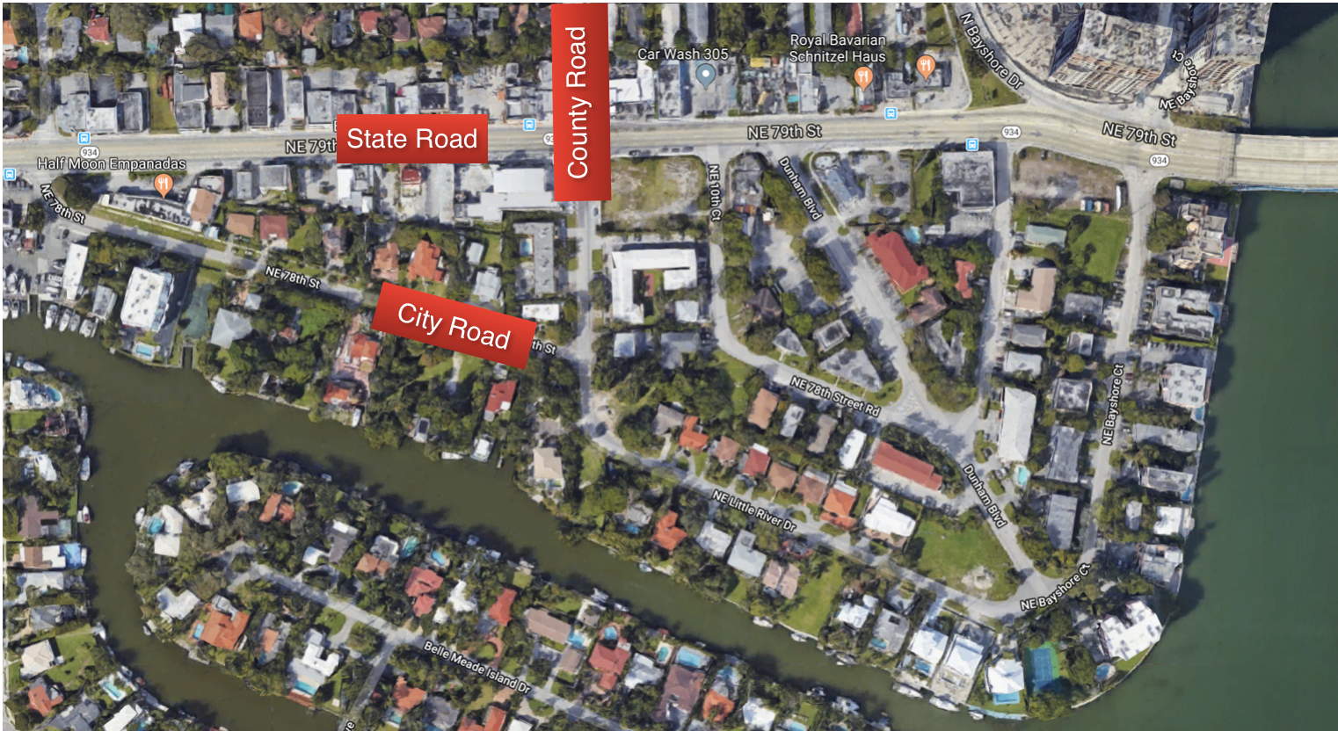
Who do I call?
Notes:
Residents addressing flooding have to figure out who to cqll. This is not always easy to determine, when water is bubbling up onto streets with multiple government jurisdictions.

Slide 20
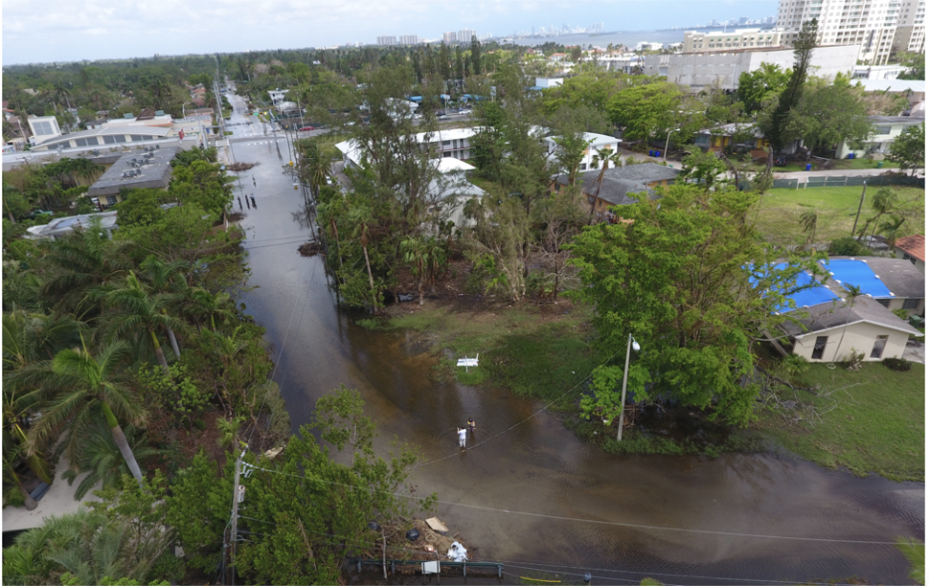
Notes:
Shorecrest, Miami King Tide October 2017

Slide 21
Notes:
It takes many partners to solve large problems.

Slide 22
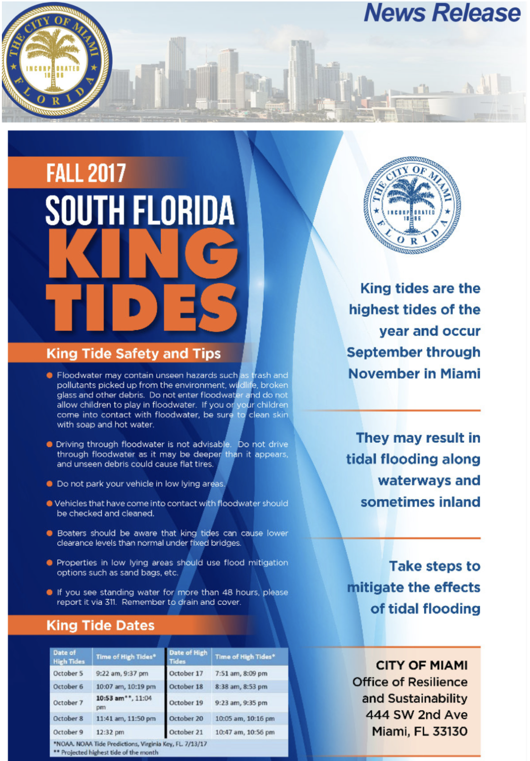
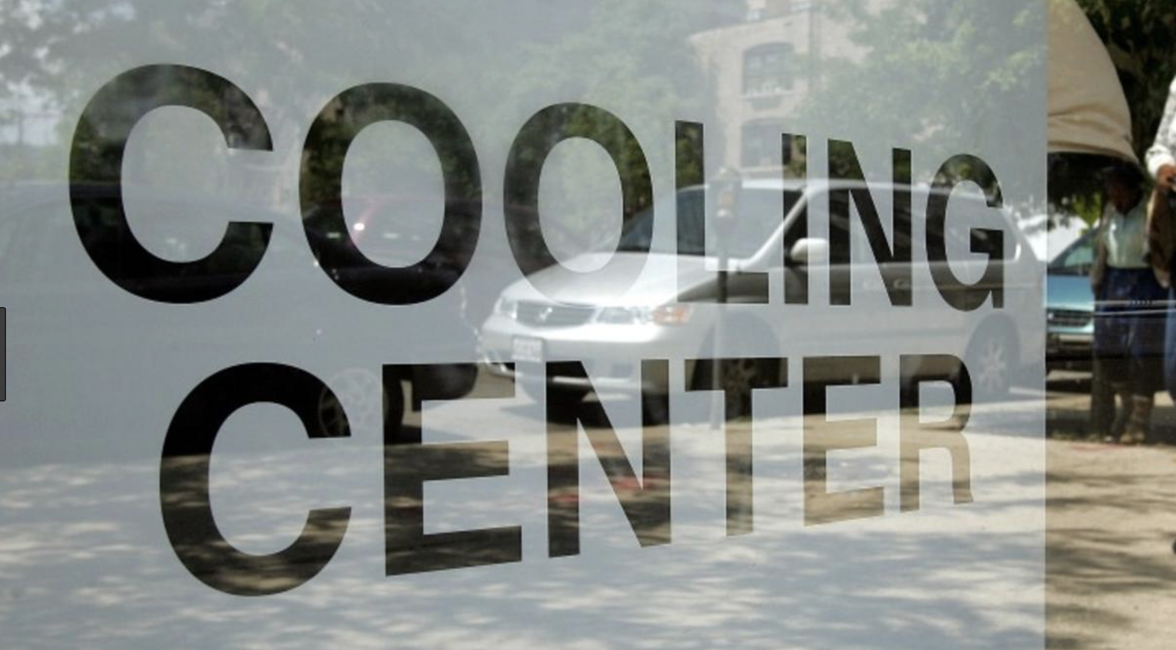
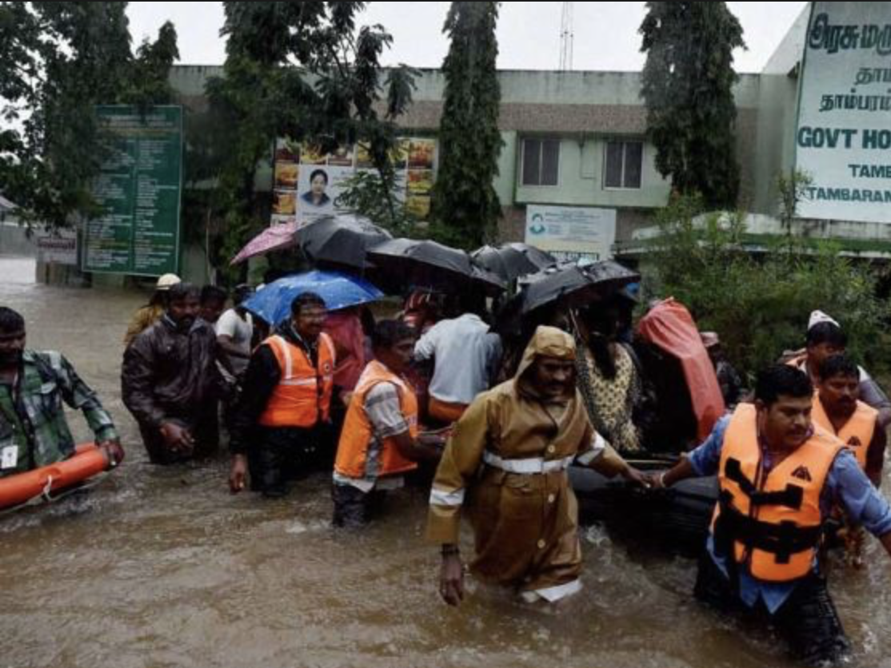
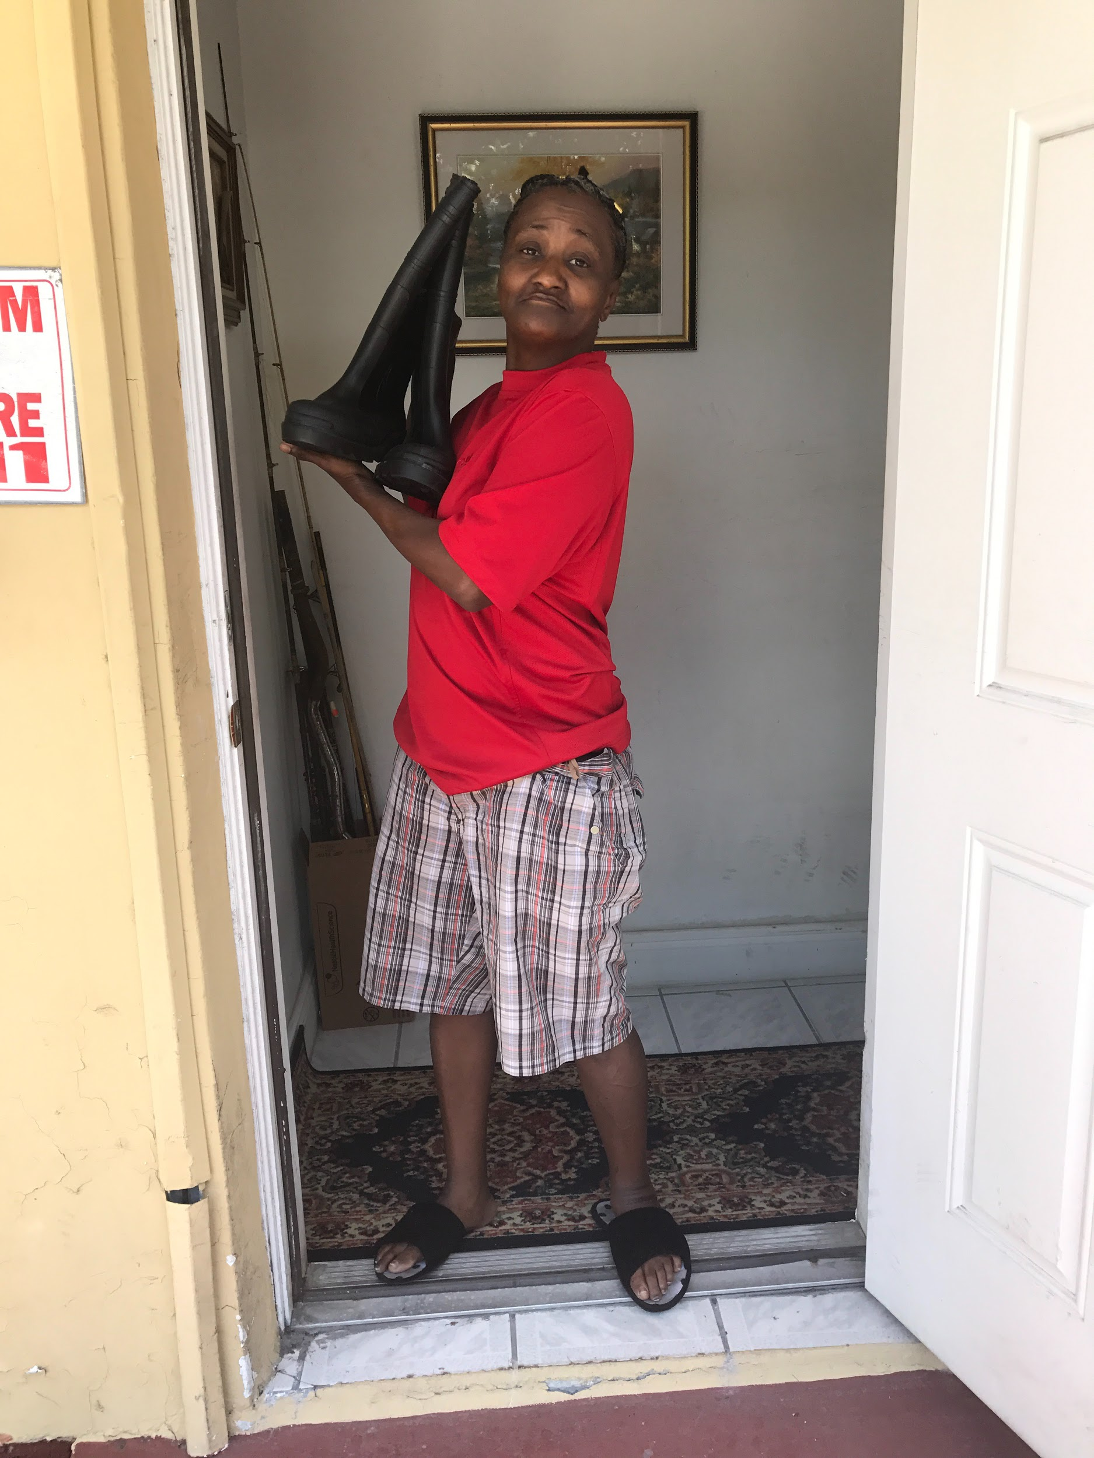
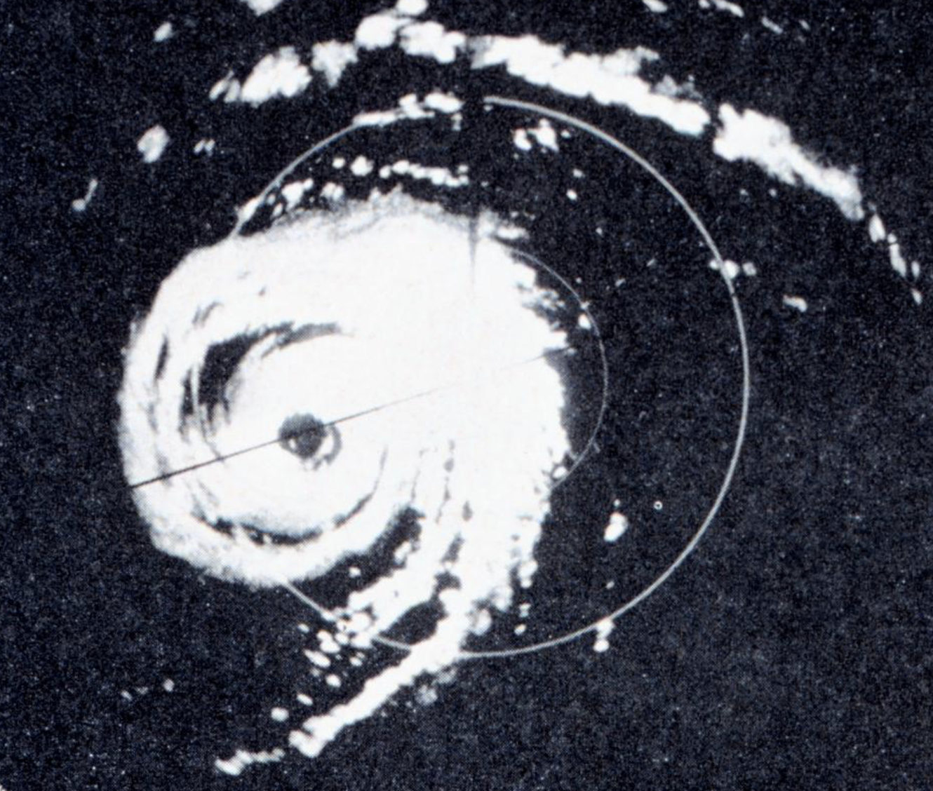
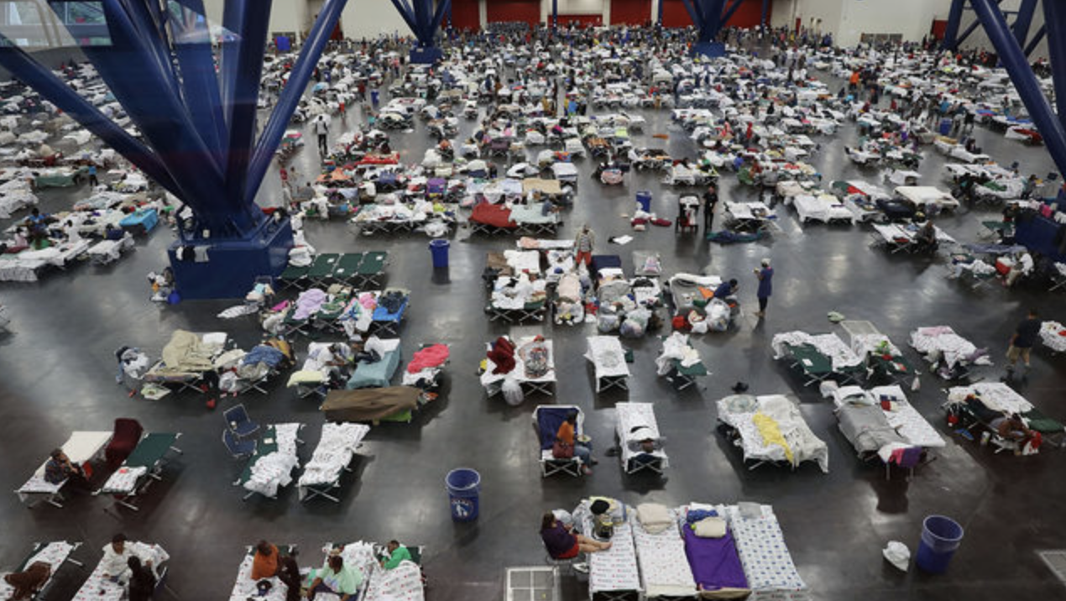
It takes all
of
us!

Slide 23
Critical Functions in Disaster Planning
Water
Food Security
Agriculture
Housing
Environmental Health and Safety
Health Services
Shelter in Place and Evacuation Systems
Psychosocial Resilience
Supply Chains & Logistics
Energy – Temperature Management
Energy – Lighting and Cooking
Renewable Energy vs. Grid Energy
Education
Hygiene and Prevention
Communication Systems
Sewer / Septic Systems
Solid Waste Management
Transportation
Community Security
Community Commons Areas
Social Services
Value Chains
Climate Threat Mitigation and Transformation
Data and Information Management
Emergency Management
Management & Governance

Slide 24
FAU Climate Resilience Seminar

